Slide 1
On-line Mapping Services and Custom ESI Web Applications
Robby Wilson, Chief, Spatial Information Technology
NOAA/NOS Special Projects
May 2, 2012
Silver Spring, MD. 20910

Slide 2
SPO Agenda
Robby (8-10 mins)
  (overview @ SPO, web services, leveraging services to build the NOAA CMSP Data Registry Tool)
Robb Wright (20 mins)
  (packaging ESI pdfs as web services, capabilities & limitations of web services, demo)
Nipa Parikh (20 mins)
  (ESI Shoreline as web service, migrating ESI data from desktop GIS app to a web service, demo)

Slide 3
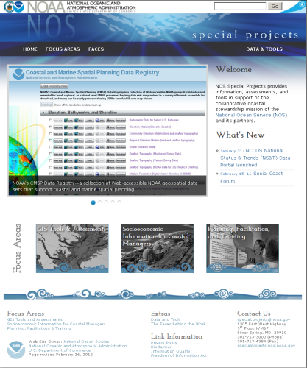
Background
About Special Projects Office
Partnered with OR&R on GIS Projects
  raster nautical server, NOS/DE,
  DWH, ERMA, CMSP Data Registry
Active role in supporting ESI data http://specialprojects.nos.noaa.gov/
Technology changes everything…web services & Cloud solutions (i.e.. ArcGIS Online)
Challenges us to rethink what and how we do business….. especially wrt older fat/thin client GIS applications and kitchen sink GIS web applications…..
99% of what we know is in a digital format

Slide 4























Making Data Discoverable via Web Services
Shared
Geospatial
Resources
Standards Support
Open Service Specifications
Access Authoritative Data
Easily Discovered
Easy to Use Clients
Services
A WMS request defines the geographic layer(s) and area of interest to be processed. The response to the request is one or more geo-registered map images (returned as JPEG, PNG, etc) that can be displayed in a browser application.
Government
Content
Open Access to Many New Users & Applications

Slide 5

















Leverage the OGC Services in ArcGIS Server
Non-Esri Clients
ArcGIS Server
gvSig
uDig
OGC Services
Quantum GIS
Gaia
WMS
Map Service
Google Earth
WMTS
Tiled Map Service
WCS
Image Service
OpenLayers
WFS
Feature Service
GIS Cloud
WPS
Geoprocessing Service
GeoNode
KML
GeoCommons

Slide 6

Find, get, store, reformat, open data.
User
User Tool
Manual search across NOAA organizations
NWS
NESDIS
NOS
NMFS
OAR
OMAO
Grantees
Satellite
Geodetic
ESI
Ship
UAS
Sonar
Gauge
Chart
Model
Marine
Mammals
Fish Surveys
Enforcement
ROV/UAV
NOAA Labs

Slide 7
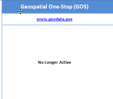
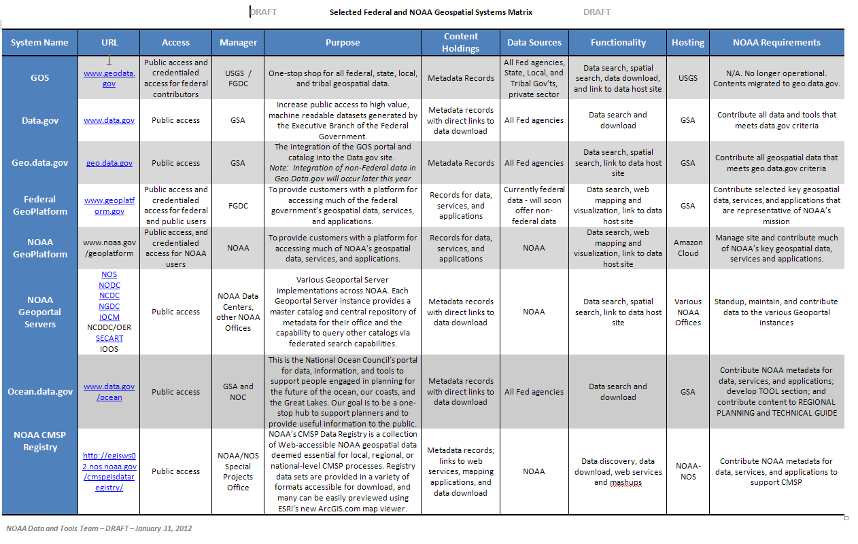

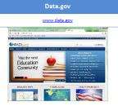





Selected Federal and NOAA Geospatial Systems

Slide 8
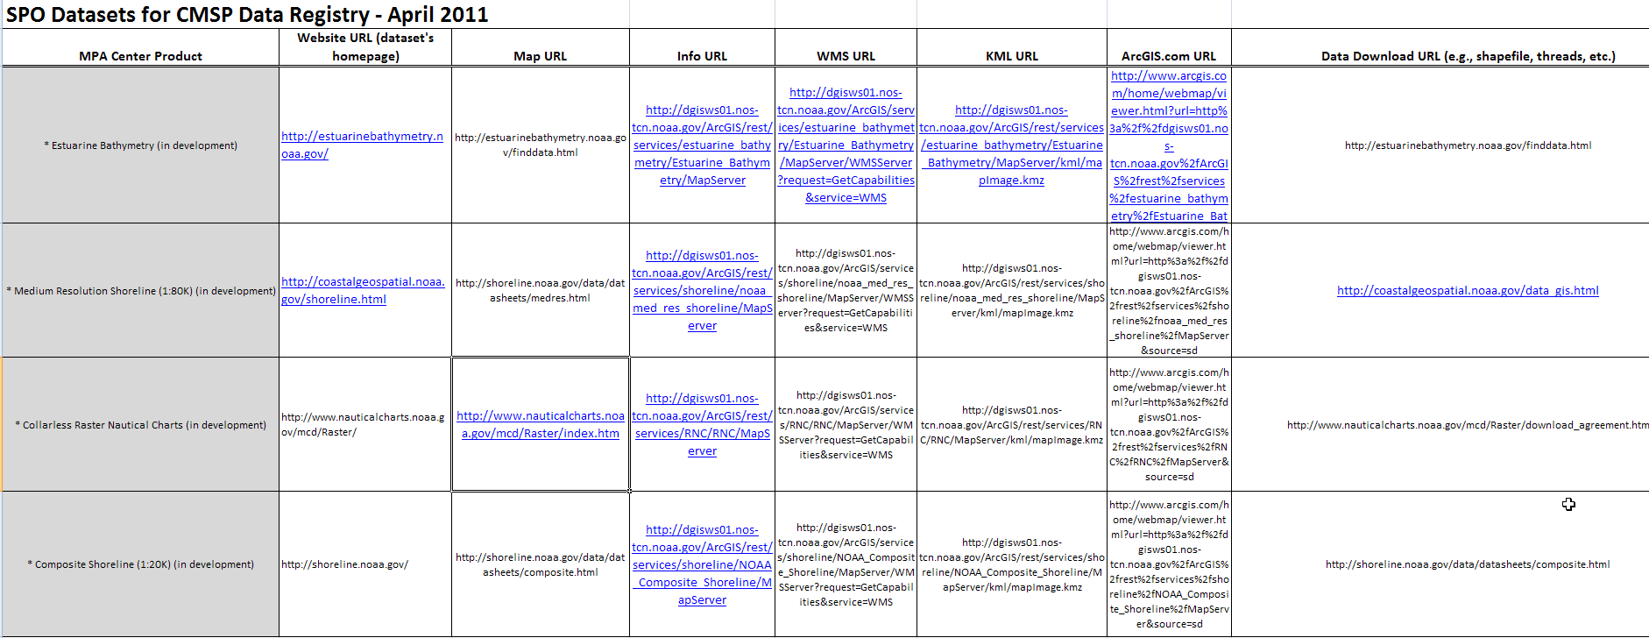
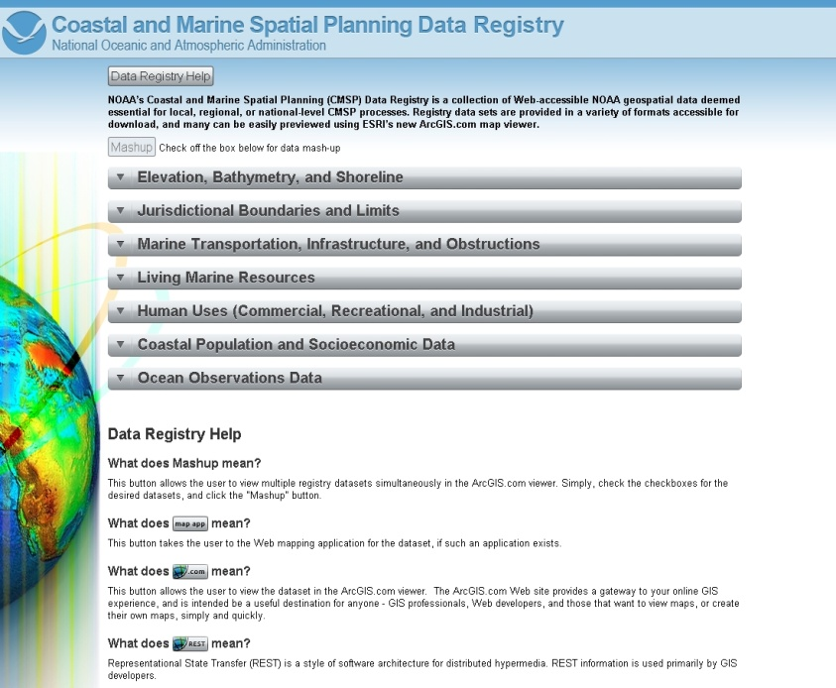
NOAA CMSP Data Registry: Keep it Simple
Find NOAA Data:
Web presence
FGDC/ISO metadata record
Data download capability
Deemed essential for CMSP
Available as web service (+++)
Package Data:
Packaged in thin client web app
and binned thematically
Converted to web services and hosted
Contains a metadata “lite” record
Published in ArcGIS 10 for data “mash-up”
Registered in ArcGIS Online

Slide 9
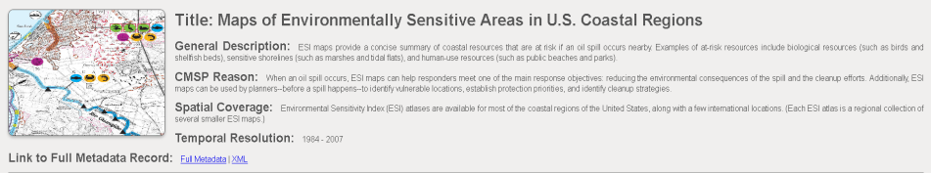
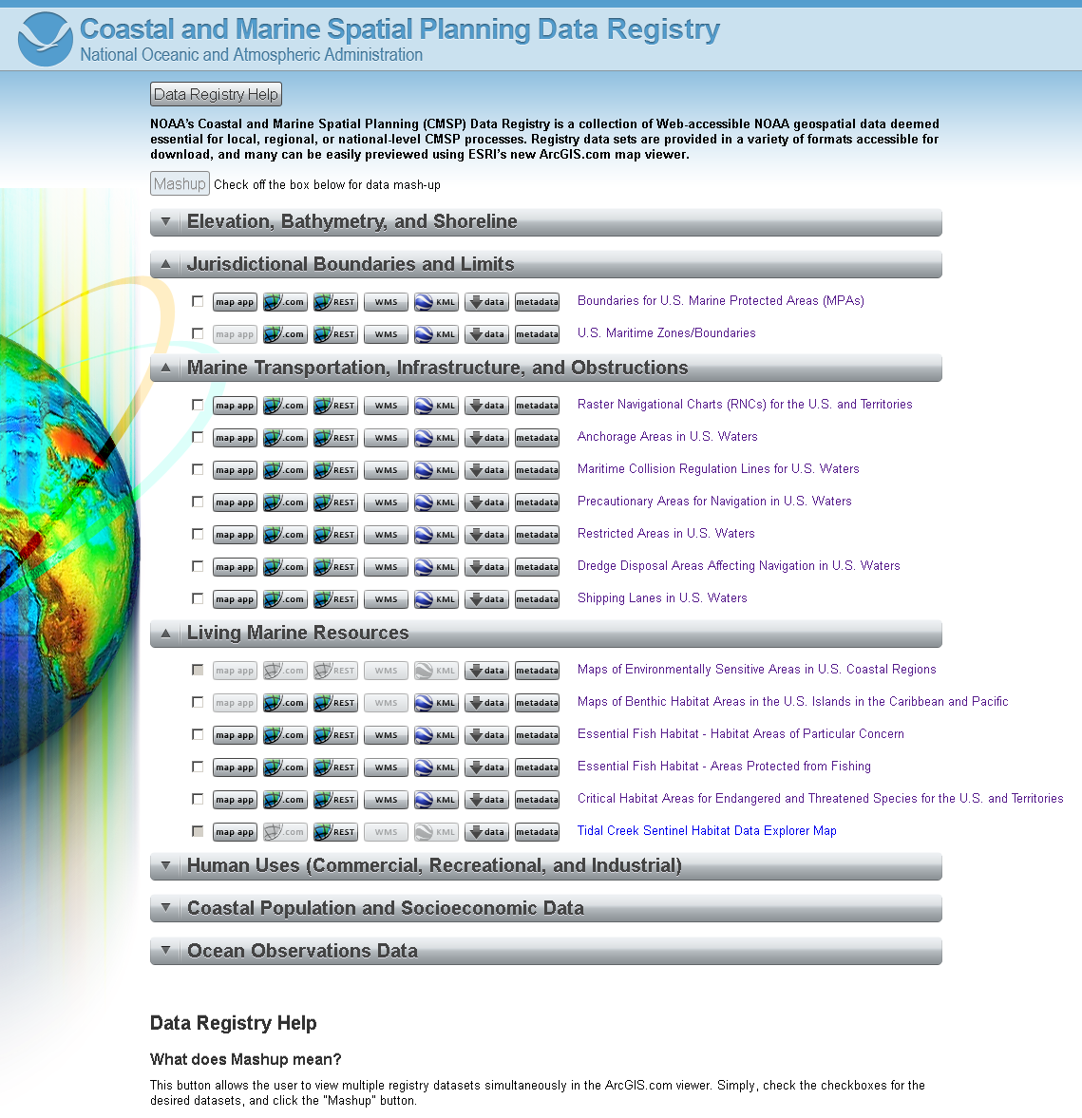
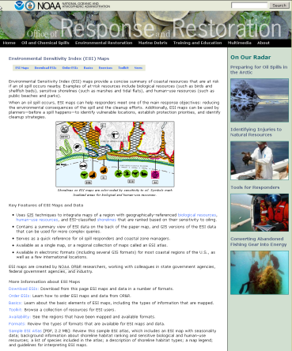
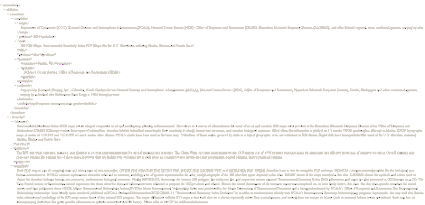
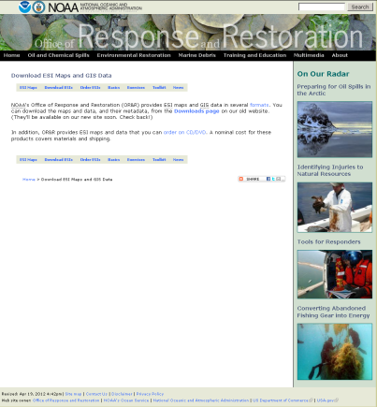

ESI in NOAA CMSP Data Registry
~ 50 NOAA baseline data sets
Metadata lite
Full Metadata record
points to WAF (html, xml)
Main web site (home page)
Data download
http://egisws02.nos.noaa.gov/cmspgisdataregistry/
What’s missing?

Slide 10
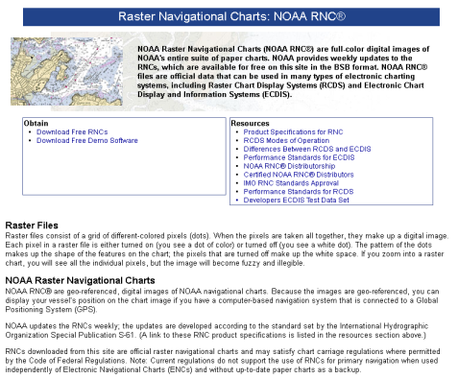
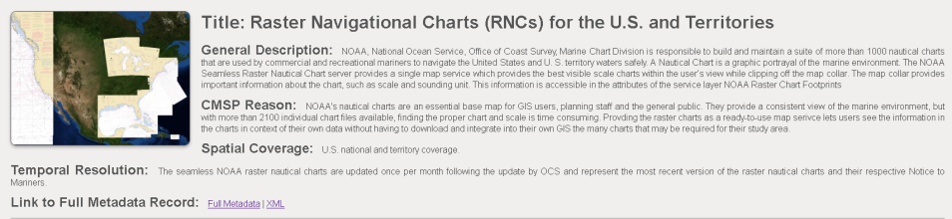
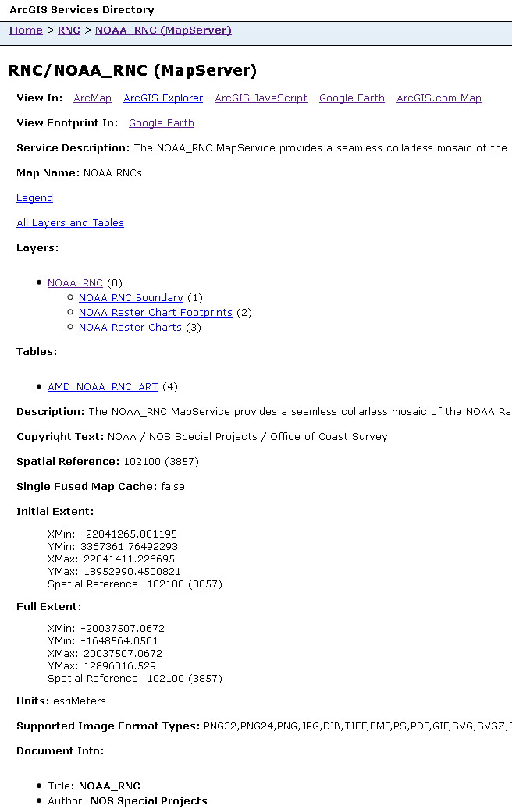
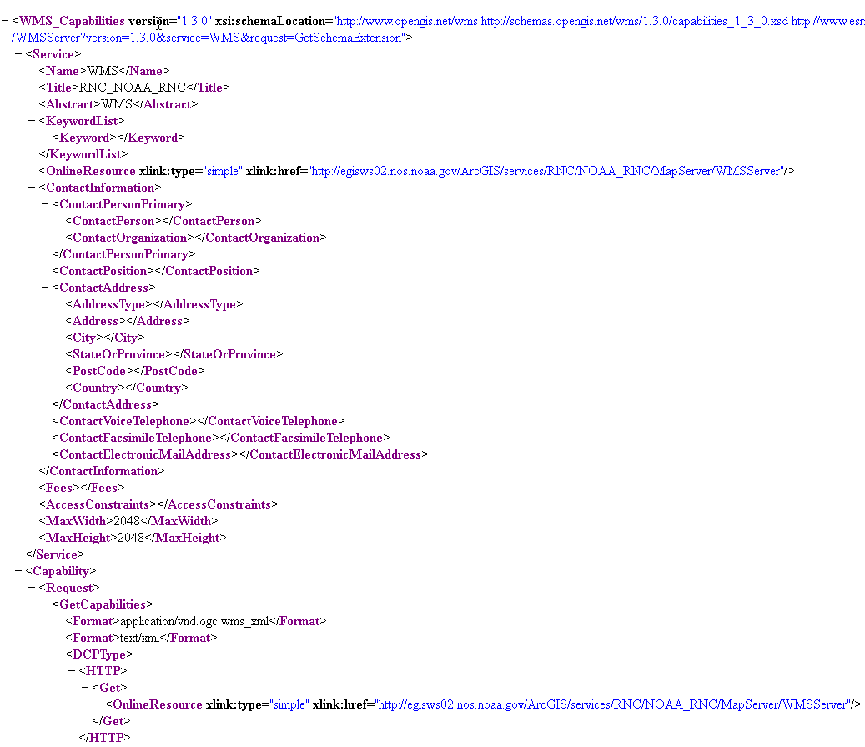
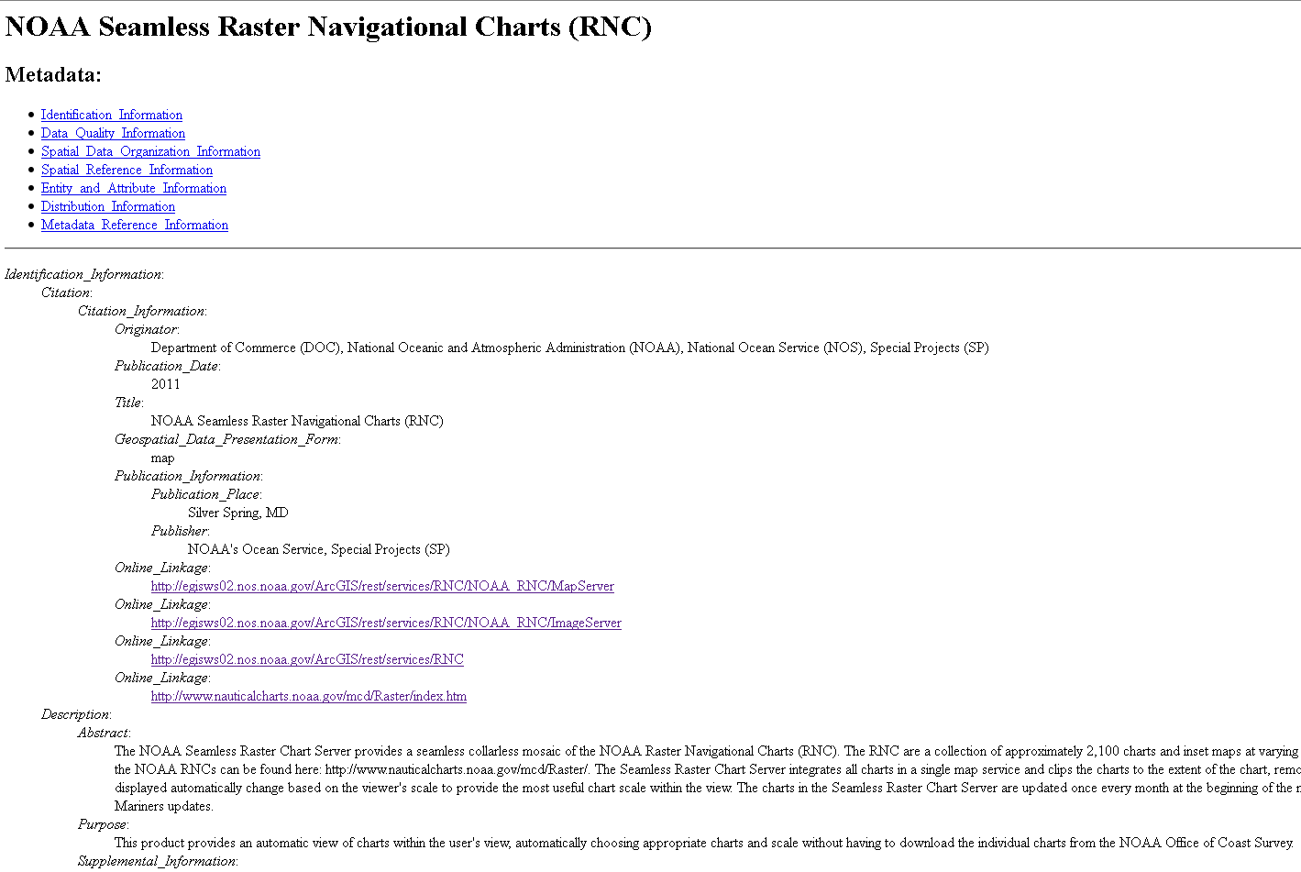
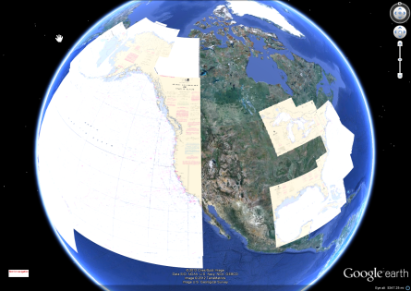
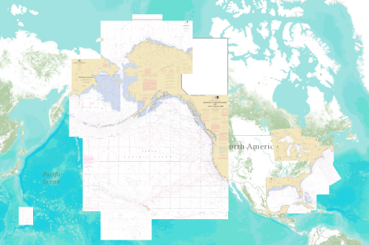
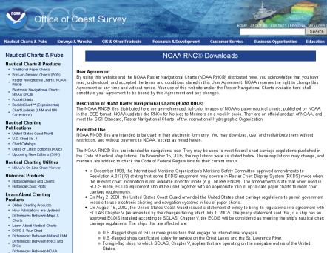
Raster Navigational Charts in Data Registry
Metadata lite
Main web site (home page)
REST/SOAP Services (ArcMap, ArcGIS.com, ArcGIS JavaScript)
WMS,WCS,WFS (WMS_Capabilities)
Full Metadata
record points to WAF (html, xml)
KML
View RNC as “single”
service in ArcGIS.com
Data download

Slide 11
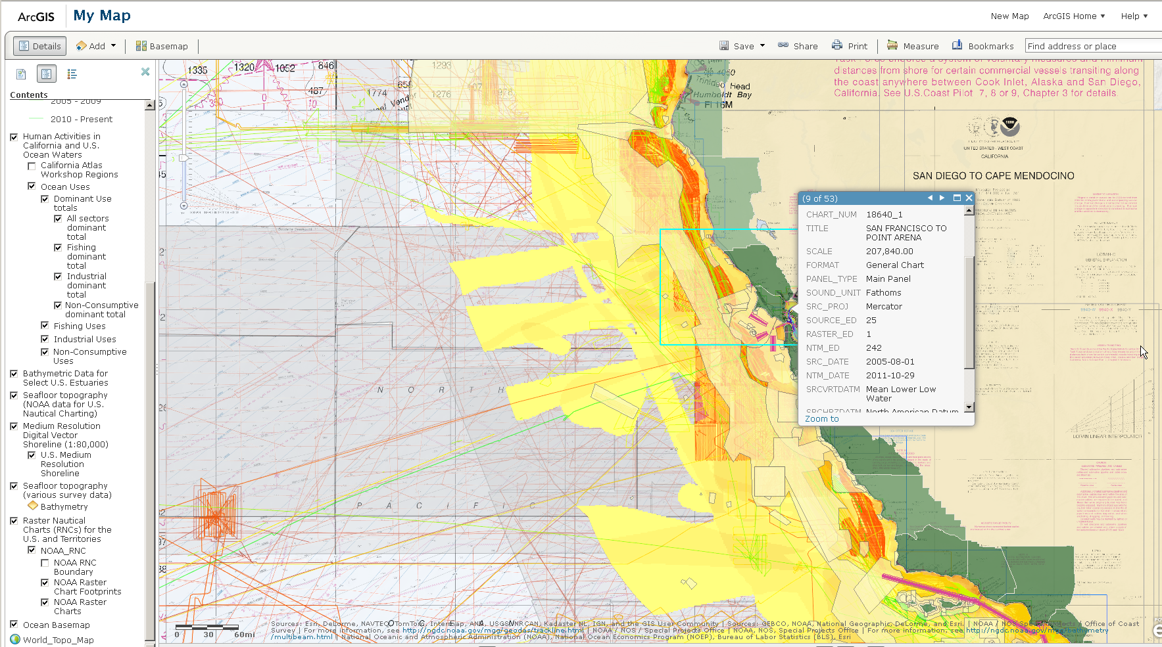
Supports a Data “mash-up” in ArcGIS Online
Multiple data layers are packaged and grouped into a single service

Slide 12
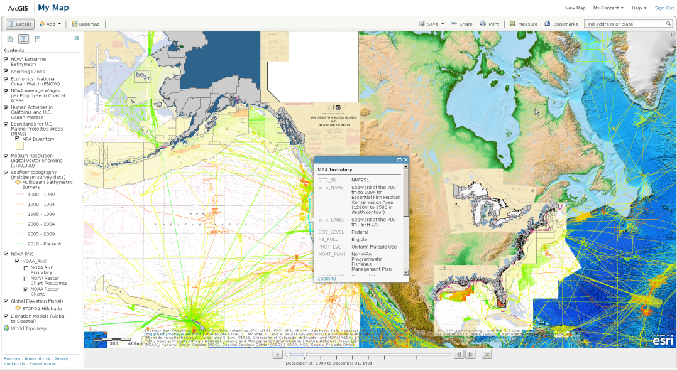
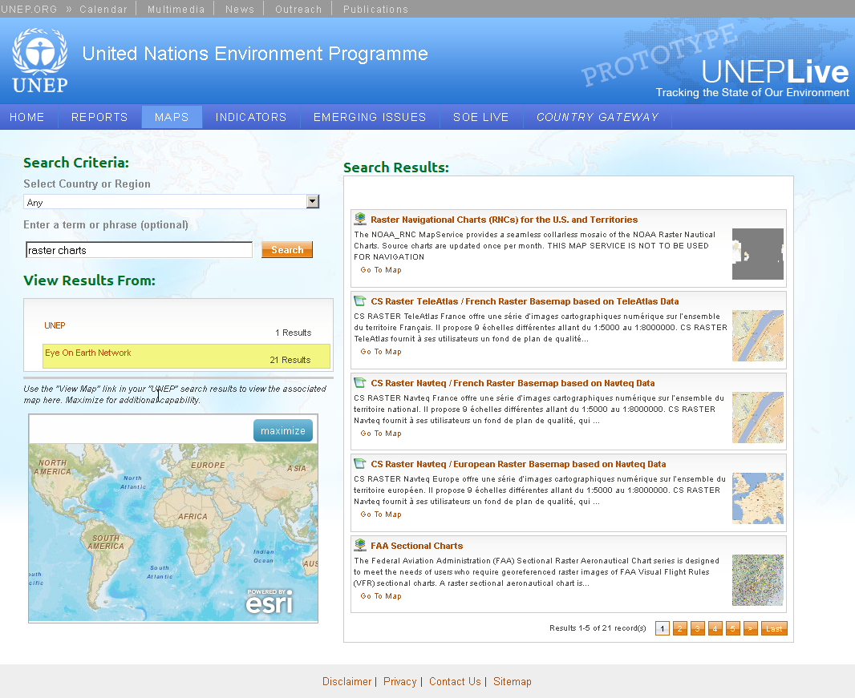
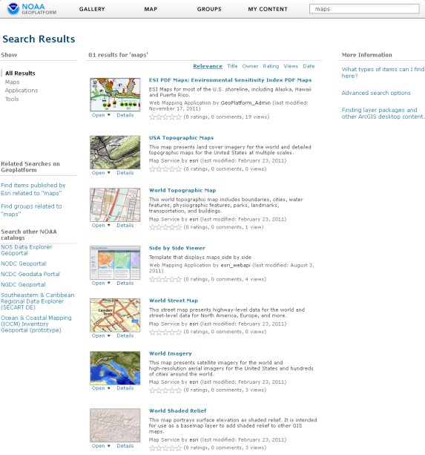
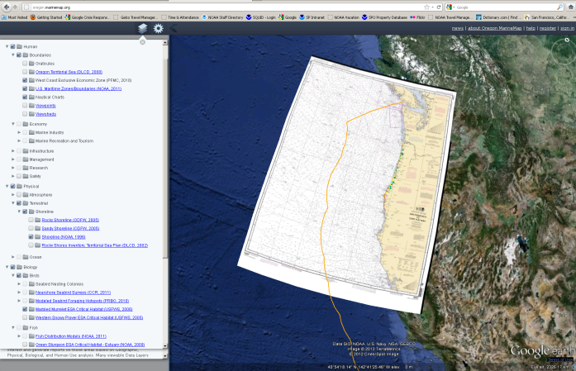
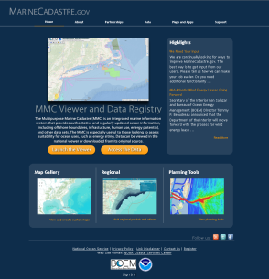
NOAA PORE: Publish Once Run Everywhere

Slide 13
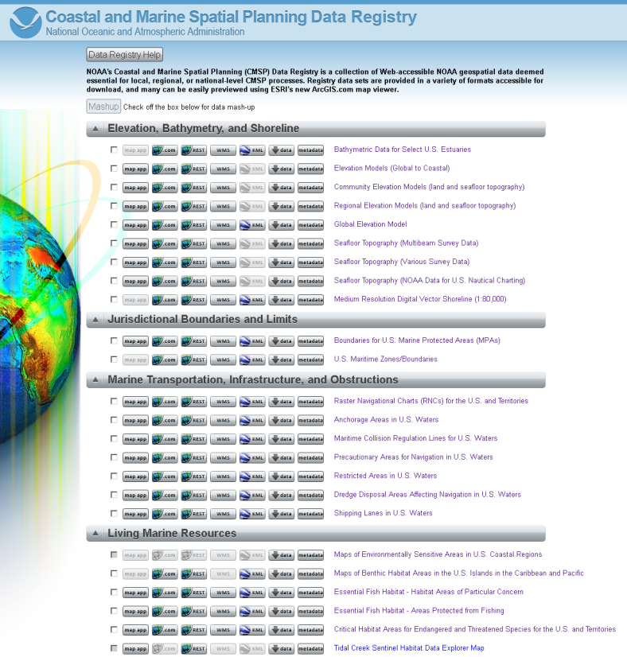
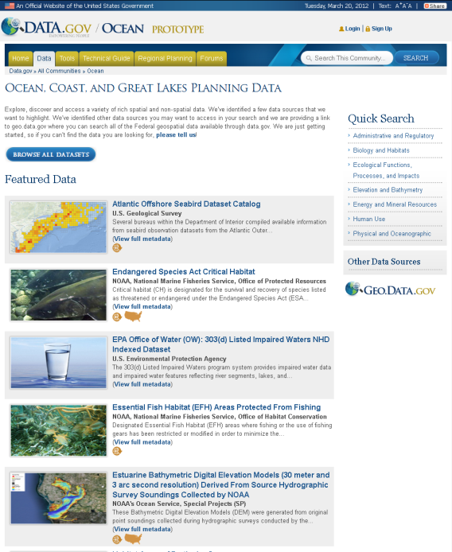
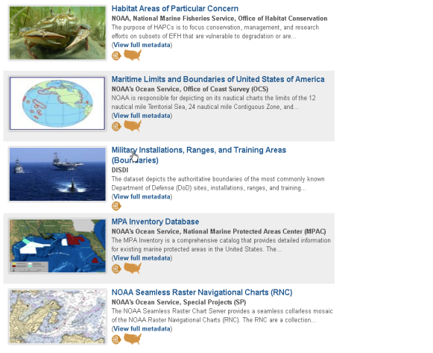
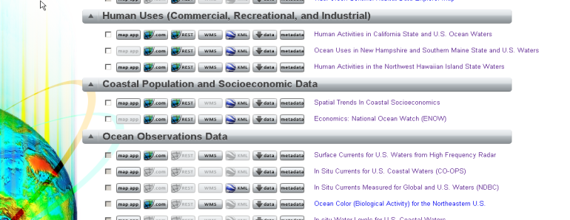
Migrate NOAA Data to oceans.data.gov
http://www.data.gov/communities/ocean

Slide 14
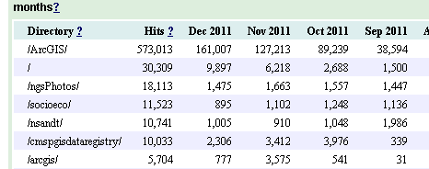
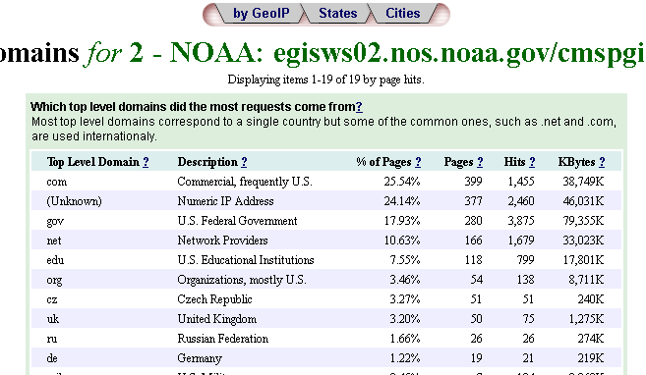
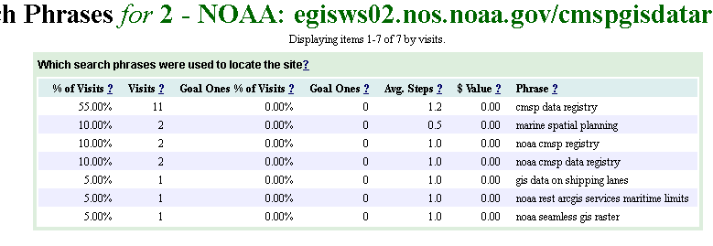
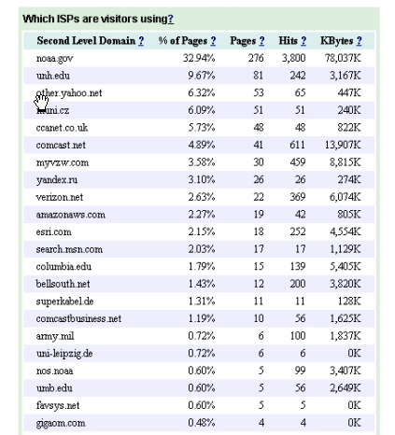
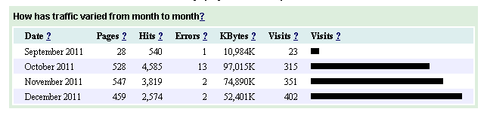
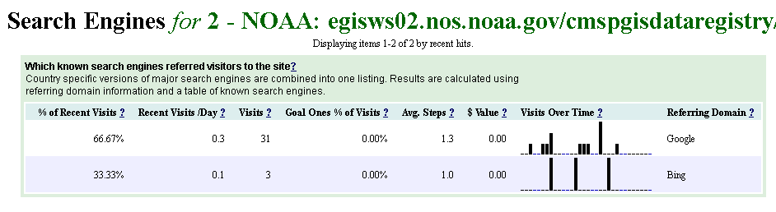
FY12 Web Metrics for CMSP Data Registry

Slide 15
Conclusion
Leveraging data to web mapping services
Improves data sharing and coordination
Easily consumable by GIS and non-GIS users
Light weight technology and leverages off Cloud services
Provides access to “authoritative” source data
Supports user defined data mash-ups
If you’re not doing something different you’re not doing anything at all… Edward Tufte

