Slide 1
ESI Data Online @
ESIonline – Pilot Project
Research Planning, Inc
May 2, 2012
ESI workshop, Mobile, Alabama

Slide 2
ESI Data Online @
ESIonline – Pilot Project
Goal: provide ESI data in Google environment
ESI in Google Earth - most of our effort to date
ESI in Google Maps – smart phones & tablets
Open source – MapServer & PostGIS
ESIonline website – pilot project http://esionline.researchplanning.com/

Slide 3
ESI Data Online
Data currently being served (for some states)
  Index of all ESI atlases
  ESI shoreline
  Oblique photos
  ESI PDF maps downloadable from NOAA
  ESI PDF map overlays (grayscale DRGs removed from the PDFs)
  Grid of T/E counts for Alabama (hot spots)
  Links to video tutorials and ESIonline users guide

Slide 4
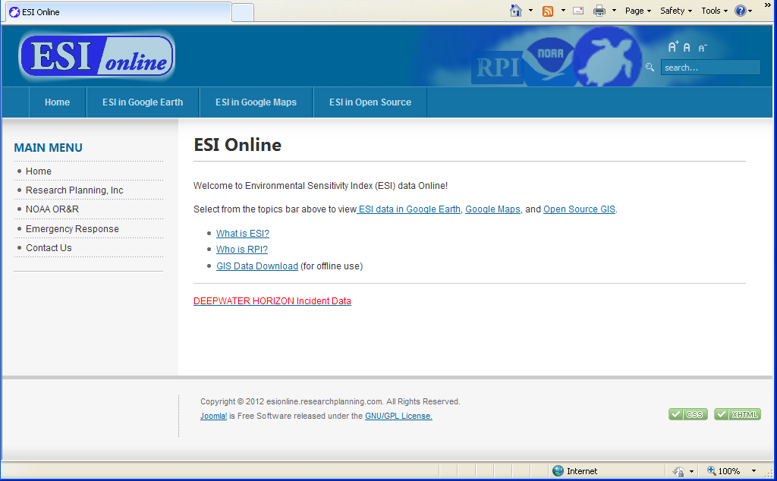
ESI Data Online
http://esionline.researchplanning.com/

Slide 5
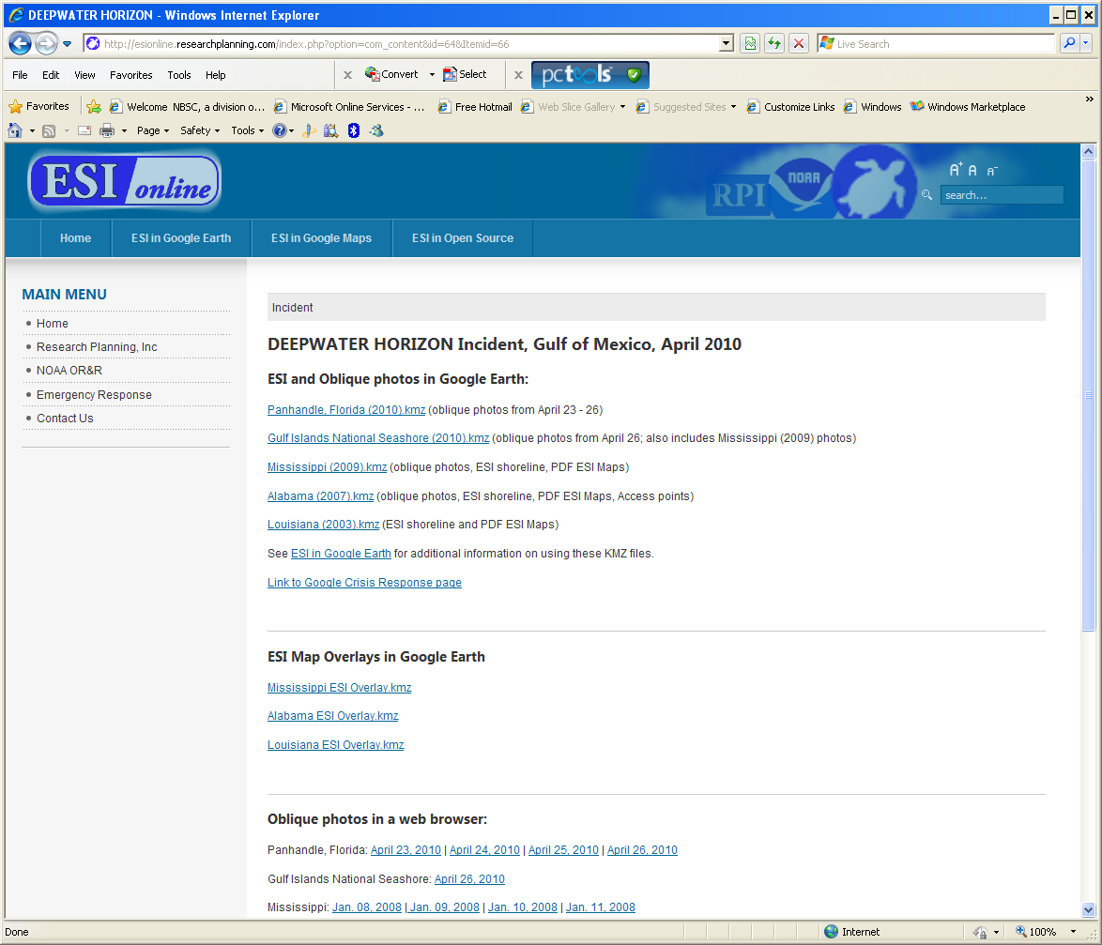
ESI Data Online

Slide 6
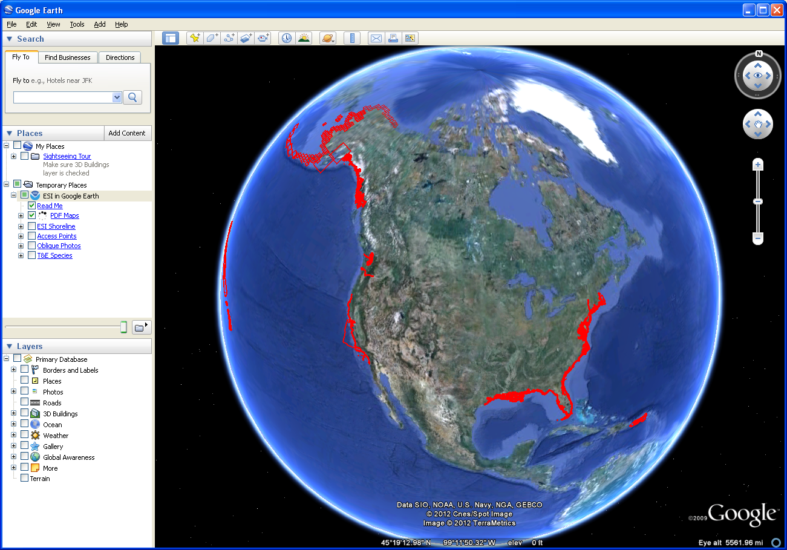
ESI Indexes

Slide 7
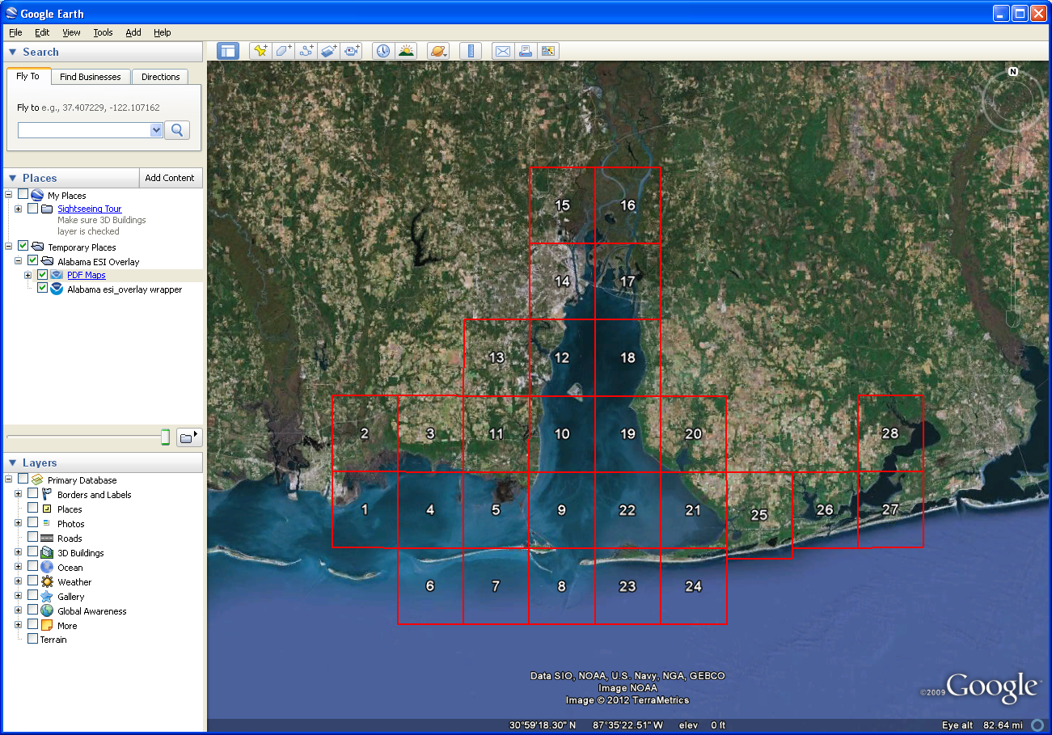
Alabama Index

Slide 8
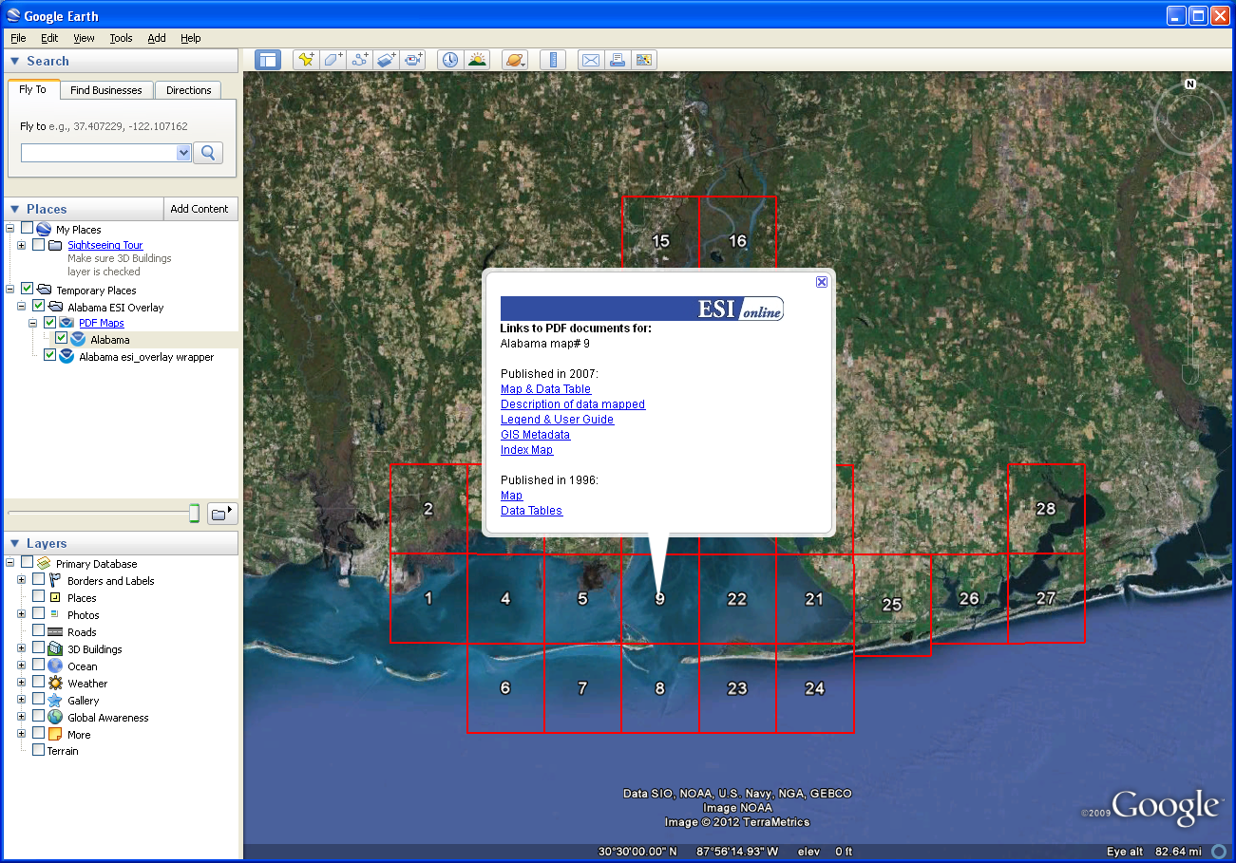
PDF Map Links

Slide 9
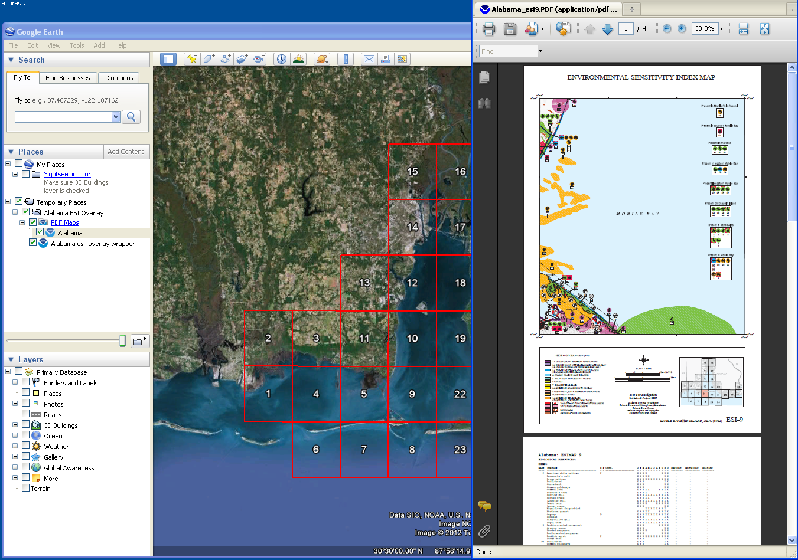
Nosimagery.noaa.gov

Slide 10
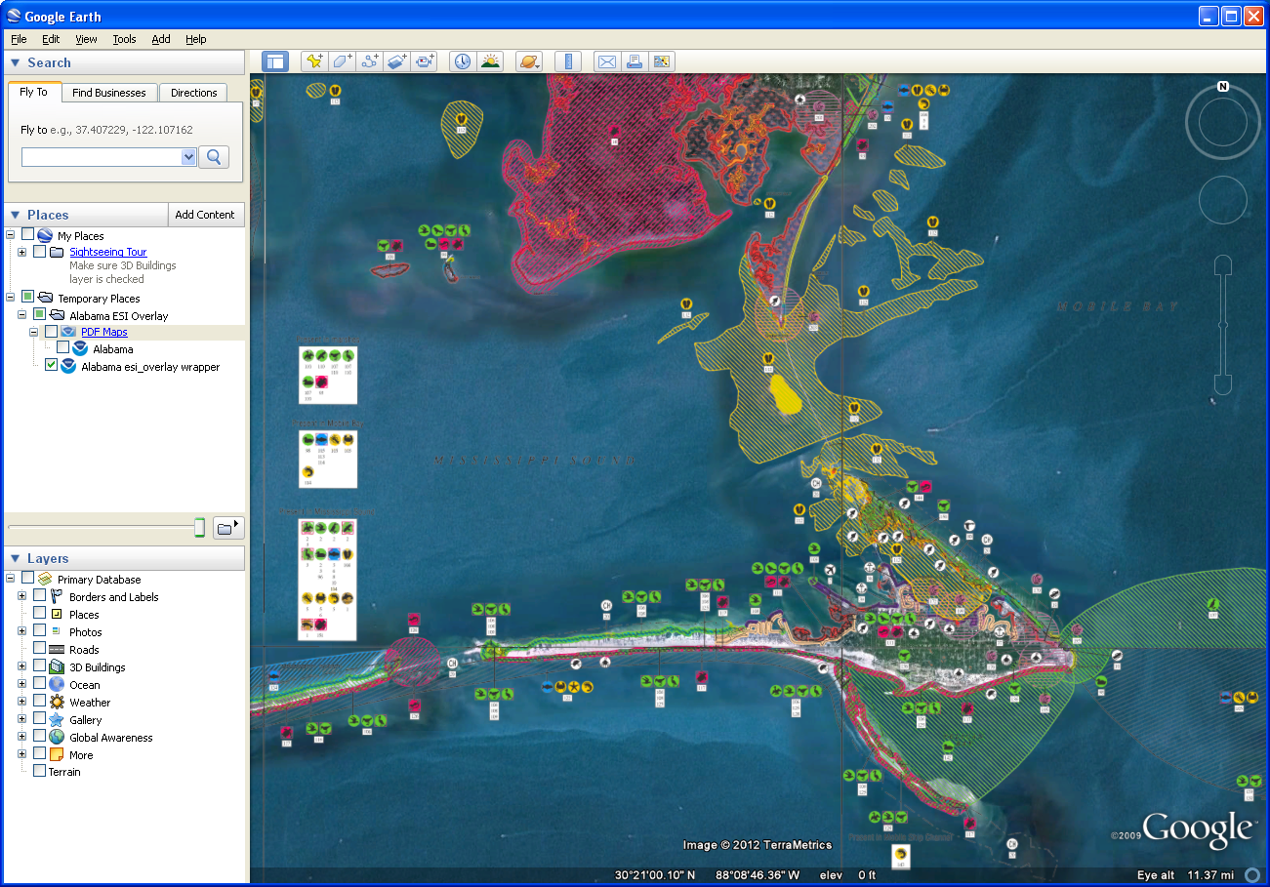
Map Overlay

Slide 11
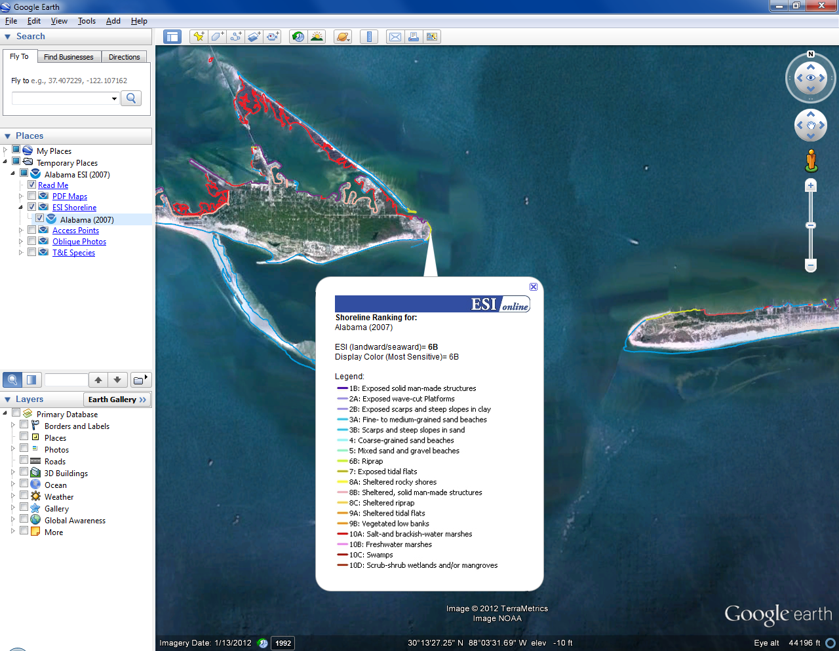
ESI Shoreline in Google Earth

Slide 12
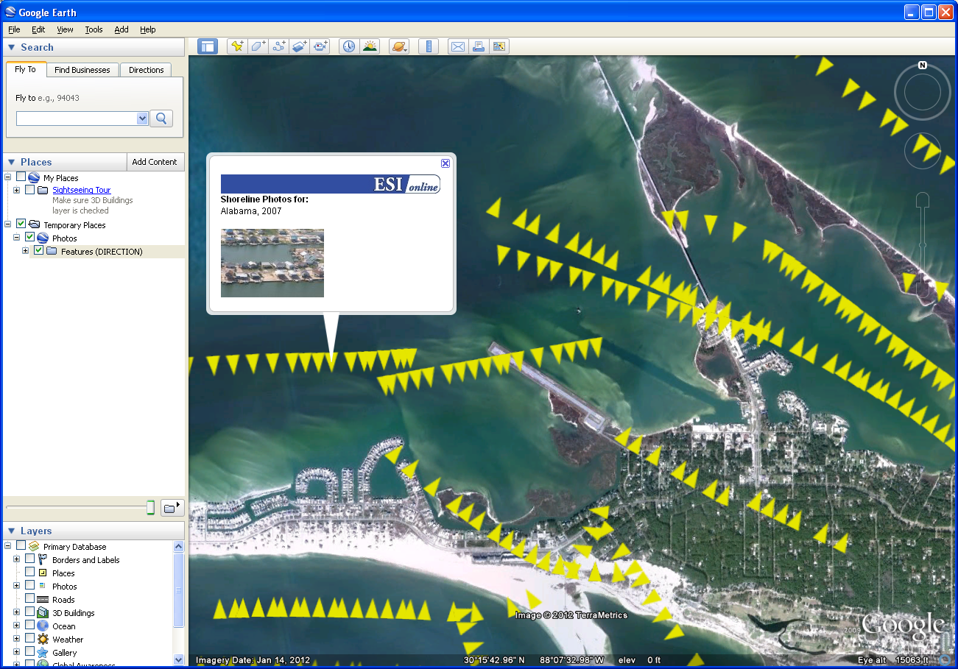
Oblique Photos

Slide 13
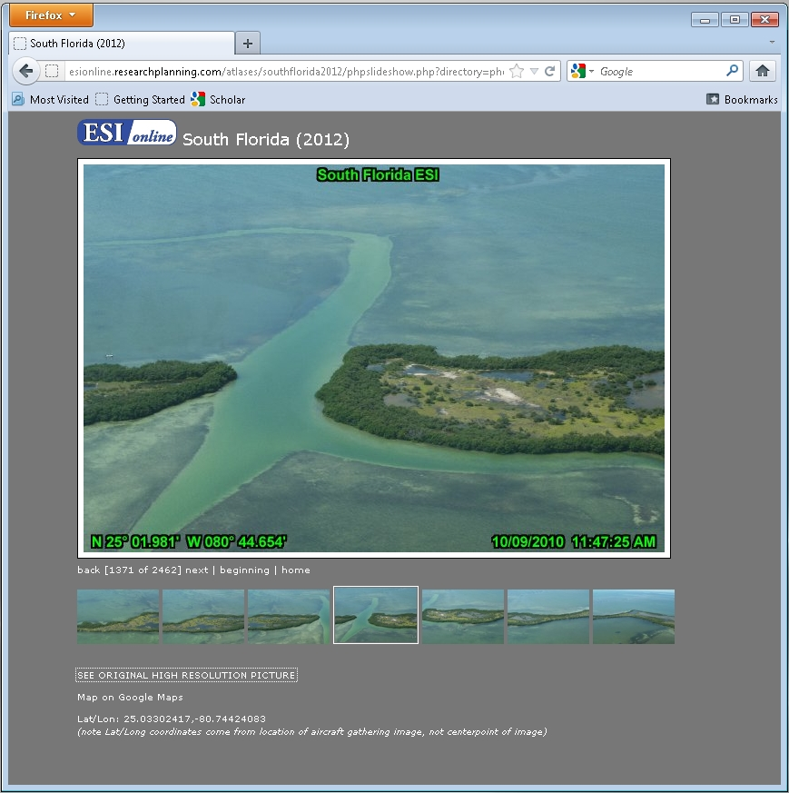
PHP Photo Viewer

Slide 14
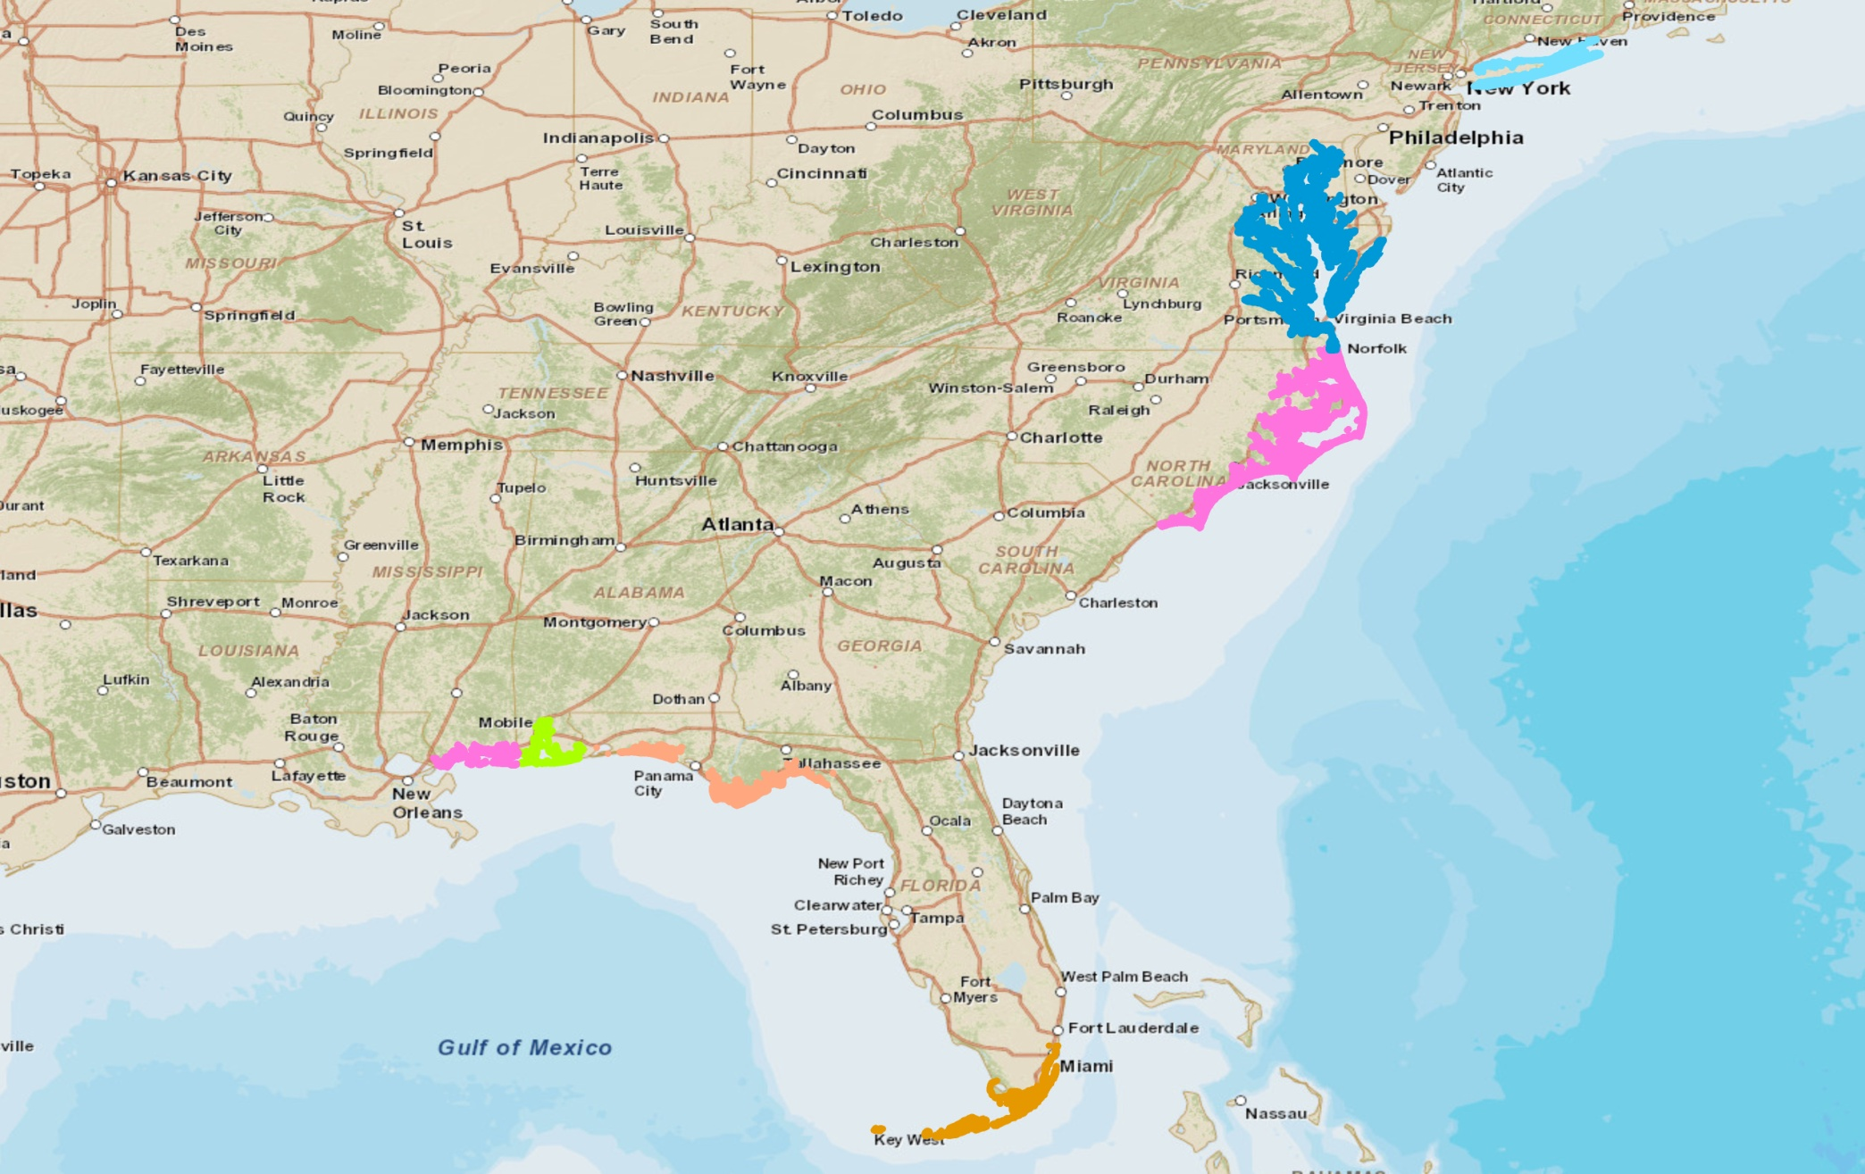
Coverage for Oblique Photos
State | # Photos | Est. File Size (GB)
Mississippi | 7,297 | 14.59
Alabama | 9,296 | 18.59
FL-Panhandle | 11,994 | 59.97
FL-South | 10,942 | 21.88
North Carolina | 42,620 | 85.24
Virginia | 15,000 | 30.00
Maryland | 21,971 | 43.94
Long Island | 10,588 | 21.18
Totals | 122,411 | 280.80

Slide 15
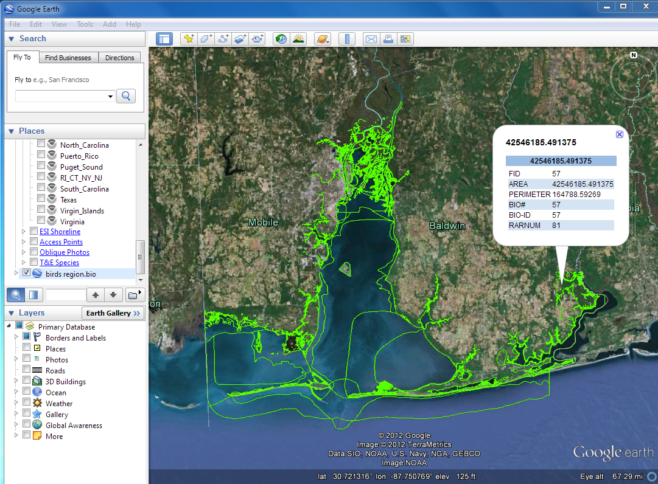
Biology Polygons

Slide 16
Biology with MapServer
Pilot implemented HTML queries
  WMS with MapServer & PostGIS
  Use with vector KML or with image overlays
  Or to generate KML from Queries
This could be set up to work with ERMA(?)

Slide 17
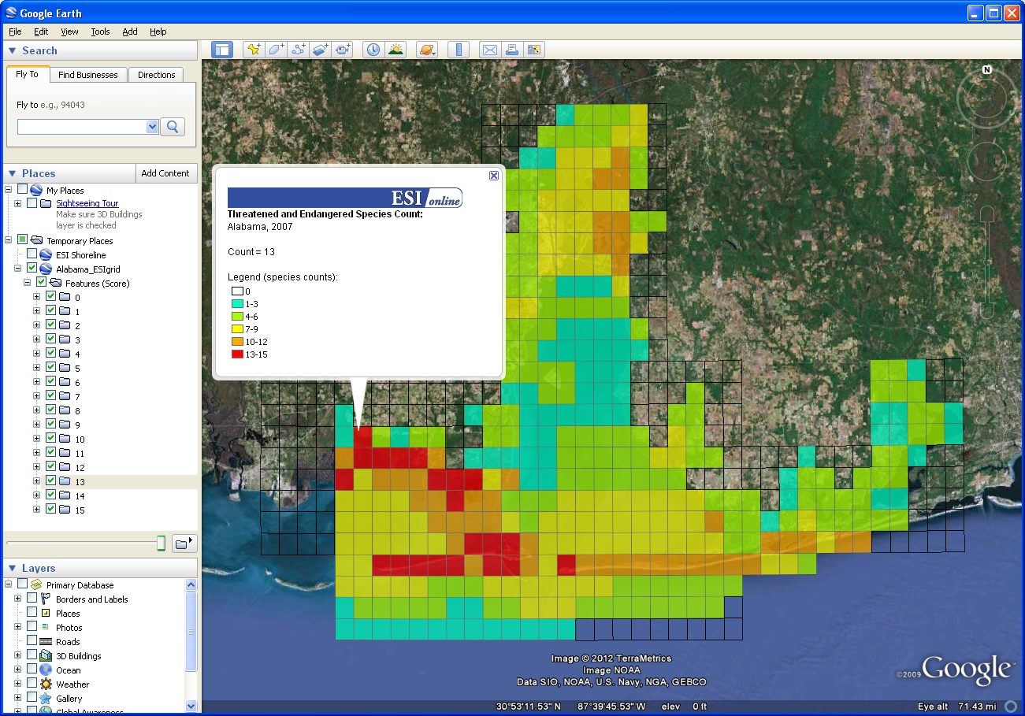
T&E Species Counts

Slide 18
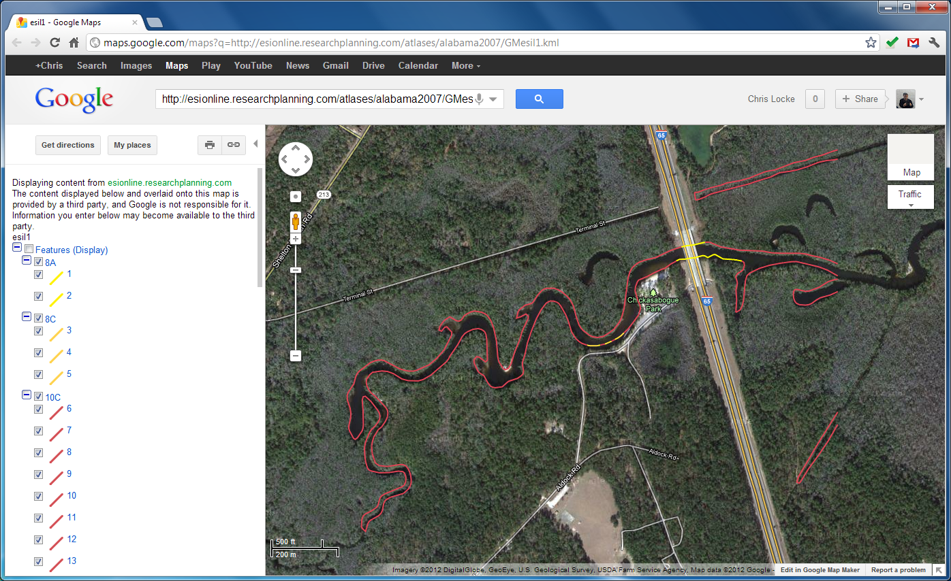
Google Maps & Mobile

Slide 19
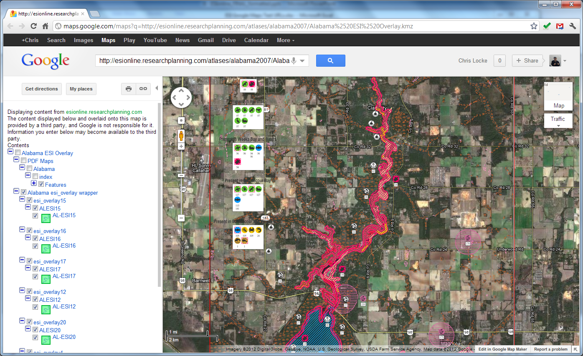
Google Maps & Mobile

Slide 20
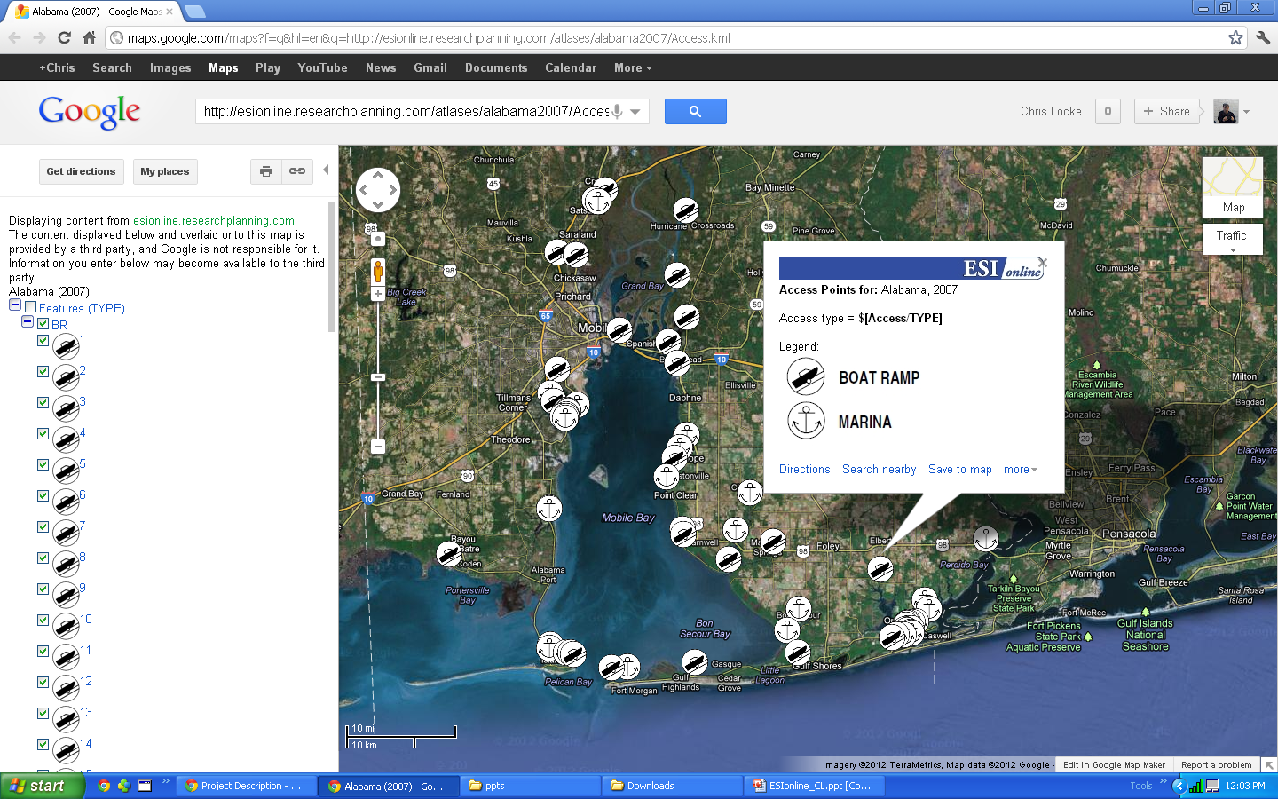
Google Maps & Mobile

Slide 21
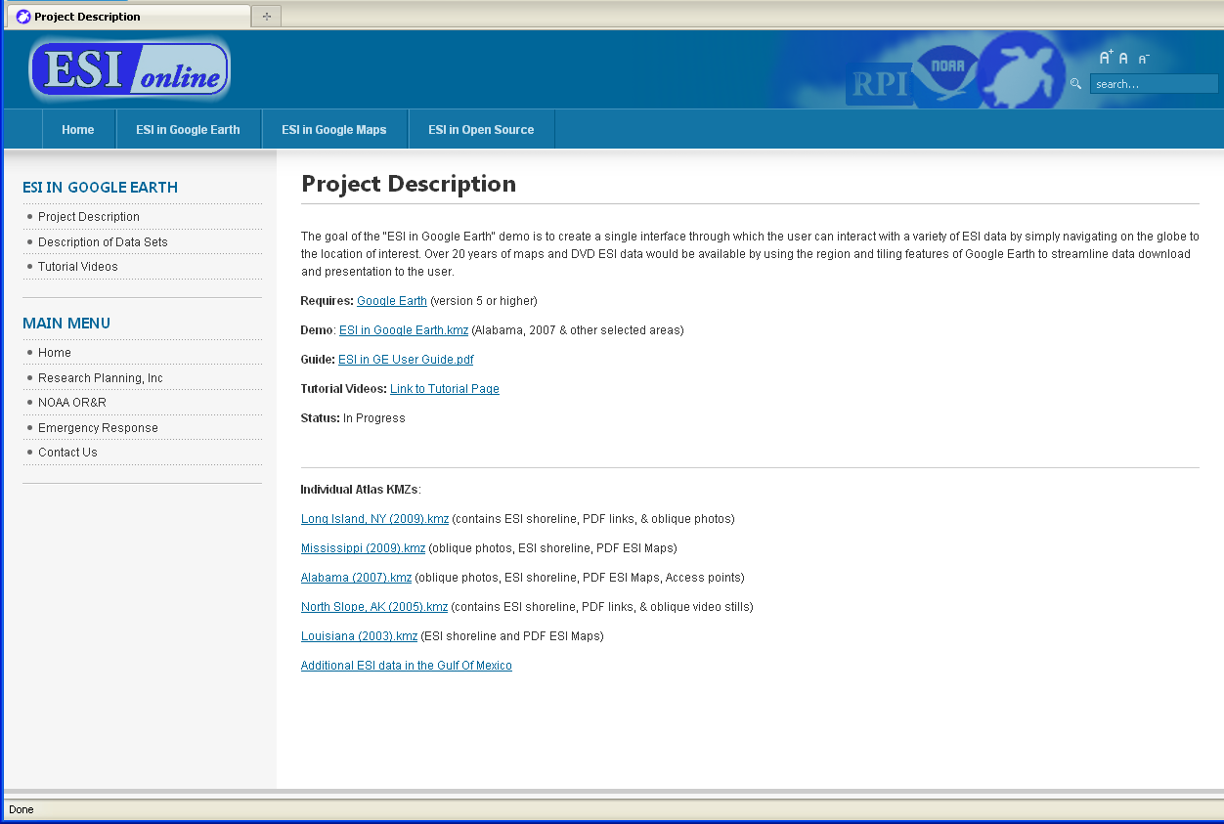
ESIonline Training Tutorials

Slide 22
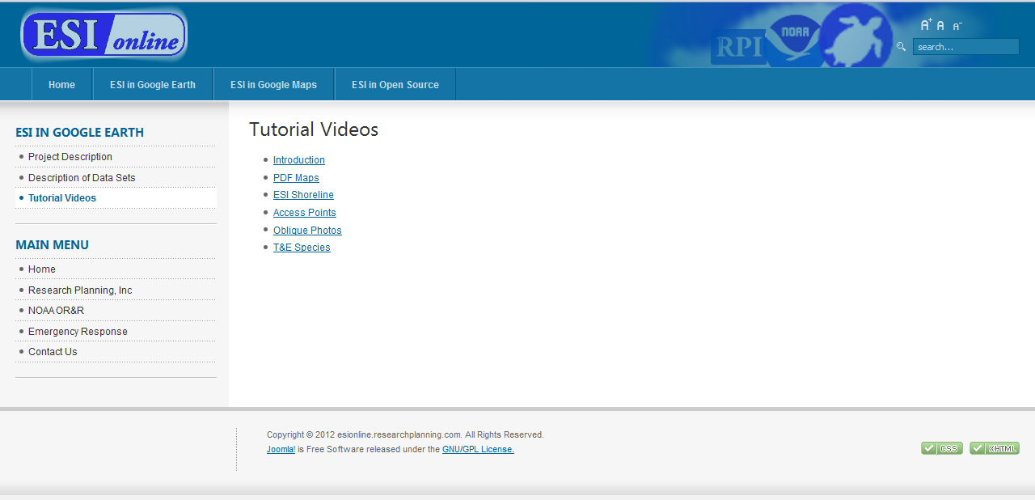
ESIonline Training Tutorials

Slide 23
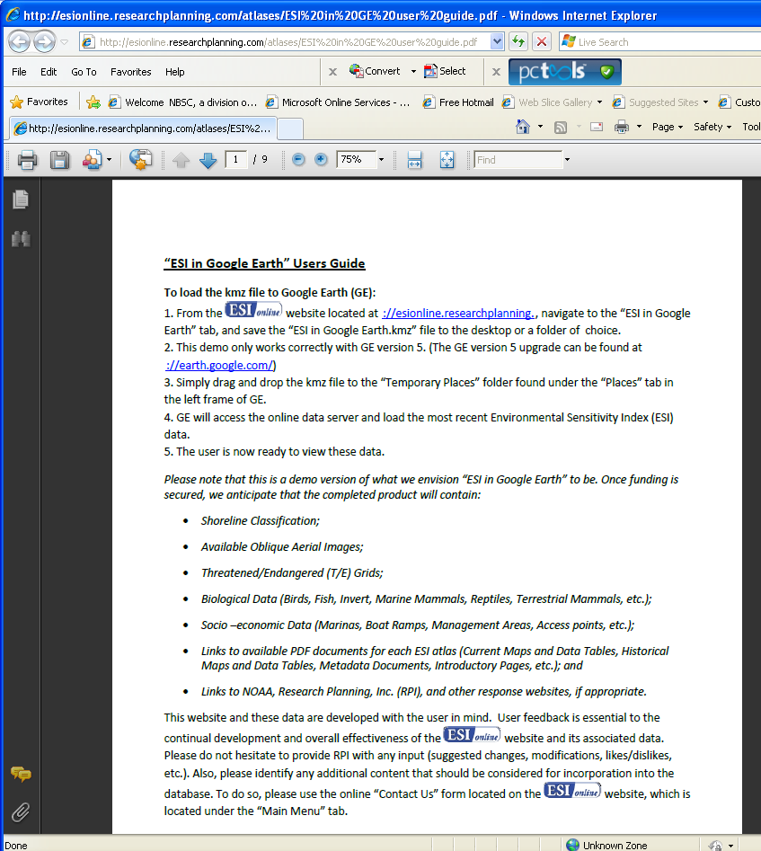
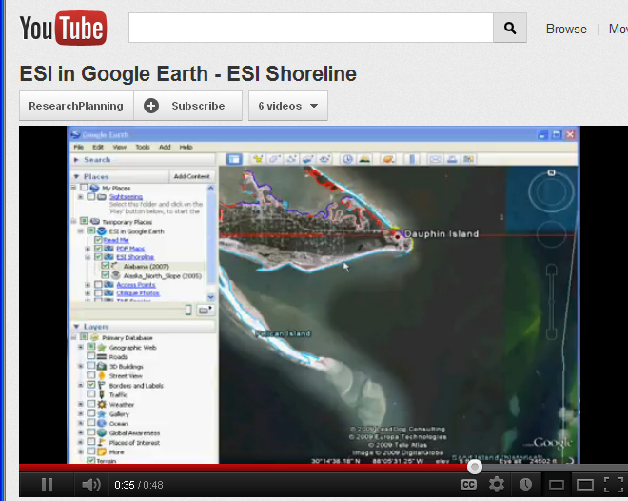
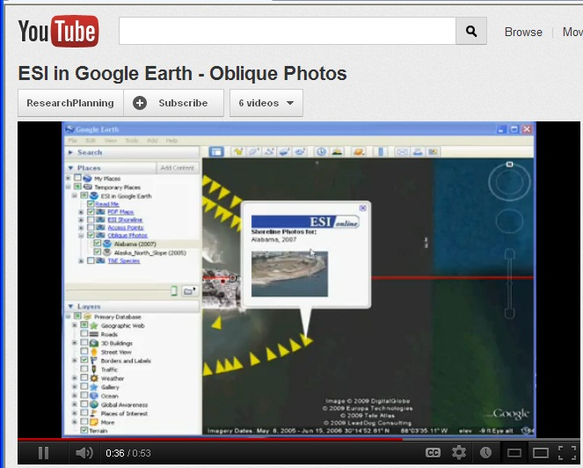
Users Guide and Video Tutorials

Slide 24
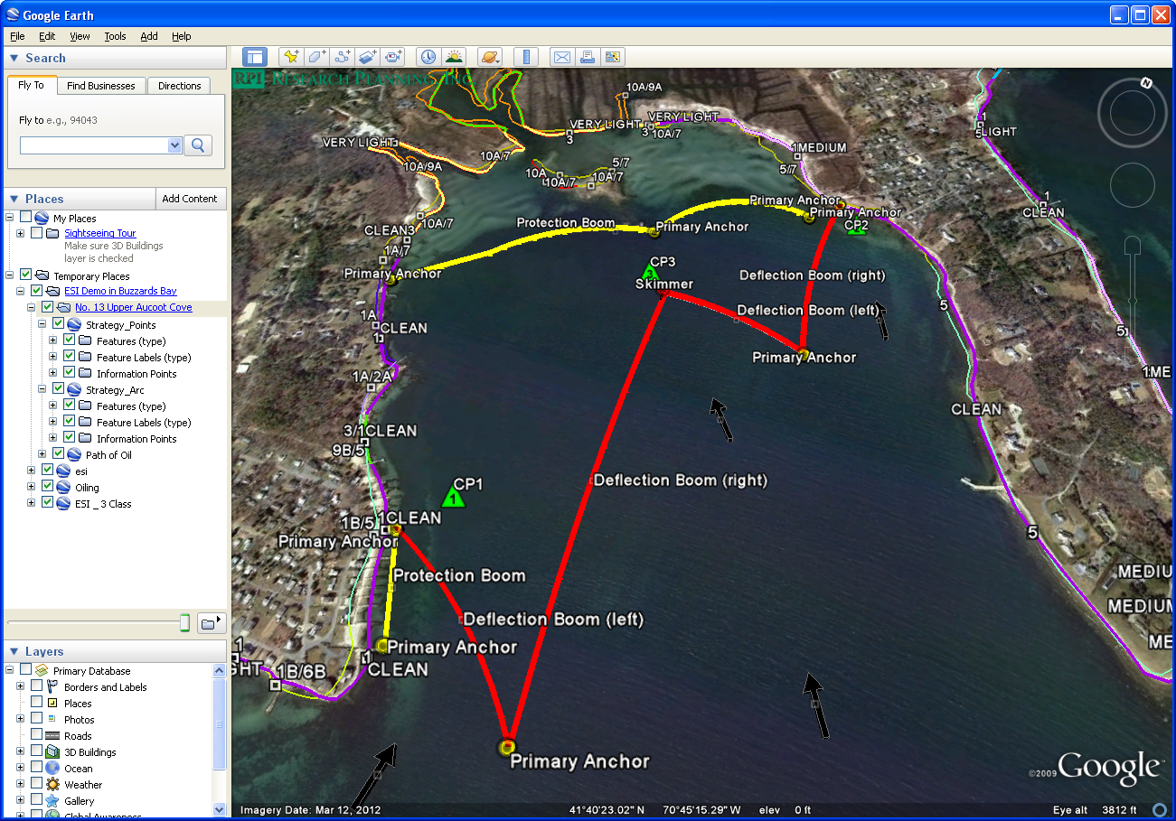
Protection Strategy in GE: Buzzards Bay

Slide 25
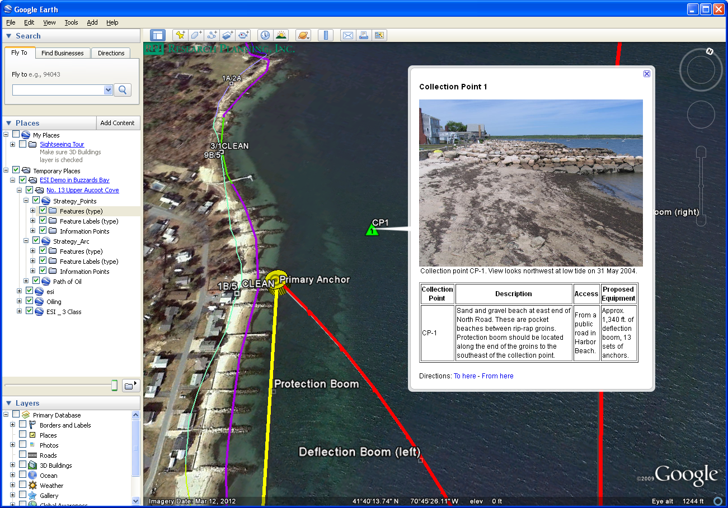

Slide 26
Conclusion
What from ESIonline could be implemented or is of value to ESI mapping?
  KMLs or KMZs for data review and final distribution
  Identifying oblique photo acquisition areas and other imagery sources used in ESI mapping
  Method for serving oblique photos
  ESI PDF maps downloadable from GE environment
  Video tutorials (YouTube) and ESI users guide

