Slide 1
Identifying Important Ecological Areas
Environmental Sensitivity Index
Mapping Workshop
Dr. Jeffrey Short, JWS Consulting LLC
Brianne Mecum and Dr. Chris Krenz, Oceana
(special thanks to Audubon Alaska)

Slide 2
Why Discuss IEAs?
ESI should continue moving from a 1D coastal framework to a 3D framework
  Especially in the Arctic, with sea ice and key pelagic feeding/hunting areas
  Offshore impacts are probable
Additional tools to prioritize response based on relative importance/sensitivity

Slide 3
What are IEAs?
Geographically delineated areas which by themselves or in a network have distinguishing ecological characteristics, are important for maintaining habitat heterogeneity or the viability of a species, or contribute disproportionately to an ecosystem's health, including its productivity, biodiversity, function, structure, or resilience
E.g., migration routes, subsistence areas, sensitive seafloor habitats, breeding and spawning areas, foraging areas, and areas of high primary productivity

Slide 4
Identifying IEAs
Geographically delineated areas which by themselves or in a network have distinguishing ecological characteristics, are important for maintaining habitat heterogeneity or the viability of a species, or contribute disproportionately to an ecosystem's health, including its productivity, biodiversity, function, structure, or resilience
Individual species level
Guild or ecological feature level (e.g., marine mammals, benthic productivity)
Ecosystem level

Slide 5
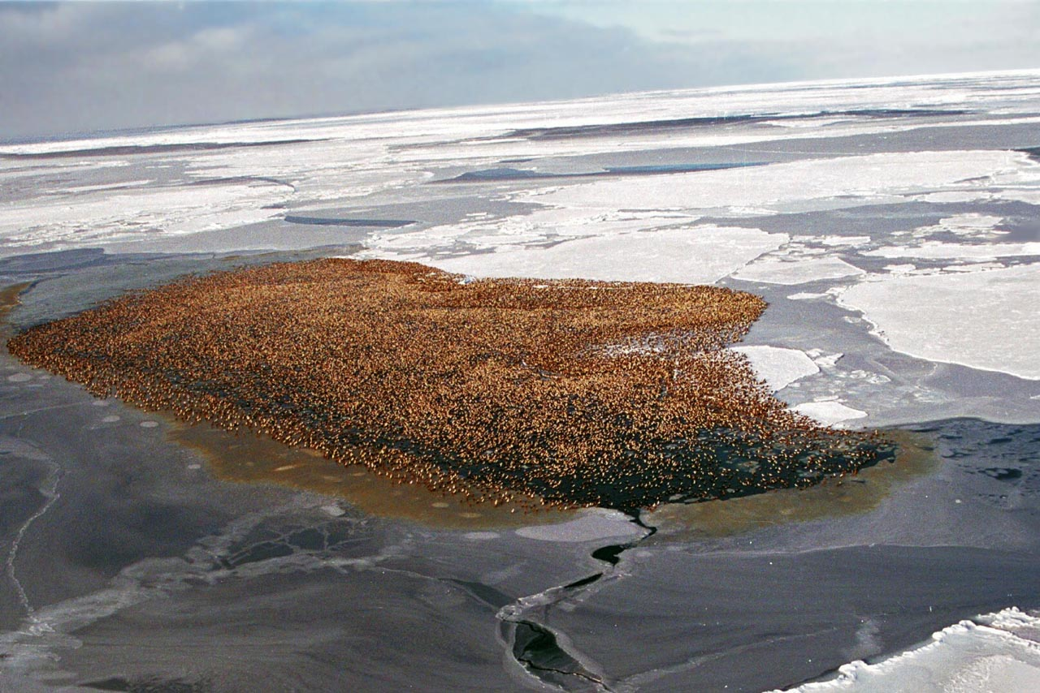

Species Level IEA
A place that is critical to a species survival
(density data, qualitative information)
All spectacled eiders overwinter in the same spot

Slide 6
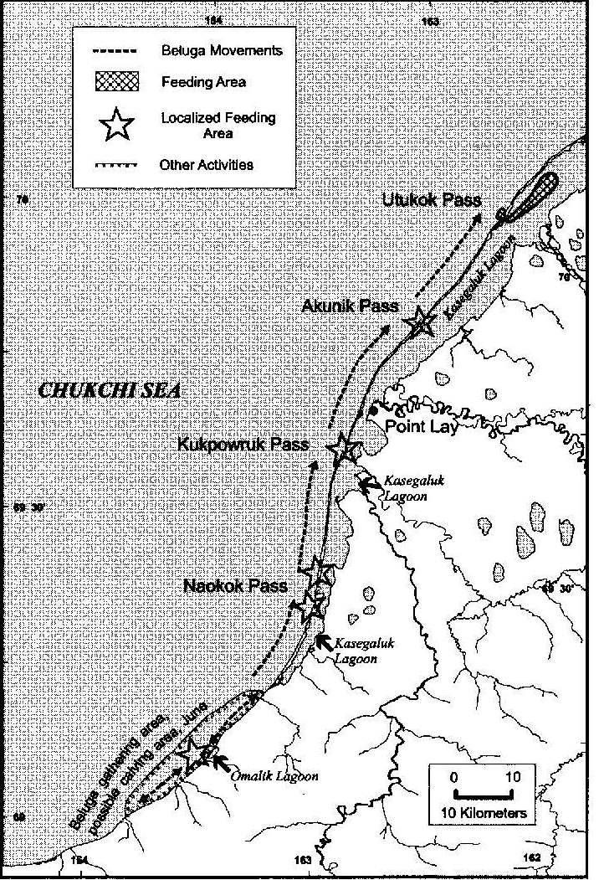
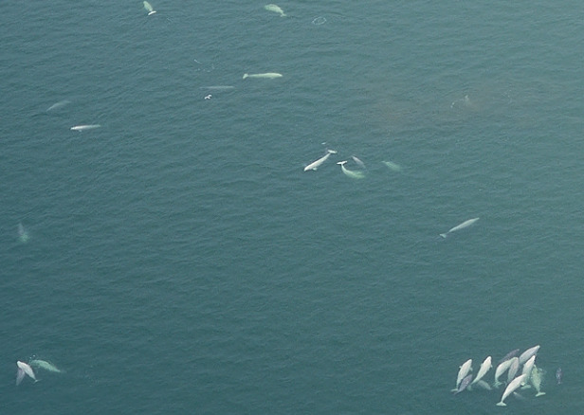
Species Level IEA
E. Chukchi Belugas Gather Near Point Lay
Huntington et al. 1999

Slide 7
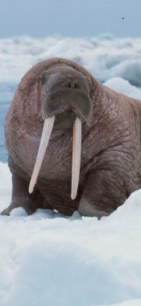
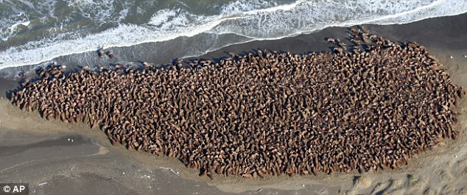
Guild / Ecological Feature Level IEA
Example fall mammal use of Barrow Canyon

Slide 16
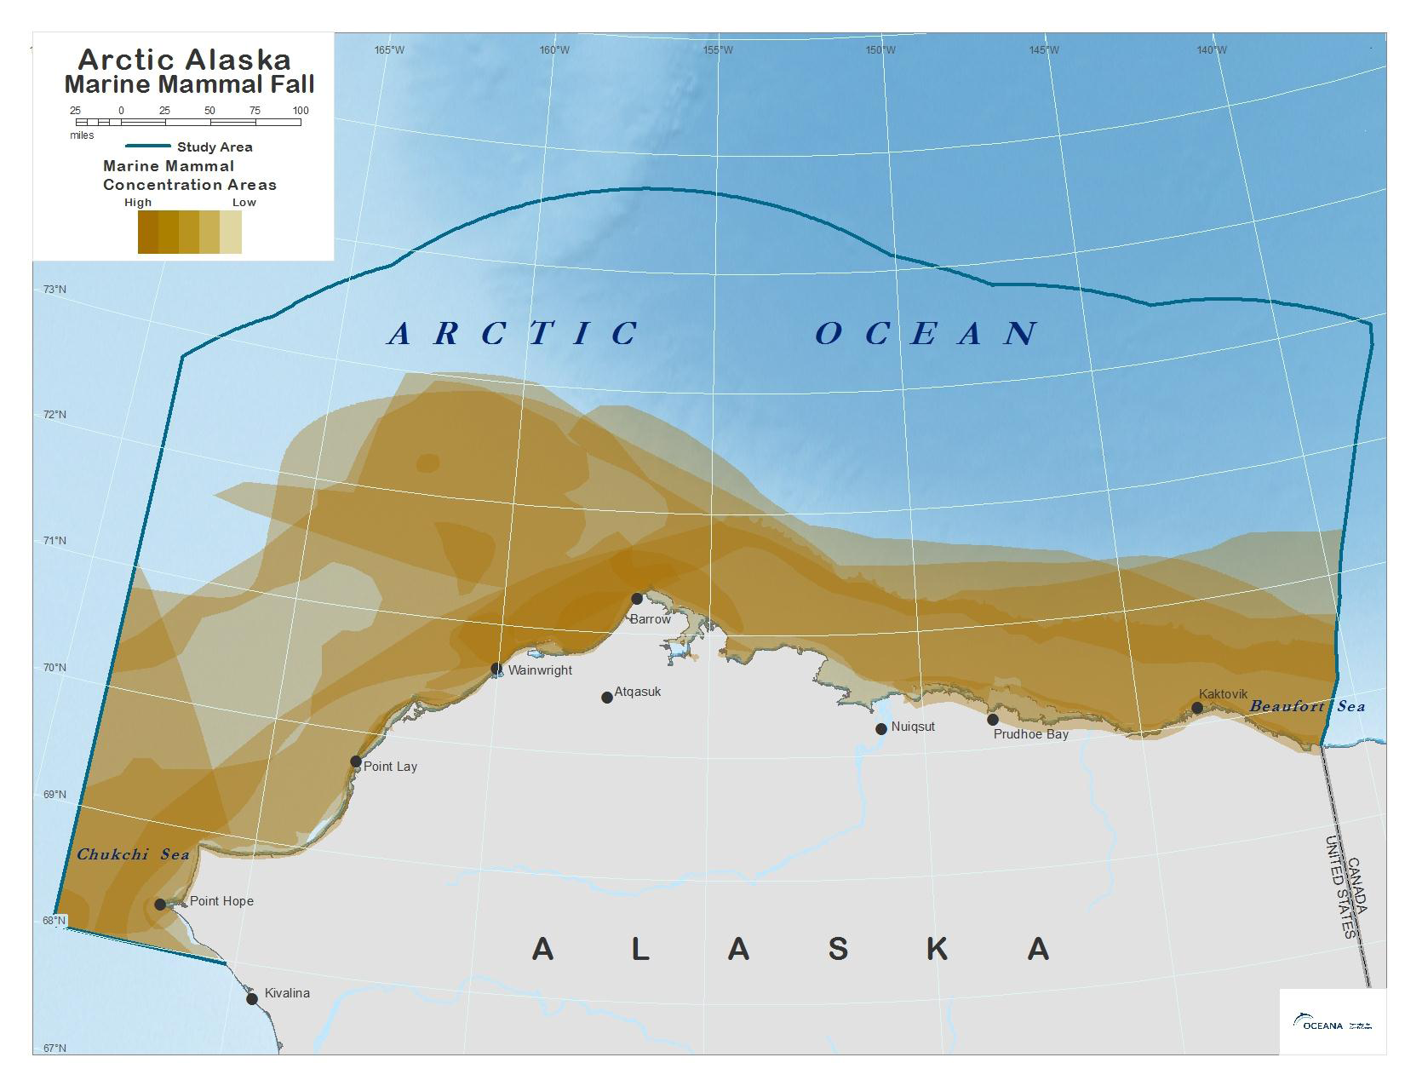
Guild / Ecological Feature Level IEA
Fall Mammal Concentration
Areas Overlap

Slide 17
Guild / Ecological Feature Level IEA
Barrow
Canyon
Fall Mammal Concentration
Areas Overlap

Slide 18
Ecosystem Level IEAs (in progress)
What information?
  -> Ecological features (e.g., marine mammals)
How does one combine different types of information? How can a single measuring stick be created?
  -> Standard deviates

Slide 20
Ecological Features Important to a Healthy, Functioning Arctic Marine Ecosystem
Subsistence | Marine Mammals
Benthic Biomass | Seabirds and Shorebirds
Primary Production | Migration Corridors
Sea Ice (edges and polynyas) | Fish
Hard Substrate

Slide 21
Ecological Features Important to a Healthy, Functioning Arctic Marine Ecosystem
Subsistence | Marine Mammals
Benthic Biomass | Seabirds and Shorebirds
Primary Production | Migration Corridors
Sea Ice (edges and polynyas) | Fish
Hard Substrate

Slide 22
Ecosystem Level IEAs (in progress)
Benthic Biomass
Sample values (g/m²)
Extrapolation (nearest neighbor)
Affix to planning units (10X10 km)
Average value / planning unit

Slide 27
Ecosystem Level IEAs (in progress)
Net Primary Productivity
Estimated from satellite data (g/m²)
Affix to planning units (10X10 km)
Average value / planning unit

Slide 31
Ecosystem Level IEAs (in progress)
Seabird Density
Density estimate (birds/km²) – Audubon analysis of N. Pacific Pelagic Seabird Database
  Filtered by species for data coverage
  Species densities combined for total
Affix to planning units (10X10 km)
Average value / planning unit

Slide 35
Ecosystem Level IEAs (in progress)
Fall Mammal Concentration Areas
Estimates/knowledge of higher use areas (presence/absence; data used in previous example)
Affix to planning units (10X10 km)
Count / planning unit

Slide 39
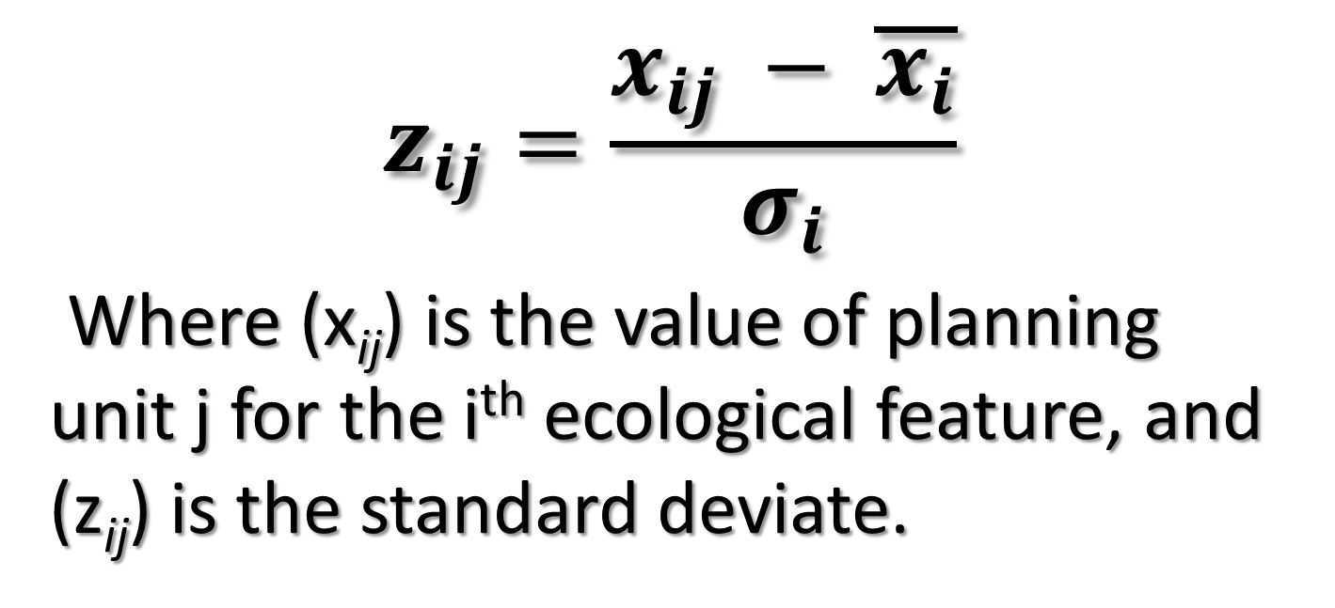
Step 1 – Standard Deviates
$$z_{ij}=\frac{x_{ij} − \overline{x_{i}}}{σ_{i}}$$
Where (x_{ij}) is the value of planning unit j for the i^{th} ecological feature, and (z_{ij}) is the standard deviate.

Slide 40
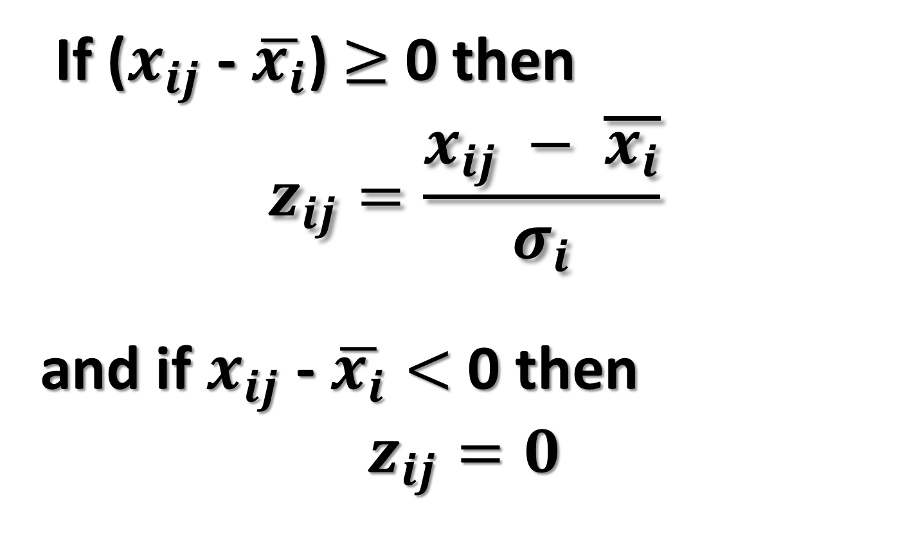
Step 1 (cont.) – but Stay Positive
If ($x_{ij}$ - $\overline{x_{i}}$)$≥$ 0 then
$$z_{ij}=\frac{x_{ij} − \overline{x_{i}}}{σ_{i}}$$
and if $x_{ij}$ - $\overline{x_{i}}<$0 then
$$z_{ij}=0$$

Slide 45
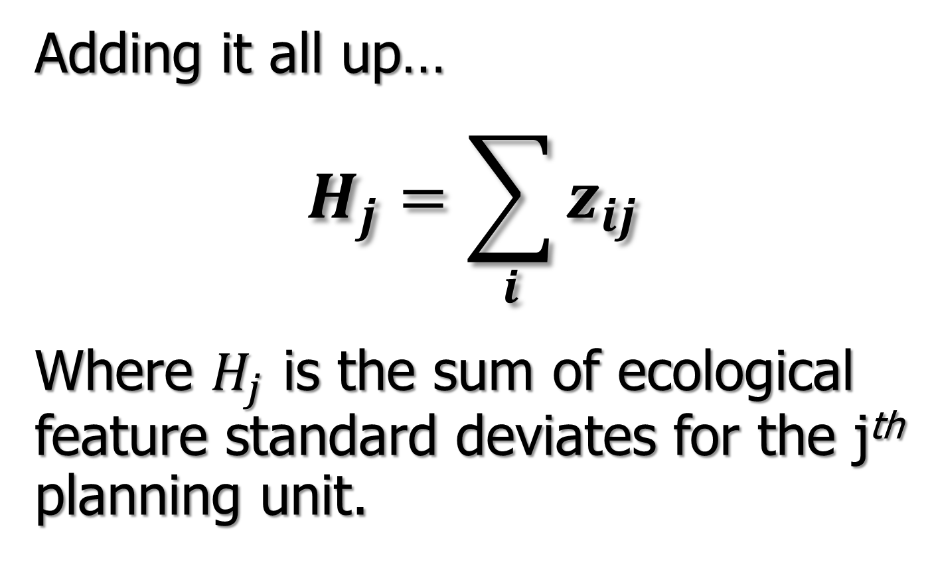
Ecosystem Level IEAs (in progress)
Adding it all up…
$$H_{j}=\sum_{i}{z_{ij}}$$
Where $H_{j}$ is the sum of ecological feature standard deviates for the j^{th} planning unit.

Slide 46
Standard Deviate Sum

Slide 47
Oil Spill Response Prioritization
History shows limited abilities in large spills
DWH: protect everything strategy saves nothing
ESI maps are prioritization tool, but…
  Need ranking (currently everything appears important)
  Decisions made during response and pit agencies against each other (e.g., mammals vs. birds)
Where should assets be staged?

Slide 48
Conceptual Considerations for ESI from IEA Identification Methods
Measuring different attributes with one measuring stick
Potential to prioritize areas based on importance & sensitivity
Can easily use weighting factors based on sensitivity (or other attribute)
Holistic versus piecemeal view of ecosystem
Response and impacts are 3 dimensional

Slide 49
ESI Mapping has HUGE Potential
Expanded/holistic ESI maps could be a planning tool
  OCSLA 2007-2012 5 year plan analysis used ESI maps but maps and info were not ripe (yet)
  Importance and sensitivity mapping should be at the heart of NEPA analyses
ESI could be a better ecosystem baseline for NRDA

