Slide 1
Shoreline Classification
Research Planning, Inc
May 1, 2012
ESI workshop, Mobile Alabama

Slide 2
Outline
ESI concept
Current production process
Challenges
Relevant programs and standards

Slide 3
Core Concepts
A consistent classification of shoreline morphology / habitat
Focus on oil spill response
National standard (arctic to tropical) with ~35 year history
Primarily linear shoreline segments, with limited polygonal features

Slide 4
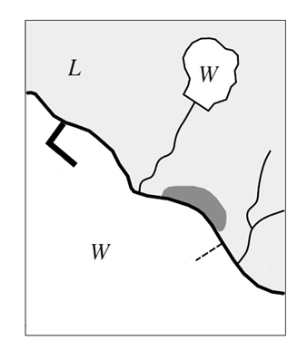

Slide 5
7/2A/10A

Slide 6
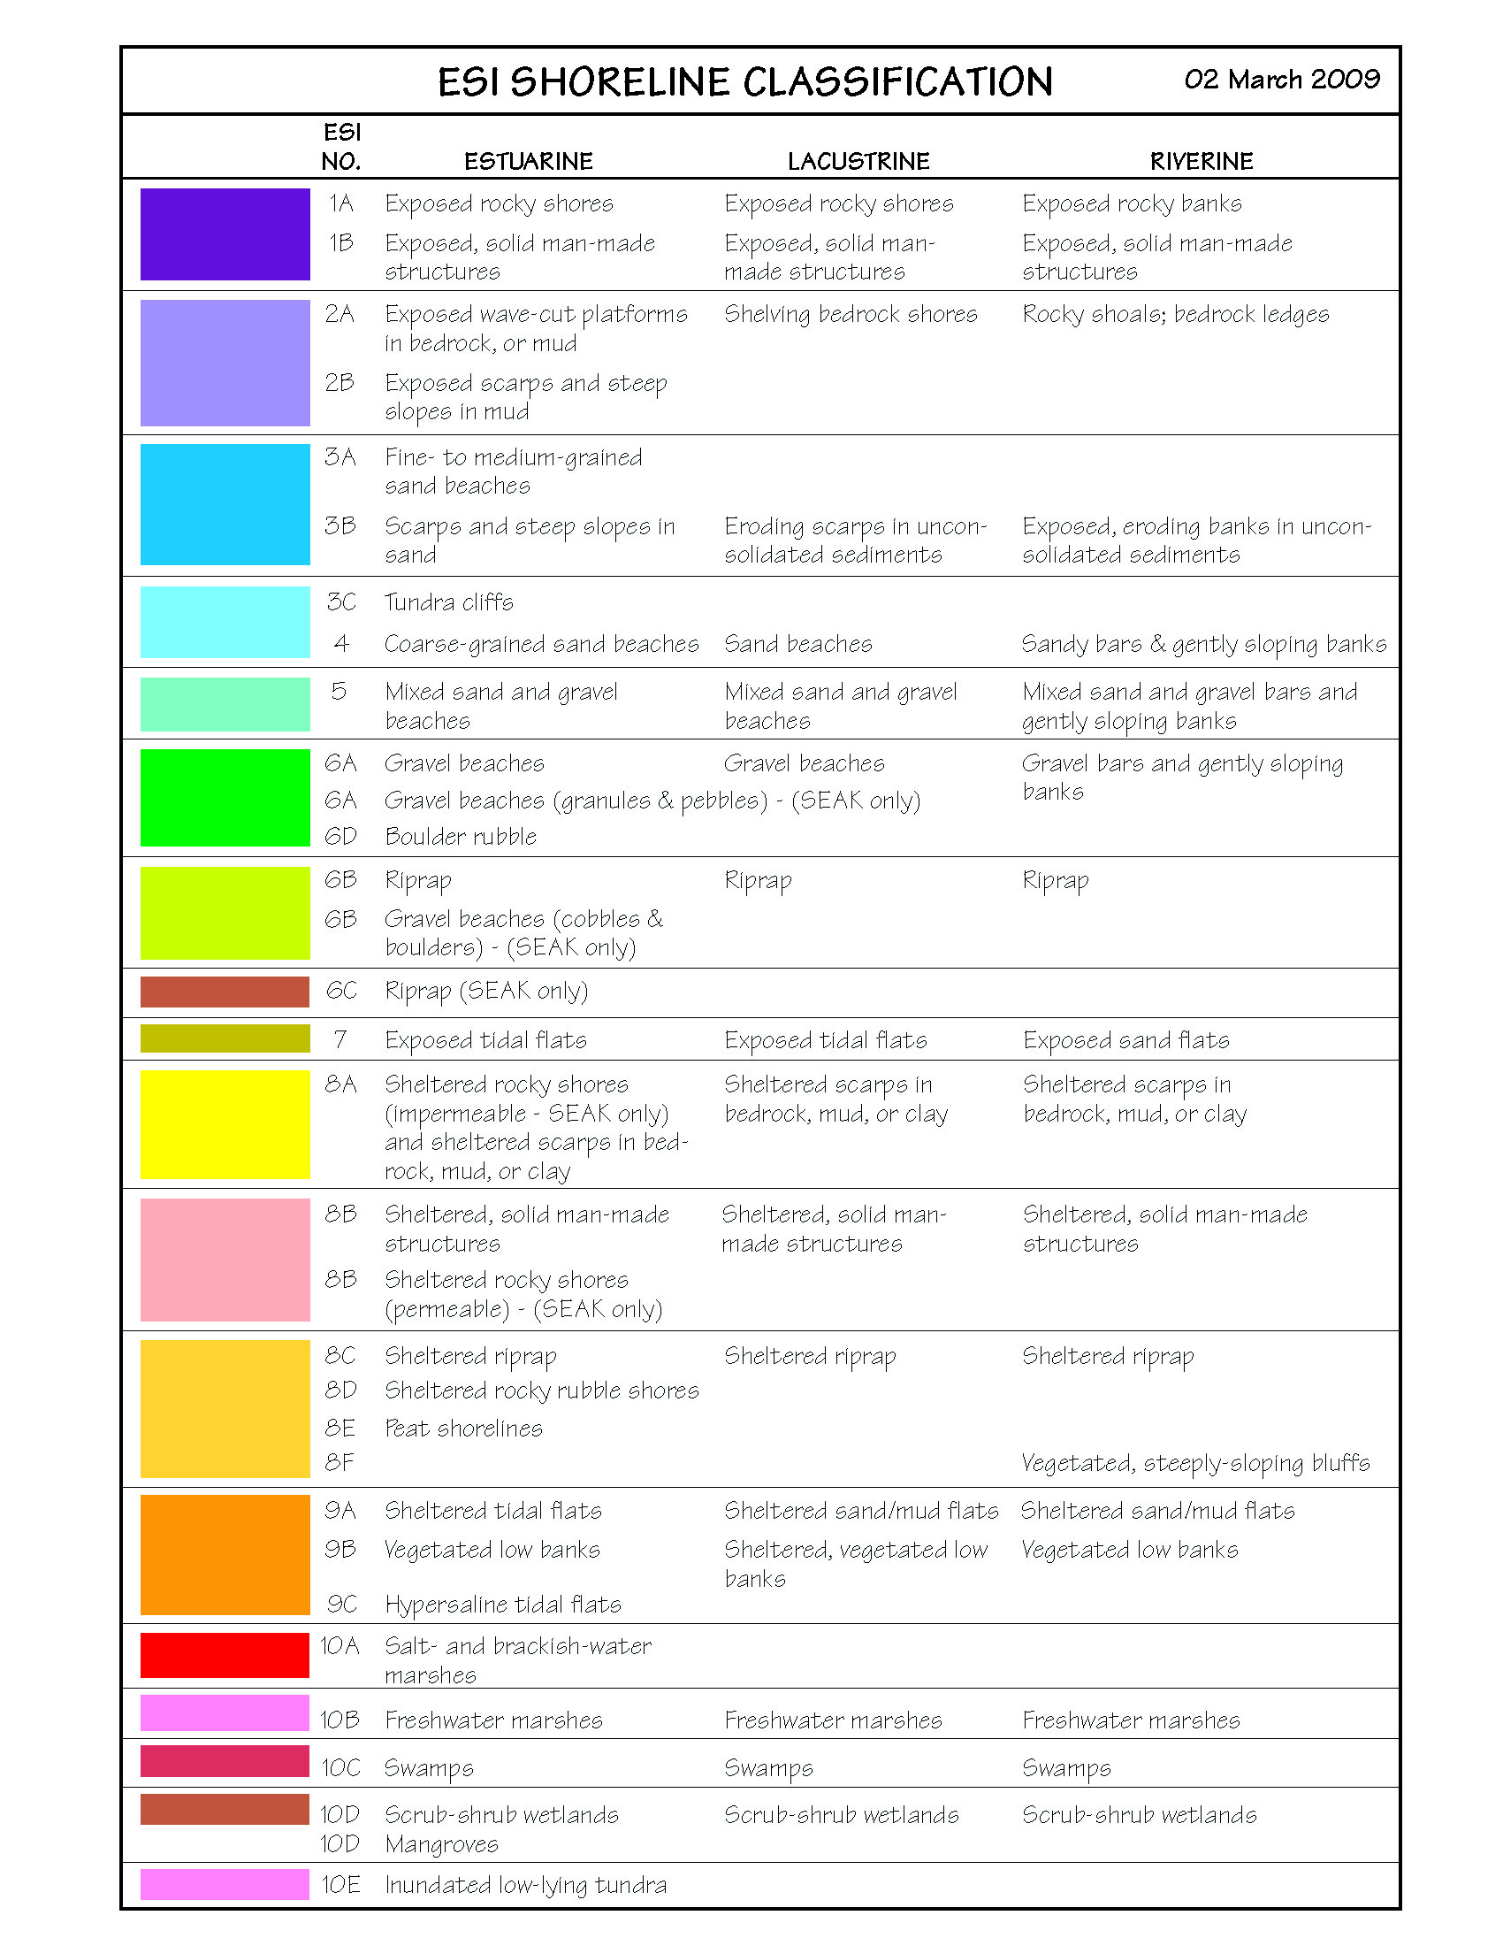

Slide 7
Process
Obtain vector shoreline
Merge with other polygonal data
Evaluate imagery sources (oblique and vertical)
Acquire imagery via overflight, if required
Desktop shoreline classification
Classification transfer

Slide 8
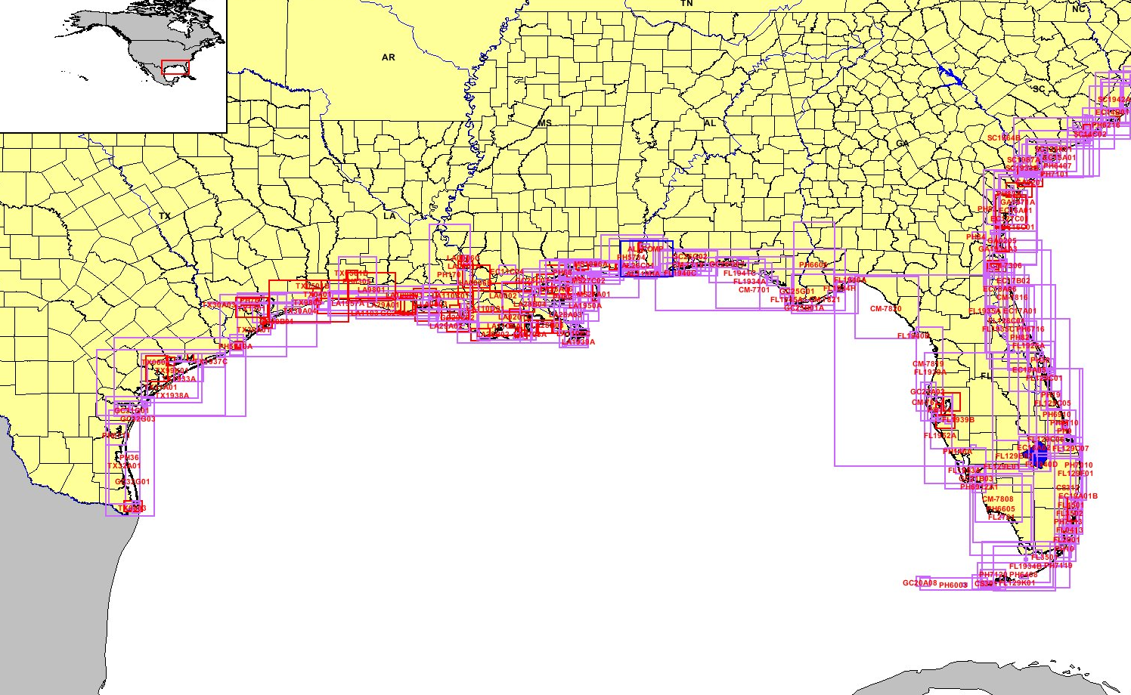
NOAA National Shoreline

Slide 9
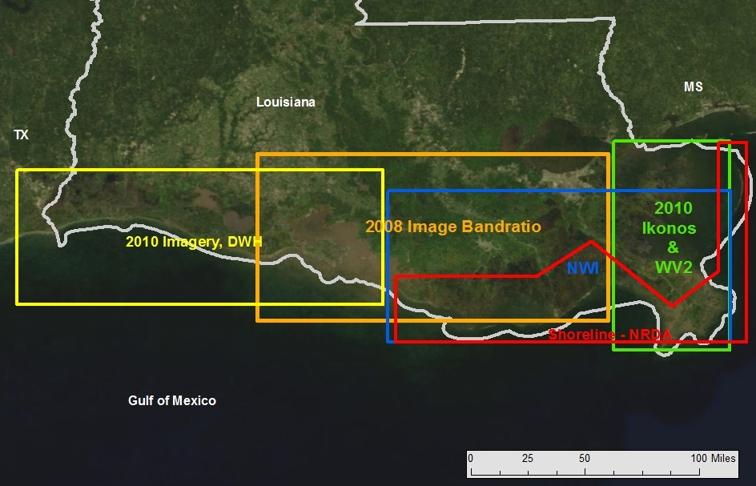
Louisiana Shoreline Data

Slide 10
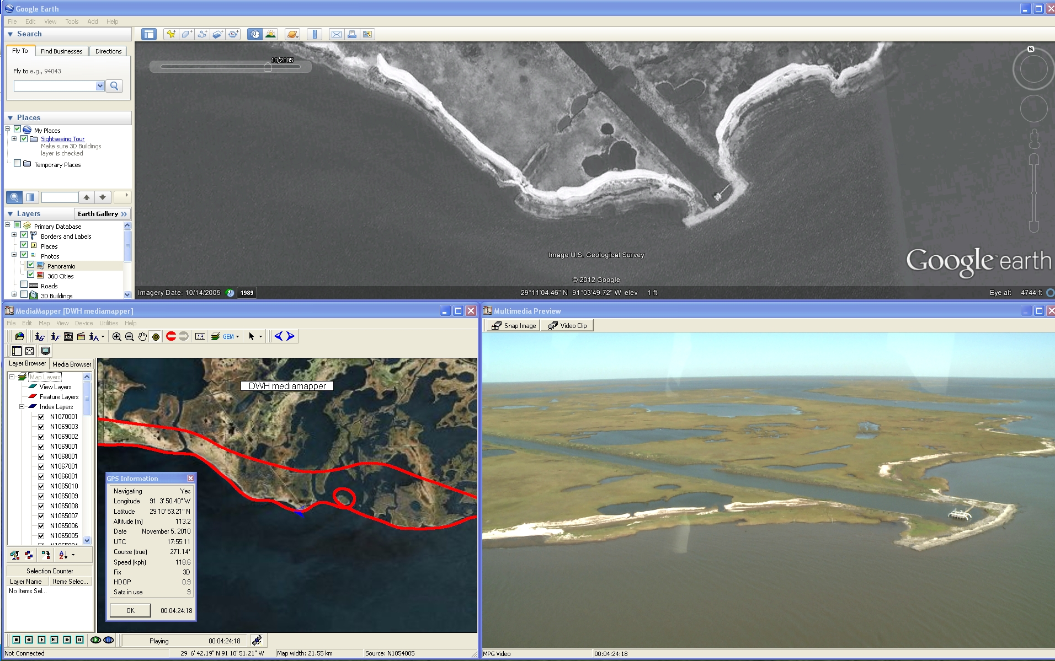
Louisiana Shoreline Classification

Slide 11
Adjacent Habitats
Polygonal habitats that are included as part of the maps and integrated with the shoreline classification
Intertidal and Benthic : wetlands, tidal flats, reefs, SAV beds
Sources: many, primarily NWI, or other more recent, state or regional datasets

Slide 12
Imagery Sources
Vertical
State/county provided image web services (e.g. FWC Image Server)
Google Earth/Maps
USGS/NAIP
Oblique
Bing Imagery
Licensed Pictometry
NGOs
Acquired for project

Slide 13
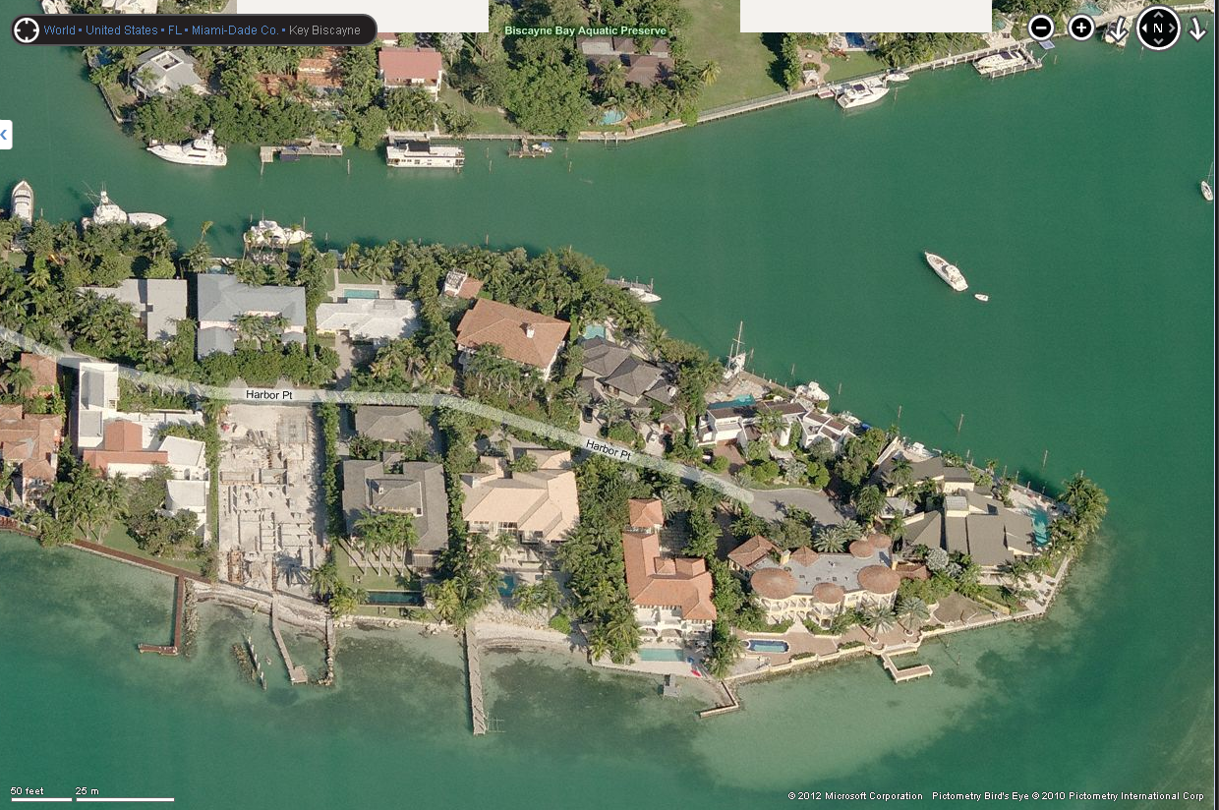
Source: http://www.bing.com/maps/

Slide 14
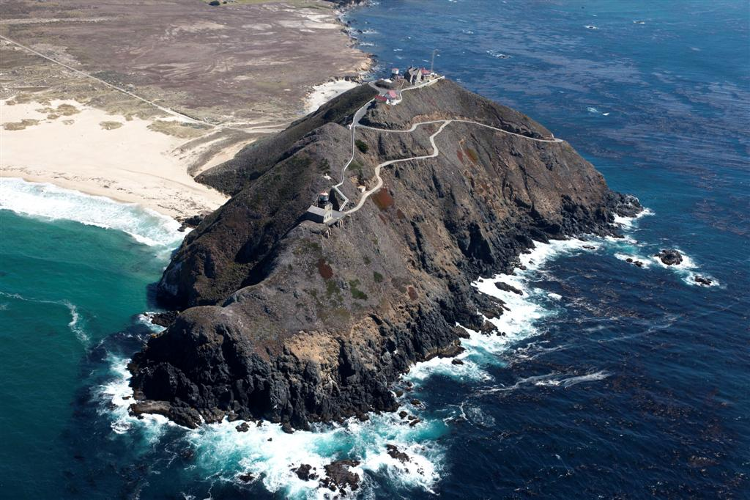
Source: http://www.californiacoastline.org/

Slide 15
Source: NOAA Mississippi ESI

Slide 16
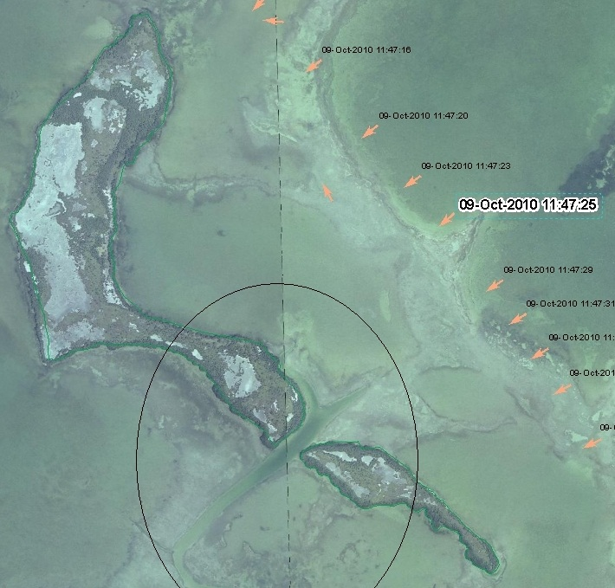
Classification via oblique aerials

Slide 17
Classification via oblique aerials

Slide 18
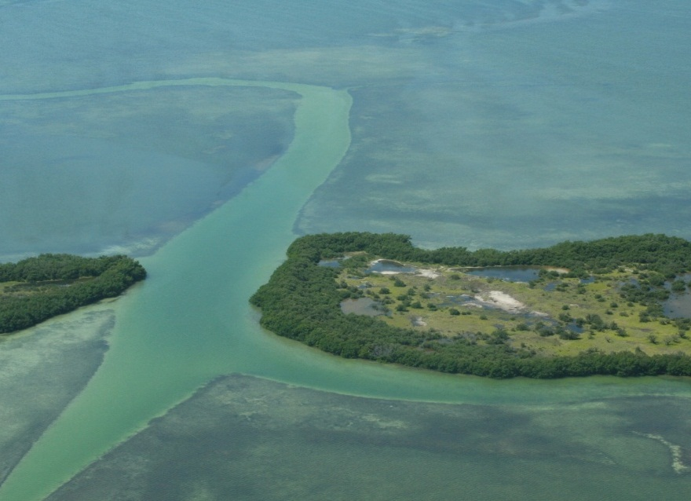
Classification via oblique aerials

Slide 19
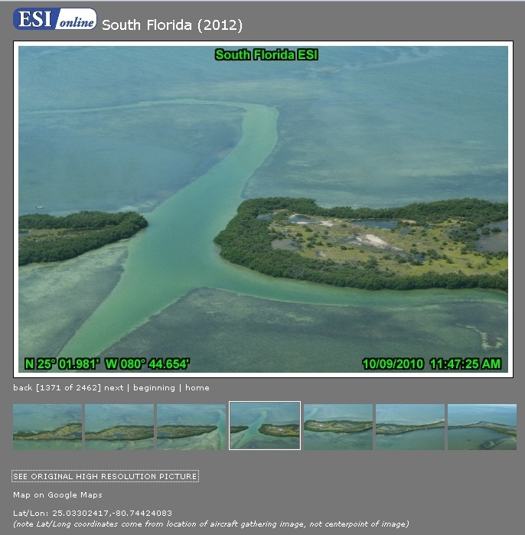
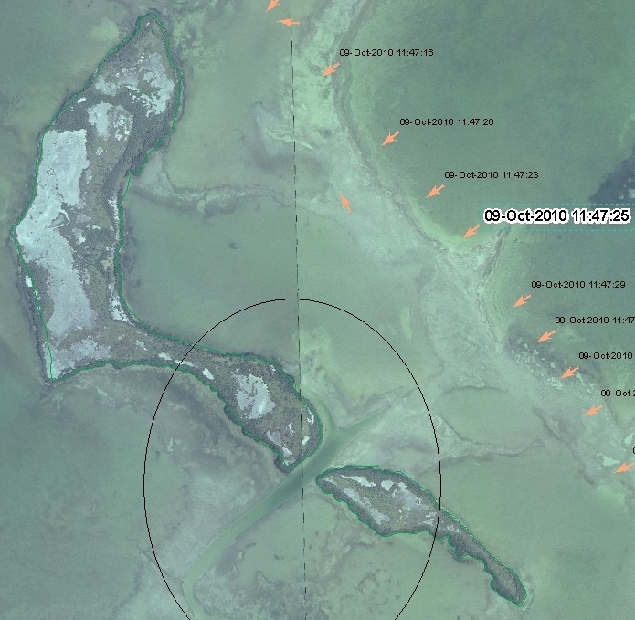
Classification via oblique aerials

Slide 20
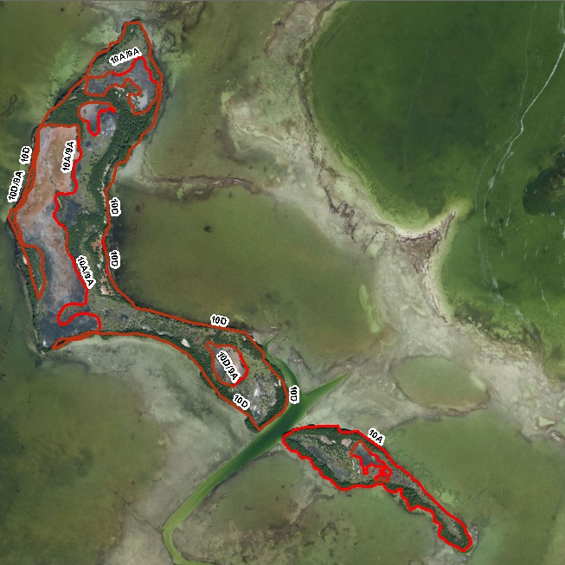
Classification via oblique aerials

Slide 21
Challenges
Shoreline geometry / integration
Classification flexibility
Minimum mapping unit (MMU)
Regional differences
Sensitivity vs. Morphology

Slide 22
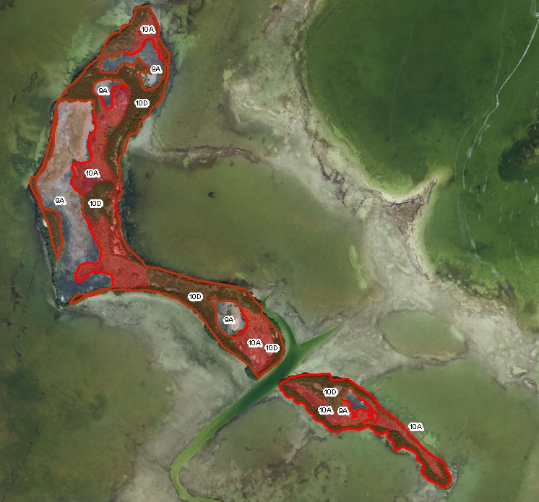
Challenges – Geometry Matching

Slide 23
Challenges – Classification Flexibility
Three releases of the NOAA ESI Guidelines: 1992, 1997, and 2002.
Limited opportunities for updating or changing standard
Sensitivity and morphology are inseparable

Slide 24
Challenges – Minimum Mapping Unit
Minimum Mapping Unit (MMU) is the smallest alongshore length of shoreline mapped as separate segment
In the past, driven by hardcopy map scale
Use of digital data in multi-scale environments and increasing urbanization/fragmentation of shoreline environments

Slide 25
Source: http://www.bing.com/maps/

Slide 26
Challenges – Regional Differences
Atlases compiled by states or region, but using a national classification standard.
Exposure: Are “Exposed” and “Sheltered” defined in the same way across atlases?
Does sensitivity of a given morphology change from region to region?

Slide 27
Relevant Programs and Standards
ShoreZone
Coastal and Marine Ecological Classification System (CMECS)

Slide 28
ShoreZone Shoreline Geologic Unit Classification
Similar geometry
Rocky coast focus
Each line segment may have multiple geologic “units” associated
More complex data structure
Biological communities directly associated with shoreline segment
Source: http://conserveonline.org/static/html/datadictionary0910/index.htm

Slide 29
Shorezone Biobands
Source: http://conserveonline.org/workspaces/shorezone/documents/supporting-documentation/view.html

Slide 30
Coastal and Marine Ecological Classification Standard

Slide 31
Coastal and Marine Ecological Classification Standard
Source: http://www.csc.noaa.gov/benthic/cmecs/index.html

Slide 32
Coastal and Marine Ecological Classification Standard
Source: http://www.csc.noaa.gov/benthic/cmecs/index.html

Slide 33
Further questions
Are there additional attributes you’d like to see tied to the shoreline? How would these be useful?
What are your opinions on adding exposure, slope, fetch or other elements of some of other classifications (CMEC/ShoreZone)?
Do you think a coarser level classification (e.g. “Beach” vs. “Mixed sand and gravel beach”) would be useful?
Would “mixed” alongshore shoreline classes useful or confusing?

Slide 34
Further questions
What do you think would be the “best” base shoreline? Why?
Is it better to select the “best” shoreline for each atlas or project, or to be consistent across the US to the extent possible?
What is more important in shoreline: cartographic detail or specific tidal datum?
What do you feel is an appropriate scale for land/water interface and classifying ESI (1:24,000, 1:5,000, 1:10,000)?

Slide 35
Further questions
Would you use oblique still imagery for other projects/applications?
How important is image quality (weather, lighting distance) vs. coverage and cost?
Would video or video stills be more useful for other applications?

Slide 36
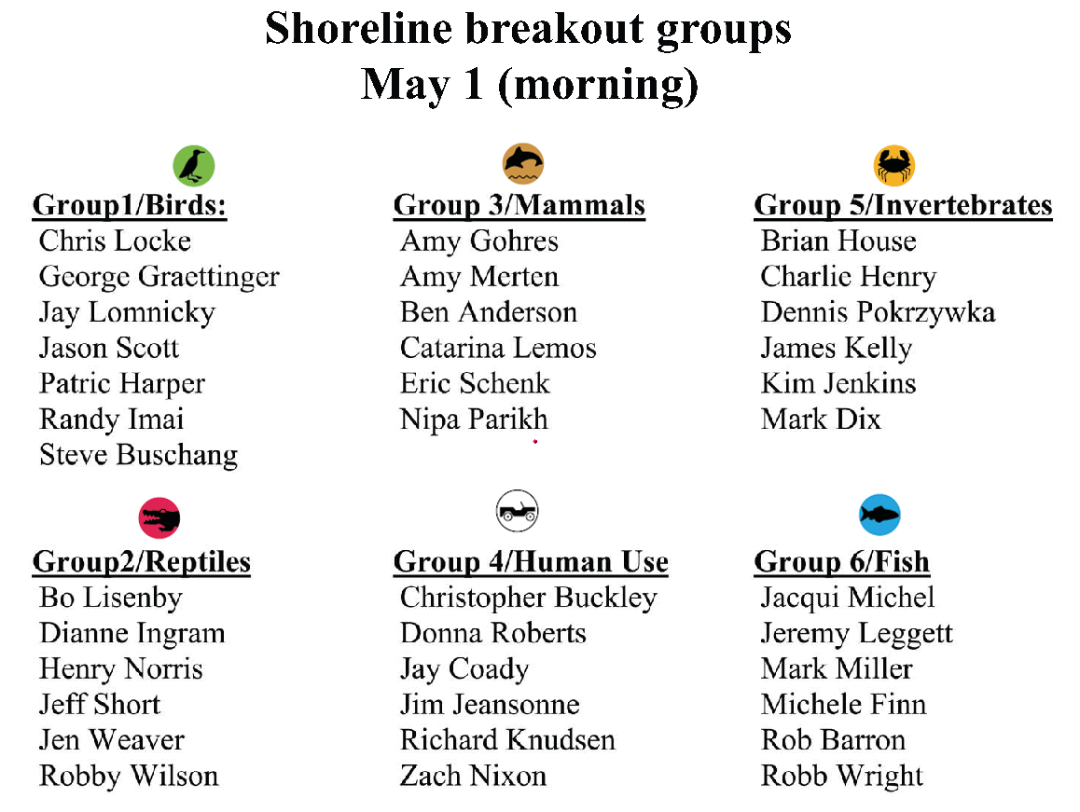
Breakout Group Assignments

