Slide 1
The Florida Marine Spill Analysis System (FMSAS) Digital Integration for Oil Spill Response and Planning
Richard Knudsen
Florida Fish and Wildlife Conservation Commission
Fish and Wildlife Research Institute
(Coastal and Marine Resources Assessment)
Center for Spatial Analysis
St Petersburg, Florida
May 2, 2012
NOAA ESI Workshop

Slide 2
Introduction
State Statutory Background
Florida Marine Spill Analysis System
Operational Context
Analysis and Reporting Tools
Future Work

Slide 3
Oil Pollution Act of 1990 Governor’s Task Force Recommendations
FL OPA 90 – F.S. 376.121 - Liability for Damage to Natural Resources
State Spill Response Strategy
State Damage Assessment Protocol
Update & Enhance Existing Environmental Sensitivity Index (ESI) Atlases
Automation of ESI Atlases
Targeted Information Management
State NRDA Formula
Coastal Protection Trust Fund – FL NPTF

Slide 4
Marine Resources GIS (MRGIS)
Currently 1300+ Layers w/ Metadata in SQL/SDE (Albers and Web Mercator)
Some Sample Data Holdings Used in Spill Response and Planning
Marine Facilities/Boat Ramps
ESI Shoreline Classification
Coral and Hardbottom
Mangroves
ESI Terrestrial Mammals
Seagrass
ESI Birds
Saltmarsh
Human Use (ESI)
ESI Reptiles
AToNs
Tidal Flats
Shoreline Sensitivity
Benthic Habitat
Shipping Lanes
Nautical Charts
Depth Contours
Administrative Boundaries
Managed Areas
Road Network
DOQQ Imagery (Standalome and Services
Field-Deployable on large external hard drive

Slide 5
Florida Department of Environmental Protection Office/Bureau of Emergency Response Support
MRGIS On-Scene Mapping and Analysis Support
MRGIS Remote Response Support
Targeted Data Layer Development
Distributed Mapping, Analysis, Equipment and Support
Annual FMSAS & GIS Training for BER staff
Response Drill Participation

Slide 6
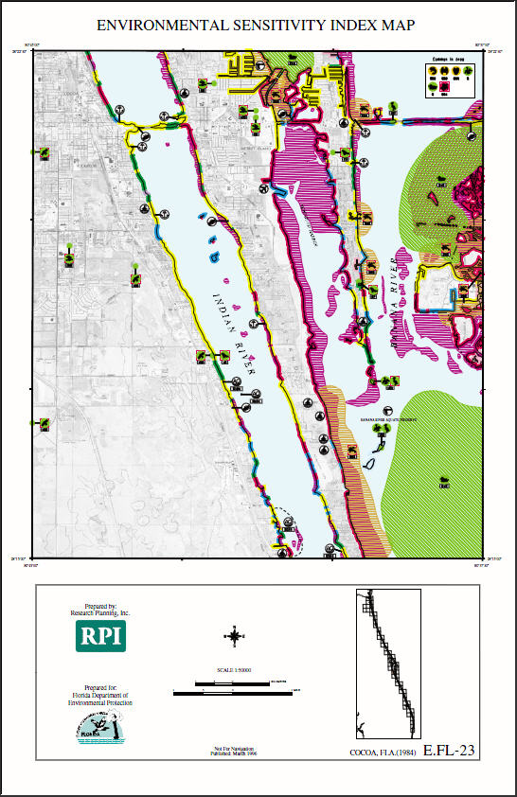
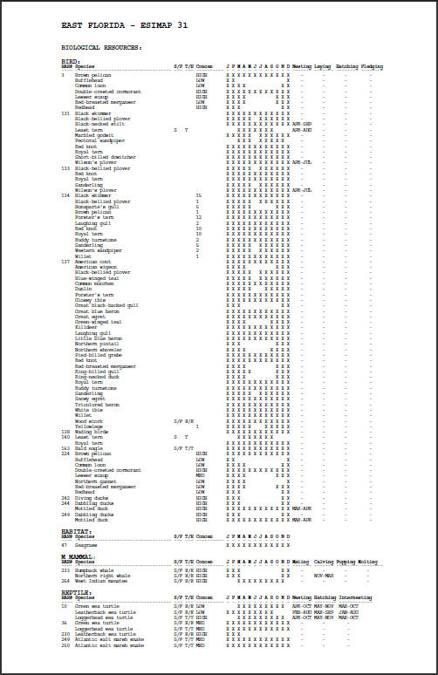
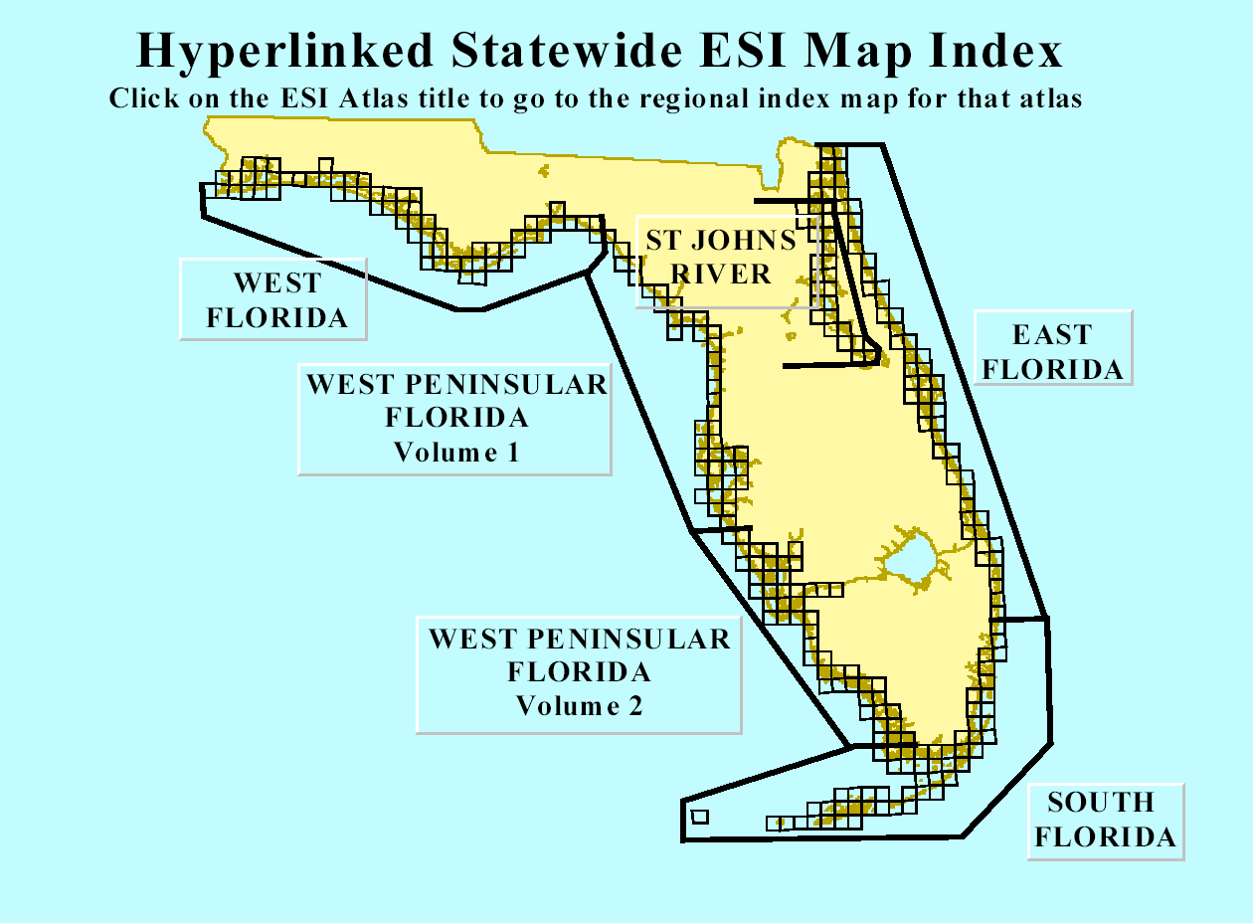
Statewide Environmental Sensitivity Index Mapping
Sensitivity of Coastal Environments and Wildlife to Spilled Oil Atlases
Statewide mapping (1:24k+) of coastal Florida’s natural and socio-economic resources
Creation of six hard-copy atlases covering Florida’s marine coastline & the St Johns River , and one very old atlas for the Apalachicola River (7 total)
Creation of CD-ROMs and web access with PDF versions of the atlases
Creation of ESI GIS for integration into the “Oilspill Application” (FMSAS)

Slide 7
FMSAS (Florida Marine Spill Analysis System)
Originally developed with ESRI as a UNIX ARC/INFO based oilspill planning, response, damage assessment and long term monitoring tool.
Successfully used to support 1993 Tampa Bay spill.
Converted to ArcView and running on Windows 2000/XP/Vista PCs and laptops.
Deployed in the field at nine Bureau of Emergency Response field offices and headquarters.
Previously a regional application, but as hardware capabilities have moved forward, a single statewide version is now the rule,
Notes:
Note use during 93 spill
Note FORD, County, and Env Excellence Awards.
Explain portability for BER and our response responsibilities.

Slide 8
Operational Context for the FMSAS Desktop Application
Contingency Planning
Spill Response
Resource Mapping and General GIS Data Management
Natural Resource Damage Assessment
Environmental Monitoring
Self Contained and Easily Distributable

Slide 9
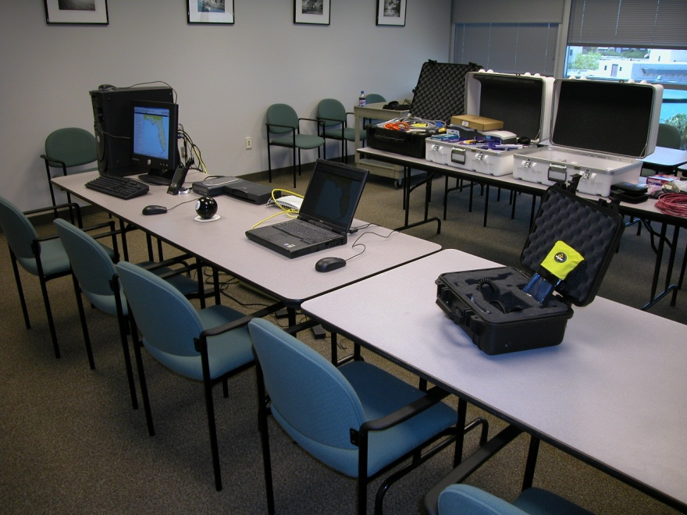
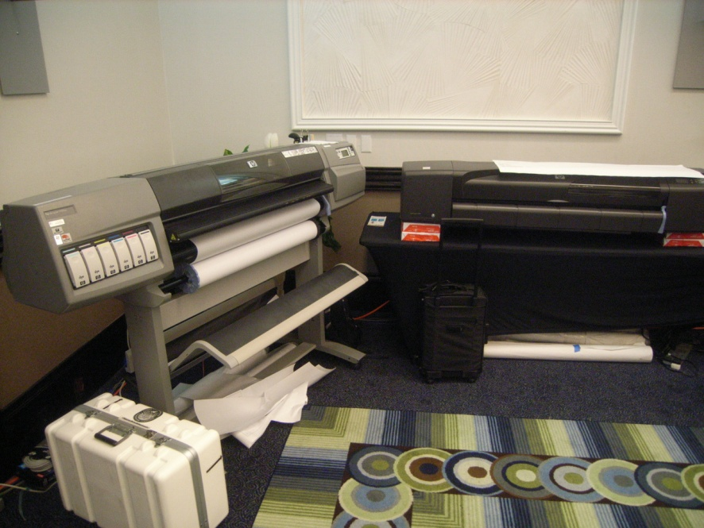
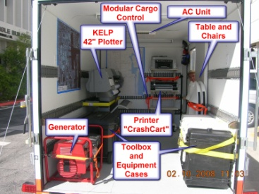
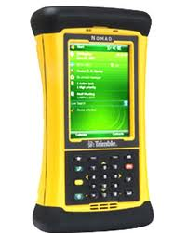
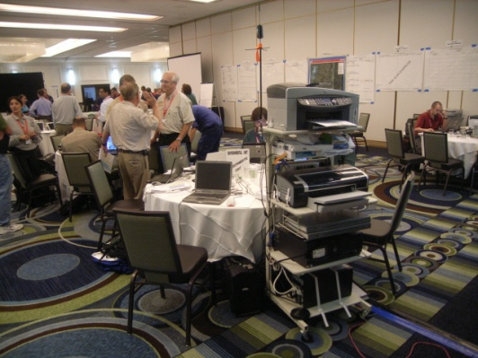
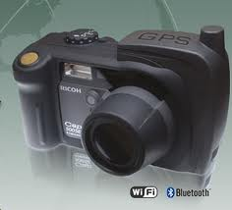
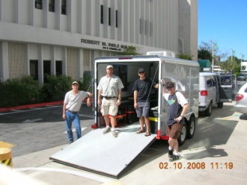
Elements of the FMSAS System
Deployable anywhere in the state within 24 hours
Hardware, Software, and Local Area Network
HP 42” Plotter (KELP)
PDAs/GPS/Cameras
Mobile Printers
ER Trailer

Slide 10
FMSAS Query and Analytical Tools
Gazetteer
Species Identify (On-The-Fly)
Complex Event Manager (Spill Manager)
Resources-At-Risk Analyses
BioQuery
Reporting and Mapping Capabilities

Slide 11
*Post-ERMA Disclaimer*
The Following Images are Graphics In Nature and Are Quite Old but Illustrate A Design Concept That Has Proven Itself Over Years of Active Spill Response and Planning That Have Won Numerous Awards
Please Try To Ignore the “Old School Look” and Embrace the Concept For The Future

Slide 12
Gazetteer Functions
Locate features in any point theme and then zoom to that location based upon a user-defined zoom radius.
USGS Geographic Names Information System (GNIS) is used as the primary location database for the FMSAS
Other data themes commonly used are:
US Coast Guard Aids to Navigation
ACOE Commercial Ports
Marinas
Regulated Petroleum Facilities
Oil Spill Sensitive Site Names/IDs

Slide 13
Other Locate Functions
Address (Statewide)
Zip Code Centroid
Bearing and distance from a Gazetteer located point
Full suite of coordinate tools:
Locate coordinate by map units
Locate coordinates by Lat/Long
Coordinate reporting by mouse location
Decimal Degrees (DD) ie: 27.7617° –82.6343°
Degrees, Decimal Minutes (DDM) ie; 27° 45.701’ –82° 38.056’
Degrees, Minutes, Seconds (DMS) ie; 27° 45’ 42.24” –82° 38’ 3.79”
Bounding Coordinates Box
Click to get coordinates

Slide 14
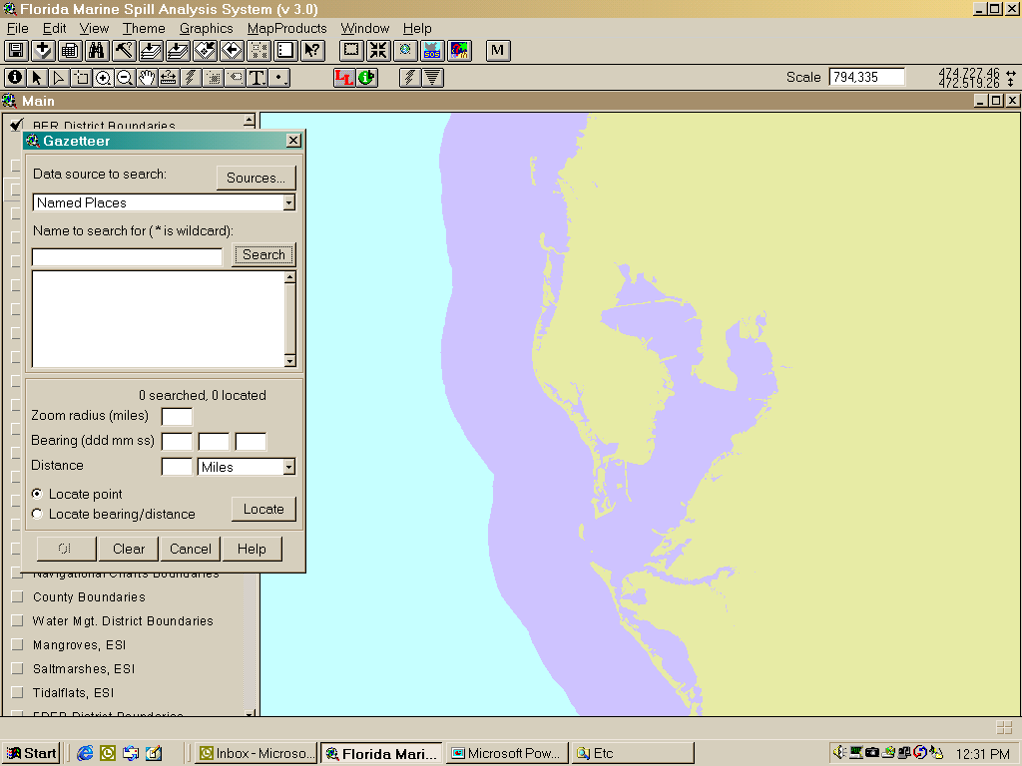
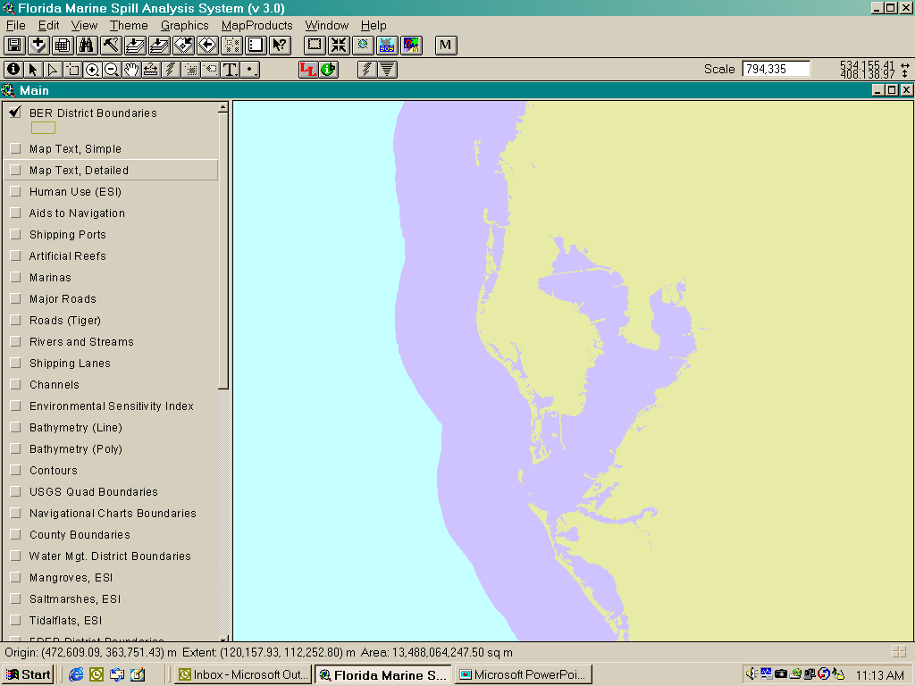
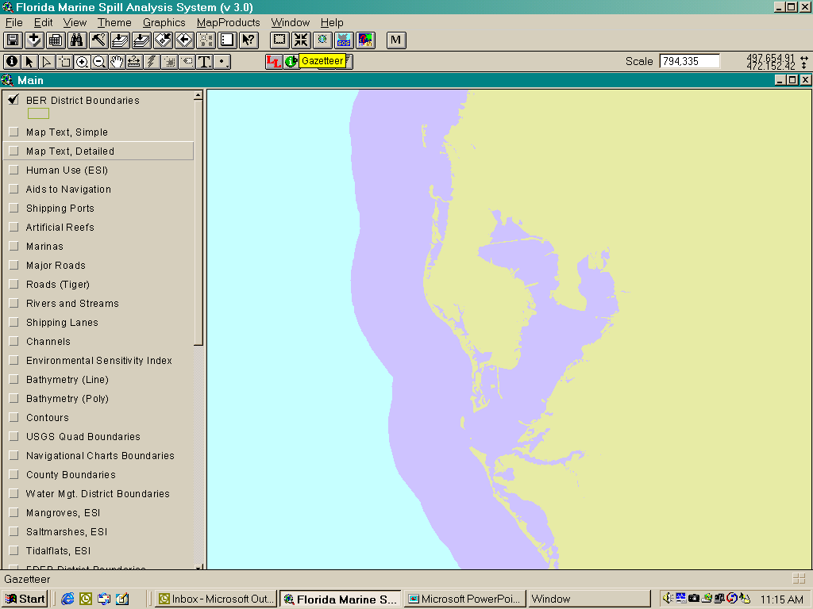
Locating Fort DeSoto Park
Fort De Soto Park
10
180 00 00
3

Slide 15
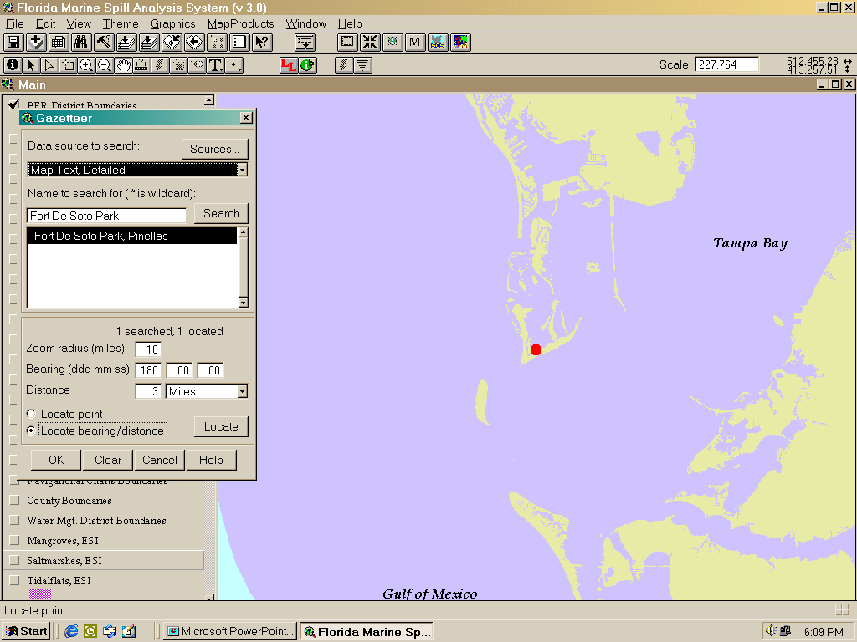
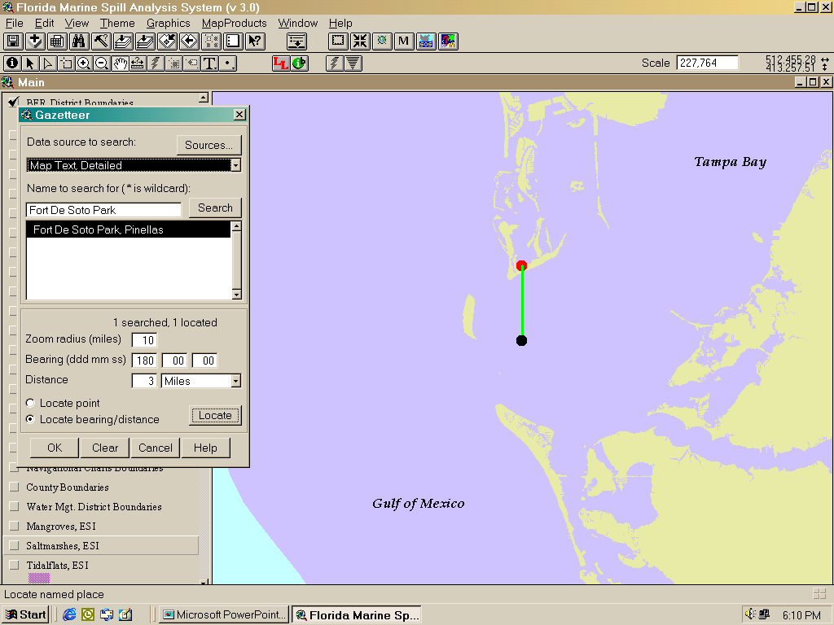
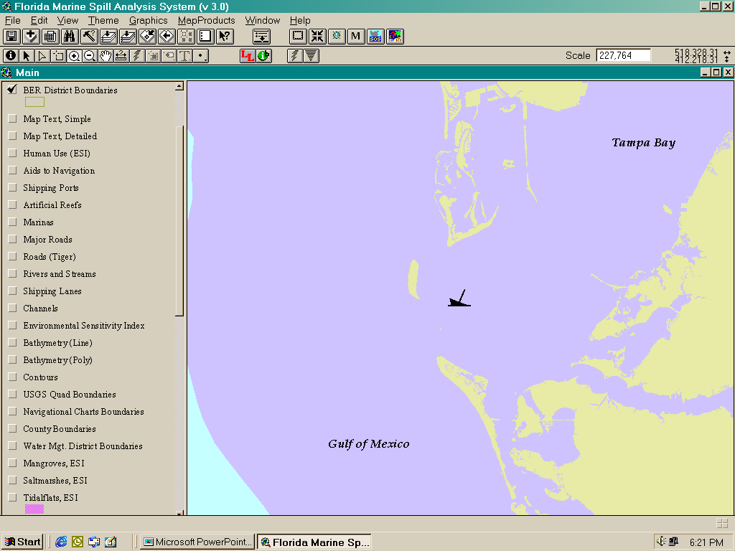
Locating a spill 3 miles due South of park

Slide 16
Species Identification
“On the fly” resource analysis and reporting based upon the Environmental Sensitivity Index (ESI) database that lies at the heart of the FMSAS
Spatial querying tool
Quick, user-friendly access to detailed information about animals and habitats that may be at risk of damage from a spill
One click GIS analysis and reporting

Slide 17
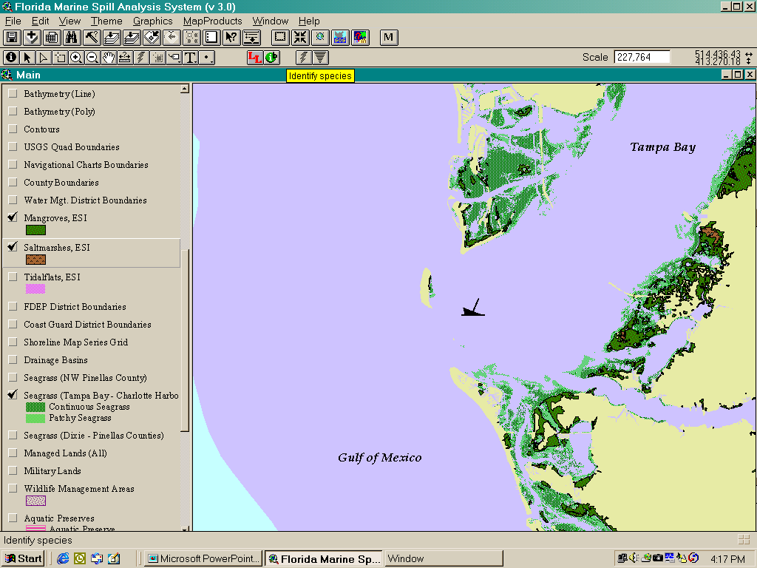
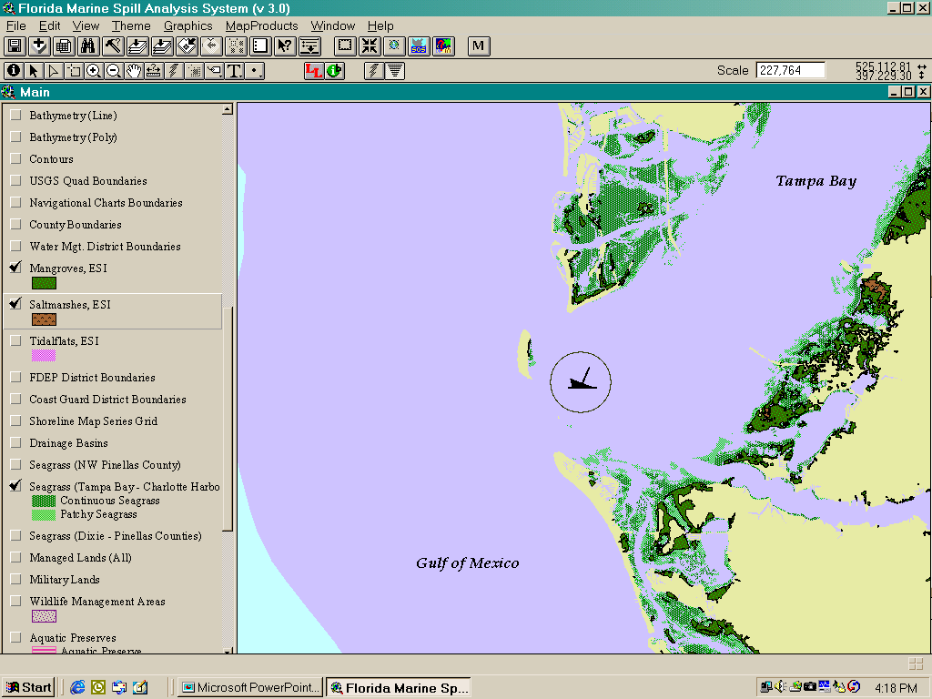
Turning map layers on, then identifying species at risk

Slide 18
Species Identification Reports
Based upon the Environmental Sensitivity Index (ESI) database that lies at the heart of the FMSAS
Biological information is keyed down to species
Reported items are:
Element: Type of animal, ie. Invertebrate, Bird
Sub-Element: Sub-class of type of animal, ie. Crab, Diving Bird
Species: Reported as common name
Status: Threatened or Endangered (Federal and State)
Concentration: Relative abundance; High, Medium, Low
Seasonality: By month of presence

Slide 19
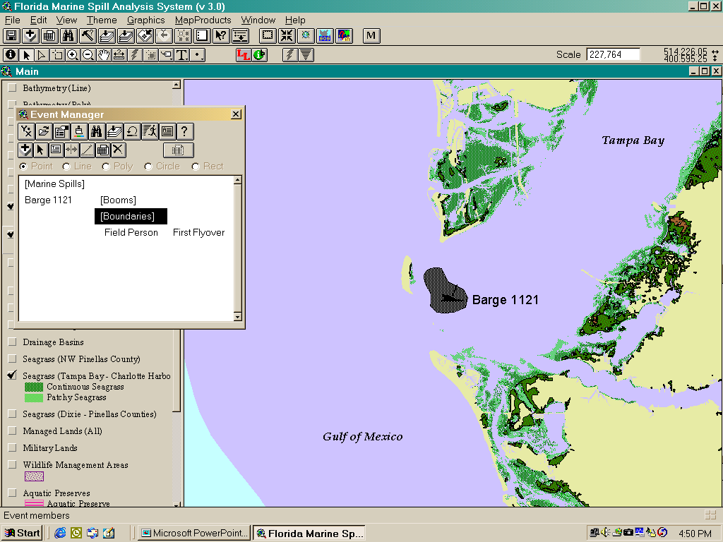
Spill Manager

Slide 20
Enter Boundaries……..
Boundaries of a spill can be entered in many ways,
modeled, overflight, shapefile, imported, or drawn

Slide 21
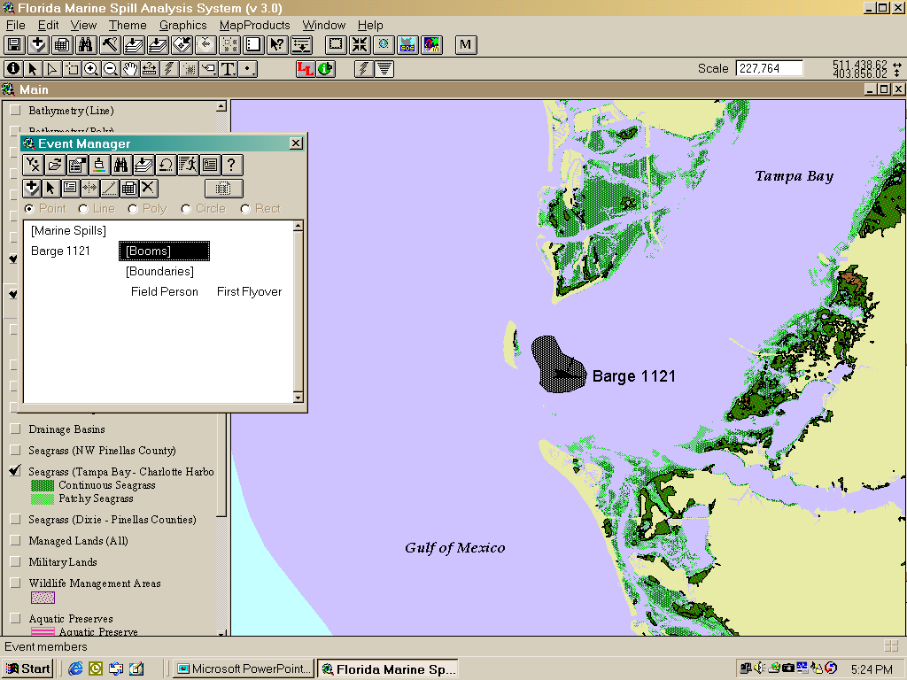
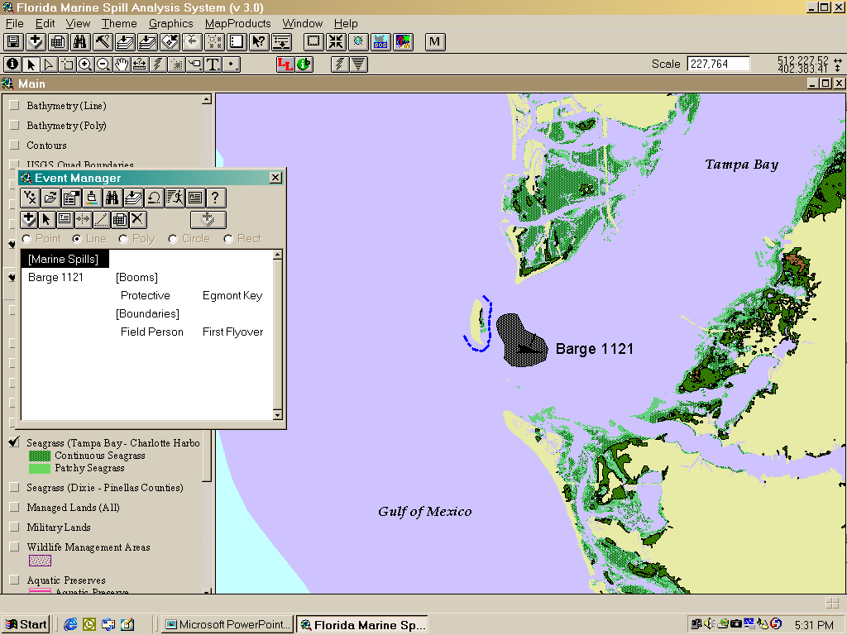
Booming strategies can then be entered.
The entire spill event database can be saved,
exported, and imported as a single file, allowing
sharing on a network or by email.

Slide 22
Creating Quick Maps
Often there is a need to produce planning and response maps in quick succession. The “Quick Map” tool allows one click creation of these maps in three standard sizes for printing, plotting, or delivery via mail or web
8.5” x 11”
8.5” x 14”
D size (24” x 34”)
Custom sizes can be created and saved as templates
Additional map creation tools allow for a map series based upon an index grid such as USGS or ESI quad grids

Slide 23
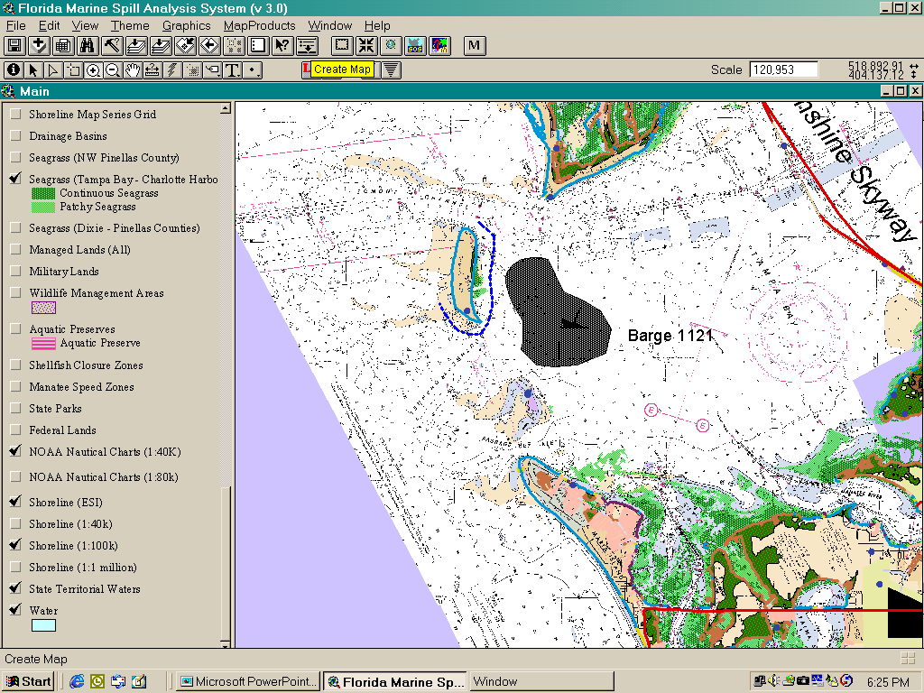
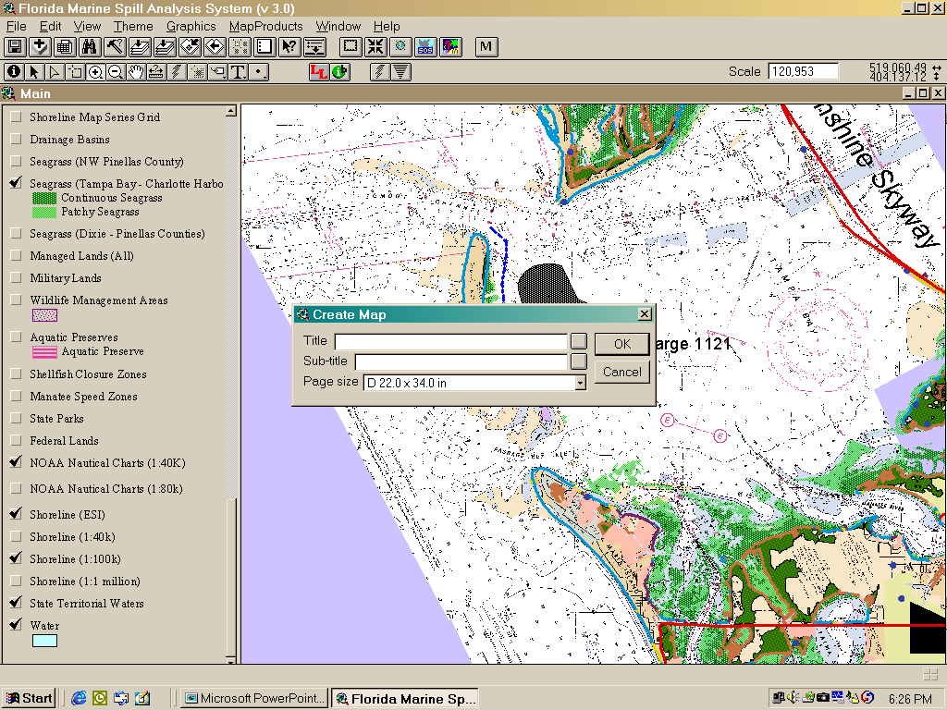
Quick Map Making
Click “Create Map”, enter title and subtitle of the map, choose size of the map, click OK

Slide 24
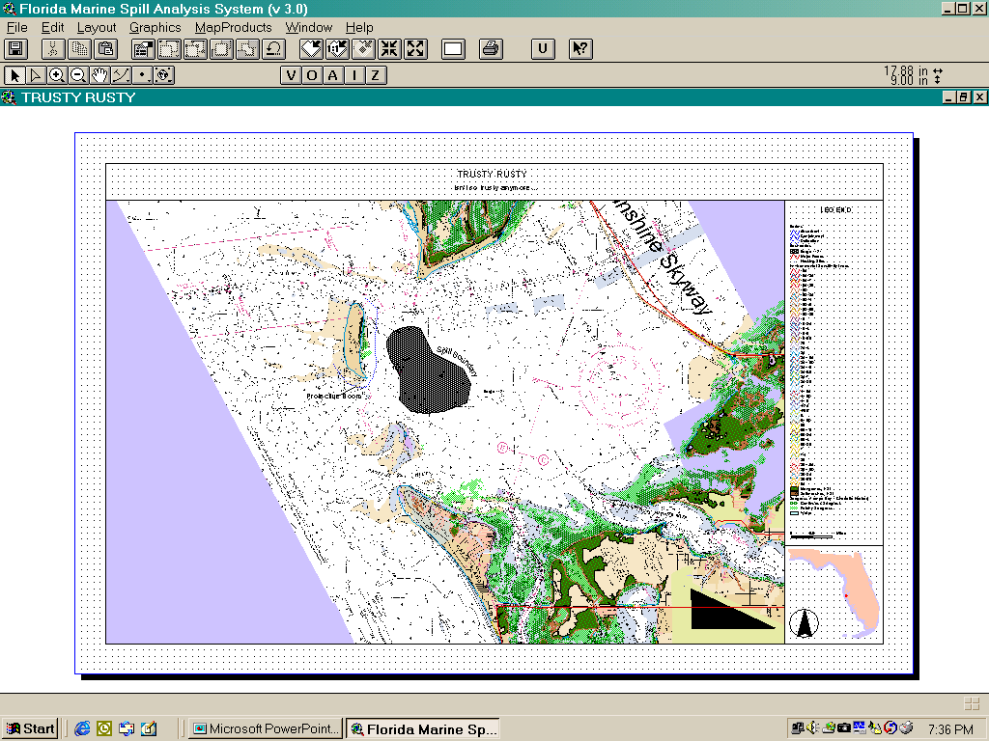
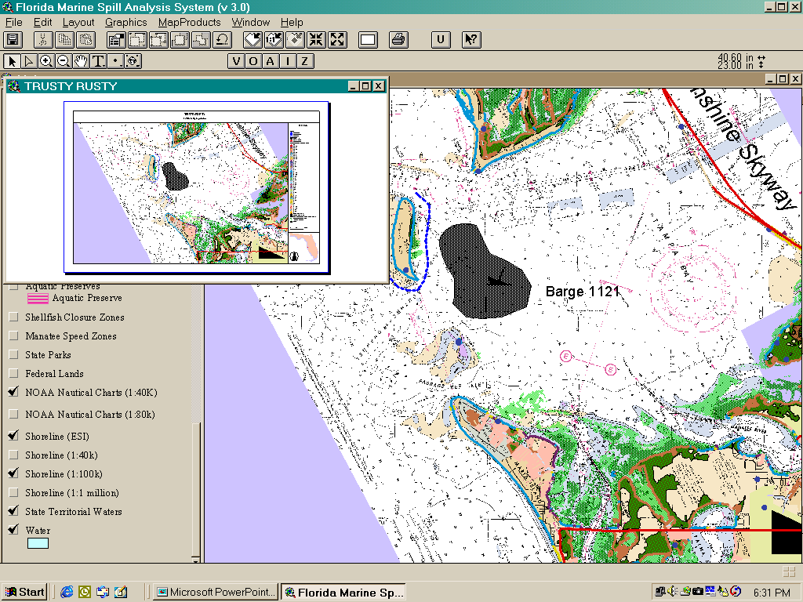
Quick Map Making
Printing Map...
Map is created automatically for the user, then can be printed

Slide 25
Resources-At-Risk Analyses
Using the boundaries of a spill, the user can analyze resources affected by the area of the spill.
Reporting is based on the Environmental Sensitivity Index database or other layers that have been loaded into the resource analysis tool.
True-clipping GIS function with reporting in linear or area measurements, ie; feet, meters, acres, hectares.
Text reports are saved as a database integrated with the event and always retain their relationship to their corresponding polygon or line.
Allow buffering at user-defined distance.
User defines the characteristics to report on.

Slide 26
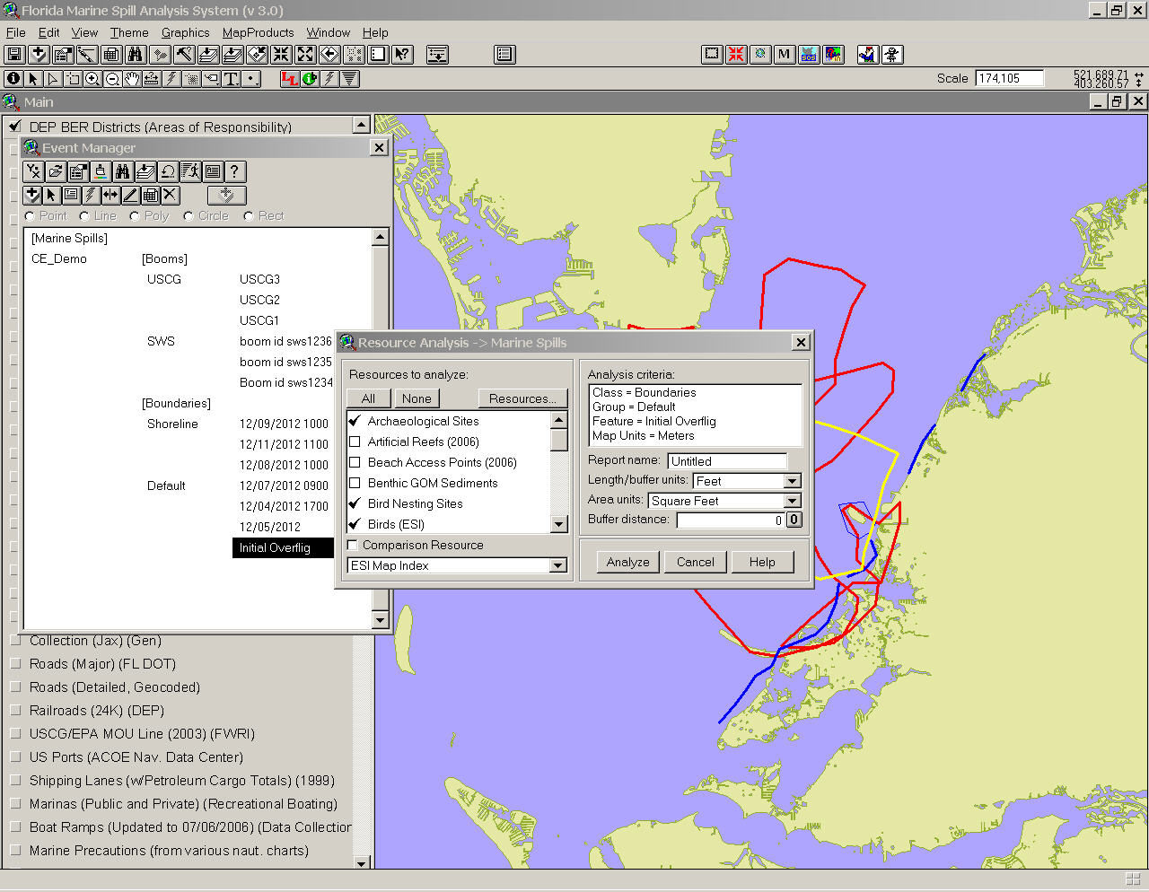
Managing Layers for Reporting

Slide 27
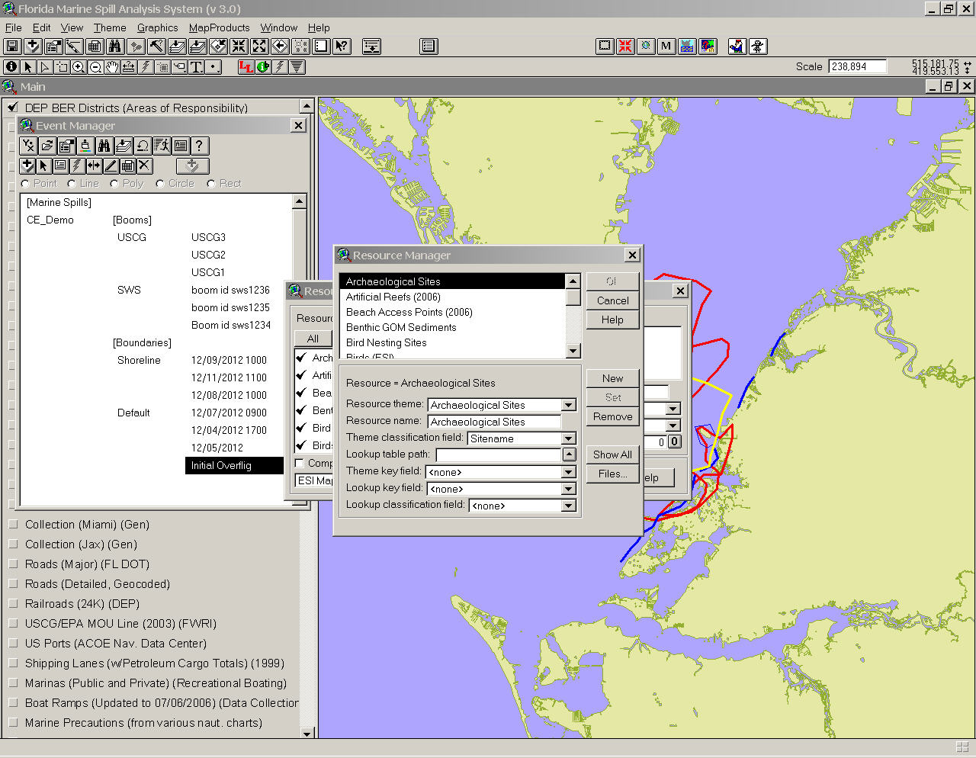
Managing Layers for Analysis

Slide 28
“Resources at Risk” Report
=========================
The Following Resources Were Affected
===============================================================================
Nests (gwis) Number Within
Bird, Ruddy turnstone Affected Managed Areas
------------------------------------------ ---------------- ----------------
Count = 5 1 1
-------------------------------------------------------------------------------
Status: Not threatened or endangered
Presence: Jan Feb Mar Apr May Jun Jul Aug Sep Oct Nov Dec
===============================================================================
Nests (gwis) Number Within
Bird, Least tern Affected Managed Areas
------------------------------------------ ---------------- ----------------
Count = 15 1 1
-------------------------------------------------------------------------------
Status: Threatened (FL)
Presence: Mar Apr May Jun Jul Aug Sep
Apr: Nesting
May: Nesting
Jun: Nesting
Jul: Nesting
Aug: Nesting
===============================================================================
Seagrass (acp) Kilometers Within
Classification (Recode99) Affected Managed Areas
-------------------------------------------------- -------- ----------------
discontinuous 8 8
continuous 2 2
==============================================================================
Turtle Nesting Beaches (acp) Meters Within
Classification (Turtletype) Affected Managed Areas
-------------------------------------------------- -------- ----------------
Loggerhead 109 109

Slide 29
Managing Multi-Theme Drill Down Analysis

Slide 30
BioQuery
The BioQuery tool allows querying of the ESI database by multivariate query string.
User friendly interface for a complex database
ESI data tables are joined with proper relationships
User can locate any species in the database by any variable or combination of variables
Shapefile export…
The BioQuery tool enhances ESI by:
Allowing easy extraction of species or higher level spatial data
Filtering by season/status/activity/concentration
Facilitating the use of ESI biological data for other purposes

Slide 31
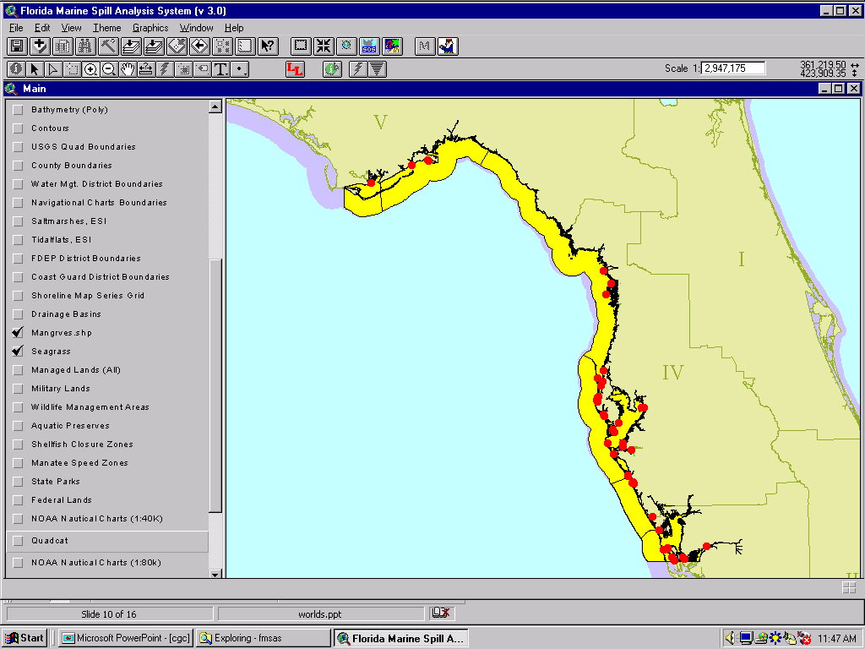
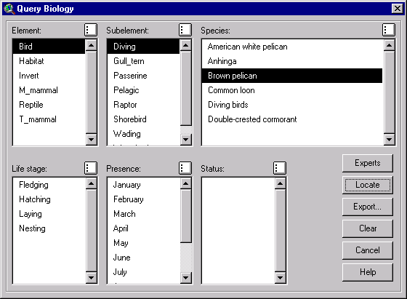
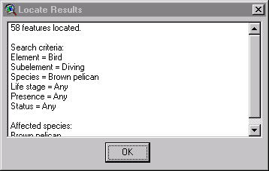
BioQuery

Slide 32
Operational Principles of the FMSAS
Standalone Capable
Best Available Data
Enhanced by Web Services
But Not Dependant Upon Them

Slide 33
On-Going Work
Much of the data related to preparation for oil spills was collected by the area scientific and spill response community and then digitized (GIS) by FWRI for the ACPs. This targeted data development has been integrated into the FMSAS.
Priority Protection Locations (Oil Spill Sensitive Sites)
Tidal Inlet Protection Strategies
General Booming and Collection Strategies
Staging Areas
Sources of Pre-Staged Equipment
Detailed Port Infrastructure
Complex Administrative MOUs Within The State

Slide 34
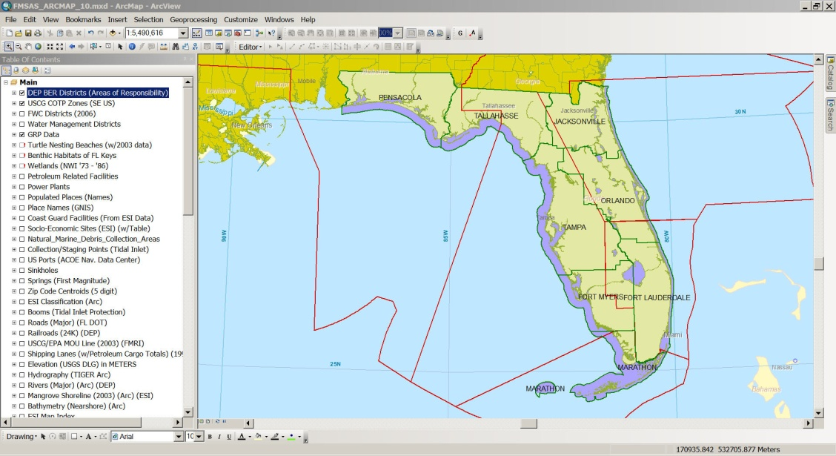
Future Work
FMSAS Tools for ArcGIS 10.x and beyond

Slide 35
Future Work
This Year to Within a Year: Desktop
Gazetteer Tool for ArcGIS 10.x - done
Spill Manager for ArcGIS 10.x
Complex Event Manager for ArcGIS 10.x
Species Identify for ArcGIS 10.x
ESI BioQuery for ArcGIS 10.x
Map Products/Series for ArcGIS 10.x – Data Driven Pages already exists, just needs to be reconfigured into the broader toolset
Coordination on these tools is HIGHLY DESIRED

Slide 36
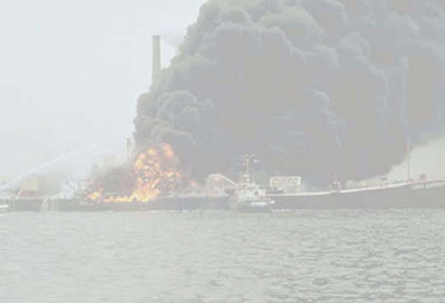
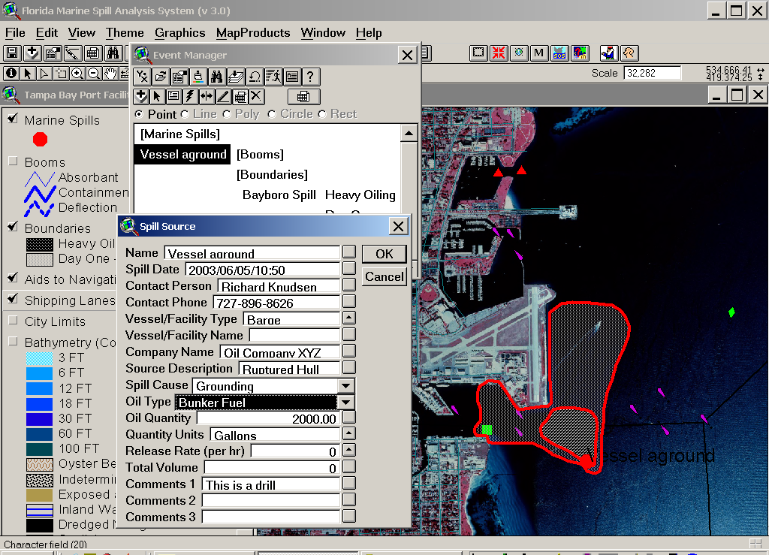
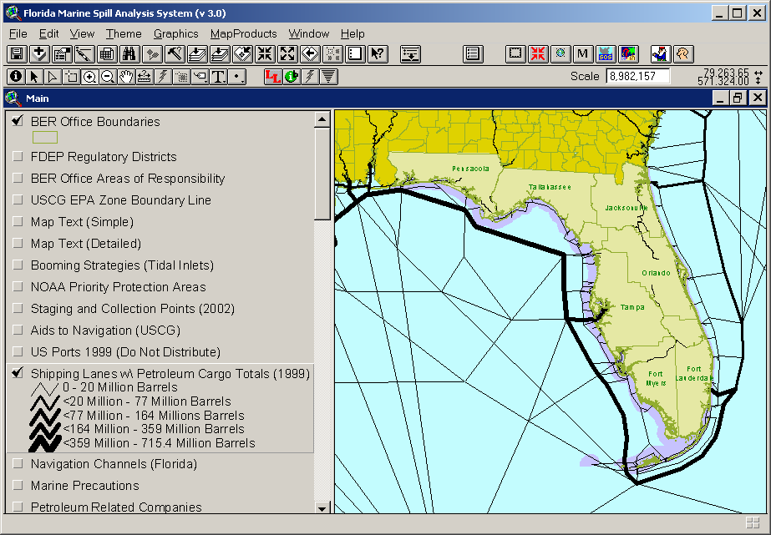
Future Work (From 6 Years Ago)
Spatially aware, GPS-enabled wireless mapping and database applications running on ruggedized, water resistant PDAs or Pen Computers that are designed for viewing or modifying map services and data in the field.

Slide 37
Future Work
Possible Applications Include iPad and Android Tablets for:
Spill response and planning
Shoreline cleanup assessment
Field data collection and verification (qa/qc)
Overflight spill boundary collection
“Eye in the Sky” for field crews (Image Server)
Change analysis at specific sites
“Where is” in relation to current position
“Go To” navigation
Communications (email, web, real-time data)
Reference (Chemical abstracts, MSDS)

Slide 38
Questions???
Collaborating???
Cost Sharing??? hahaha
Email: Richard.Knudsen@MyFWC.com
Phone 727 896-8626
Web: http://research.myfwc.com
ACP ”Home”: http://ocean.floridamarine.org/acp

