Slide 1
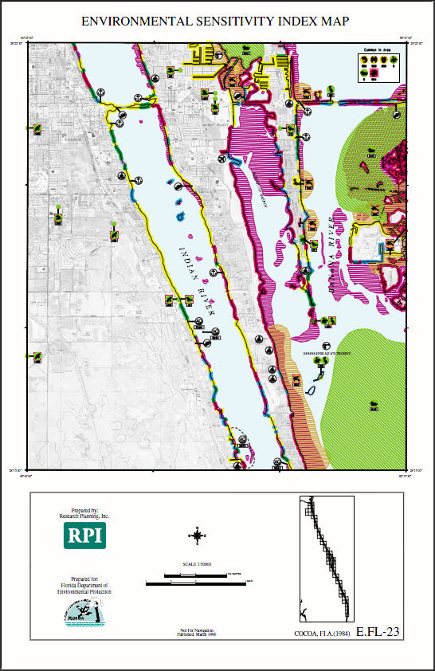
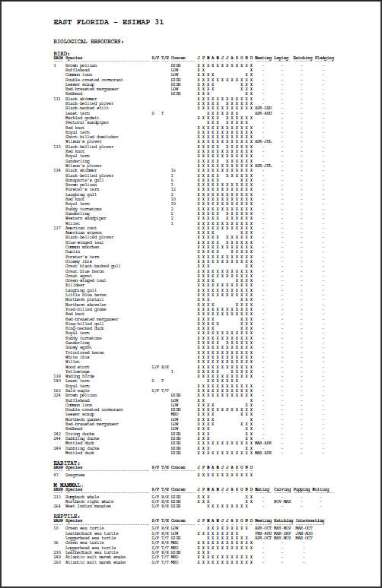
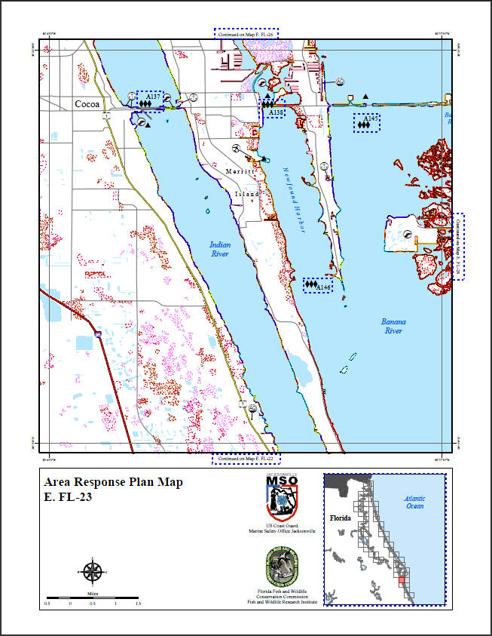
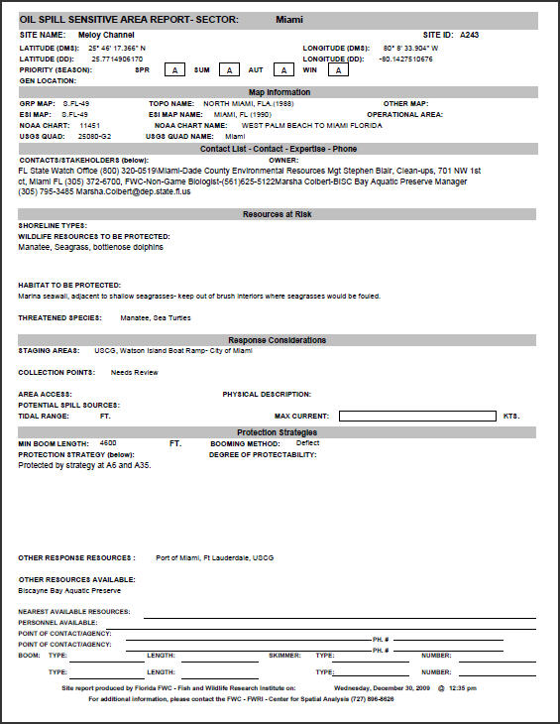
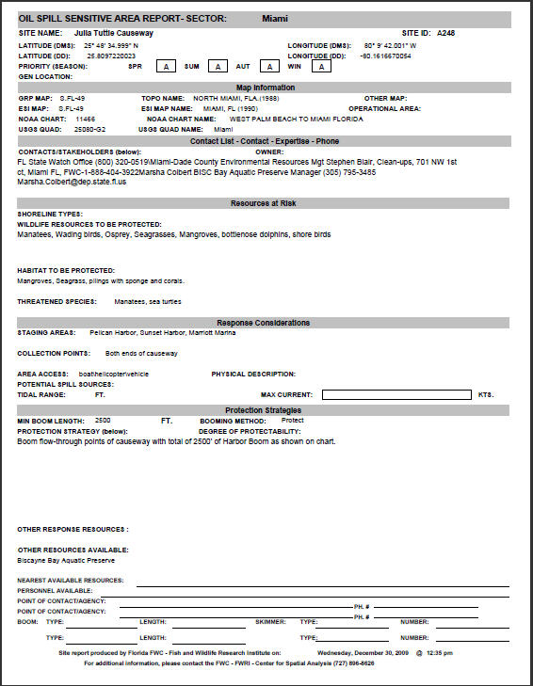
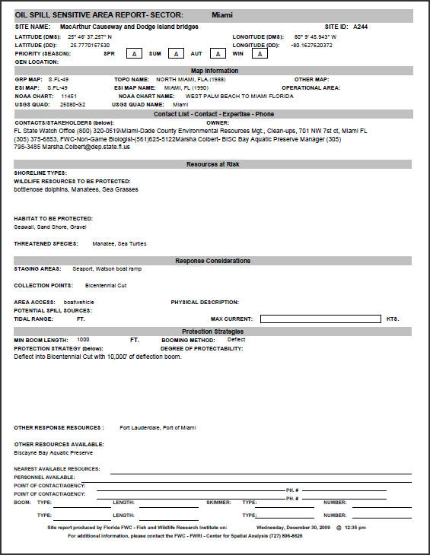
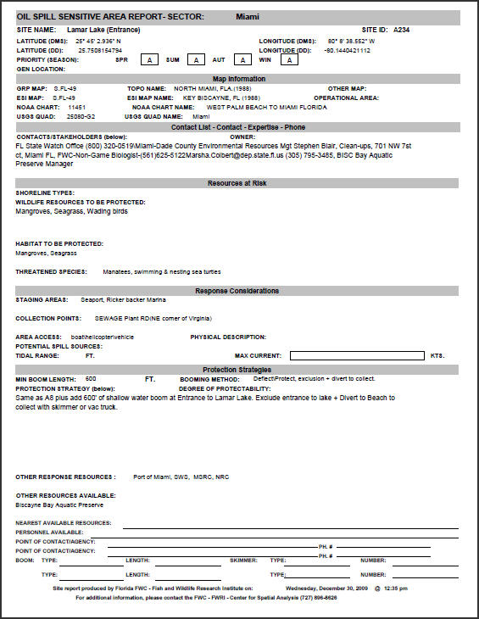
ESI Map
GRP Map
Use of ESI Atlases/Data in Contingency Planning and Response
FWRI and What We Do
GIS in Oil Spill Planning and Response – DWH
Digital ACPs & Geographic Response Plans
ESI vs. GRP Maps
The GRP Process & ESI’s Role
Pushes for ESI Updates in Florida
ESI Challenges for Planning and Response
Richard Knudsen - May 1, 2012
NOAA ESI Workshop

Slide 2
The Florida Fish and Wildlife Conservation Commission
Fish and Wildlife Research Institute (FWRI)
Center for Spatial Analysis
Marine Resources GIS (MRGIS)
State Scientific Support Coordinators
DEP-BER Scientific and Technical Support
State NRDA Support
USCG Digital ACPs and GIS Support
FWC Law Enforcement GIS Support
Spatial Analysis Support for “Fins, Furs,
and Feathers” Scientific Studies

Slide 3
Marine Resources GIS (MRGIS)
Currently 1300+ Layers w/ Metadata in SQL/SDE (Albers and Web Mercator)
Some Sample Data Holdings Used in Spill Response and Planning
Marine Facilities/Boat Ramps
ESI Shoreline Classification
Coral and Hardbottom
Mangroves
ESI Terrestrial Mammals
Seagrass
ESI Birds
Saltmarsh
Human Use (ESI)
ESI Reptiles
AToNs
Tidal Flats
Shoreline Sensitivity
Benthic Habitat
Shipping Lanes
Nautical Charts
Depth Contours
Administrative Boundaries
Managed Areas
Road Network
DOQQ Imagery (Standalome and Services)

Slide 4
Why We Are In The Spill Response Business
MOUs With FDEP, USCG, NOAA
Statewide Environmental Sensitivity Index (ESI) mapping and data maintenance
The Florida Marine Spill Analysis System (FMSAS) maintenance and support
Digital Area Contingency Plans (ACP)
Scientific Support for Oil and Hazardous Material Spills in Florida
State NRDA Trusteeship

Slide 5
Why GIS in Spill Response?
Multipurpose
Multiuser
Easily Shared
Planning Work >>> Feeds Response
GIS data from Geographic Response Plan (GRP) workshops in Florida and surrounding states are used to create NEW GRP maps and then maintained for actual spill responses and exercises

Slide 6
Daily Maps Produced to Support DWH Operations
Planned Boom Going In (by Division)
Actual Boom Deployed (by Division)
Vessel Operations
Common Operational Picture Maps
Daily Trajectory Updates
Shoreline Oiling Condition Maps (SCAT)
Etc...Etc…
Specialty Maps
Identification of Critical Habitats
Identification of Special Managed Areas
T and E Species Maps
Identification of Cultural Resources
Trigger Zone Maps – Trajectory Edge to Trigger Distance
Loop Current Maps
Etc…Etc…

Slide 7
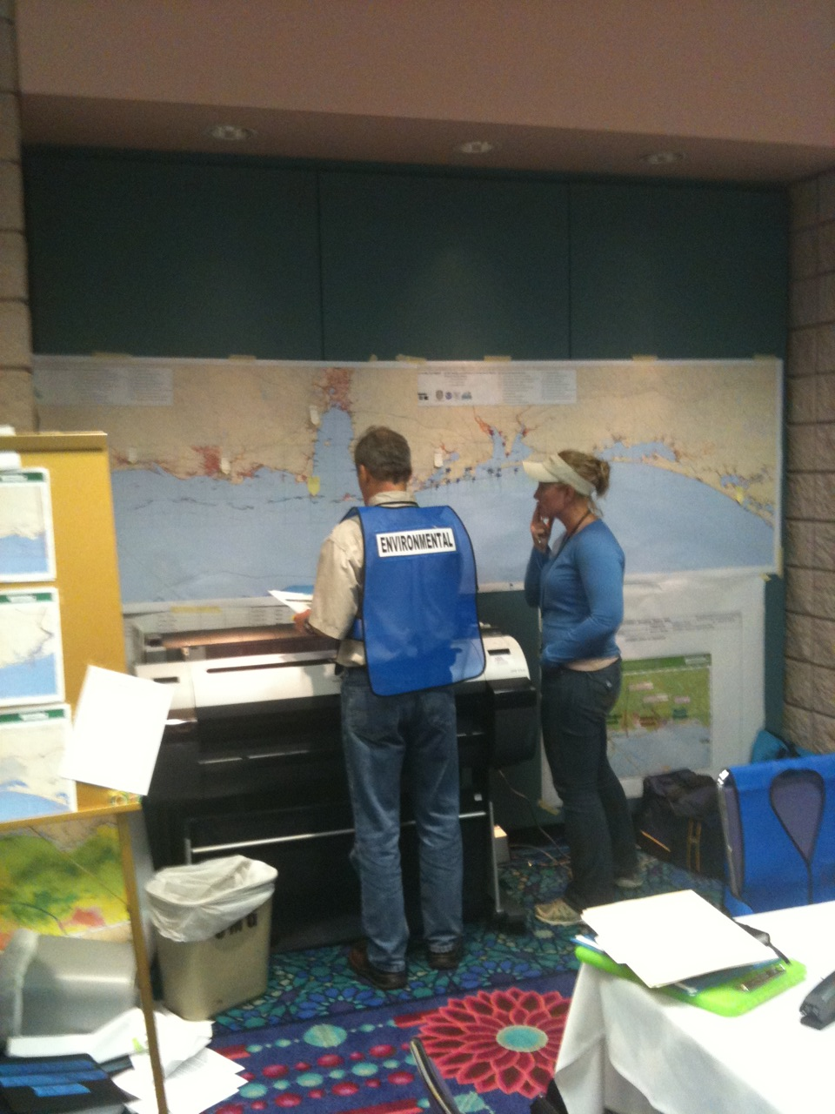
ESI, GIS, and DWH
Environmental Unit in the Planning Section
Extensive Coordination on Data Throughout
ESI was first on scene
BP – “Give us all your data”
The Digital ACP – Done
ESI – Drove Response
I’ll try to explain how…

Slide 8
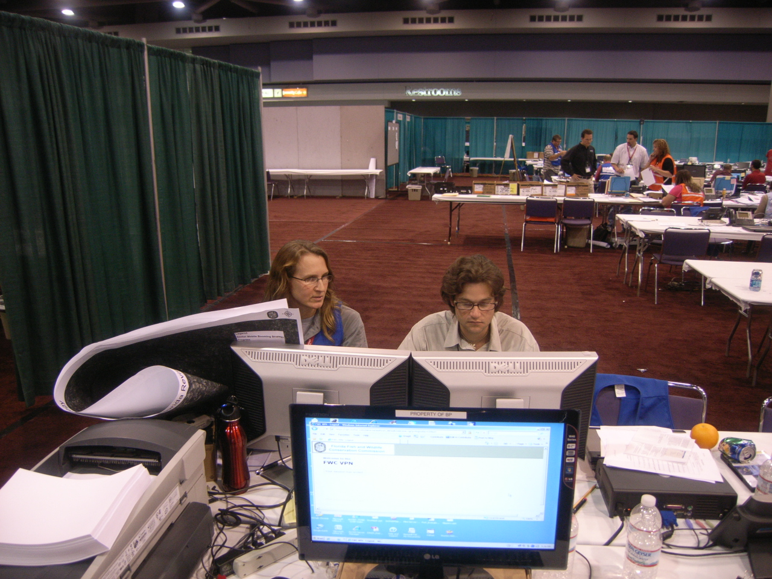
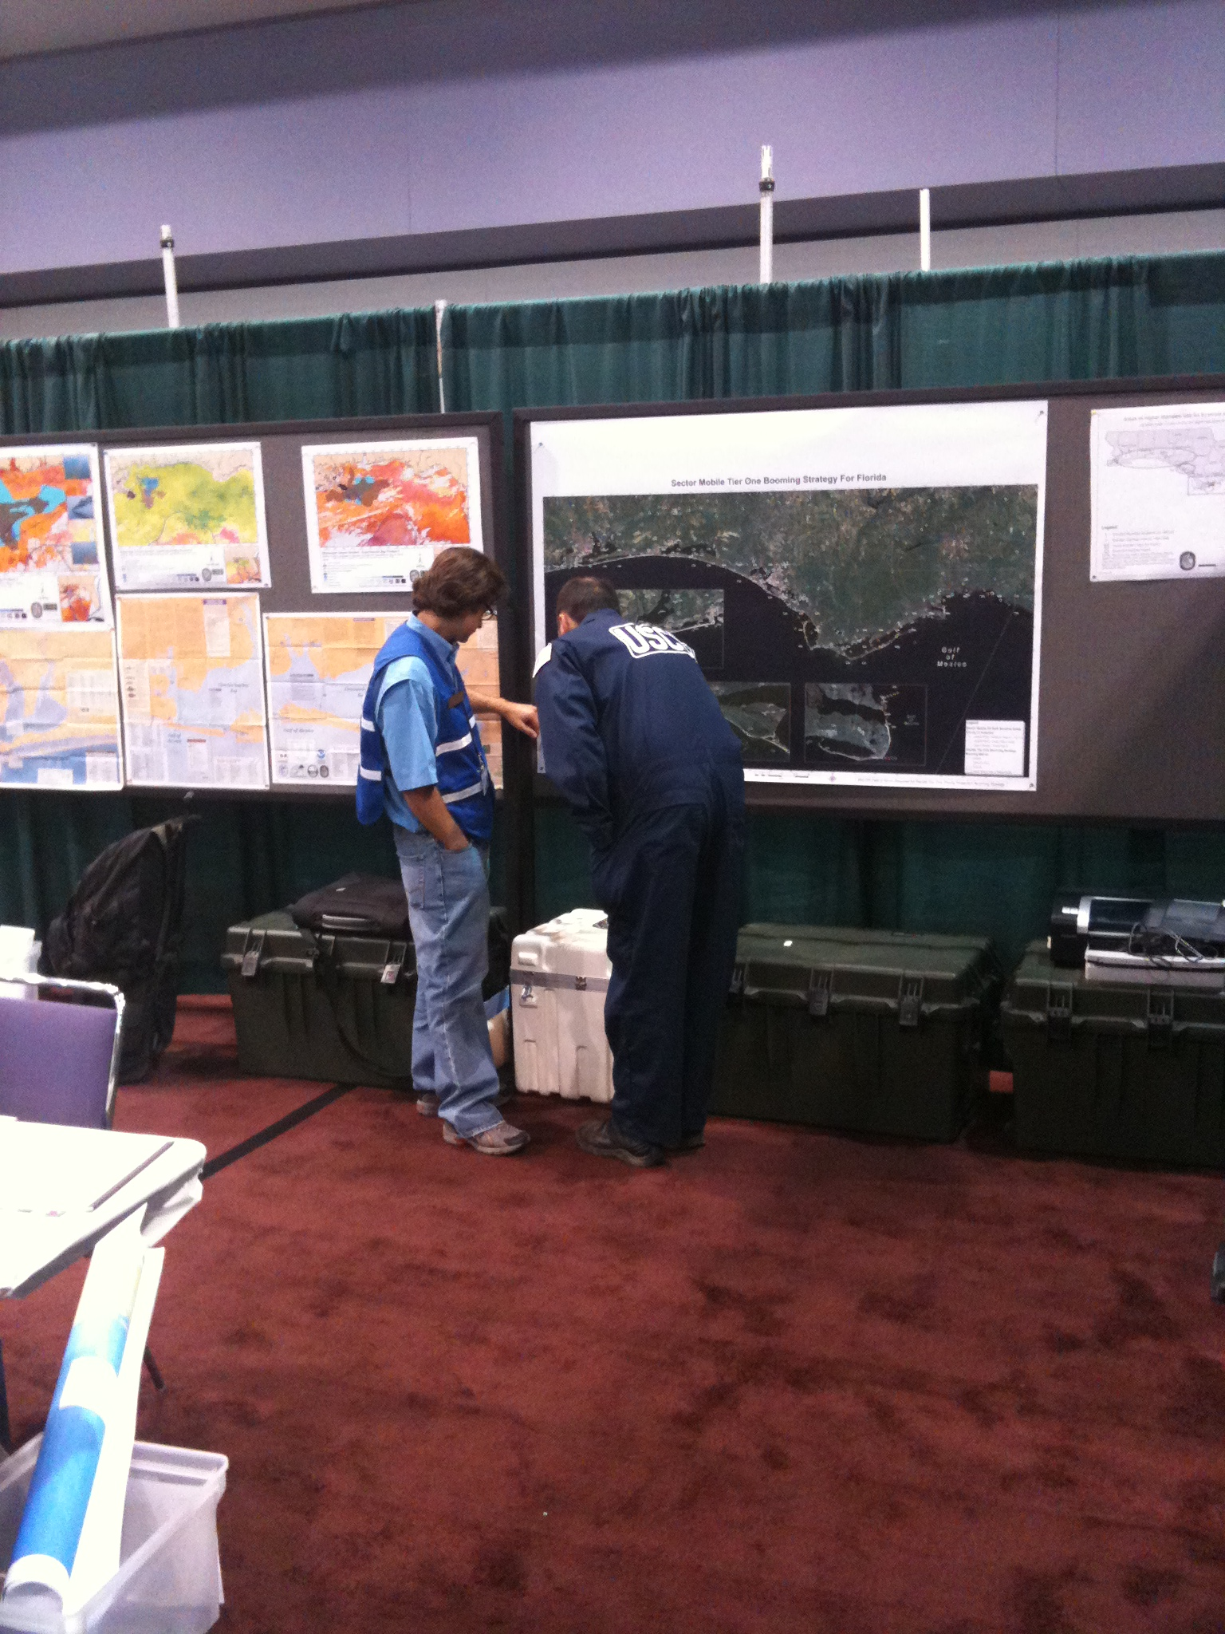
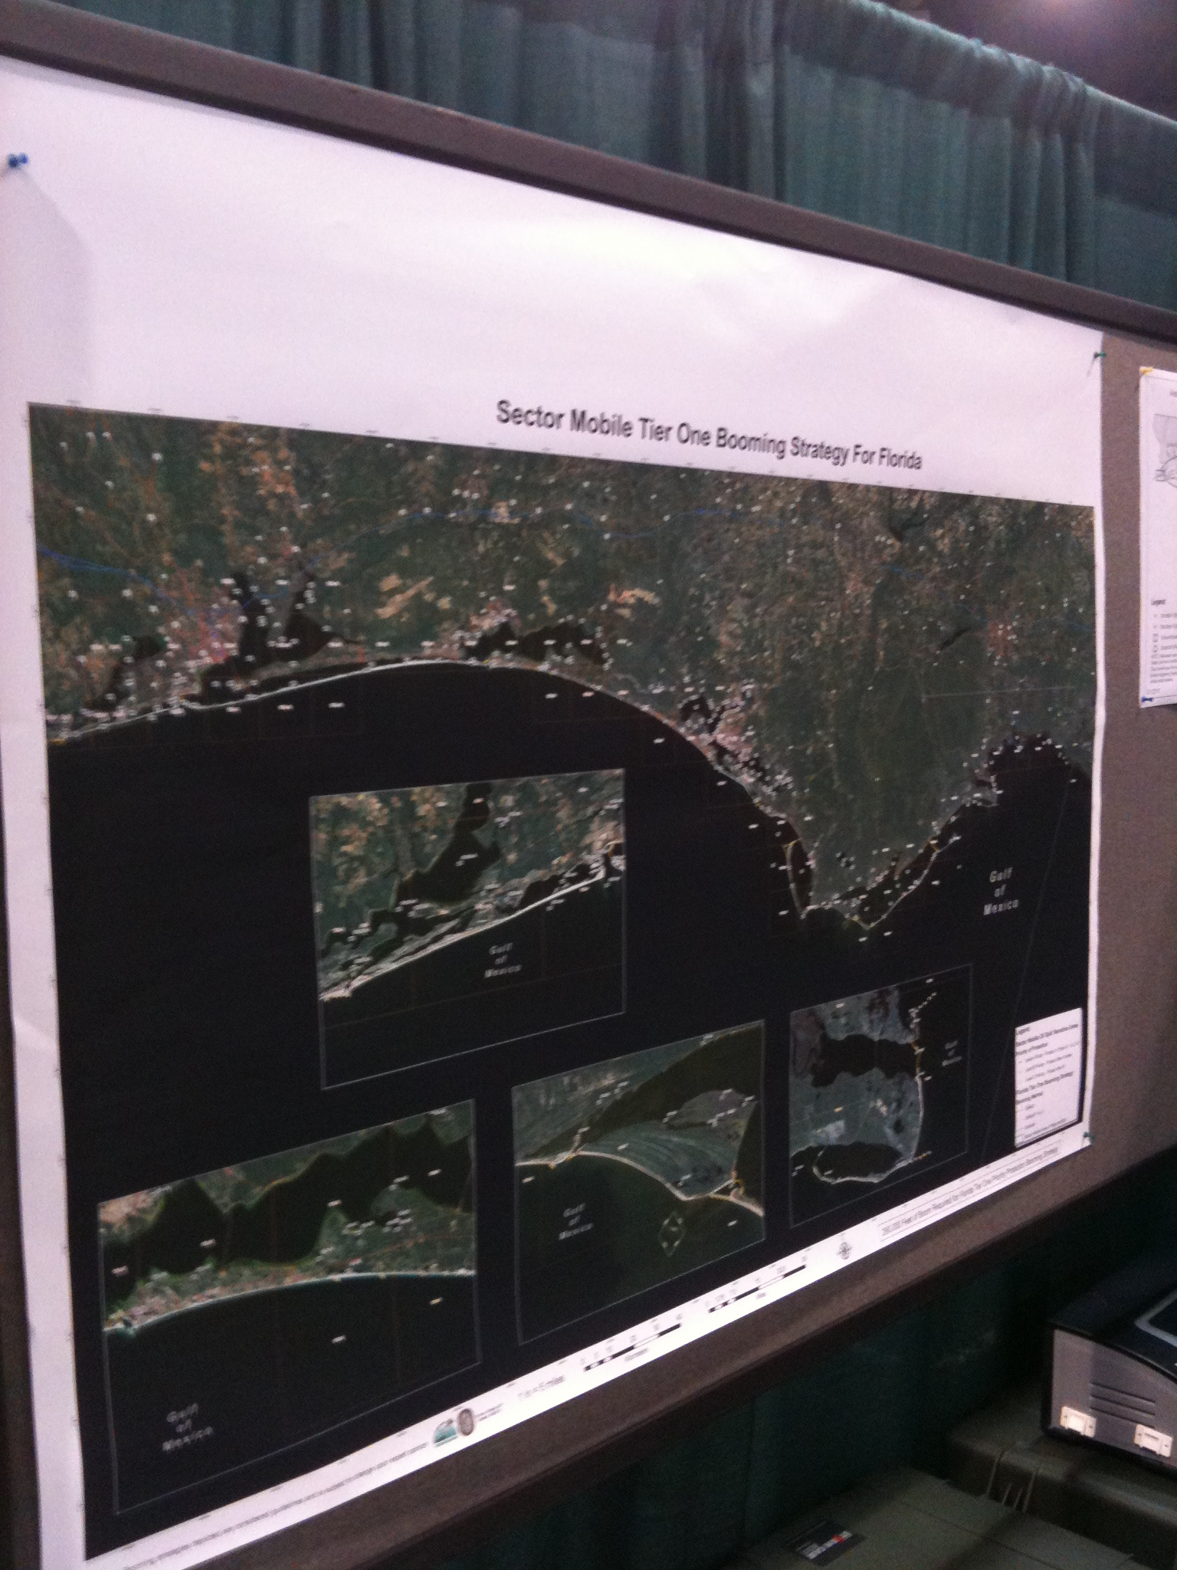
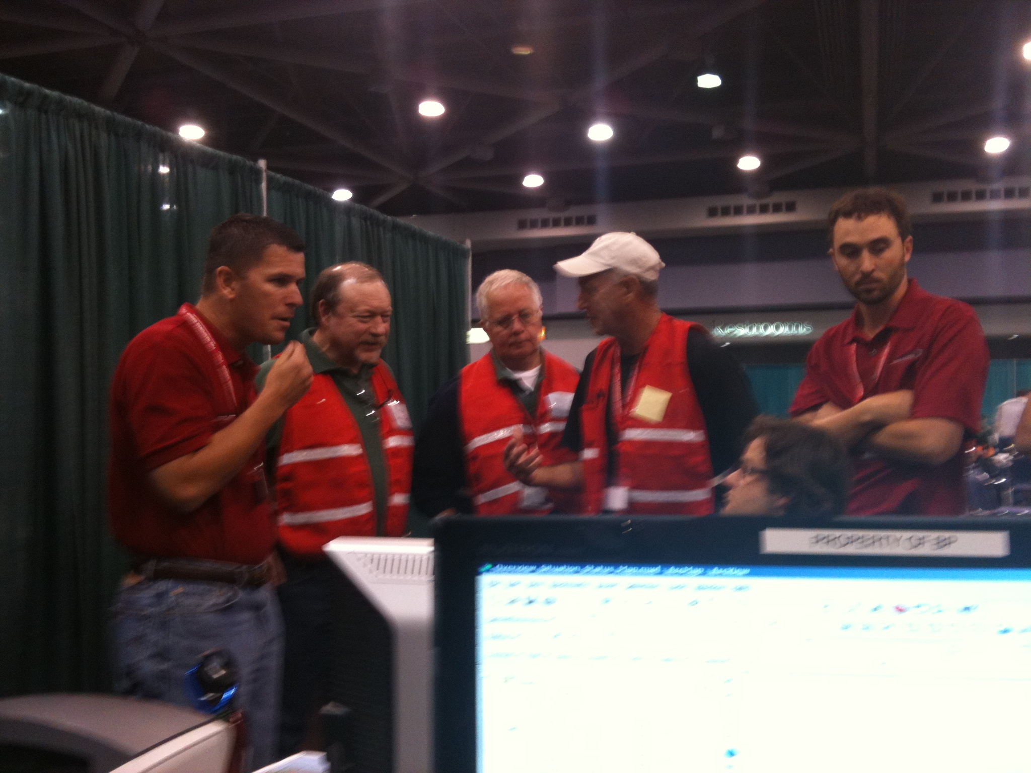
DWH Daily Boom Planning & Operations
Florida

Slide 9
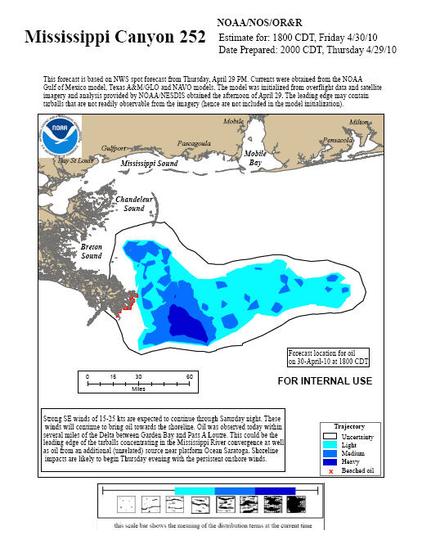
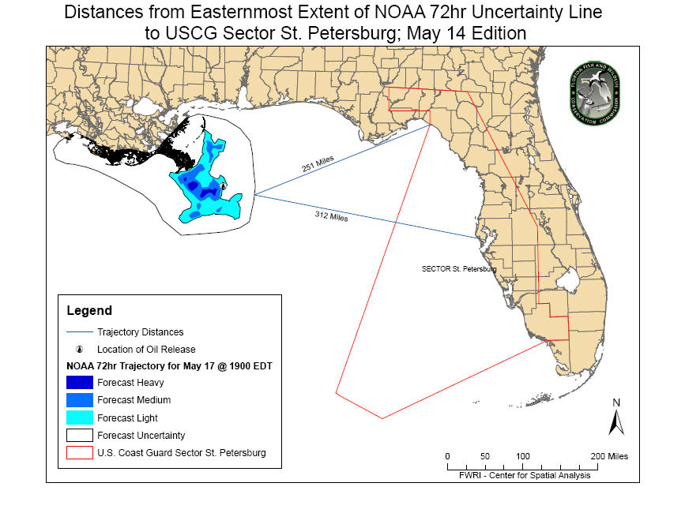
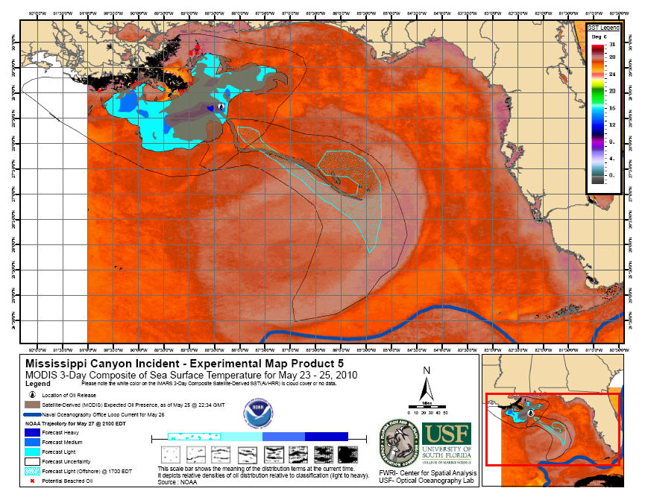
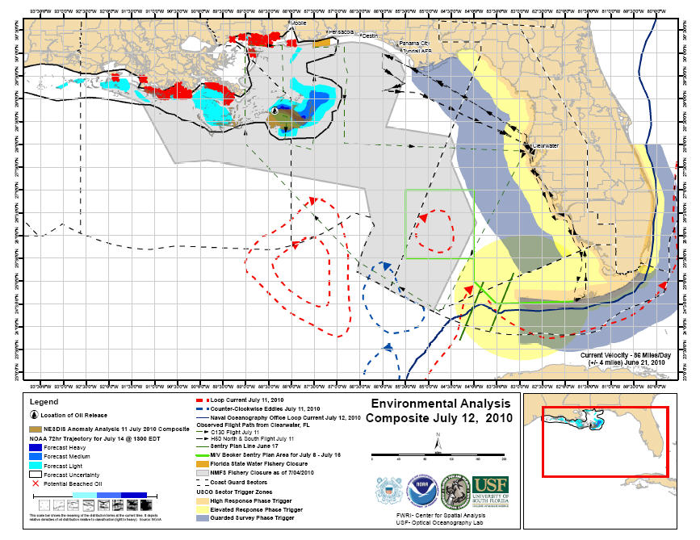
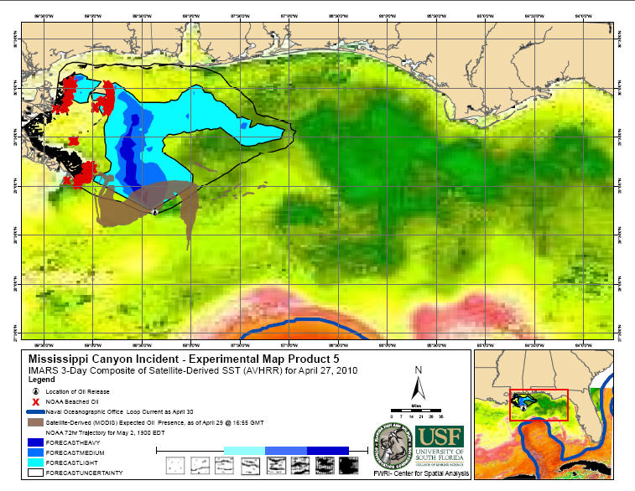
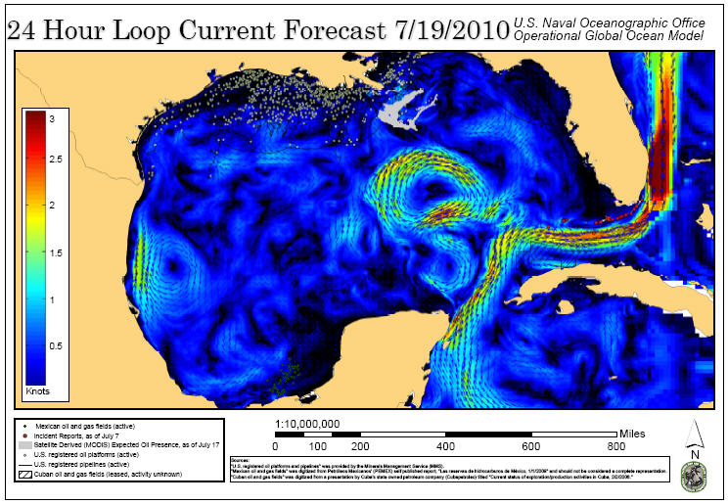
DWH NOAA Trajectories in GIS
GIS Map Products

Slide 10
DWH SCAT GIS – Sector Mobile
Segmentation largely based upon ESIL linework and FL 1:12k shoreline – FWRI provided this to Polaris (SCAT for Sec. Mobile)
Additional digitizing based upon FWC_Imagery ArcGIS Server Map Service
SCAT Operational DIVISIONS – Produced by TRG, but not so good... FWRI tried to fix, but operationally it was too late. SCAT mold cast
ESI and GRP Grid was LOST when Operational Divisions were established…DS Map Book

Slide 11
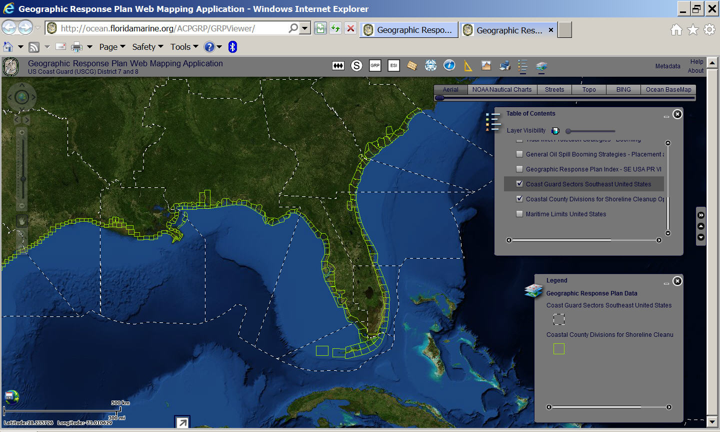
SCAT/Operational Divisions
Coastal County Based
Post-DWH Florida Adopted Statewide, other regions
Florida Shoreline Now Pre-Segmented Based Upon Divisions
“Field-Smart” Sub-Divisions – Bridges, Roads, Fed Boundaries, etc.

Slide 12
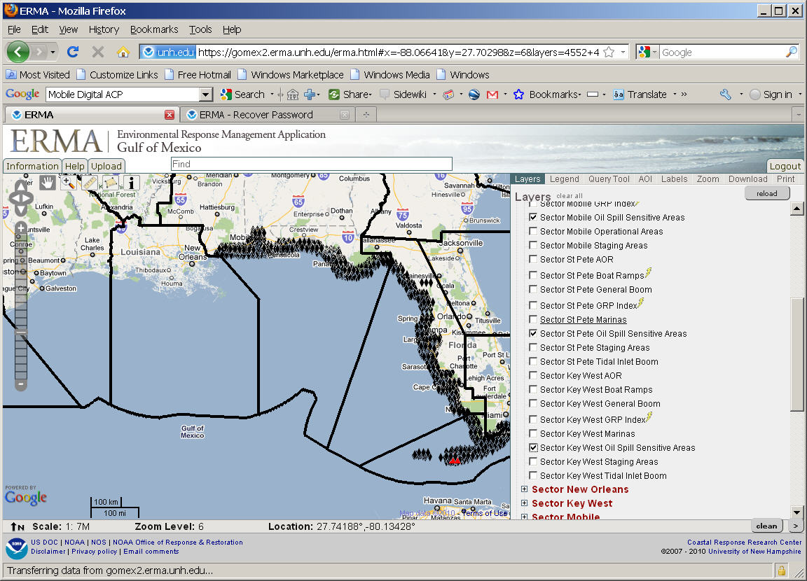
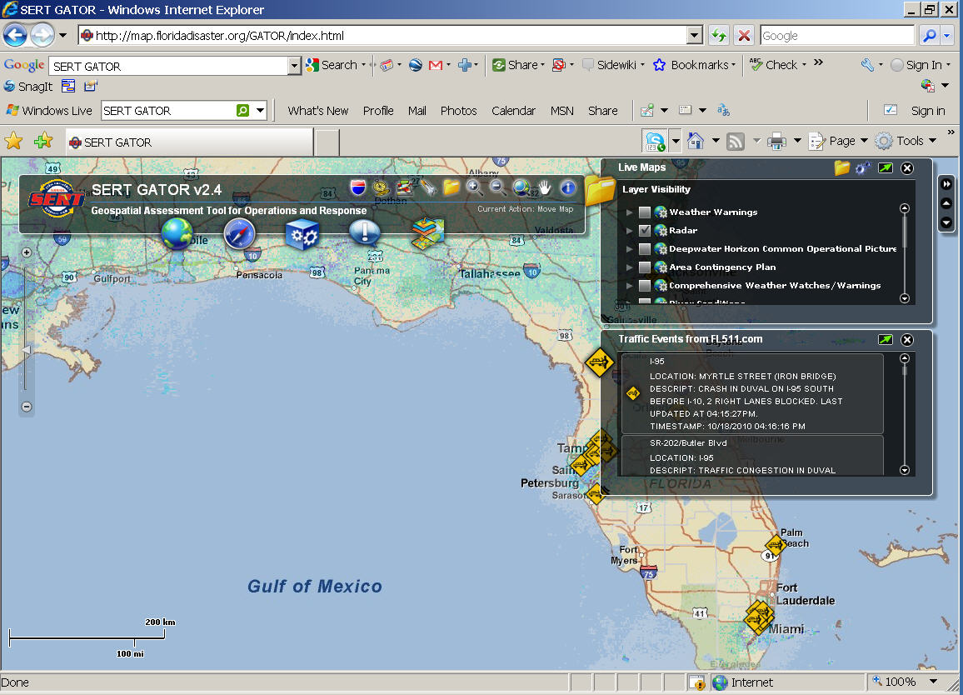
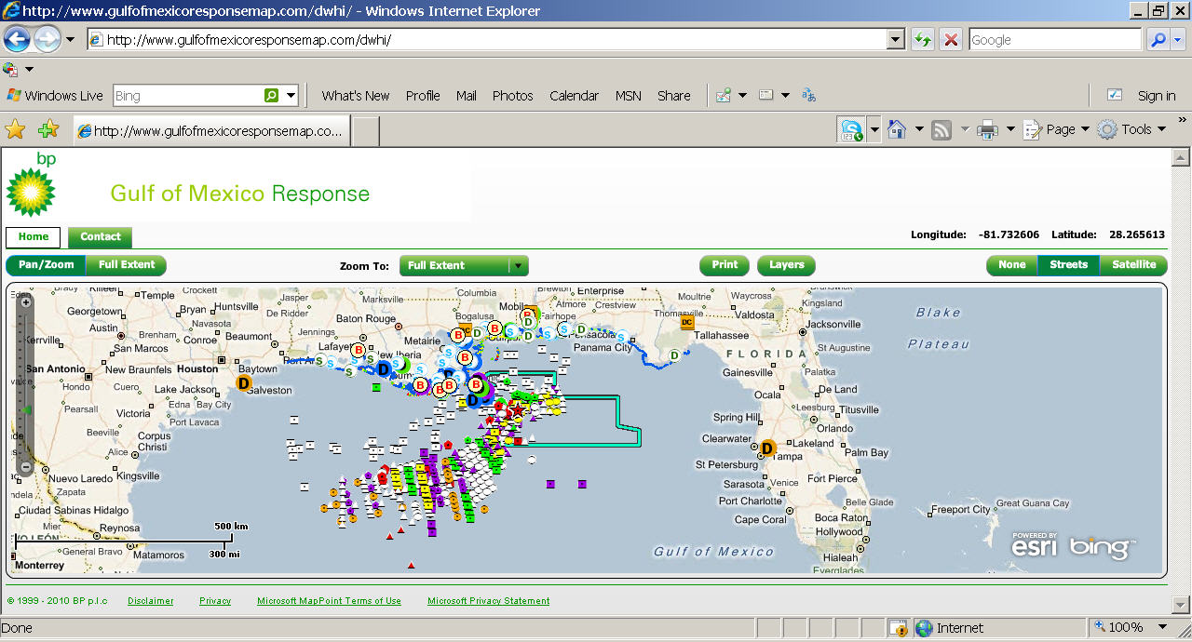
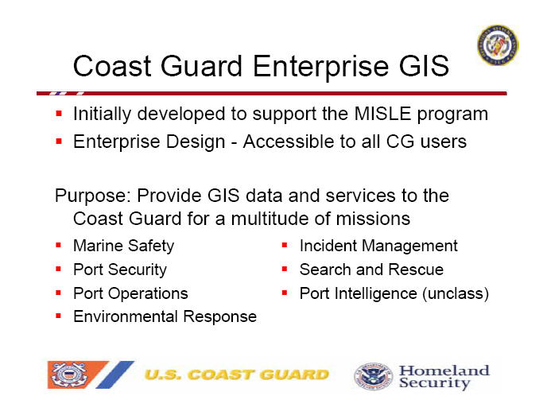
DWH GIS Applications
NOAA ERMA
FL State EOC GATOR
BP/TRG FLEX Map Viewer
USCG Enterprise GIS
And Many Others…

Slide 13
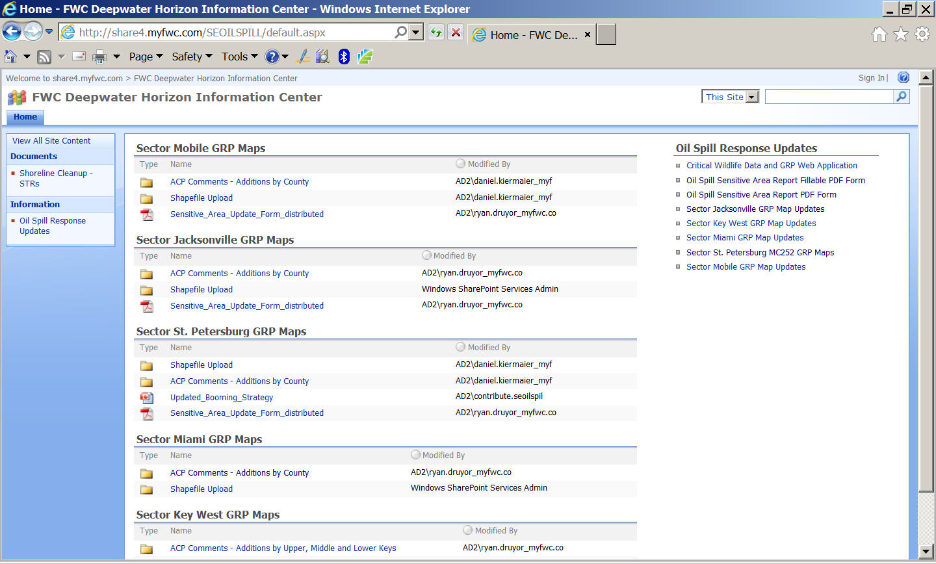
DWH GRP Updates – Conducted for Sector St Pete during DWH Response – County EMs

Slide 14
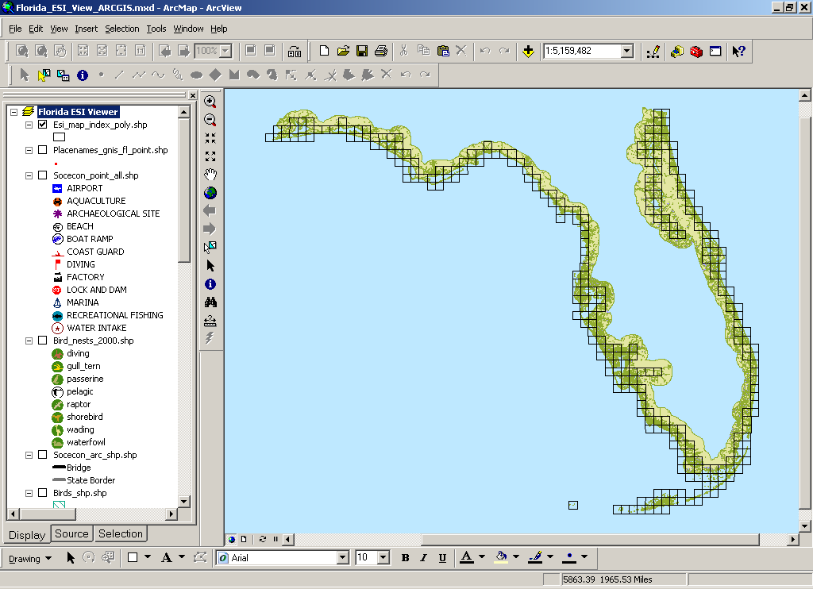
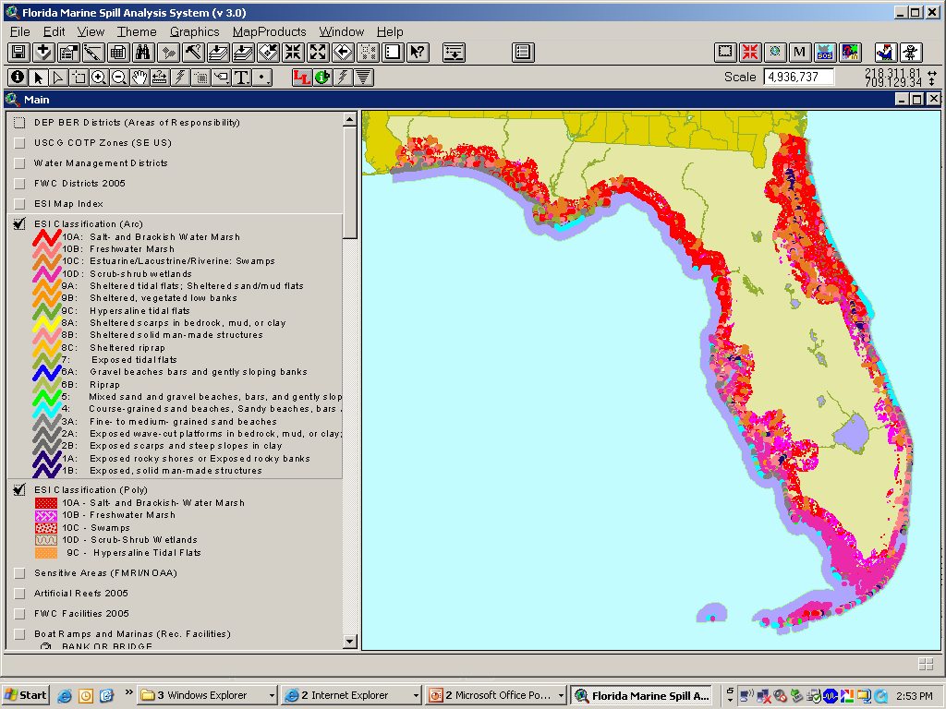
FL’s Statewide Environmental Sensitivity Index Mapping
6 Atlases, 297 Quads, 303 Maps
190 Species, 50 Threatened or Endangered – 2012 – x 2
21,200 Miles of shoreline
14,760 sq mi. of marine waters
ESI serves as core data for the Marine Spill Analysis System and USCG Area Contingency Plans

Slide 15
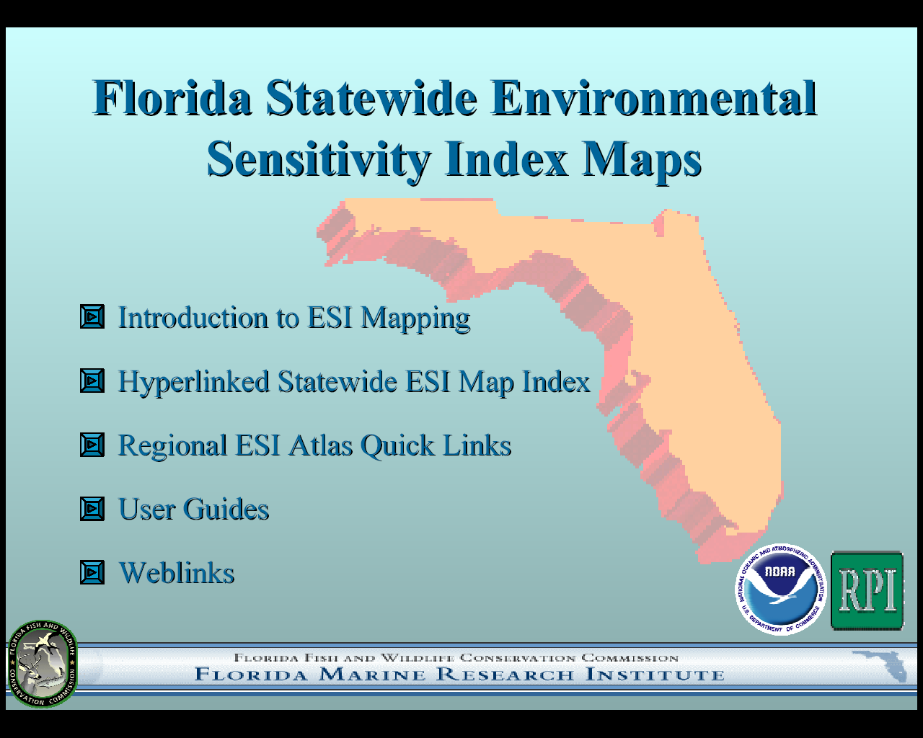
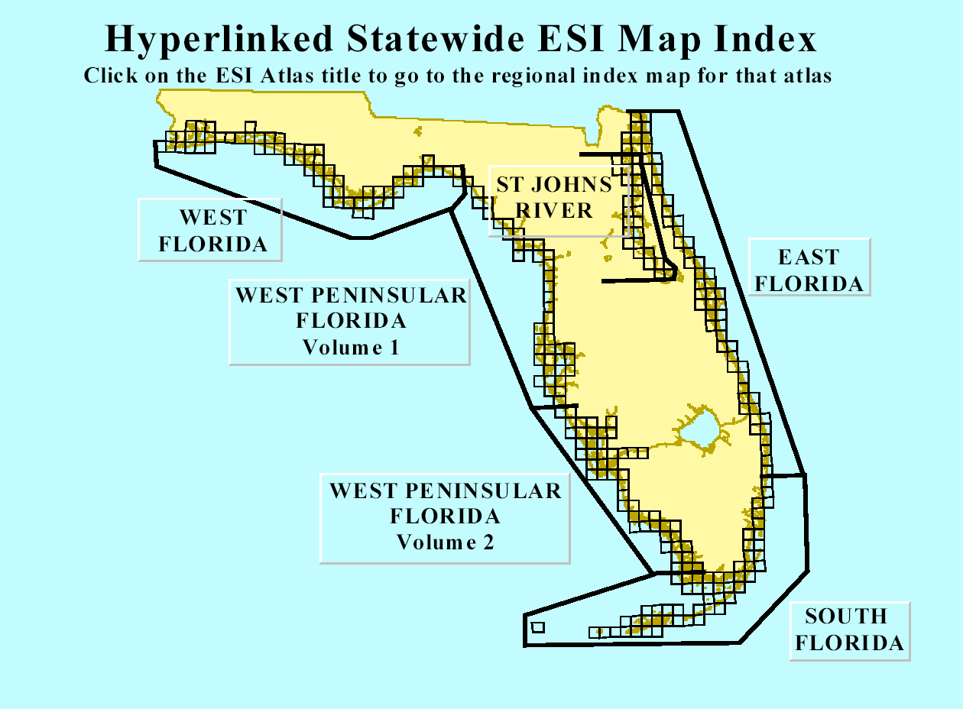
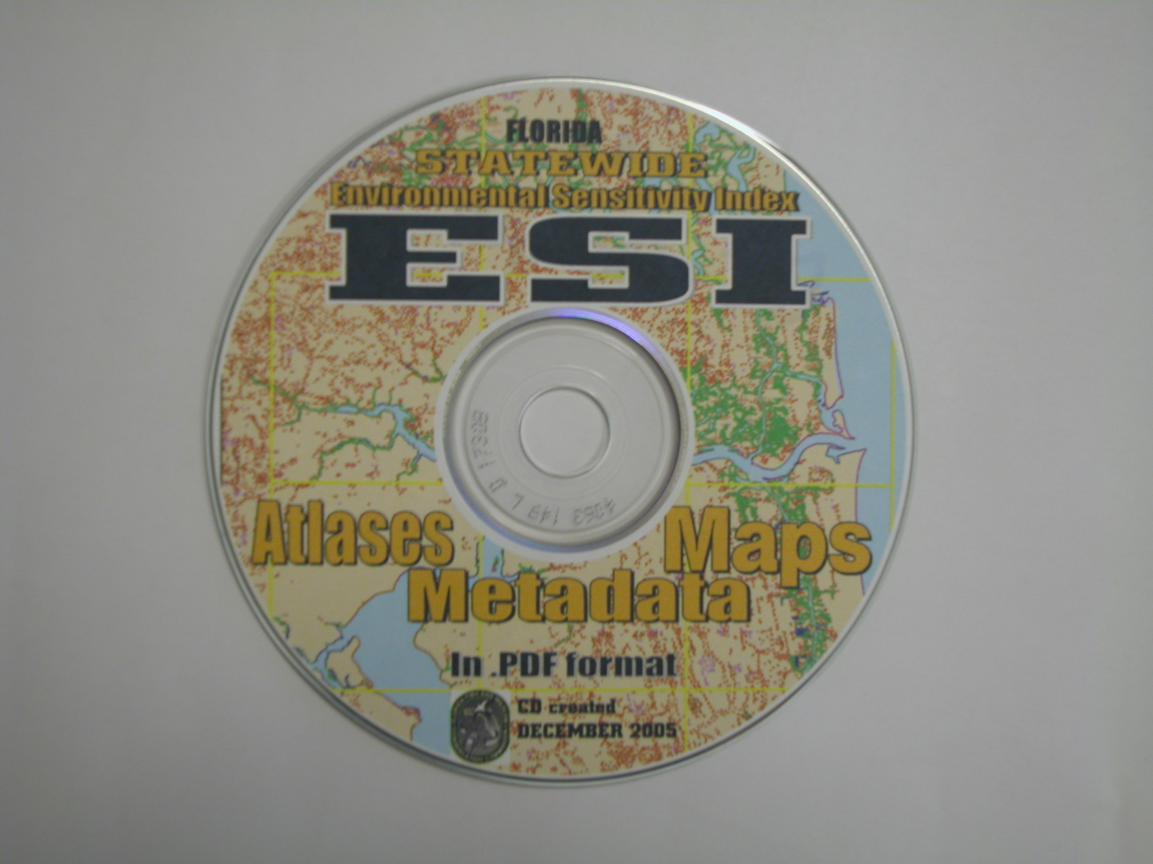
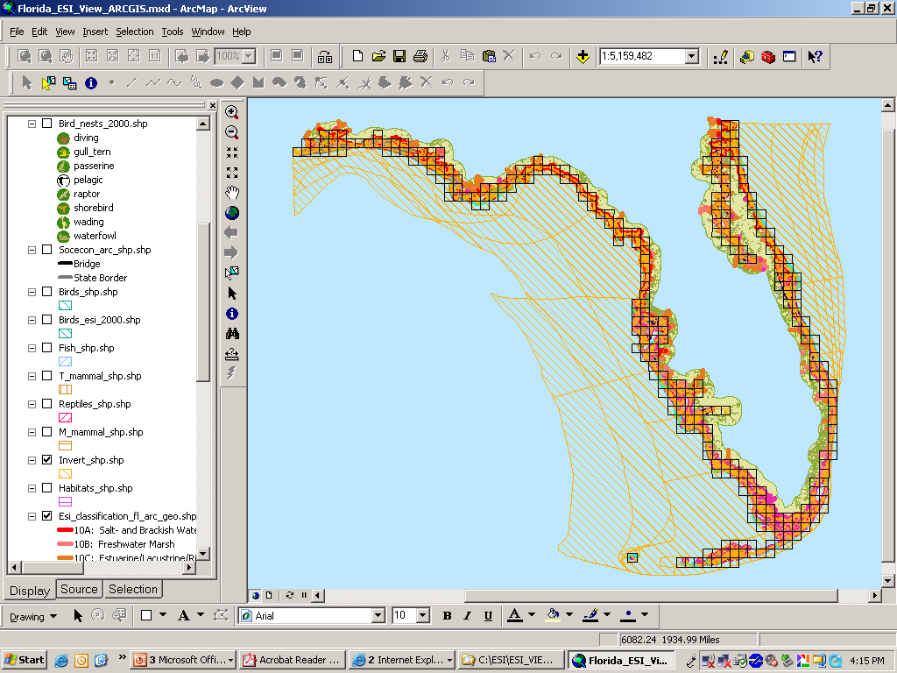
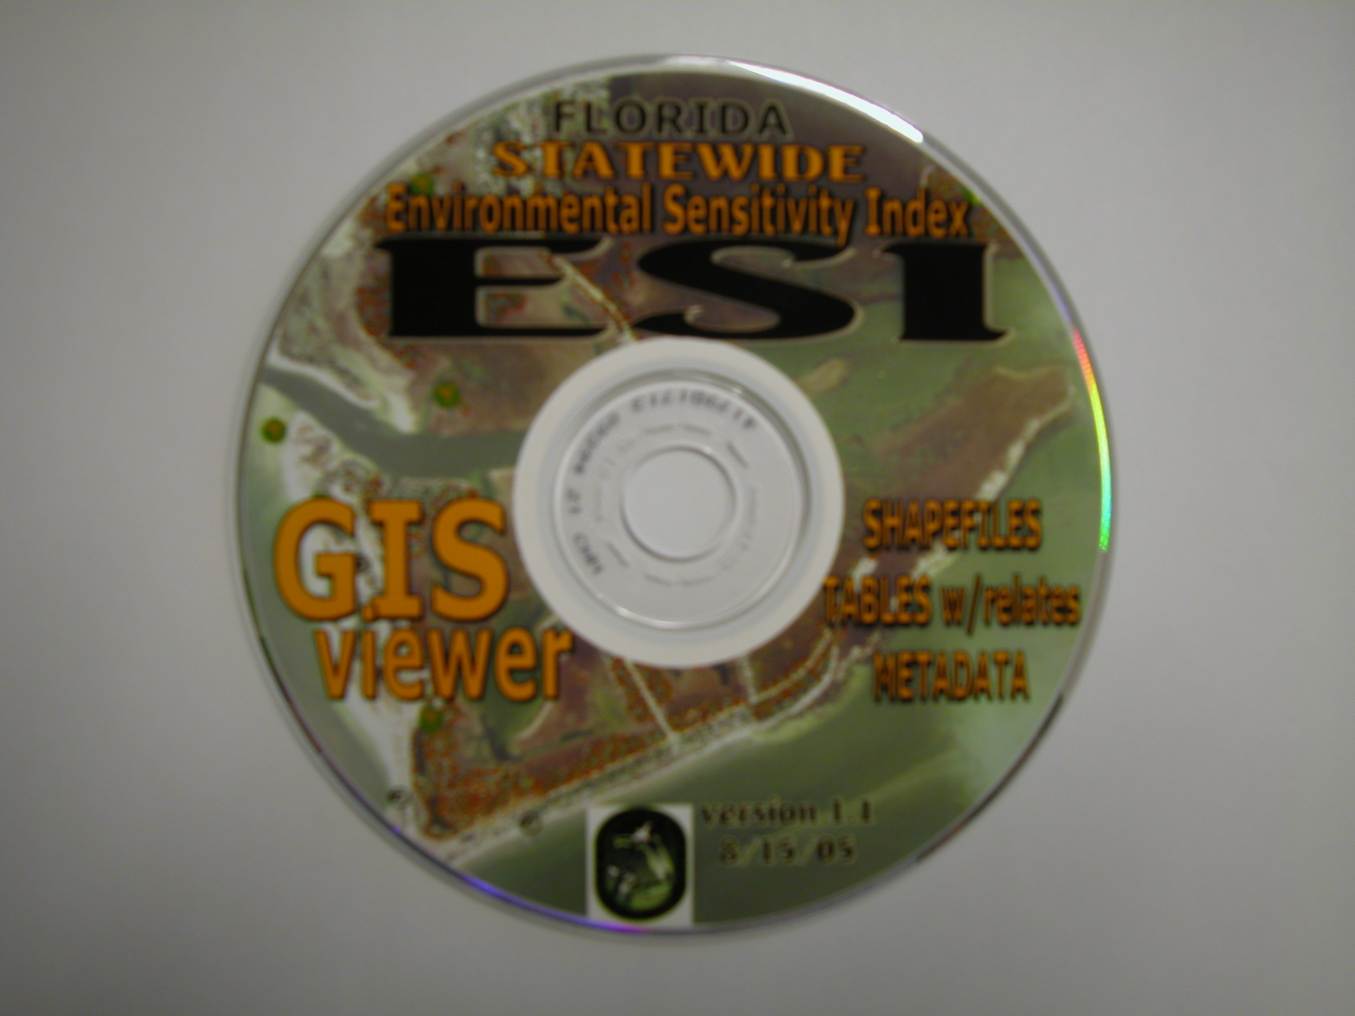
FL’s Statewide Environmental Sensitivity Index Mapping
Data Products
All ESI Atlases and Maps are available online:
http://ocean.floridamarine.org/esimaps/
Statewide ESI Atlases
and Maps CD (PDF)
Statewide ESI GIS Data Viewer CD w/
ArcView 3.x and ArcGIS projects
set up with proper tables and relates
to query the data – NOAA Re-Release

Slide 16
Digital ACPs
Initially this was the simple conversion of the paper document to a (PDF) format on CD
  User friendly
  Hyper-linked internally & externally
  Platform and operating system independent
Today this is a far more complex animal
  GIS-enabled with ArcGIS, ArcExplorer, and data
  Includes related supporting documents and applications
  Addition of an Internet Map Server
  Easily updated as newer data becomes available

Slide 17
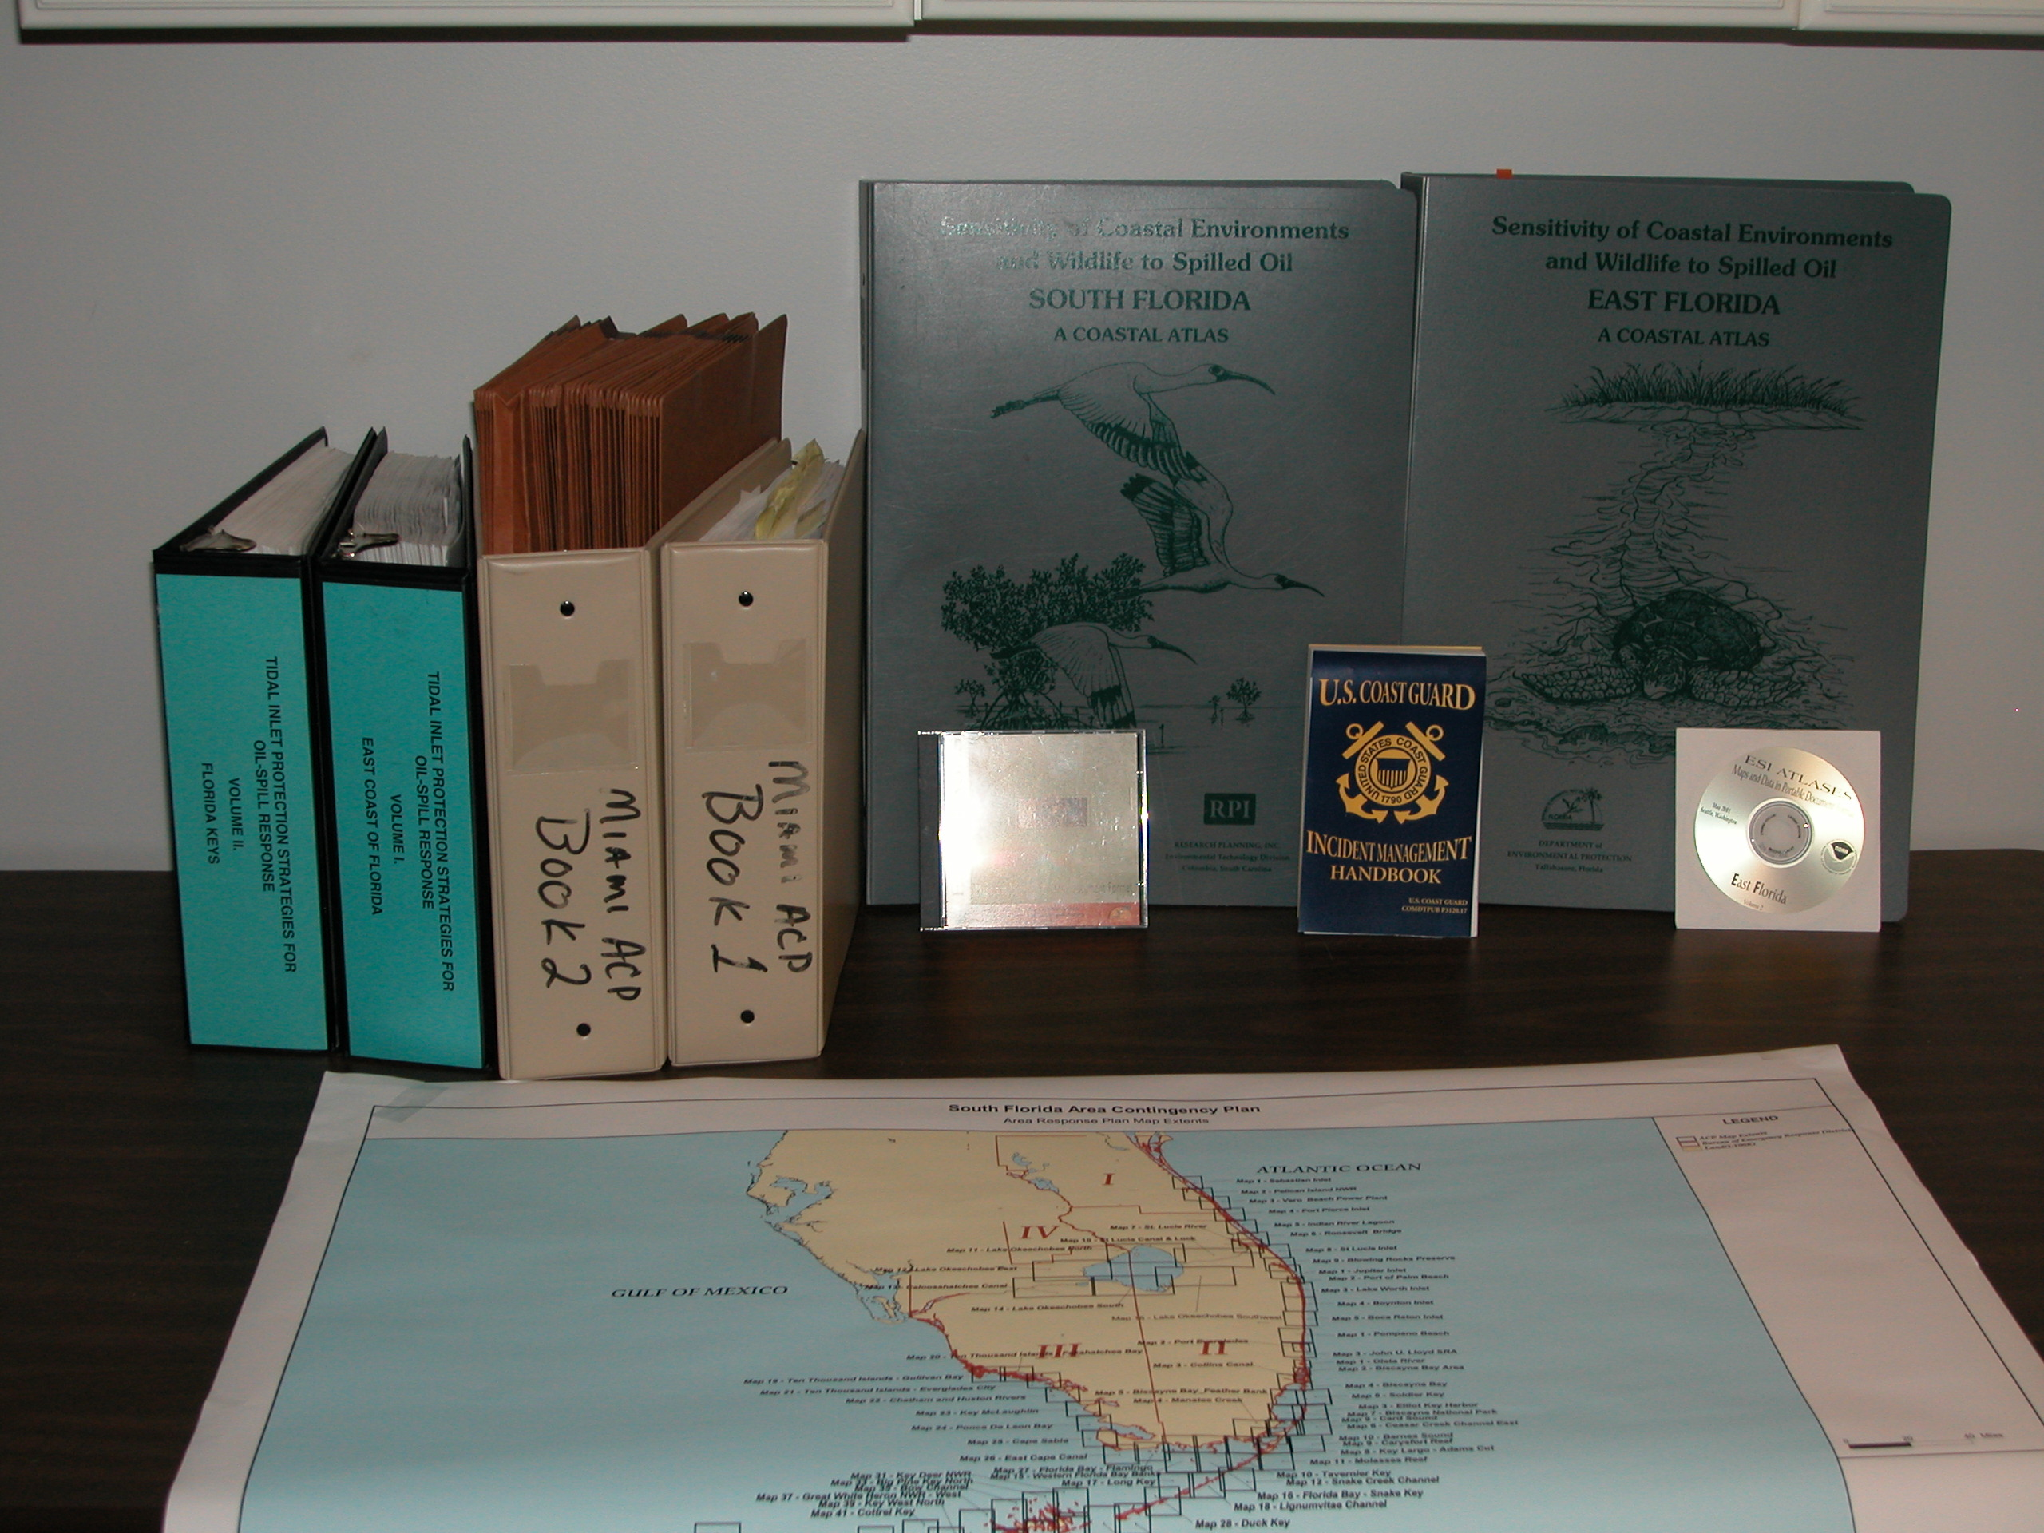
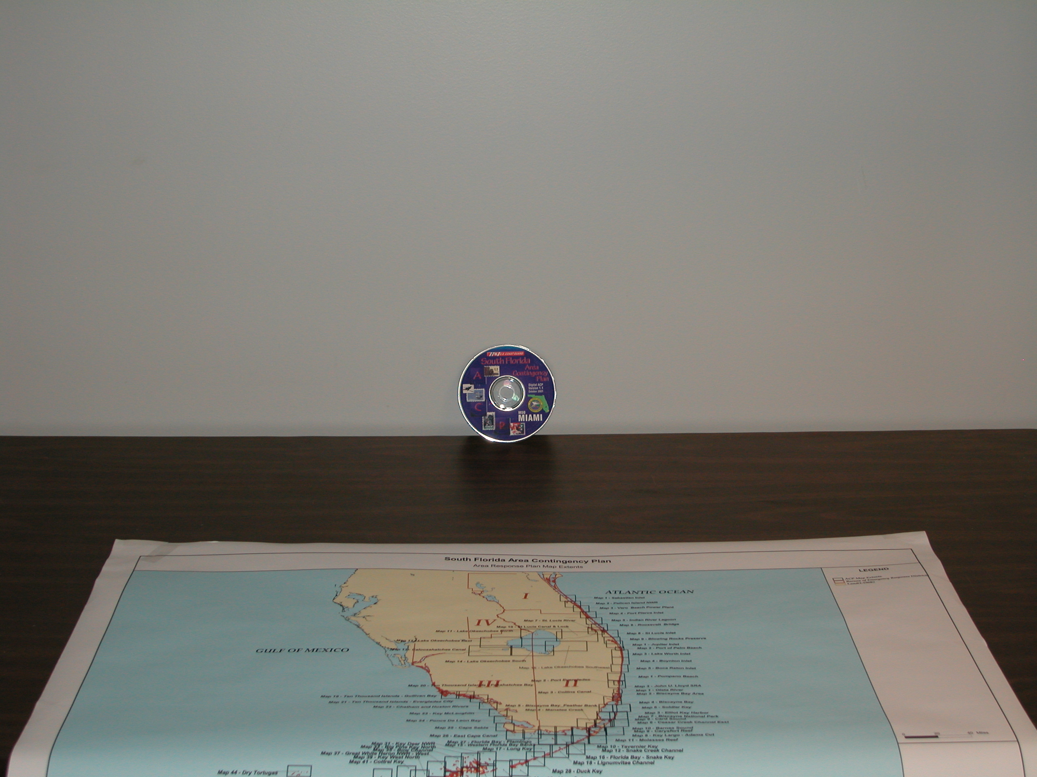
ACPs - The Old Way
ACPs - The “New” Way

Slide 18
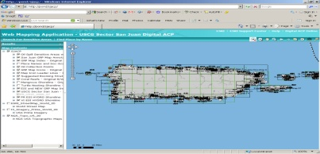
Digital ACP Regions

Slide 19
Digitized Oil Spill Area Contingency Plans - Contents
Digital ACPs by Sector = Disk, Website, Map Service
ACP DOCUMENT and Annexes – PDF and Word
Policy and Guidance Documents
Contact Lists – Fed, State, Local, Industry
GRP Atlases, ESI Atlases – Hyperlinked PDF
Tidal Inlet Protection Strategies – PDF/GIS
All Geodata with pre-built GIS Projects - free & $
Google Earth files for key GIS layers
Area Committee Developed
Area Committee Reviewed and Accepted

Slide 20
Geographic Response Plans
The ACP DOCUMENT is just a DOCUMENT
The GRP is the MAP-BASED plan for response
The GRP is TACTICAL and GETS USED
FWRI worked with the USCG to devise a GIS-based approach to the GRP mapping
These GRP data are now maintained in Enterprise GIS for the Southeast US and Caribbean by FWRI and used to produce GRP MAP products for Planning and Responses
The GRP Workshops are the ‘reality-check’ for all the fine details of the plan – They take time……… WHILE YOU HAVE IT.

Slide 21
The Geographic Response Plan
The spill responder’s essential 1 to 72 hour tool for quickly identifying sensitive areas for protection and how to protect them (mapped).
Details the most important features of environmental and strategic considerations – (sensitive sites, prioritizations, and protection strategies)
Supports the ICS Planning/Environmental/Operations Sections with the information that they need – THIS IS THE JOB, YOU JUST GET TO DO IT AHEAD OF TIME!
Produced by the people who would be involved in the event of a spill – key stakeholders and responders

Slide 22
The GRP Mapping Process
Why and What?
Determining Spill Risk –> Planning Assumptions
Determining and MAPPING Sensitive Areas
Prioritizing Protection, BEFORE a spill
Priorities are determined by stakeholders
Response strategies, tactics, and logistics – Determined by responders (USCG and OSROs)
Sensitive Sites and Protection Strategies are pre-identified on a map…well before any actual spills
Designed to collect the information to “hit the ground running” and collate it on MAPS (& GIS)

Slide 23
Map Elements for GRPs
Priority Protection Areas: A, B, C (w/data sheet)
Boom and Skimmer Placement
Risk Sites - potential spill source locations (w/data sheet)
Equipment Sites - locations of staged/available response equipment (w/data sheet)
Access information: marinas, boat ramps, etc
Staging Areas: Assembly or equipment staging
Collection Areas: Natural or desired
Special Resource Areas: turtle beaches, rookeries, special managed or protected areas
Command Post Locations – Potential/Actual

Slide 24
ESI vs Geographic Response Plan
ESI Map
GRP Map
RESOURCES – 11” x 17’’
TACTICAL – 8.5” x 11’’

Slide 25


Generalized GRP Sensitive Site Prioritizations
Priority for Protection in Spill Response – “You Can’t Protect It All”
A - Protect First
Human Health and Safety
Inlets, tidal creeks and passes
Species of special concern, threatened, or endangered species and their critical habitats/facilities
Large Areas of Mangroves
Salt-, Brackish-, & Fresh-Water Marsh/Wetlands
Coral Reefs and Hard ‘live’ bottom, shallow (<3 meters deep)
Seagrass, shallow (<l meter deep)
Public utilities water intakes
Aquaria, and aquaculture facilities
Cultural resources
B – Protect After A Areas
Deeper, Smaller, More Common
C – Protect After B Areas
Man-Made Shorelines

Slide 26
Resources used at the GRP workshops
Big Maps – BOTH GRP and ESI, organized by county
BIG INDEX MAPS, to figure out where the maps are
PRINTED data forms for each atlas
BLANK (highlighted) GRP Sensitive Site Forms
Plenty of pencils, pens, markers, sticky notes, etc
Two printers and a plotter
Wireless Internet
Broad use of Google Earth, Google Maps, Bing! Maps, GRP map service, iPads, etc…
Two GIS Technicians
NOAA SSC
State SSC

Slide 27
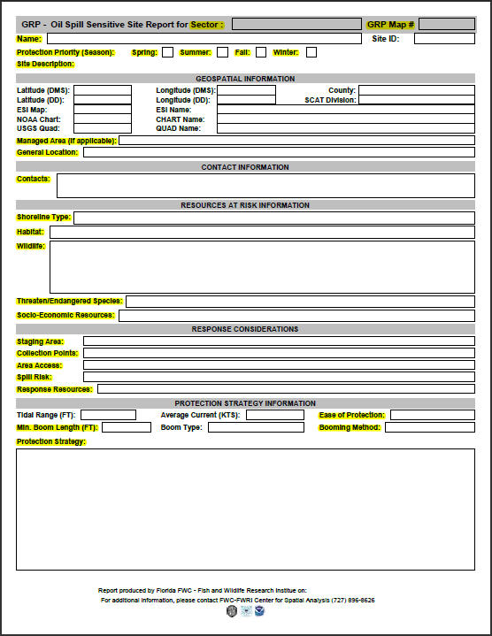
GRP Sensitive Site
Data Form
This form, used in the GRP workshops, collects all of the information needed for the ICS 232 and 232a forms
Resource
Section
Response
Section
THESE BECOME THE CORE GIS DATABASE

Slide 28
What’s on the form (highlighted)?
Name, Location, and Stakeholder Contacts
Site Description, Managed Areas Within
Shoreline Types, Habitats, Wildlife, T/E Species
Socio-Economic Resources
Staging, Collection, Access, Spill Risks, Response Resources, Boom Length Needed
Descriptive Protection Strategy, Ease of Protection
Note that this is much of what is done within the Planning Section within ICS during a spill!

Slide 29
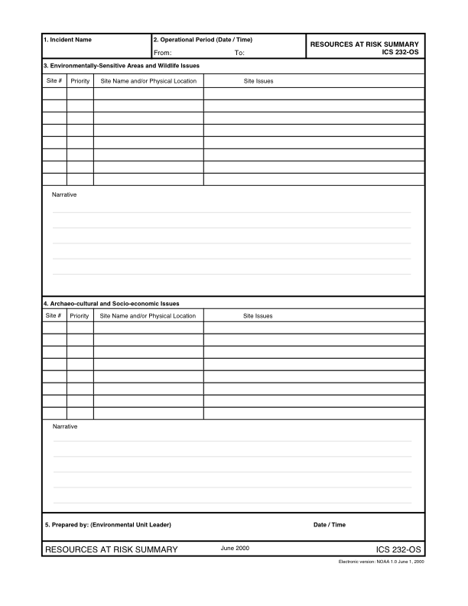
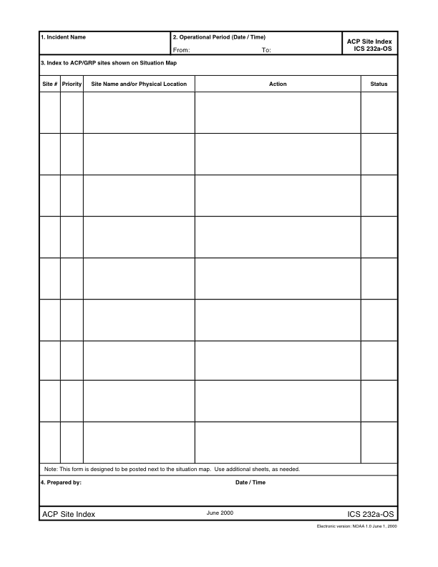
ICS-232 and ICS-232a
Resources At Risk Index to Sensitive Sites

Slide 30
GRP Workshop Objectives
  High Priority
  LOCAL Review and Input by County Emergency Managers - Based upon DWH ISPR lessons
  Key Stakeholder Ivolvement – Environmental, Wildlife, and Cultural - Federal, State, and Local
  Oil Spill Sensitive Sites - Review of existing sites, Identification of new or missing sites within the current plan, and PRIORITIZATION given a WCD (Offshore Drilling) planning assumption.
  Protection & Booming Strategies - Review and update of the existing strategies given a WCD planning scenario and evaluation of sensitive sites.

Slide 31
GRP Workshop Objectives (cont.)
  Moderate Priority & Ongoing
  Collection Points (Boom Strategy Related) - Skimmer, Vacuum Truck, Manual Collection - These are areas where oil can be corralled or diverted to for collection that are related to the configuration of boom strategies
  Natural Marine Debris Collection Points - the identification of "Natural" marine debris collection points is important because this is where product will naturally accumulate given seasonal winds, currents, and tides. We maintain this as a separate layer from the boom strategy related collection points for this reason.
  Water Intakes – As Sensitive Sites and also for the ESI Update – Aquaria and Commercial/Research Aquaculture
  Tidal Inlet Protection Strategies – Review and Comment to be passed to RPI

Slide 32
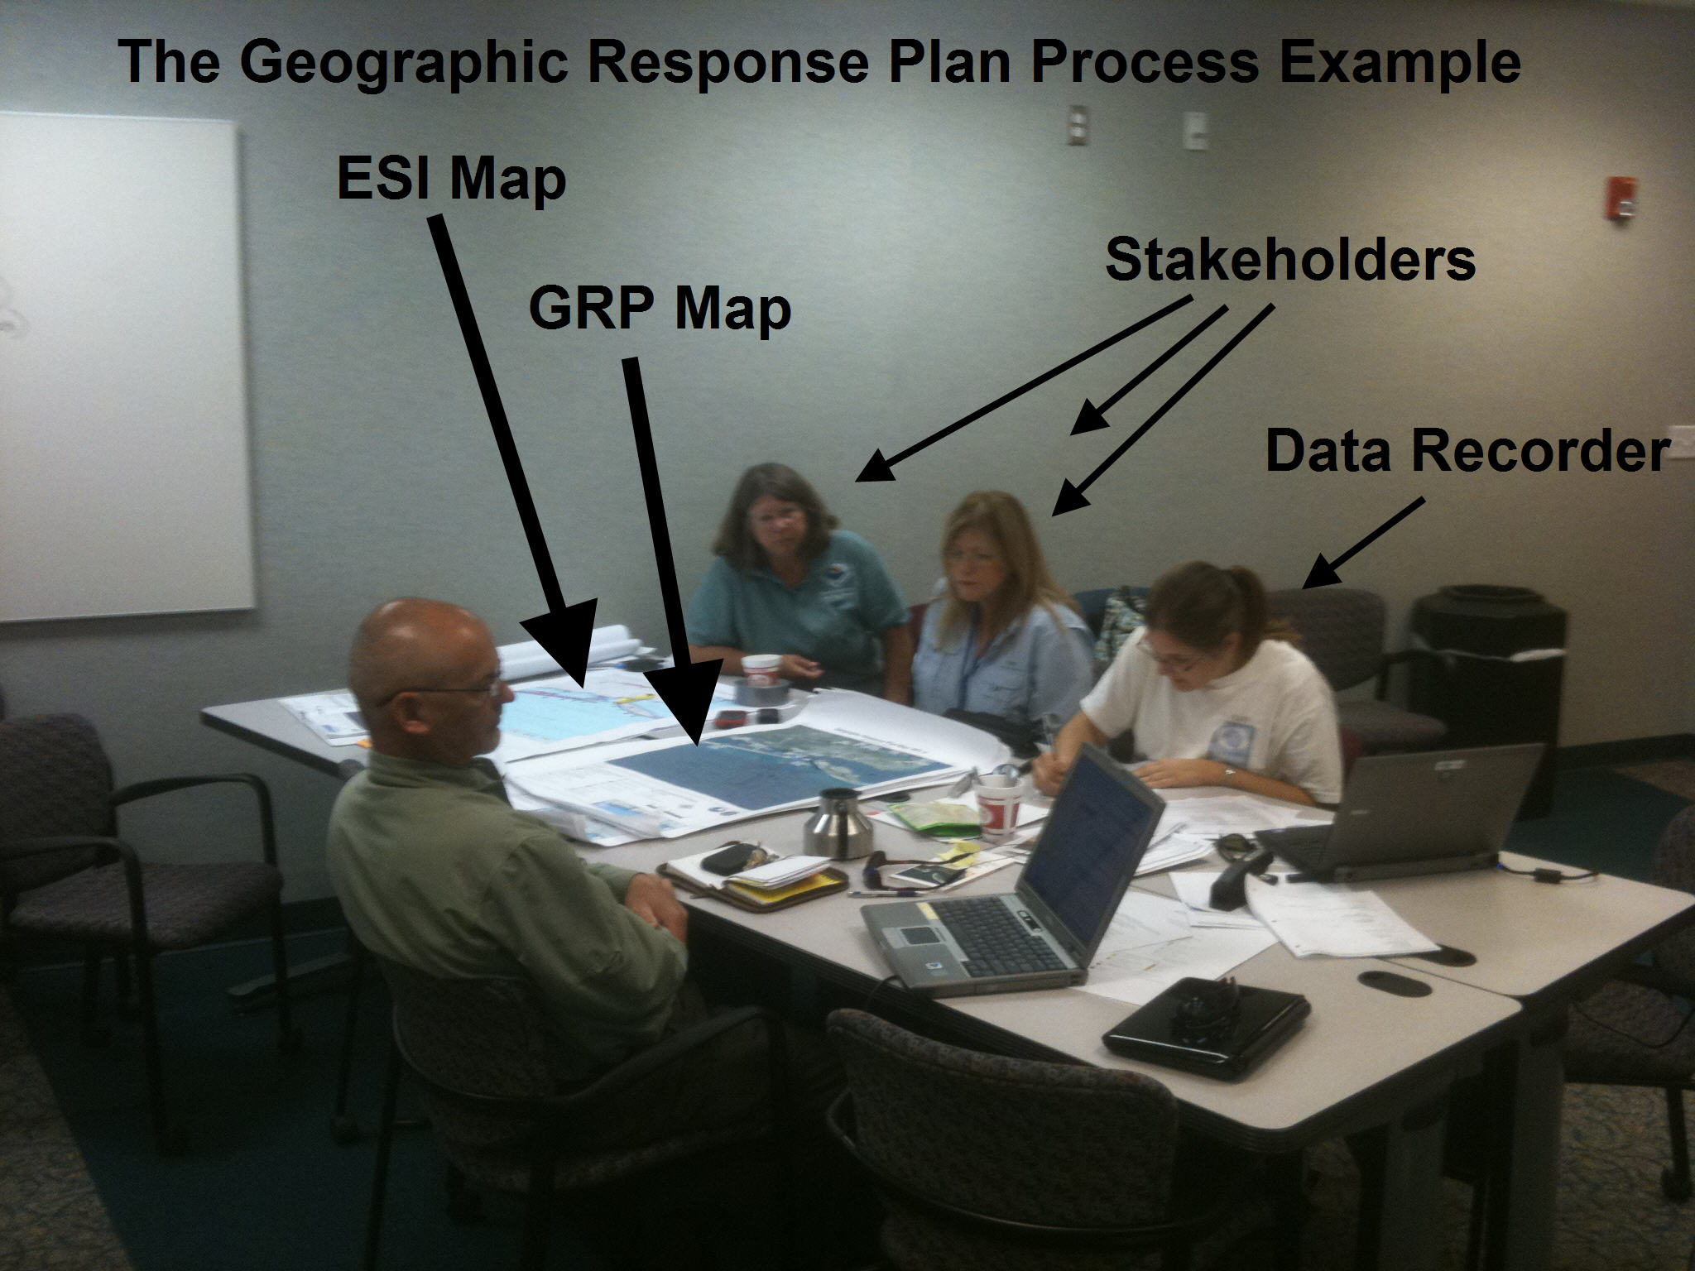
GRP Workshops in Pictures

Slide 33
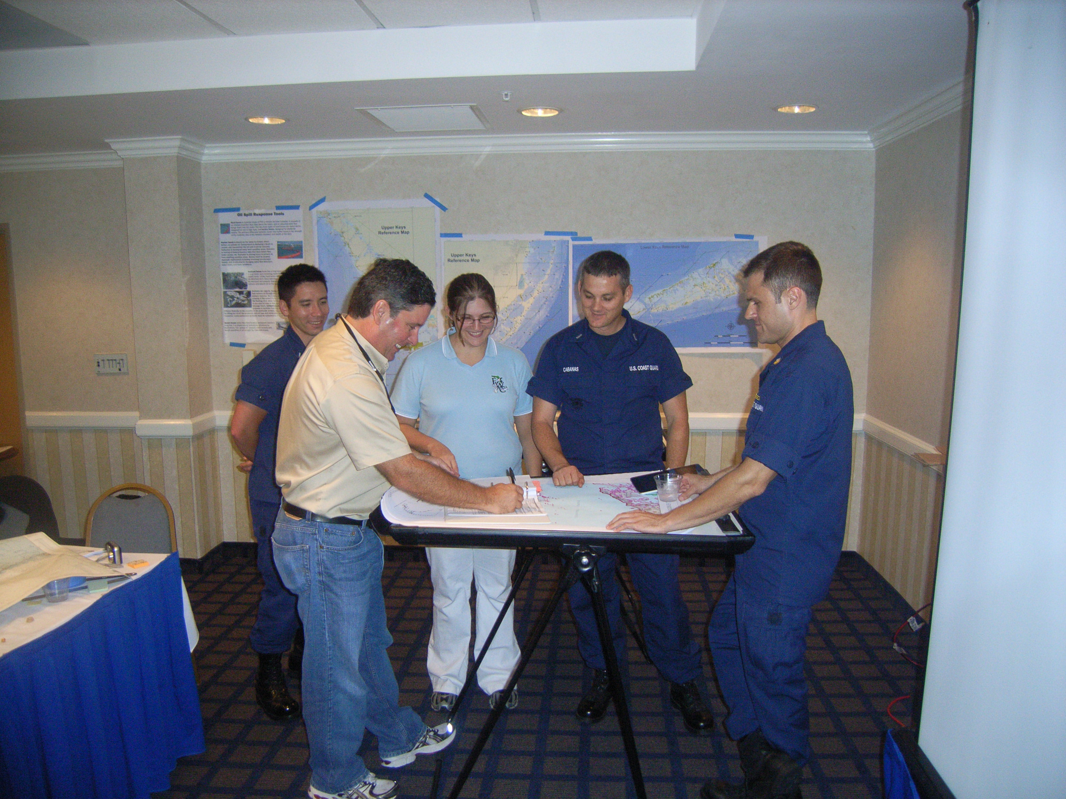
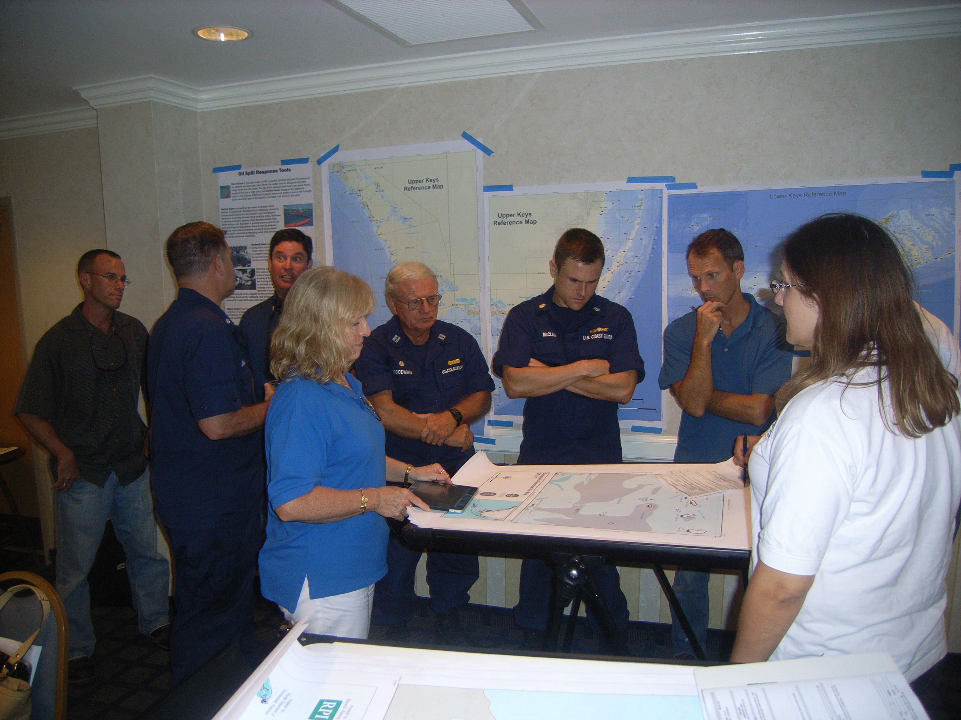
GRP Workshops in Pictures

Slide 34
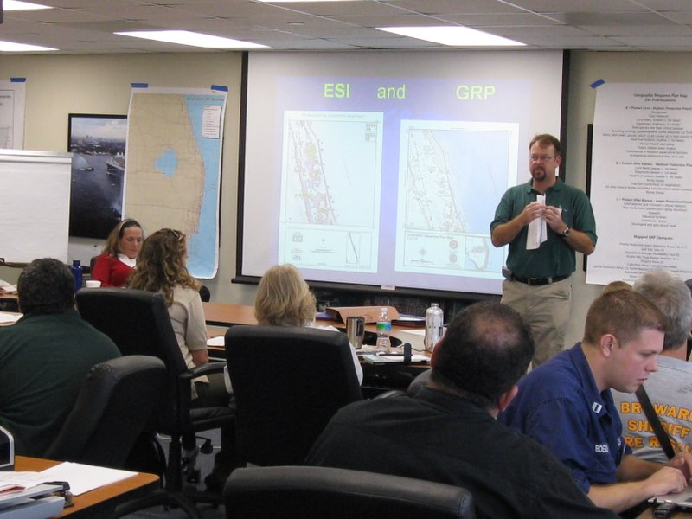
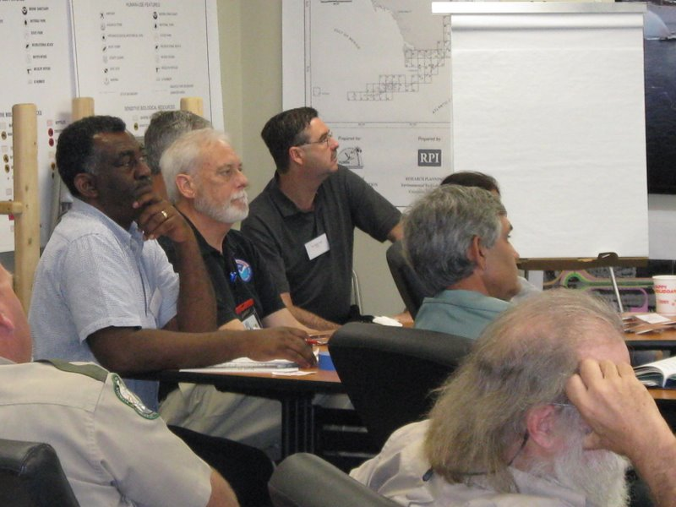
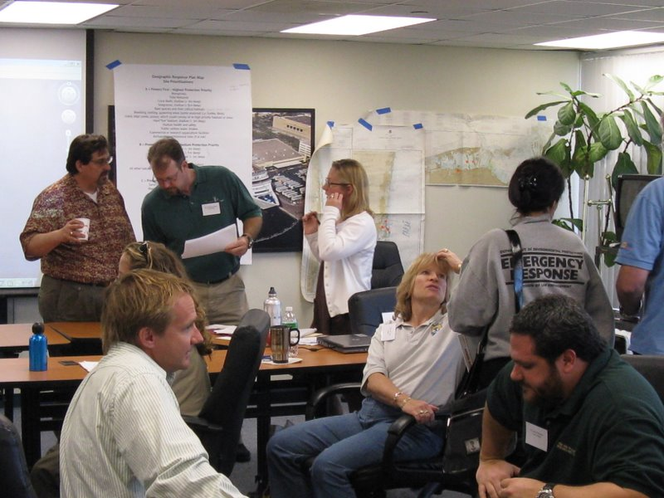
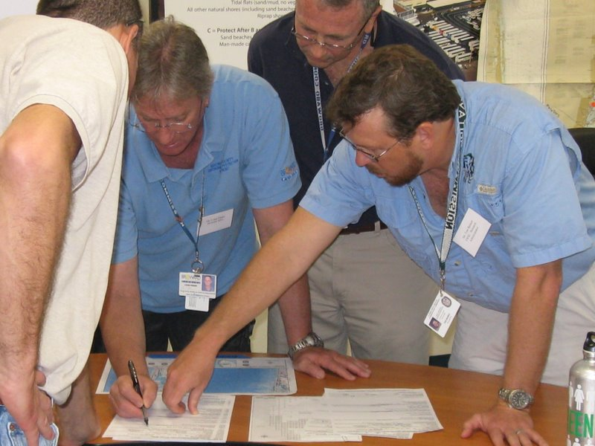
GRP Workshops in Pictures

Slide 35
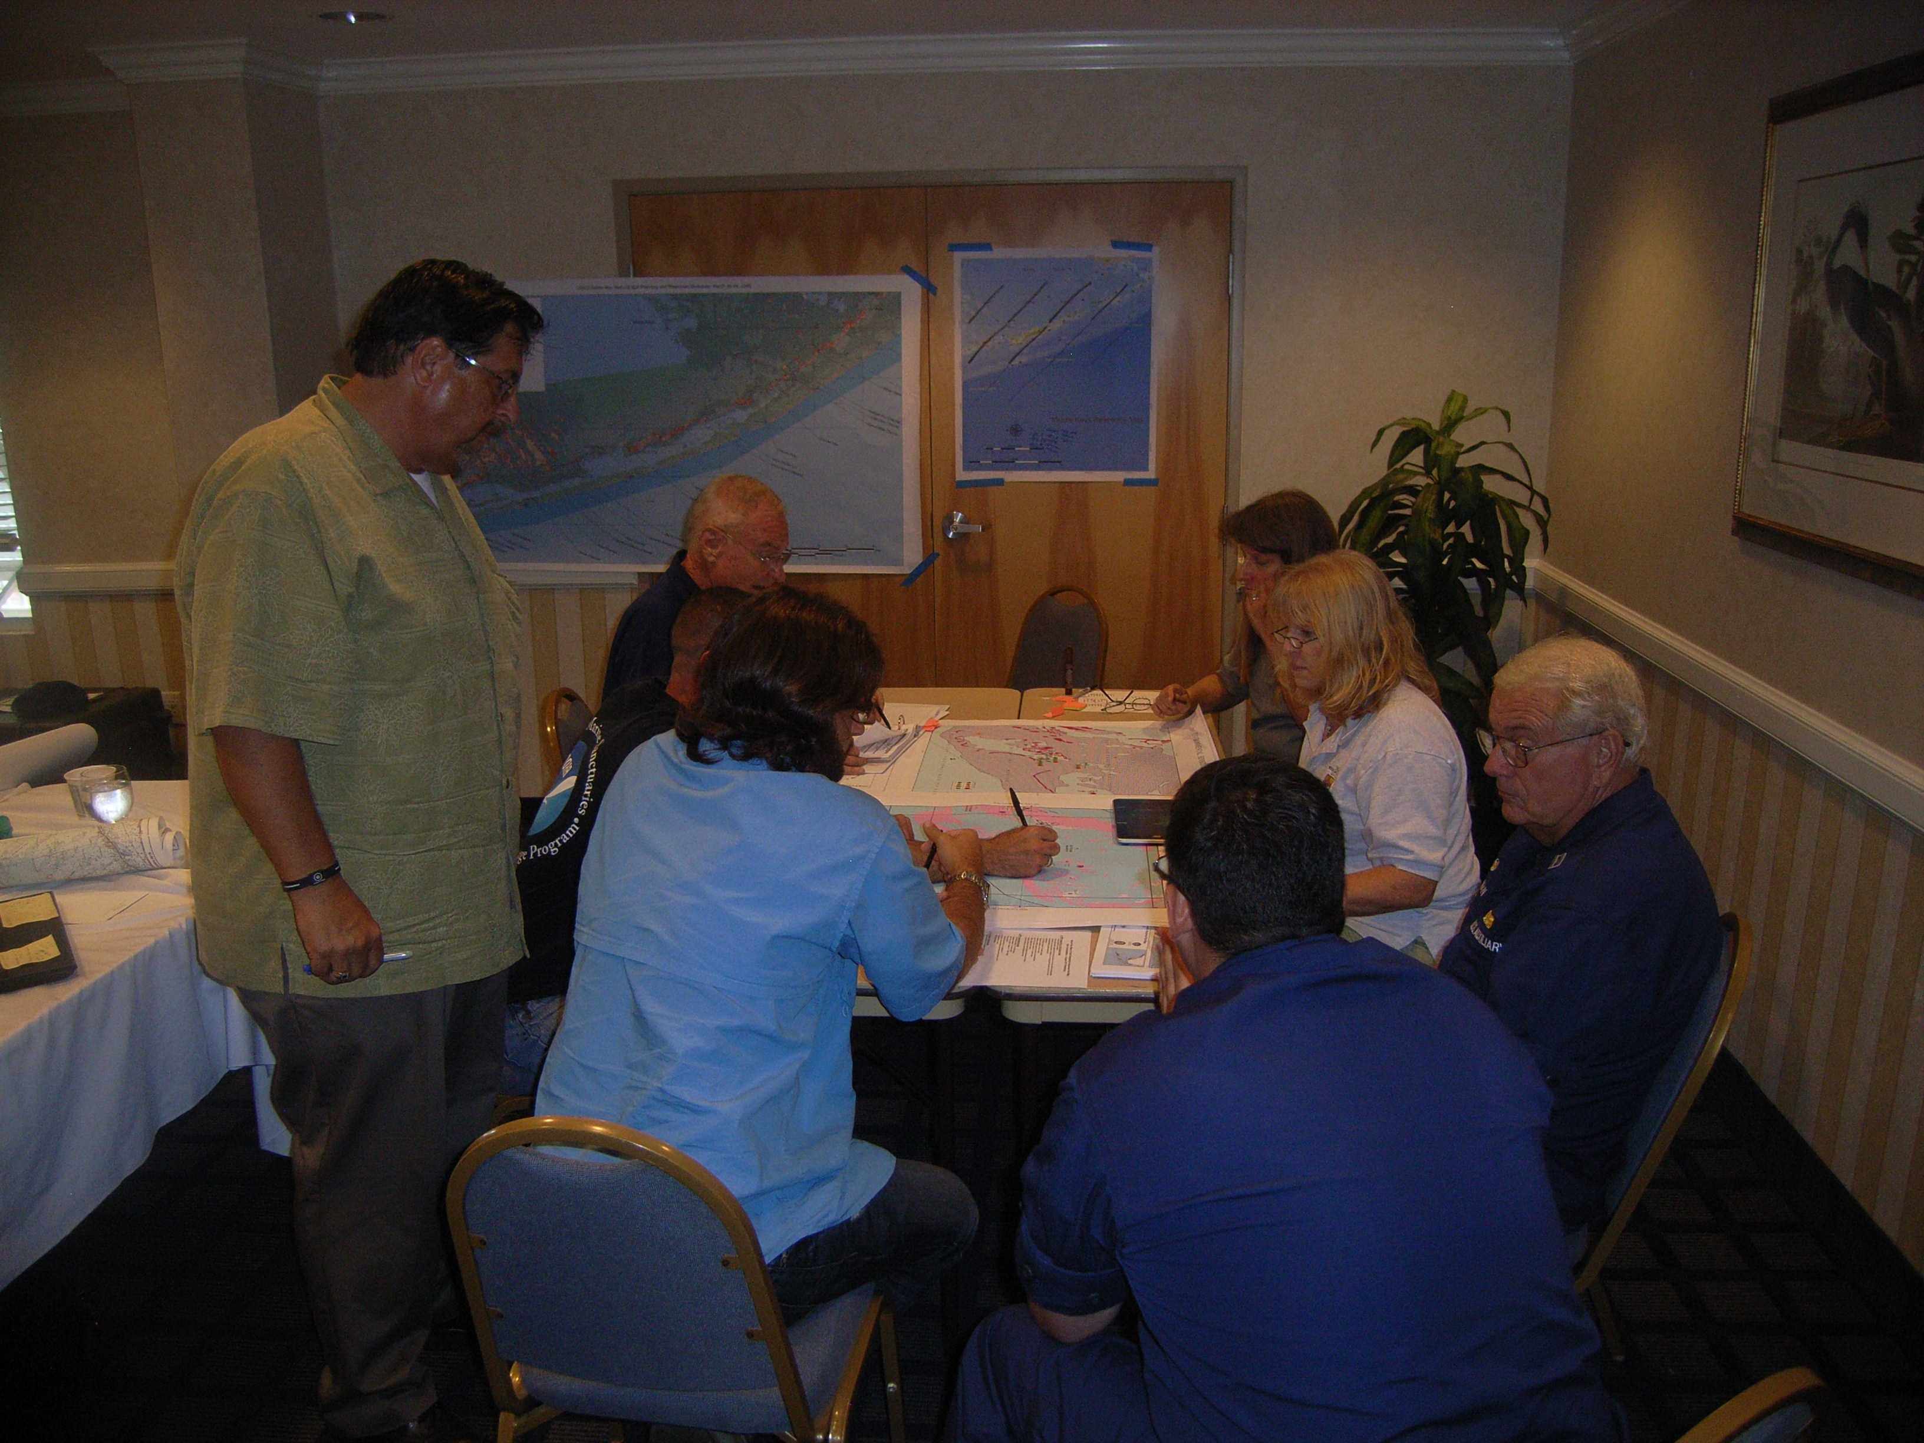
GRP Workshops in Pictures

Slide 36
RESULT:
NEW GRP maps
are produced
as a full
Digital ACP
update
The GRP workshops are GIS data only with updates appearing
via the map service until full map production

Slide 37
GRP and ACP Document Alignments
Following the GRP workshops, further efforts will be made to align the GRP with the ACP Document in describing Sensitive Area prioritizations and geographic features of the AOR. These will be included in the update to the ACP document along with DWH derived Best Management Practices for these habitats, wildlife, and shoreline types.

Slide 38
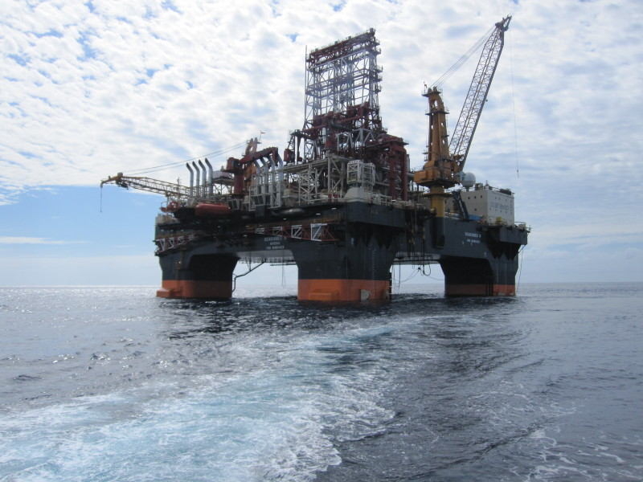
Eastern Gulf of Mexico Offshore Oil and Gas Exploration Overview
Coast Guard offshore Response Plan
Notes:
Main Purpose of Presentation Today
Educate with credible information
Clear up any misinformation that may be floating around
Explain the Coast Guard’s planning efforts following Deepwater Horizon
Explain how a response to a major oil spill in the Florida Straits will be different than the Deepwater Horizon response
** Note ** The rig pictured on this opening slide is the Scarabeo 9, which started drilling about 16 miles north of Havana on January 31, 2012
FIVE OVERARCHING ISSUES THAT NEED TO BE WORKED INTO PRESENTATION
Coast Guard planning efforts have involved multiple federal, state and local government agencies as well as industry interests and academia across the State of Florida
Coast Guard has received the licenses required for us to respond to an oil spill in the Cuban EEZ, these licenses also include companies the Coast Guard hires to respond and does so under the direction of the FOSC
Coast Guard is part of the governments efforts in a multi-lateral international forum with other countries on the issue of offshore drilling prevention and response issues. Other countries include Mexico, Jamaica, The Bahamas, Cuba and other nations contemplating offshore oil and gas exploration. IMPORTANT NOTE – EMPHASIS SHOULD BE ON MULTI-LATERAL; THE US GOVT IS NOT IN BI-LATERAL DISCUSSIONS WITH CUBA.
An oil spill in the Florida Straits will move the oil quickly and threaten U.S. waters and shoreline. The exact impact on the shore will be completely dependent on the surface currents and winds in place at the time. While it is not expected the Florida Keys or Shoreline will be inundated with oil, eposodic oiling of the shoreline is certainly a possible scenario.
Coast Guard response efforts will be to minimize the long term environmental and economic impacts throughout the region. Focus will be on protecting the tidal inlets to keep oil from getting past barrier islands and into the bays, estuaries and tidal marshes which are very sensitive to long term impacts of oiling.

Slide 39
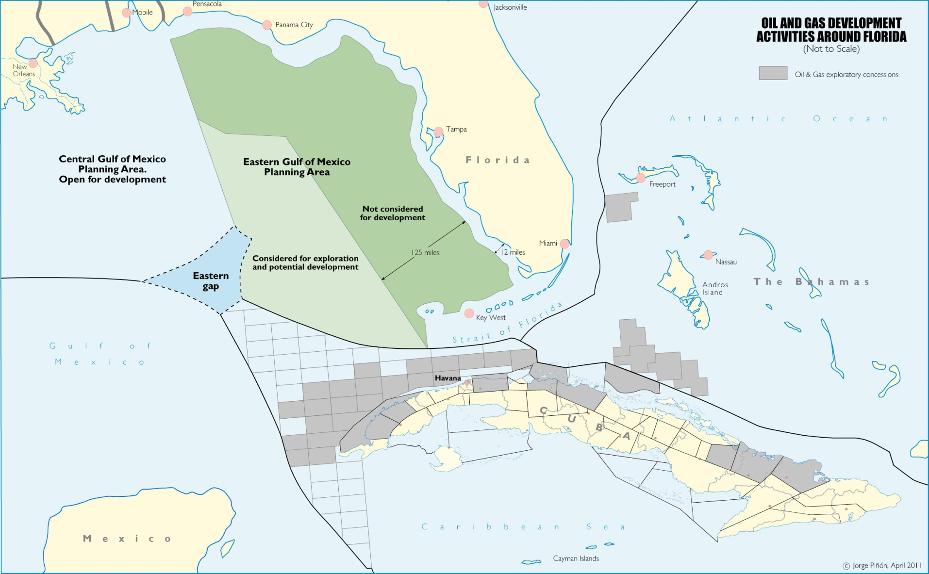
Future exploration work in the Eastern U.S. Gulf of Mexico and the Bahamas, will help validate Cuba’s NW Gulf of
Mexico and Eastern Gap hydrocarbon potential
Eastern Gulf of Mexico
O&G Development
Notes:
The grey blocks shown are the lease blocks currently leased by the governments of Cuba and the Bahamas to oil and gas companies for exploration
The U.S. Gulf of Mexico looks much like this as well with it chopped up into lease blocks for companies to explore and produce oil and gas products
Generally there is a ban on offshore drilling 125 miles off Florida’s west coast
If asked the Eastern Gap is very deep water that falls outside of all countries (Cuba, Mexico, US) EEZs and is truly international waters

Slide 40
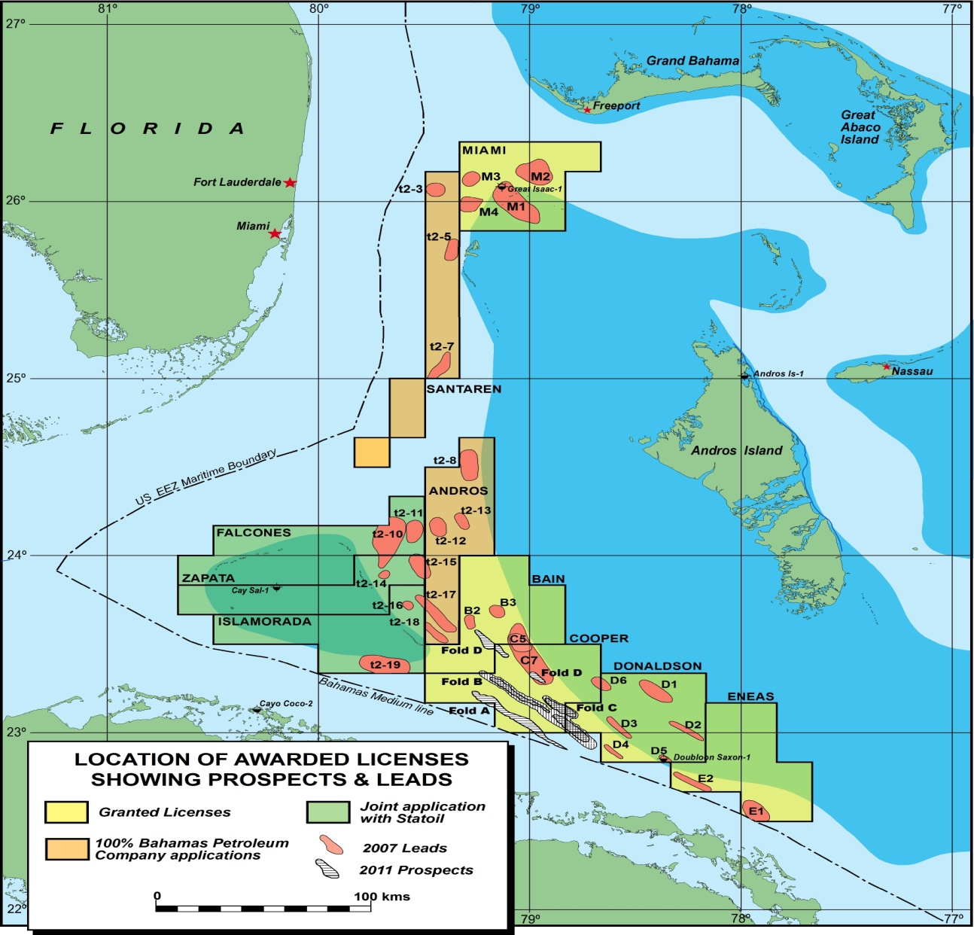
Bahamas Offshore Leases
Notes:
Leases held by Bahamas Petroleum Company and two other United Kingdom companies
Currently Bahamian Law does not allow offshore drilling - banned since the Deepwater Horizon Incident in 2010
The Bahamas is working on developing the proper governance to effectively monitor oil exploration; expected to have this in place some time in 2012, even with this government would still have to lift the ban on drilling.
Recently (October 2011) signed agreement with Cuba and Bahamas over sharing of undersea resources could lead way to commencing drilling

Slide 41
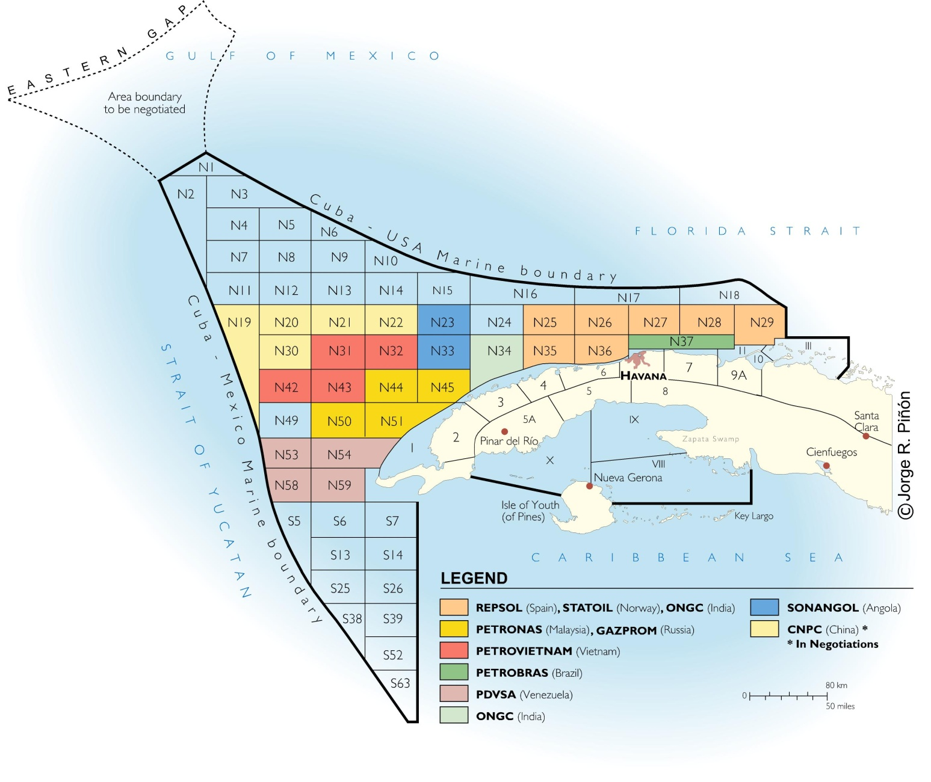
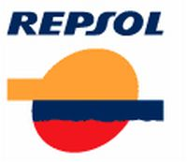








Cuba Offshore Leases
Notes:
Most companies shown have very little interaction with U.S. regulators (Repsol is lone exception)
These companies all do offshore drilling in other parts of the world and most to deepwater drilling like will be done off the coast of Cuba.
All are national oil and gas companies (owned by their countries); Repsol is again the lone exception.
Statoil – Norway
PDVSA – Venezuela
Petronas Carigali – Malaysian
ONGC – Indian
Sonangol – Angolan
Lukoil – Russian
PetroVietnam – Vietnam
Gasprom – Russian
**Note** Block N37 (Petrobras – Brazilian National Oil and Gas Company) has released their interest on this block and does not plan on drilling in Cuban Waters
COOC – One of China’s National Oil and Gas Companies – They have been negotiating with Cuba for an offshore lease but have not actually signed anything….so China is not drilling off Cuba.
Repsol – First driller – currently drilling in block N25 – Fast Facts
Publically traded Spanish Company
Has offshore leases in US Gulf of Mexico and Alaska
They have been cooperating with US Govt for more than a year and provided information regarding their spill response plan, drill plan, etc. Generally all are in accordance with U.S. standards
They have made it clear they intend to comply with U.S. law – although not bound to at all.

Slide 42

initial Area of Operations
Location: SW corner of Block 27
~ 16 NM from Cuba
~ 28 NM to US EEZ
~ 80 NM to Florida Keys
~ 5,800 ft water depth
~ 75,000 bbls/day WCD
Notes:
Main purpose of this slide is to familiarize with the first drill site
Important to note the water depth is just slightly deeper than Deepwater Horizon
The worst case discharge of Deepwater Horizon was over 150,000 barrels per day but only discharged about 57,000 barrels per day during incident
**Note** The Yamagua – 1 is the site of the 2004 exploratory well drilled by Repsol in 2004 without any incident and much less fan fare

Slide 43

NOAA Trajectory Analysis Planner – Jaquey Site Worst Case Scenario

Slide 44
Contingency Planning
Incorporated numerous lessons learned from Deepwater Horizon and other recent responses
Heavy external outreach with federal partners
Collaboration with State, local, industry and academia
Added appendix to Regional Response Plans dealing with international sources
Completely revised Area Contingency Plan (local plans), Geographic Response Plans and Inlet Protection Plans
Developed Offshore Response Plan to address nuances from uncontained source of pollution
Notes:
Extensive planning efforts over the past year involving federal, state and local governments as well as industry and academia in revising regional and local (Area Contingency Plans)
Developed new Geographic Response Plans and Tidal Inlet Protection Plans
All updates in planning, prevention, and response based on the numerous lessons learned from the Deepwater Horizon response
Numerous reports indicate that US govt and US companies could not respond (due to embargo) to a spill in Cuban waters…this has changed.
In December 2011 the Coast Guard was issued a license by the Department of Treasury (Office of Foreign Asset Control) and Department of Commerce (Bureau of Industry Standards) that authorizes the following:
Coast Guard can respond to an oil spill in the Cuban EEZ if the spill threatens US national economic or environmental interests
The CG license will also cover an US company that responds while working under the direction of the FOSC
This allows to the CG to respond with all tactics and capabilities if necessary to spill in the Cuban EEZ
In addition, there are other US companies who have their own license to respond to an oil spill as well as other international oil spill response companies who can work on a spill in the Cuban EEZ

Slide 45
Offshore Response Plan
  Creates command structure to direct offshore activities including:
    Dispersant & in situ burn ops
    Physical recovery ops
    OSRO ops coordination
    Air ops coordination
    Control of Commercial/Recreational vessel movements
    International engagement
    Tabletop Exercises were held November 2011 & April 2012
Notes:
Offshore Response Plan developed based on the lessons learned from DWH and the nuances of dealing with oil in the offshore environment vice the near shore area
Delineation of offshore and the near shore (Sector response) is based on equipment and capability
Near shore response will focus on protection of inlets, and shore based environmental resources where the offshore will focus on tactics at close to the source as possible
Offshore command will have an element dealing with the coordination of international response and engagement with other governments (including Cuba)
This plan complements but in no way replaces the existing Area Contingency Plans, which tend to be more detailed in a near shore response

Slide 46
EEZ
Incident
US EEZ
Foreign EEZ
Foreign Coastline
US Coastline
OPRC/Industry OSRP/VRP
Primary Activities
Source Control
Salvage
Surface/Sub-surface Dispersant Application
ISB Operations
Offshore Skimming
Foreign Waters
Federal Waters
Offshore Response Plan
International Coord
Primary Activities
Source Control
Salvage
ISB/Dispersant Operations
Offshore Skimming
Oiled Vessel Monitoring/Decon
Coordinate State Response
Vessel Traffic Control
Air Traffic Coord
State Waters
Foreign Nation Plan
USCG ACP
Primary Activities
Source Control
Salvage
Surface/Sub-surface DispApplication
ISB Operations
Nearshore Skimming
Shoreline cleanup
Primary Activities
Nearshore Skimming
GRP Implementation
Tidal Inlet Protection
Vessel Traffic/Decon (Port Specific)
Shoreline Cleanup (pre/post impact)
Wildlife Recovery/Hazing
Coordinate County/Local Response
EEZ
Notes:
Graphic shows interface between the multiple plans
**note”” Offshore Response Plan is not redundant to the ACPs but specifically addresses different issues
Typically federal and state level response will be contained with the Unified Area Command (Miami)
Offshore Response Plan will include federal and state level engagement
Sector Incident Command Posts will be hosts for county and other local support
New plans contemplate the need for CG to fill liaison positions at State and County EOCs during a prolonged response. However, state and local personnel at CG command posts will be encouraged…either way the importance is developing a unity of effort to eliminate redundancies and not letting things fall between the seams during a response.

Slide 47

FL’s Statewide Environmental Sensitivity Index Mapping
Florida’s ESI DATA for UPDATE in 2012-2013
  Panhandle
  South Florida
  West Pen. Florida South
BENEFIT: STANDARDIZED format for biological data so spill responders can use it easily with the right tools…
Maps/Atlases – Funded by NOAA?
All Available as PDF at: http://ocean.floridamarine.org/esimaps

Slide 48
Online Resources
FWRI hosts a number of websites and map services
for oil spill contingency planning
Digital ACP “Home”
http://ocean.floridamarine.org/acp
All of the available Digital ACP websites are linked here
GIS Internet Map Services > Oil Spill GRP Enterprise GIS Data
http://ocean.floridamarine.org/acpgrp
New 2012 TIPS! (in PDF)
http://ocean.floridamarine.org/acp/tips

Slide 49

Digital ACP “Home” http://ocean.floridamarine.org/acp
All of the available Digital ACP websites are linked here

Slide 50

GRP Web Mapping Application – Flex – NEW in 2012
http://ocean.floridamarine.org/ACPGRP/GRPViewer/

Slide 51


Slide 52


Slide 53


Slide 54







2012 FL TIPS
Include:
Background Science
Inlet Summary
Aerial Basemap
Total Boom
Collection Points
Curremt Velocities
GIS Data
Map Service
http://ocean.floridamarine.org/acp/tips

Slide 55

TIPS and GRP Booming Strategies in the Web Mapping Application
http://ocean.floridamarine.org/ACPGRP/GRPViewer/

Slide 56


Primary IODRP Wildlife Challenges
North Atlantic Right Whale Critical Habitat
and Mandatory Ship Reporting Area
15 Nov to 16 April
> 65% of Sea Turtle Nesting Occurs on the East Coast of Florida
May - Sept

Slide 57
ESI Challenges in Planning and Response
We learned…ESI Needs to be maintained! 15 YEARS! It’s Embarrassing…
Tools, Tools, Tools!
Desktop and Online
Collaboration in tool development, Fed, State, Local?
Updating, Cartographic Production, Reporting
Expansion beyond just oil spill planning and response…Get the USFWS involved?
Better education for all…YouTube videos?
More emphasis on digital vs. hardcopy maps and focus on a decision support system as GIS becomes more mainstream…with cartography! (MAPS!)
Edge match between states? Funding? Sources?

Slide 58
ACP and GRP Update Schedule
GRP GIS Digitizing For:
Sector Key West GIS: Done
Document: May 01, 2012
Sector Miami GIS: Done
Document: Aug 01, 2012
Sectors Jacksonville and St. Petersburg: Jul 01, 2012
Documents: Sep 01, 2012
Fully Updated Digital ACPs (Docs/Maps/Disk/Web)
(if all submissions are in on time)
October 01, 2012
Sector Mobile – Just started April 2012…
Panhandle ESI Almost Done

Slide 59
Breakout Questions
What is the map/index grid for your GRP maps?
How elaborate is your contingency plan mapping?
Old school black and white?
"ESI-like" color maps?
Not ESI-like at all?
What is the background/base map?? Imagery? Nautical charts? USGS Quads?

Slide 60
Breakout Questions
What is the printed size?
How are the distributed?
Does the GRP maps use any ESI information?
Is the response prioritized in any manner?
Is any spatial data produced or distributed?
How involved is the local Area Committees?

Slide 61
Questions???
Email: Richard.Knudsen@MyFWC.com
Ryan.Druyor@MyFWC.com
Teri.Dane@MyFWC.com
Henry.Norris@MyFWC.com
Phone (727) 896-8626
ALL Digital ACPs for the SE US
http://ocean.floridamarine.org/acp
ArcGIS Server GRP Map Services for the SE US
http://ocean.floridamarine.org/acpgrp
Thank You!

