Slide 1
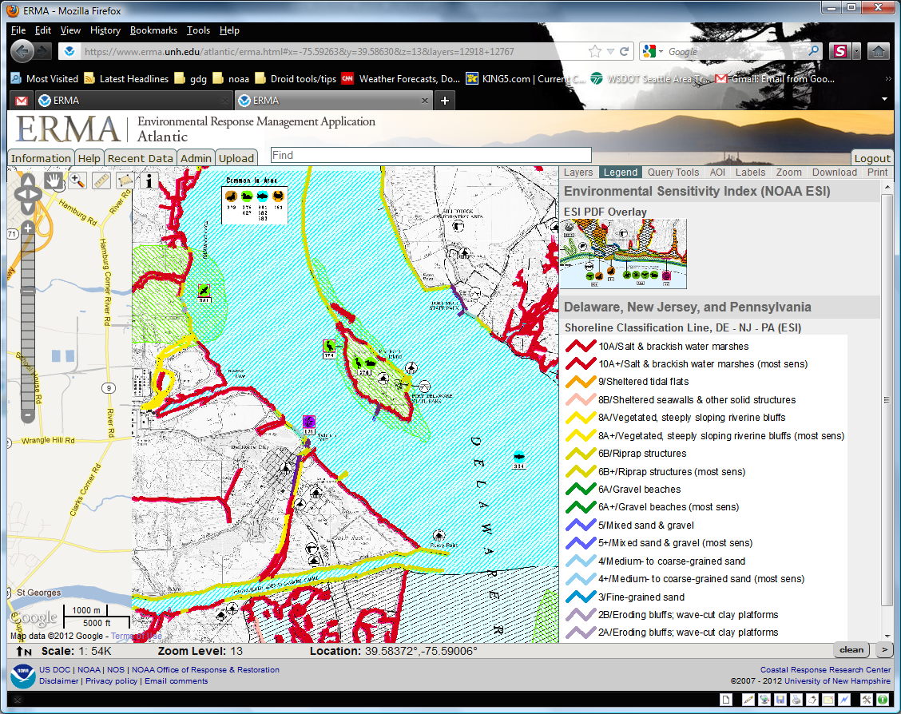

NOAA Environmental Sensitivity Index (ESI) Data, Query, and Tools in ERMA®
(Environmental Response Management Application)
George Graettinger
& Amy Merten
NOAA/OR&R Spatial Data Branch
ESI Workshop
Mobile, AL
May 1st – 3rd, 2012

Slide 2
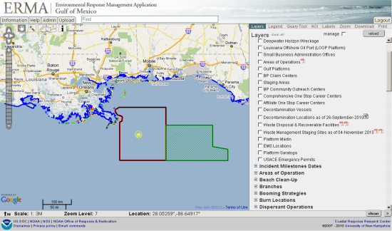
What is ERMA?
ERMA is an online mapping tool for visualizing environmental information relevant to oil spills, climate change, and natural disasters.

Slide 3
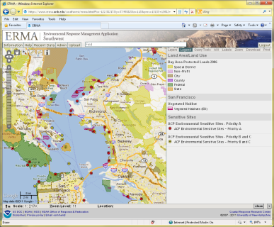
What is ERMA?
Web-based mapping tool
Provides centralized access to
information
Increases communication,
coordination, and efficiency
Prepare for, respond to,
assess impacts from hazardous incidents or conditions
Analyze and visualize environmental information
relevant to all hazards

Slide 4

Key ERMA Functionality
Access ERMA via any Web browser. No special software needed.
Tiered system security that protects data.
Standardized user interface; simplifying data uploading.
Build customized maps
using layers.
Create and view customized
sets of layers quickly with
bookmarked views.
Data sharing/download.
Notes:
Standardized interface that makes bringing data into the system simple
Tiered system security that protects data
Ability to query, filter, and search data
Build customized maps using layers
Distributive upload and viewing capability from anywhere with an internet connection
Create and view customized sets of layers quickly in bookmarked views
Tell a story through animated layers

Slide 5
Standard ERMA Data Sets
Base Mapping
    Google aerial, terrain, roads
    Nautical charts
Incident Information
    Trajectories
    Real time resource tracking
    Shoreline oiling
    Sampling data
  Weather & Buoys
    Hurricane/Storms
    Remote-sensing imagery
    Local habitat and species
    Seafood safety
  Resources at Risk
    NOAA ESI data layers
Documents & Photo Links
    ESI and GRP .pdfs
    Attached to layers
    Field photos

Slide 6
How ERMA Can Help You
Operations Section
    Incident Location
    Vessel Locations
    Dispersant Zones
    In-Situ Burns
    Divisions & Segments
    Booming Strategies
Environmental Unit
    Threatened & Endangered Species
    SCAT Data
    Sensitive Sites
    Wildlife Observations
    Overflight Observations
  Situation Unit
    Mirror SitStat Board
    Trajectories
    Weather
    Current Operations
  Unified Command
    Up-To-Date Picture of All Operations
  JIC
    Up-To-Date Picture of All Operations
    Potential to show publically released data

Slide 7
ERMA uses ESI Data to Support Response & NRDA
Shoreline assessment for SCAT and cleanup activities
Sensitive area identification
Threatened and Endangered species identification and status
Resources at Risk reporting

Slide 8
ERMA Functional Access Requirements
Strong Internet based access
  Web based data services (WMS/Arc Rest)
  Data, PDF maps and API Access
Stand-alone functionality
  Offline access to data, maps and query
  Support remote and/or disaster related access limitations
  Requires local access for data, external services are not usable

Slide 9





ERMA Architecture
Output to User
Download/Upload Source
Feature Server Tools
ESI & IPaC Query
Open Layers
AIS Ship Search
Web Mapping Service (Feature)
External GIS Data
ENCs/ RNCs
Real Time Weather Obs
Buoys
NAIS/ AFF/ AMOC
Secure Server Authentication
Data Layer Management
Access Privileges
Response datasets from SFTP
Trajectories
Satellite Interpretations for oil
SCAT Results
Overflight Planed & Obs
Booms plans/derived from imagery
Protected Resource Impact
Field sampling (subsurface, analytical chemistry, etc.)
Platform observations
MapServer
Base Public datasets
ESI
Landuse
Bathymetry
Regional Monitoring
Habitat Classifications
Restoration
Bioresource Base data
PostGres/ PostGIS
Data Base
(Full Backup routinely)

Slide 10
ESI data and ERMA
ERMA uses a dedicated Postgres database and tool set, the ESI API
ESI API is used to feed ESI data query to all of the Regional ERMA sites
ESI API allows for querying of ESI relate environment (biology, shoreline, econ.)
ESI data do not need to be drawn to be queried in ERMA

Slide 11
ESI Data In ERMA
All available ESI Atlas layers are available in each Regional ERMA site
Each ESI Atlas metadata catalog available through ERMA
ESI Atlas Index layers contains link to full ESI PDF map (front and back)

Slide 12
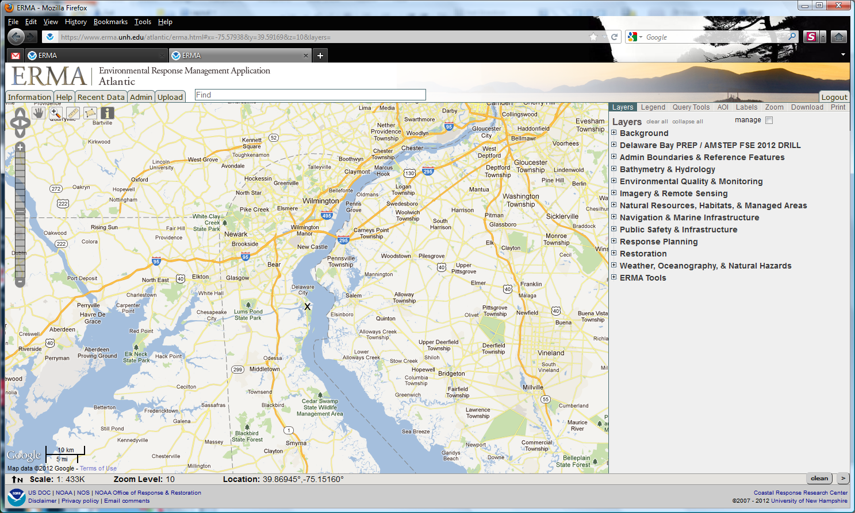
Common Data Structure

Slide 13
ERMA ESI Data Structure

Slide 14
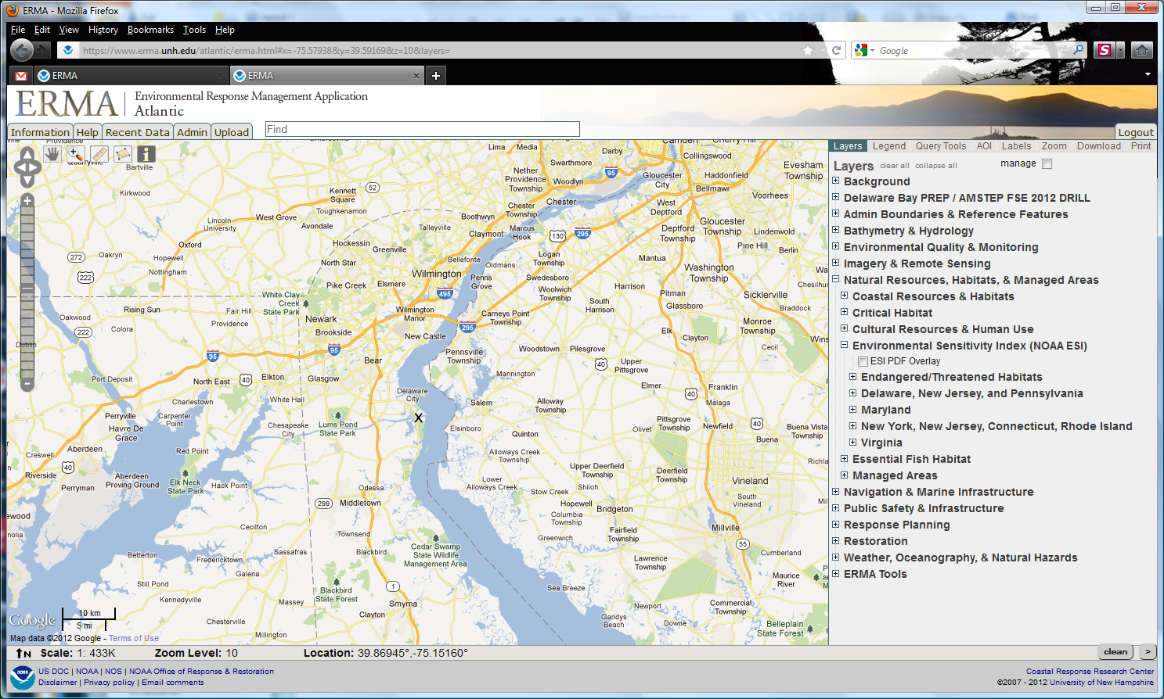
Natural Resources, Habitats, & Managed Areas

Slide 15
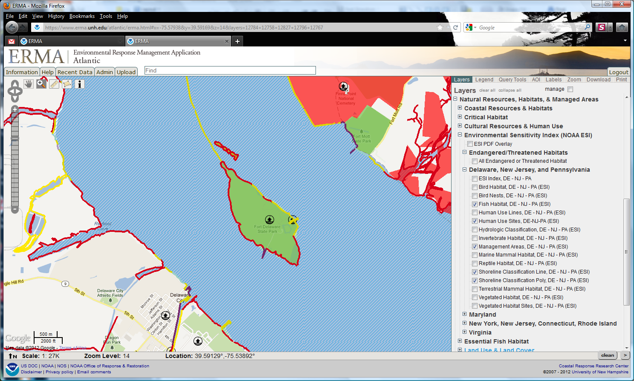
ESI GIS Data Layers: Layers

Slide 16
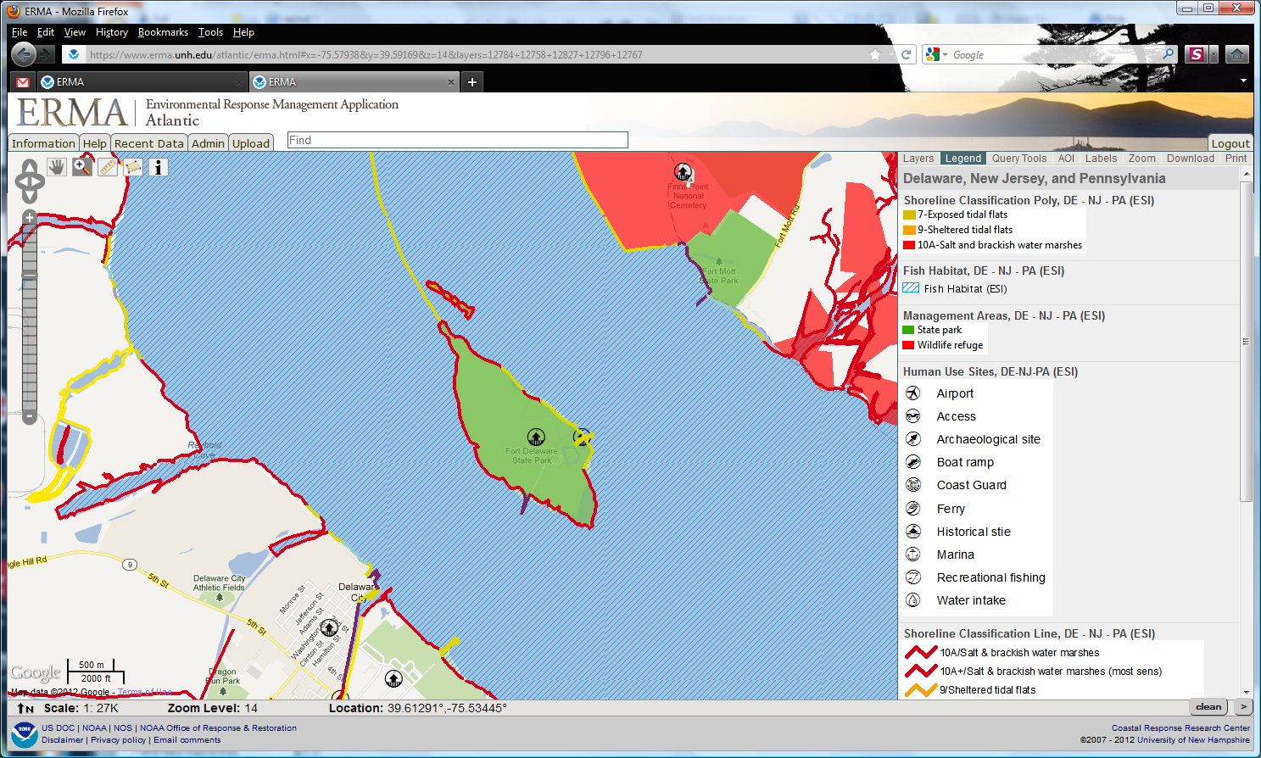
ESI GIS Data Layers: Legend

Slide 17
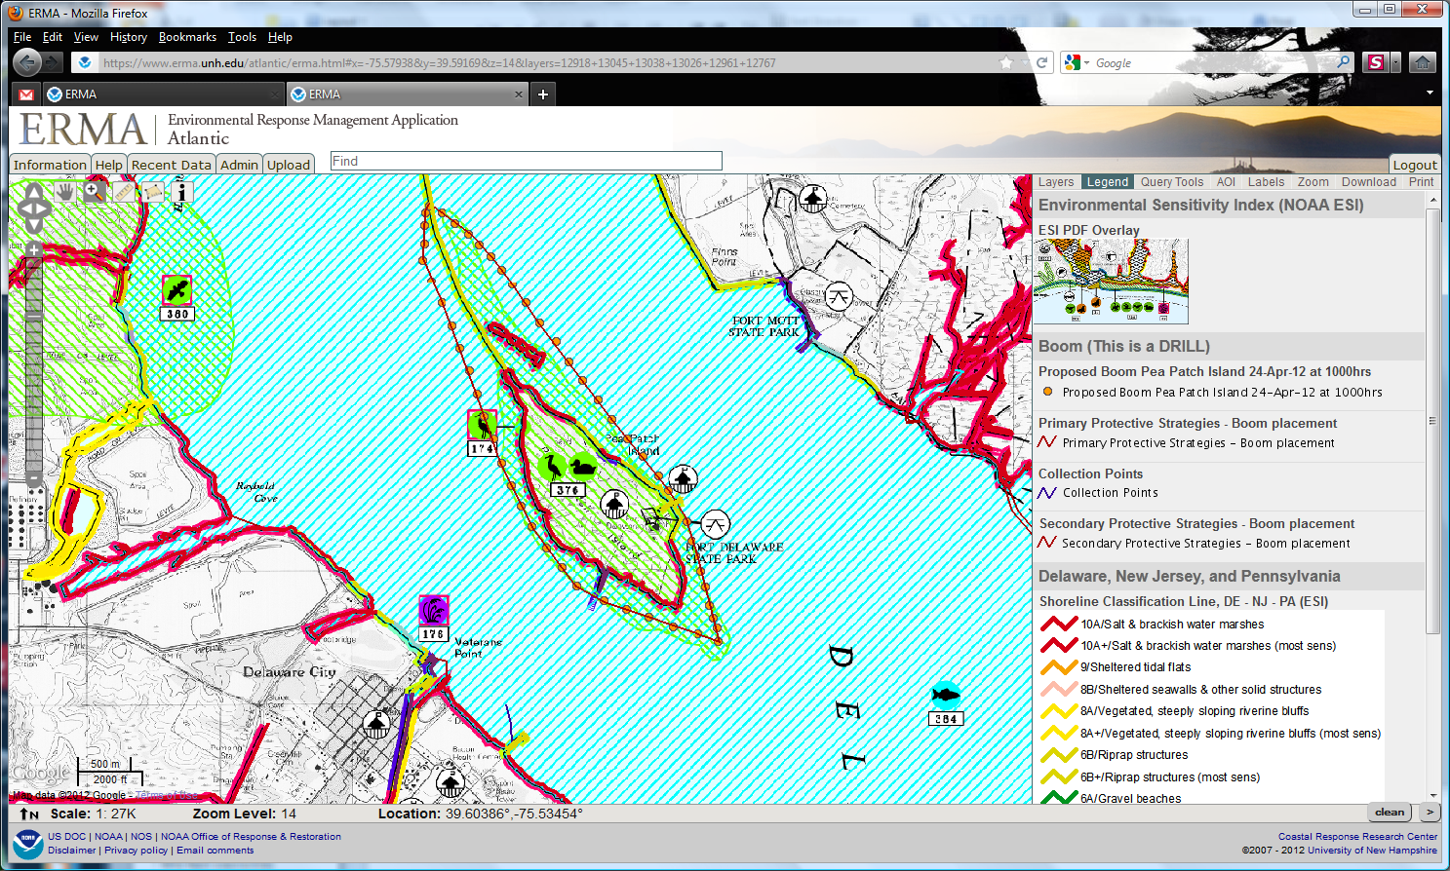
ESI PDF as Basemap

Slide 18
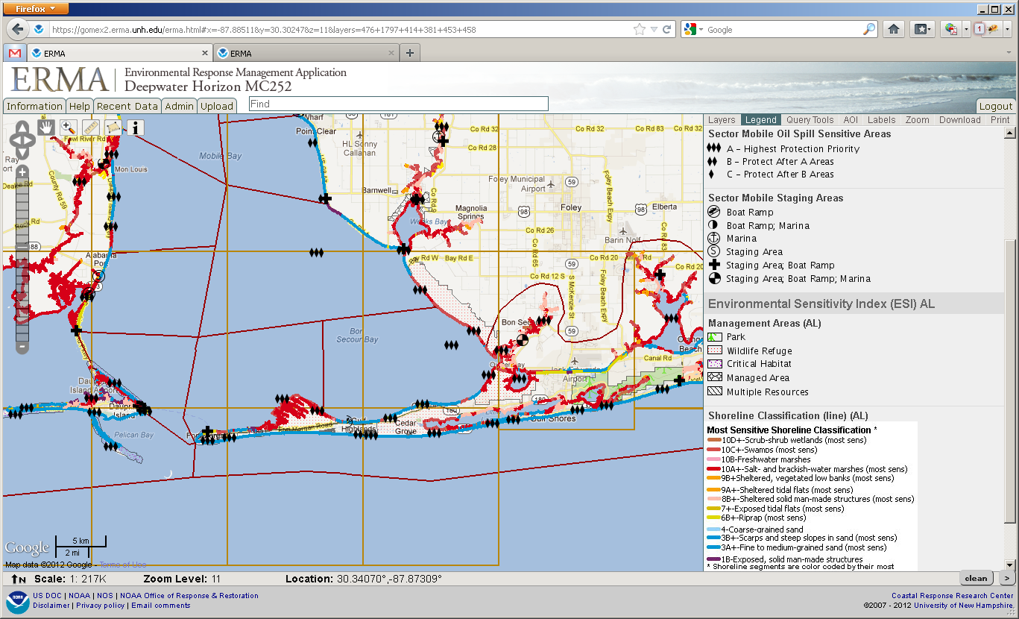
GRP and ESI Data

Slide 19
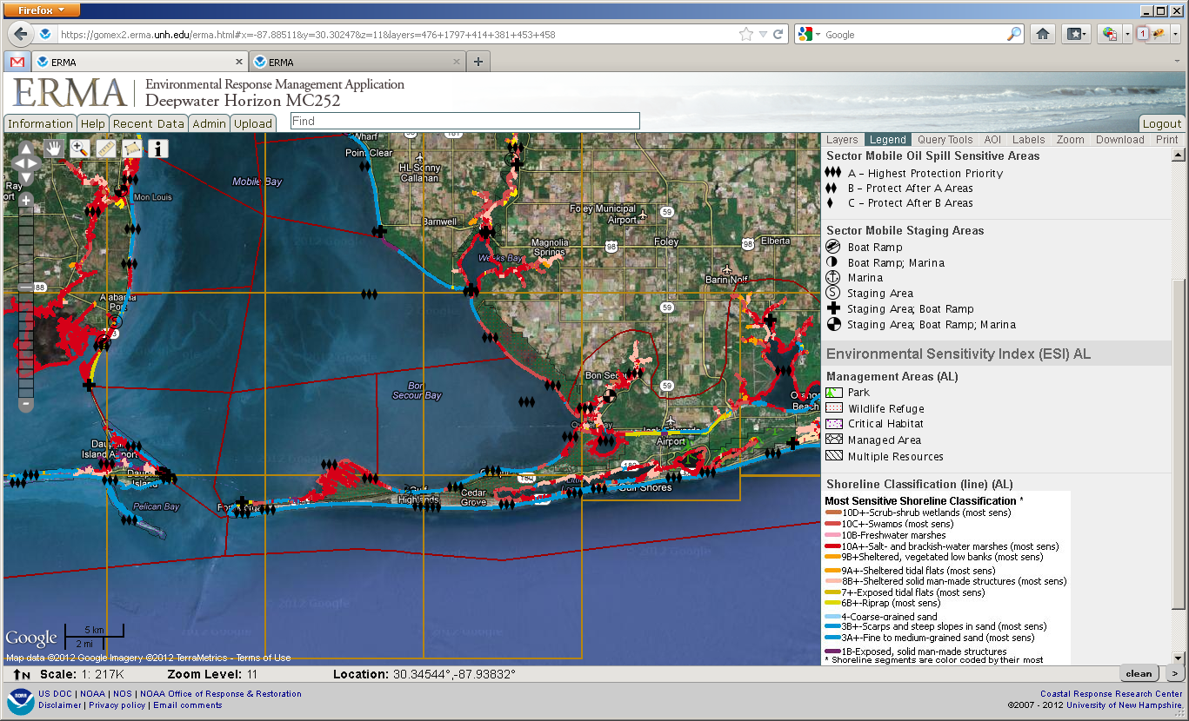
GRP and ESI Data

Slide 20
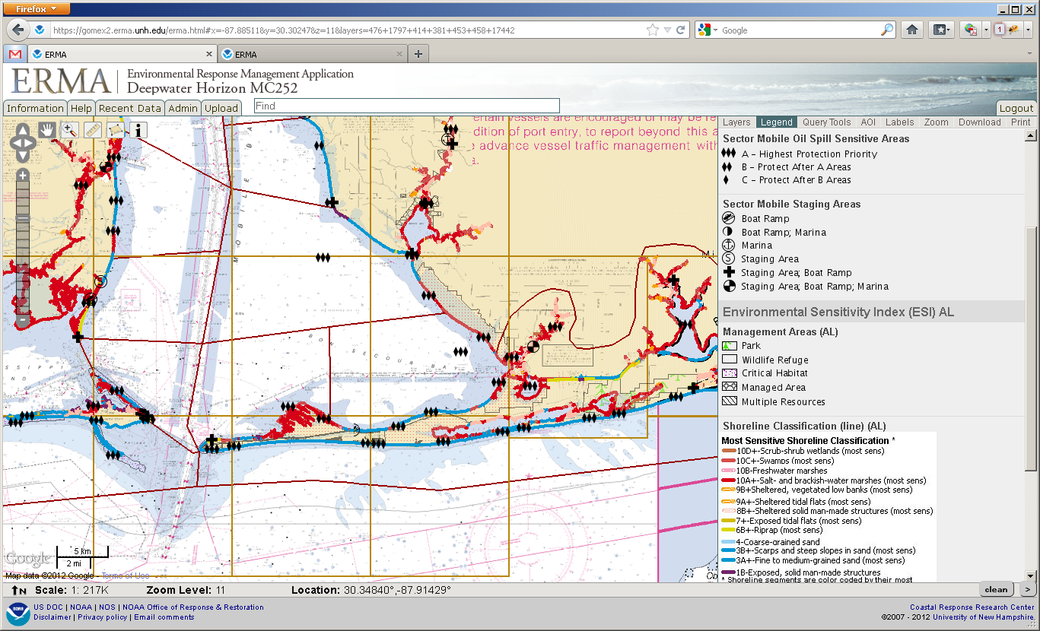
GRP and ESI Data

Slide 21
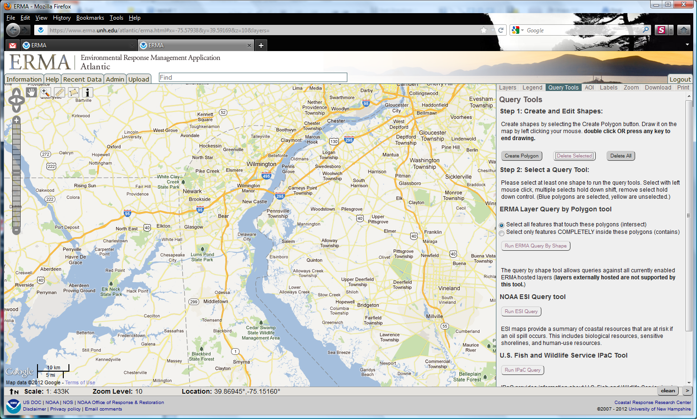
ERMA Query Tools
Select Query Tool Tab
ERMA query tools for NOAA ESI, USFWS IPaC, and free-form queries

Slide 22
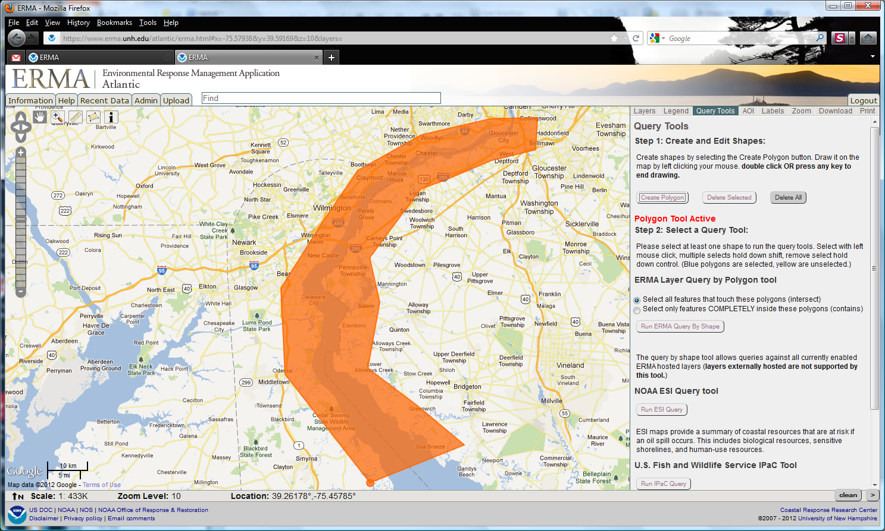
ERMA Query: Polygon Tool
Create Polygon for Area of Interest
Double-click to complete

Slide 23
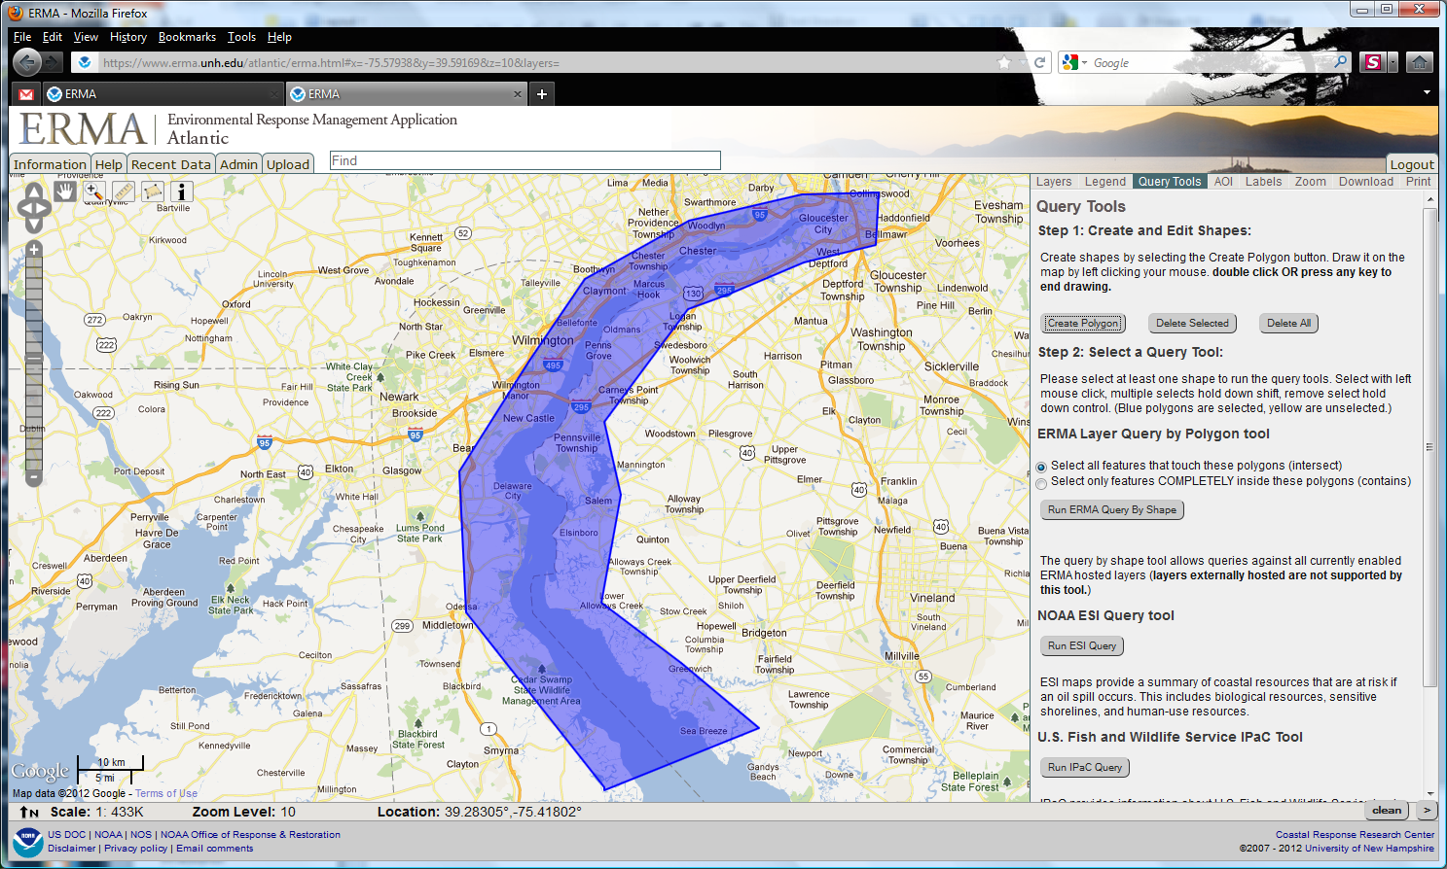
ERMA Query: Polygon Tool
Polygon for Area of Interest will identify all available ESI data in area

Slide 24
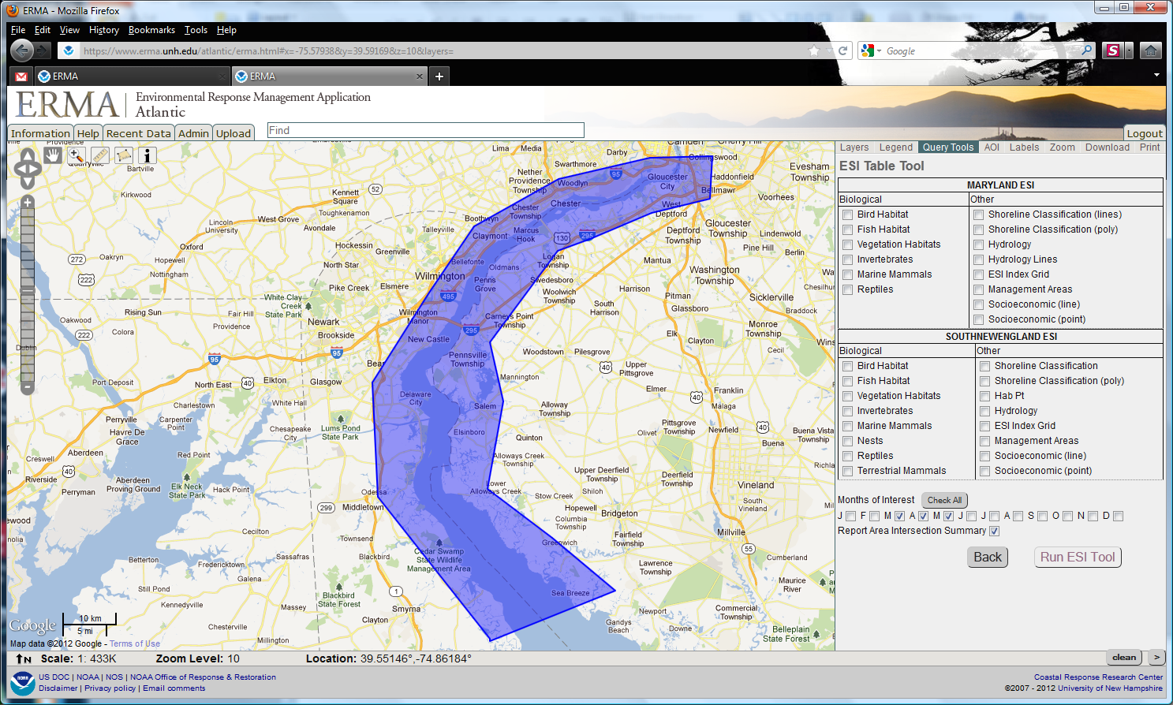
ESI Data Selection Query
Only intersected data will be available for selection

Slide 25
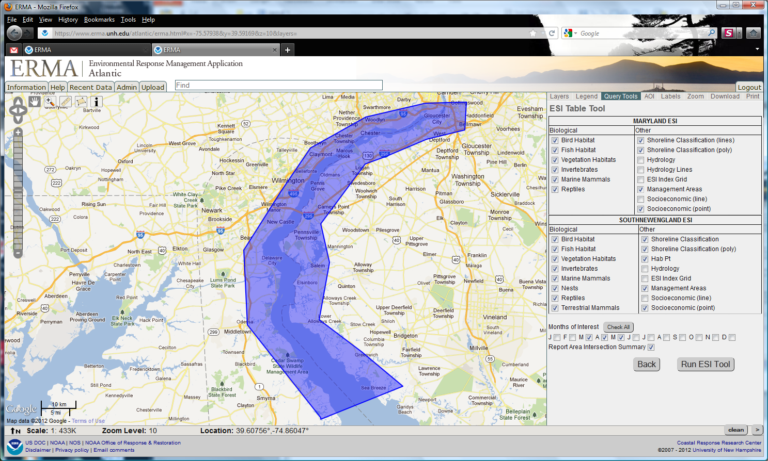
ESI Data Selection Query
Select habitats and species of interest
Specify date range for query
Percent intersection

Slide 26
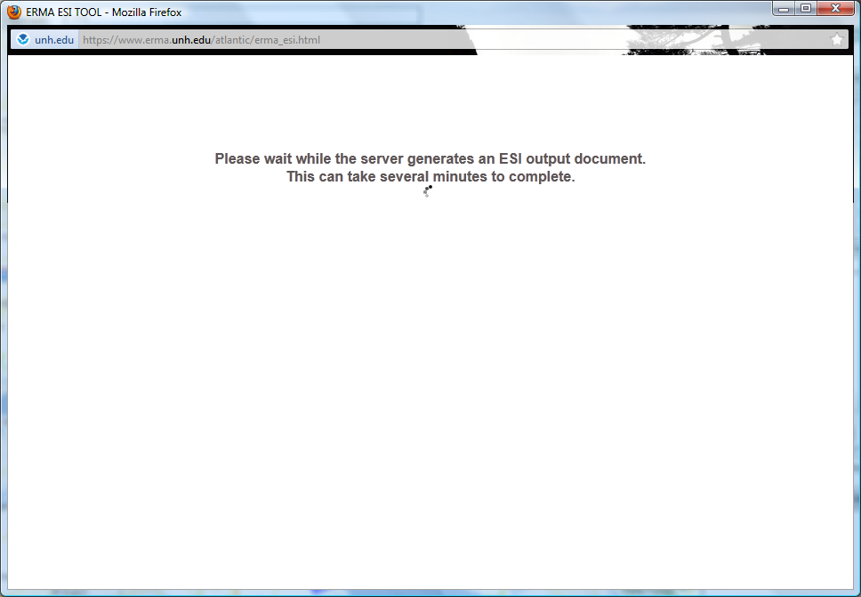
Run ESI Tool
Run your query
Patience may be required!

Slide 27
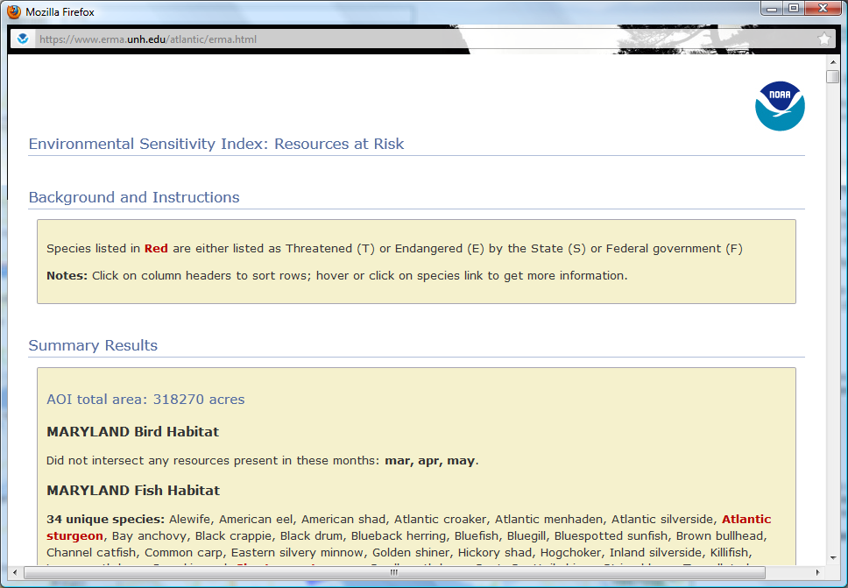
ERMA ESI Resources at Risk Report
Selected habitat & species summary
Shoreline classification
Detailed information on species life histories
PDF, excel file output

Slide 28
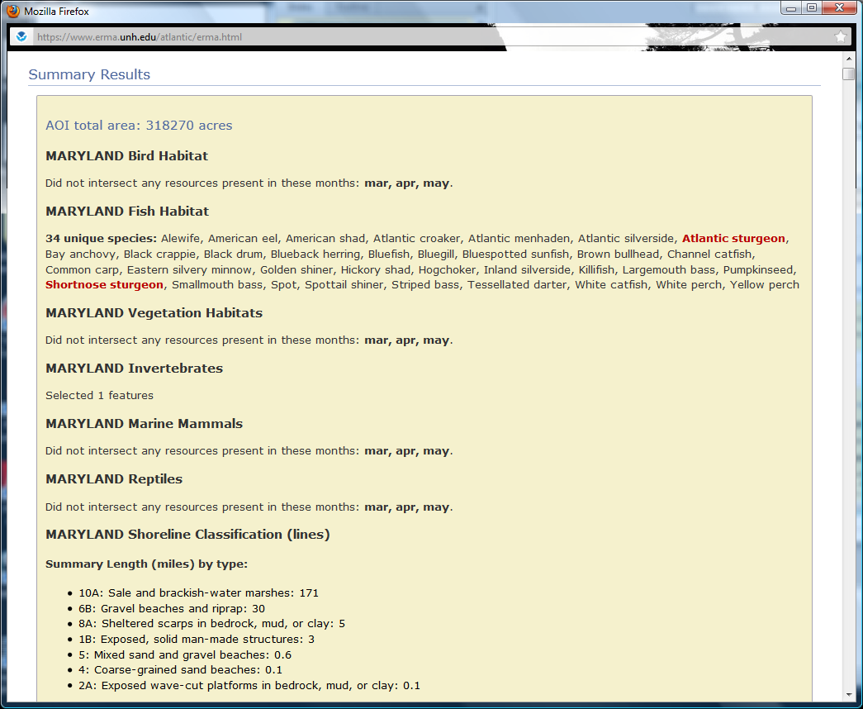
ERMA ESI Resources at Risk Report: Summary
Intersected habitat & species summary
Threatened or Endangered species status flagged in Red
Shoreline classification in total miles/type
PDF output

Slide 29
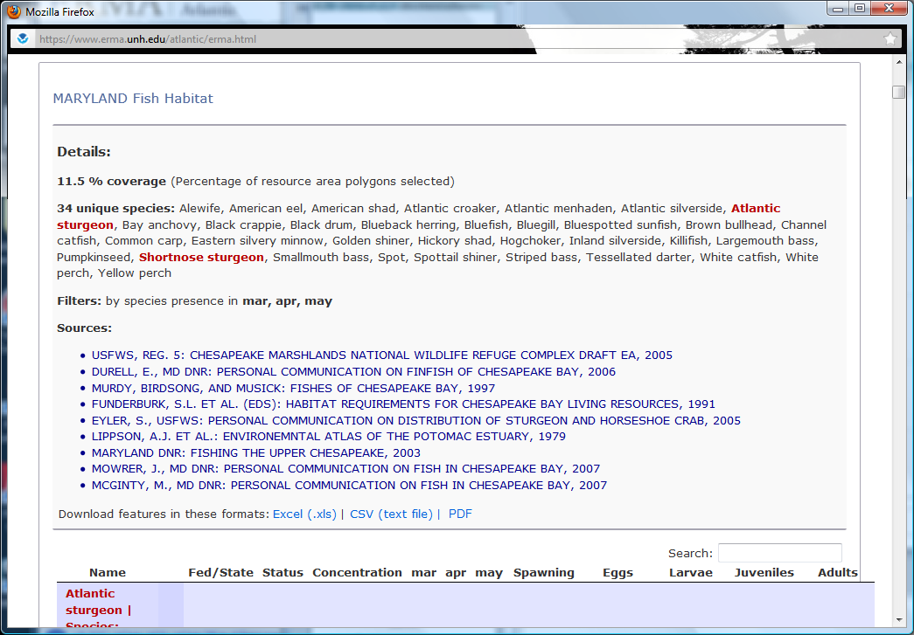
ERMA ESI Resources at Risk Report: Detail
Percent area of selected habitat & species
Detailed information on source data
PDF, excel file output

Slide 30
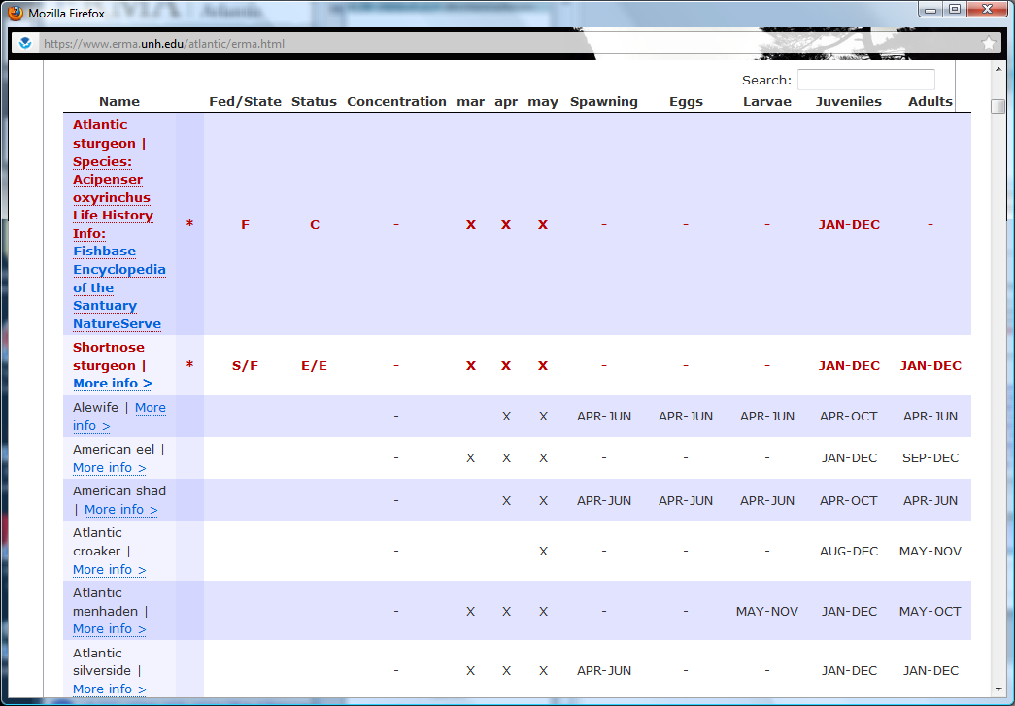
ERMA ESI Resources at Risk Report: Connections
Scientific names
Detailed information on species life histories
External resource links

Slide 31
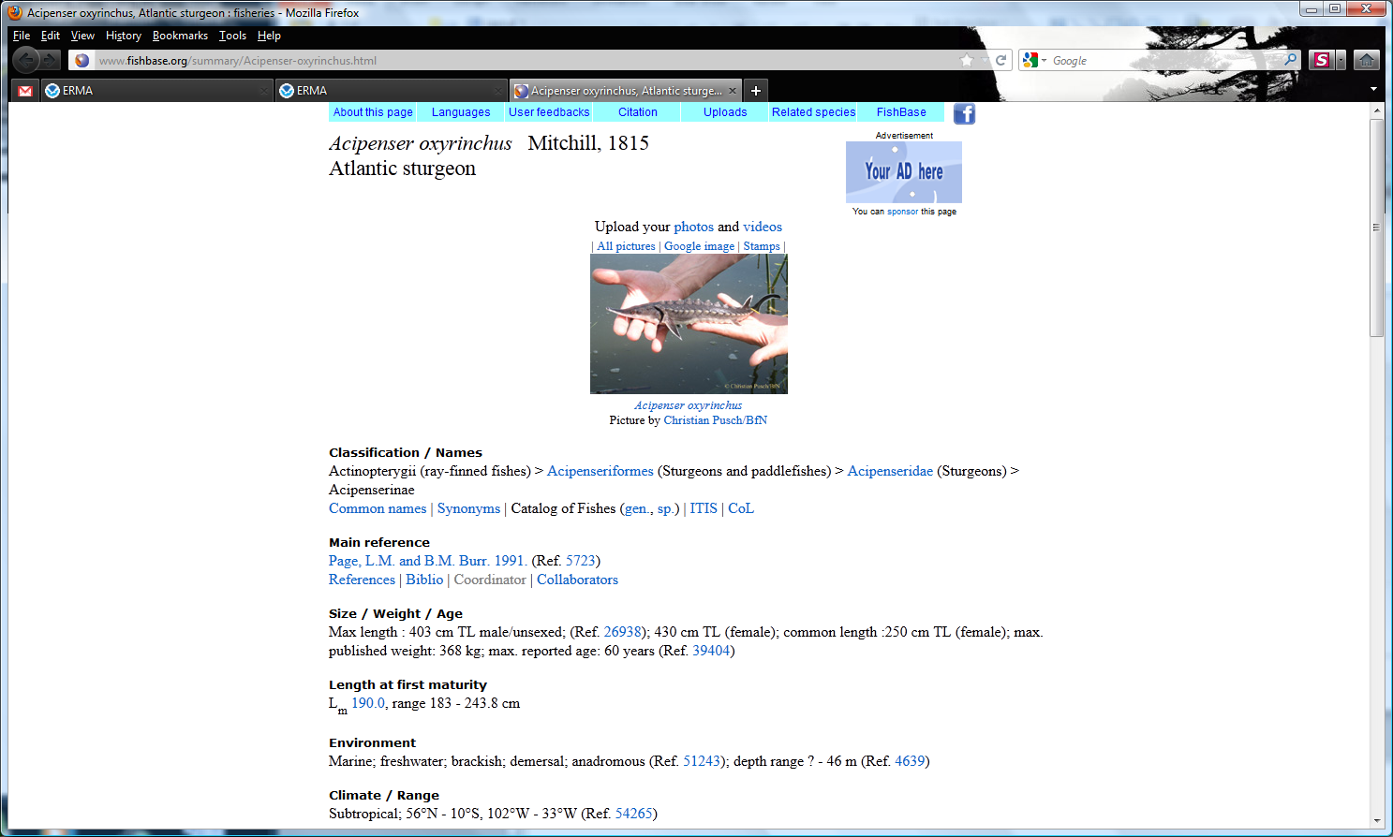
Life History Information: FishBase
Notes:
( 32300 Species, 295800 Common names, 51400 Pictures,
47100 References, 1910 Collaborators, 33 million Hits/month )

Slide 32
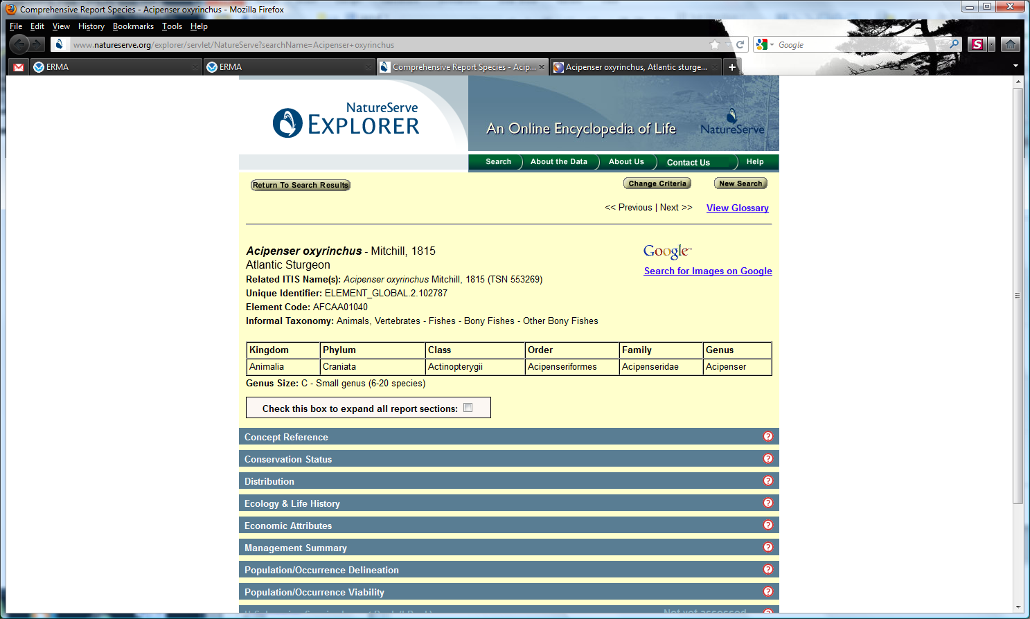
Life History Information: NatureServe
Notes:
The Nature Conservancy and a collection of public and private partners built a network of natural heritage programs in the United States to collect and manage data about the status and distribution of species and ecosystems

Slide 33
ERMA ESI: Summary
ERMA ESI data and tools provide simple access and use of ESI data for Response and NRDA support
ESI API provides functionality to quickly generate Resources at Risk summaries for specific areas of interest
ERMA integrates ESI data and tools providing an improved COP for real-time decision making

Slide 34
Next Steps
Incorporate outcome of Workshop
Expand use of data services for ESI in ERMA
Continue coordination with ESI Manager and SPO on development issues
One-click geographic species/habitat listing
Refine Report output: summary & detail
Add map thumbnail to report output
Expand PDF link support in Report output
Notes:
Refine Report output summary and detail sections
- additional data tables, Breed and Source
- reduced length, provide improved summary

Slide 35
Questions?
Please visit the ERMA Public Gulf of Mexico site
http://gomex.erma.noaa.gov/erma.html
NOAA – Office of Response & Restoration – Spatial Data Branch
George Graettinger
  George.Graettinger@noaa.gov
Amy Merten
  Amy.merten@noaa.gov
Michele Jacobi
  Michele.jacobi@noaa.gov
Allison Bailey
  Allison.bailey@noaa.gov

Slide 36
Acknowledgments
NOAA:
  Michele Jacobi
  George Graettinger
  Amy Merten
  Mark Miller
  Ben Shorr
  Kari Sheets
  Kim Jenkins
Genwest Systems:
  Jill Bodnar
  Heather Lilly
  JB Huyett
  Zach Winters-Staszak
  Hayley Pickus
I.M. Systems Group
  Matt Dorsey
  Laura Johnson
  Jay Coady
Development Team:
  University of New Hampshire:
    Phillip Collins
    Robert St. Lawrence
    Kurt Schwehr
  Allison Bailey, SoundGIS
  Aaron Racicot, Z-Pulley
  Chander Ganesan, OTG
Funding Sources: Coastal Response Research Center, US EPA Region II, U.S. Coast Guard, NOAA’s Office of Response and Restoration and Coastal Storms Program

