Slide 1
Biology Data Collection and Integration: Current Practices, Challenges, and Future Perspectives
Research Planning, Inc
May 1, 2012
ESI workshop, Mobile Alabama

Slide 2
Biology Data Discussion
Current bio data collection protocols
Example source datasets and ESI integration
Challenges faced, past solutions, future perspectives

Slide 3
Current biology data collection protocols

Slide 4
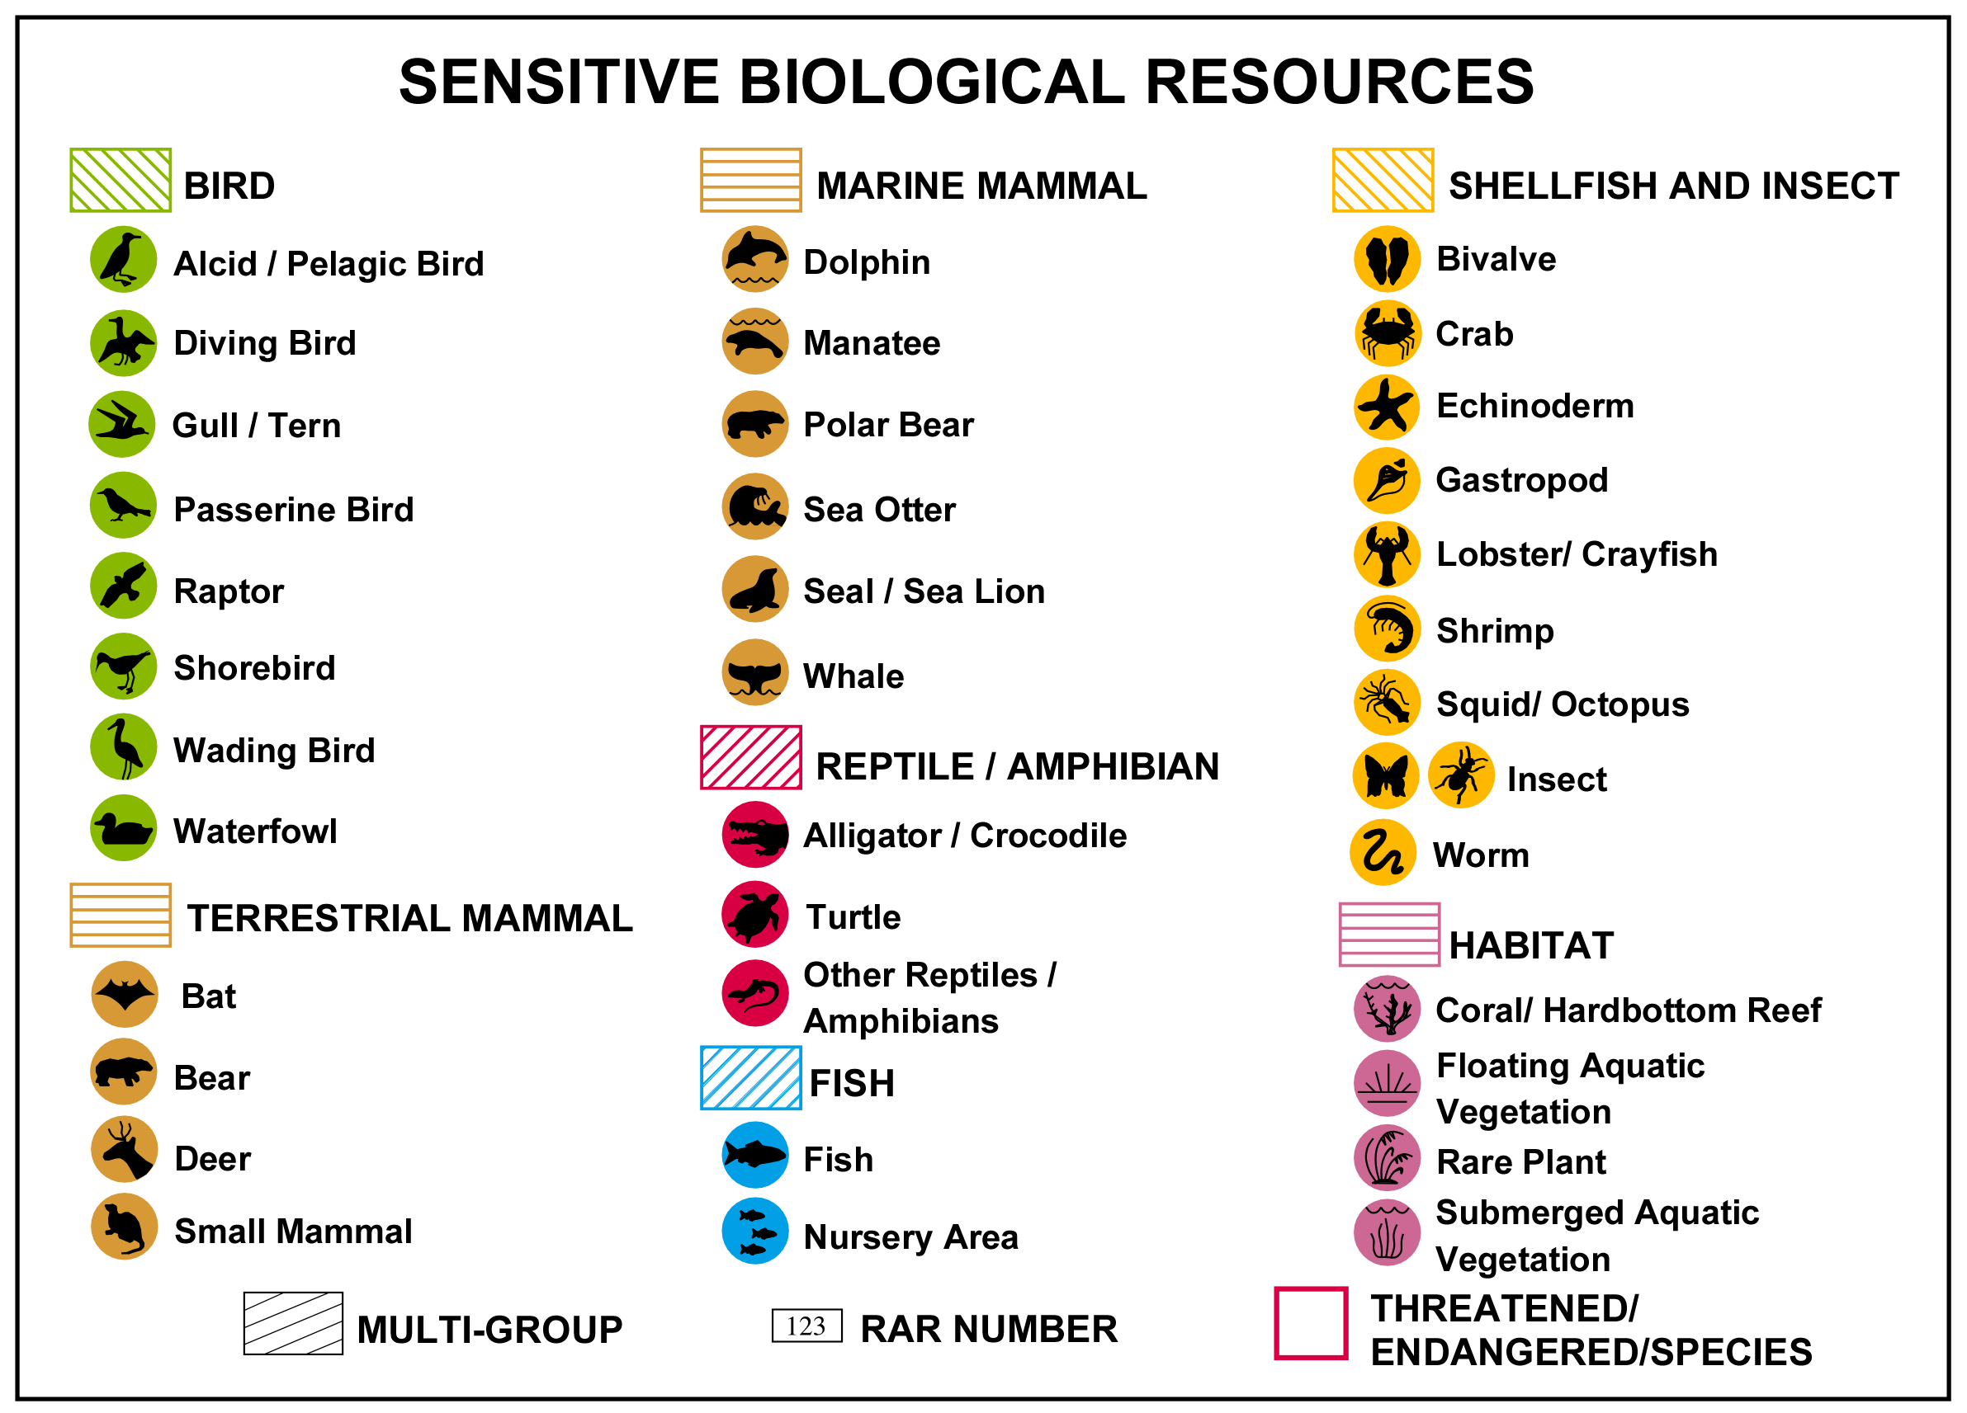

Slide 5
Biological Resources Emphasized
Rare, threatened, and endangered species
Commercial and recreationally caught species
Sensitive or ecologically valuable species
Concentration areas
Areas where sensitive life-history stages or activities occur
ESI product is a national standard!

Slide 6
Biological Data Table Attributes
Species name (common and scientific)
Conservation status (Threatened/Endangered)
Concentration, density, or abundance
Seasonality and life-history time-periods
Feature and species level source metadata (geographic and seasonality sources)

Slide 7
Data Providers
Look to strong State or Federal lead for list of contacts
NC Example:
  14 data collection workshops throughout the state
  5 primary State/Fed agencies; 13+ total agencies/organizations
Critical to find data providers and generators (not consumers or holders of other people’s data)
  Field biologists with significant local knowledge (dirty boots!)
  Also important to include management level staff for buy-in
  Scientists who created the digital data or worked closely with GIS dept.
  GIS Clearinghouse websites are rarely useful, or only for soc/mgmt data
Challenge: We get ignored…A LOT.

Slide 8
Meeting Structure:
Week of Regional Workshops
Informal and conversational around a table in small groups where everyone contributes
Can project previous version of ESI maps via overhead or ArcMap project for discussion
Capture anecdotal information by drawing on paper maps, pinning GoogleEarth locations, or editing in ArcMap
Meetings are geographically or resource focused
  Bird or waterfowl meeting or fish/invert meeting
  NWR HQ meeting that covers all resources of the refuge(s)
  NPS HQ and bring in county and state experts that also cover associated region

Slide 9
Meeting Discussion Topics
Inclusion and exclusion of species in the Atlas
  Final species list up to discretion of the data providers with guidance from RPI based on past experience
Seasonality for mapped features
  All polygon/point/arc features MUST have seasonal presence associated for each species occurring in them
Collection of relevant reports, additional contacts and expert knowledge (by drawing on maps)
Examination of digital data sources available or already collected to determine appropriateness and mapping approach

Slide 10
Types of Bio Data Requested
Spatial data files (shp, gdb, kml) with point/polygon locations of species based on survey data
Excel spreadsheets or Access databases with species occurrence data
Hardcopy reports and/or maps with detailed info on spp. distribution and/or hot spots
Expert, local knowledge that can be transferred to maps and notes during a workshop setting
We do not do field surveys, so the quality of the data is dependent on providers’ collection and presentation of data, local knowledge of resources plus their
willingness to participate.

Slide 11
Post Meeting Follow Up
Post meeting follow up is critical and extensive
  A lot of additional contact names are provided during meetings
  GIS and/or tabular data is often generated, cleaned up, tracked down, etc. after in-person discussions occur, or the data are held by non attendees
  Gaps are filled once data compilation commences
Challenges
  Tasks 5 and 7 can be time consuming because they require extensive coordination, follow up, and waiting for datasets

Slide 12
Integration of Data Sets
Biologists provide GIS with spreadsheet of all data sets that are to be included with specific instructions on use of attributes, inclusion/exclusion of features
Biologists provide GIS with hand drawn features on base maps (typically 1:24,000 quads) with detailed tabular information used to create RARNUMS
Data entered into geodatabase following ESI data structure
Draft maps and/or ESIViewer produced

Slide 13
Review Process
Quick overview of review process
  Contact all data providers
  Contact non-providers who could be key contributors
  Hardcopy product: upload pdfs to ftp site for pre-meeting review
  Digital only product (FL): prepare ESIViewer
  Spend one week on repeat workshops to collect review edits
  Follow up with those who did not attend
  Incorporate all appropriate edits to generate the final products

Slide 14
Common Feedback from
Data Providers
How often will this ESI be updated?
  Answer: It has been 15 years since the last update.
  Response: OK, well I should give you multiple years of data to show more of a historical pattern of use than ‘current’ conditions. Also, animals move, so we should be more general as to what habitats they COULD occur in.
We don’t have consistent hot spot information for the whole study area, so I’d prefer to give you general habitat use info in place of (or in addition to) the more important areas we know about.

Slide 15
Common Feedback from
Data Providers
Often group splits over the following issue:
  If this data is used for things other than spill response, I want to make sure that I’m very inclusive of all habitats and/or species that COULD occur to err on the side of protection.
  OR: We should group species and limit what we include to stick to oil spill response purpose and/or simplify/generalize what is mapped.
Hurricanes, etc. could, or have, greatly impacted the locations of nests, barrier islands, etc.
Funding! A lot of our surveys have been cut and/or we don’t have funding or time to do systematic statewide surveys anymore (move toward citizen science) OR to summarize the survey data we have.

Slide 16
Common Feedback from
Data Providers
One of the most common questions/comments:
  “I was just asked to do this ‘same exercise’ for NOAA/the State/some other group or project. Is this the same thing? Do you know about and are you coordinating with projects X, Y, and Z?“

Slide 17
Example source datasets and ESI integration

Slide 18
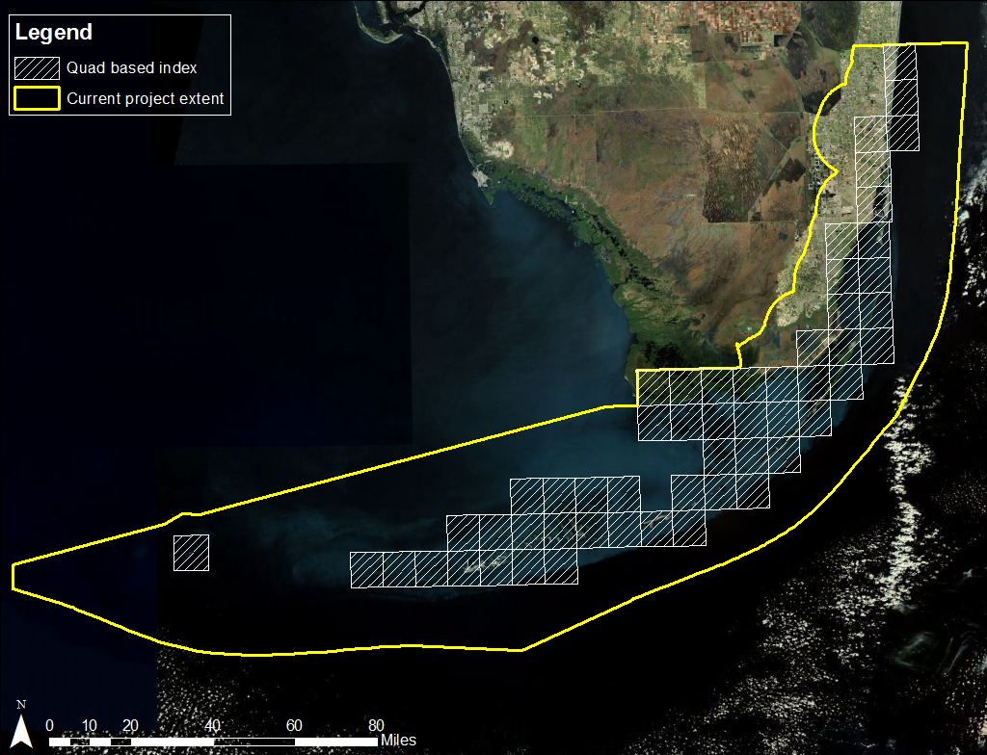
South Florida Project Extent

Slide 19
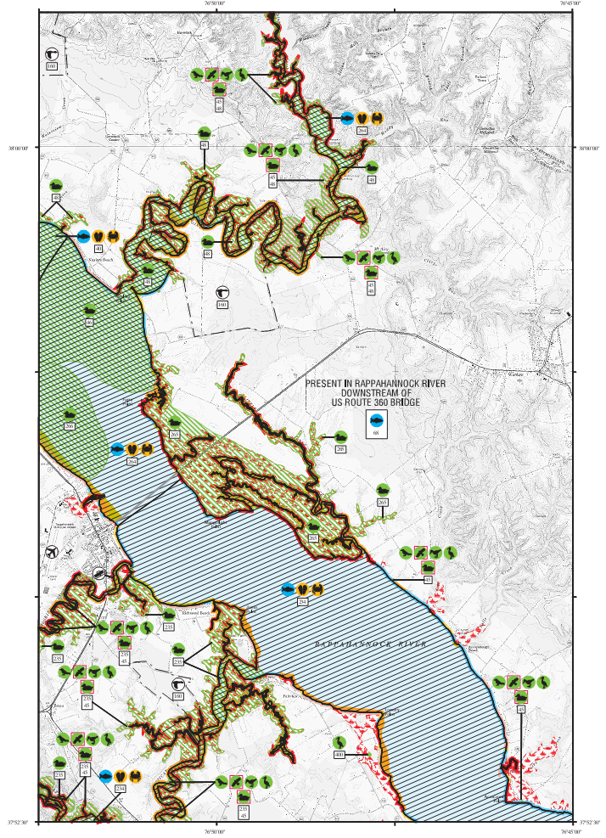
Expert Drawn Polygons: VA Waterfowl

Slide 20
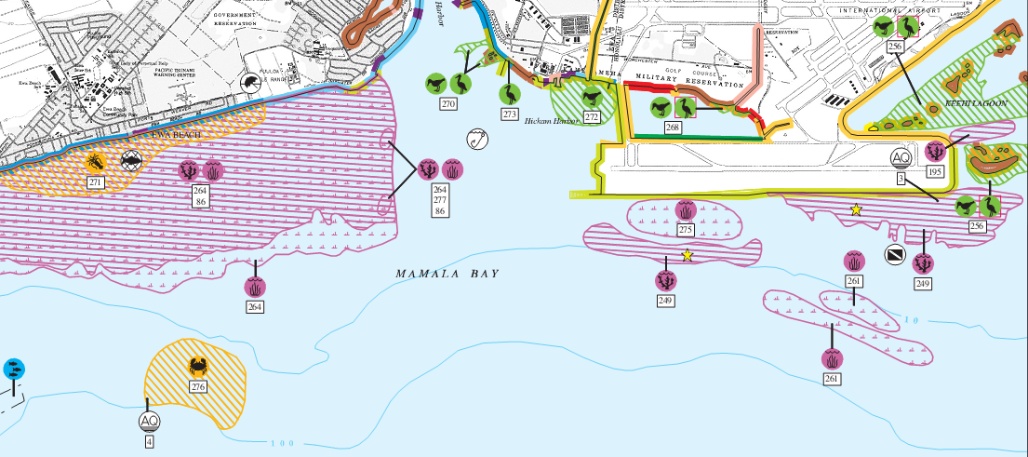
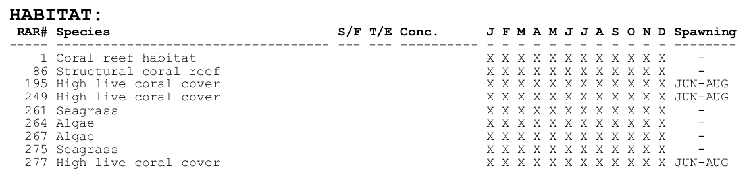
Expert Drawn Polygons: Reef

Slide 21
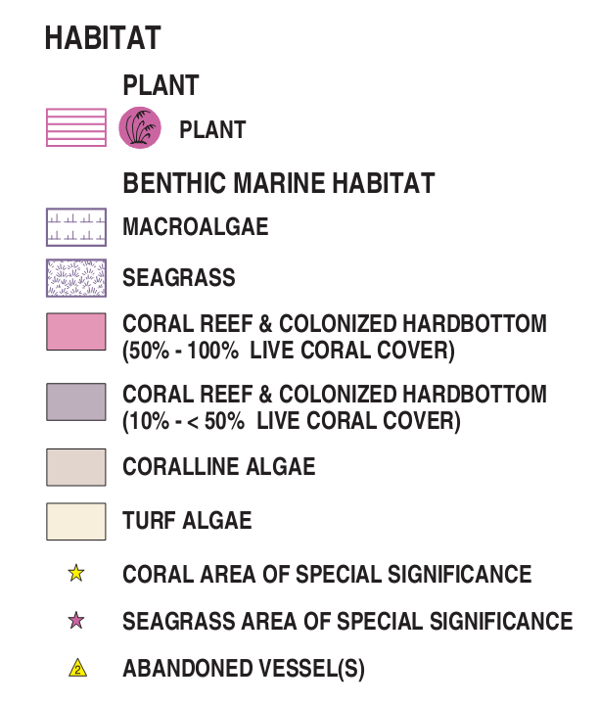
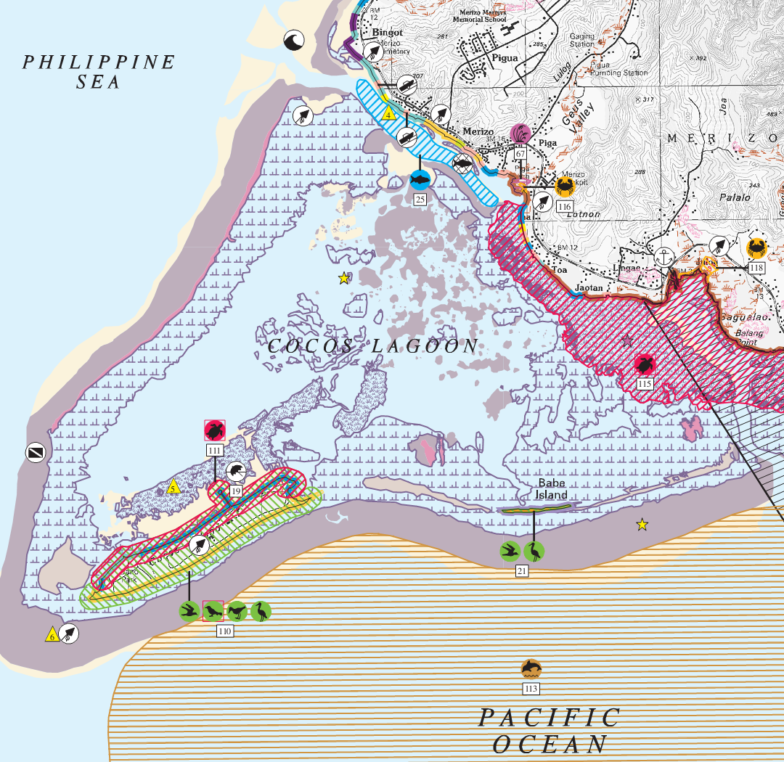
Benthic Dataset + Expert Knowledge

Slide 22
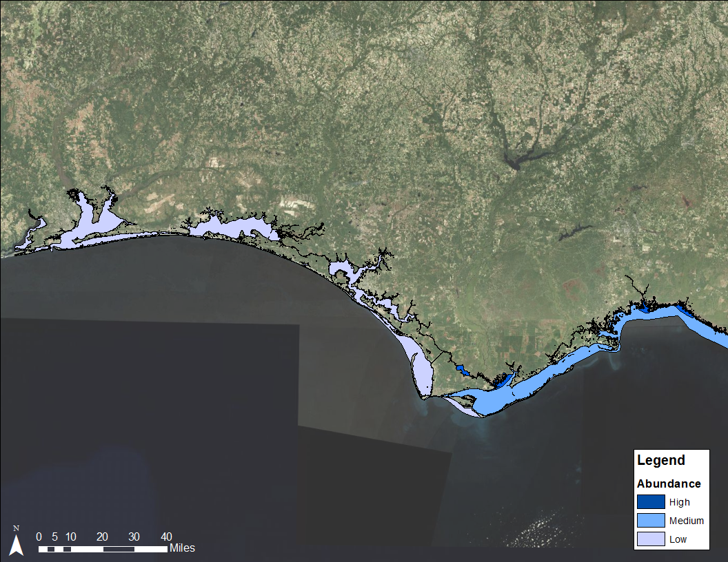
Ideal Source Dataset: Manatees

Slide 23
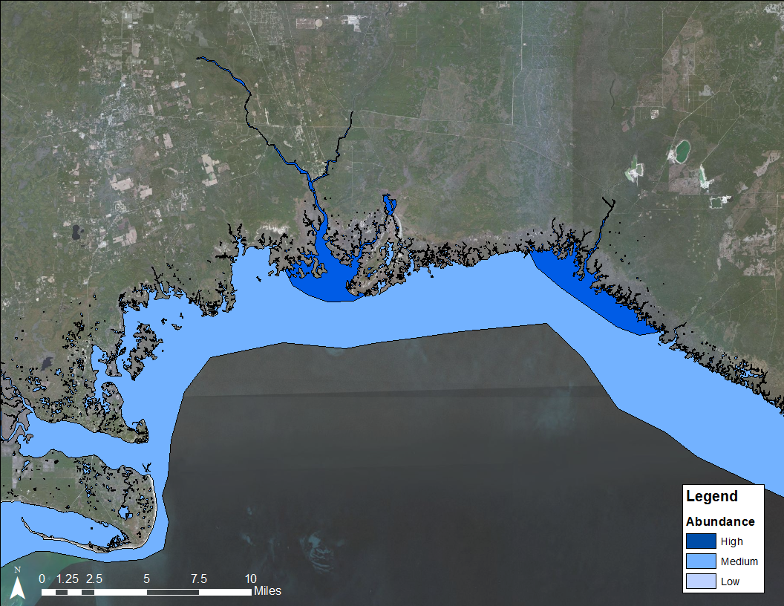
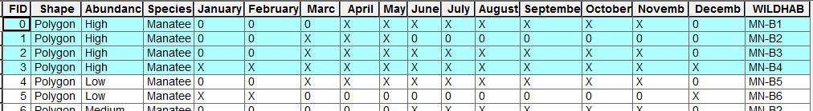
Ideal Source Dataset: Manatees

Slide 24
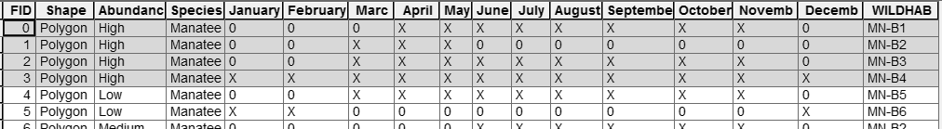
Ideal Source Dataset: Manatees

Slide 25
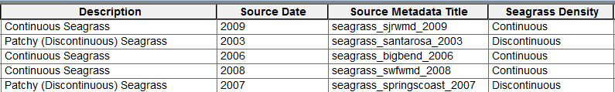
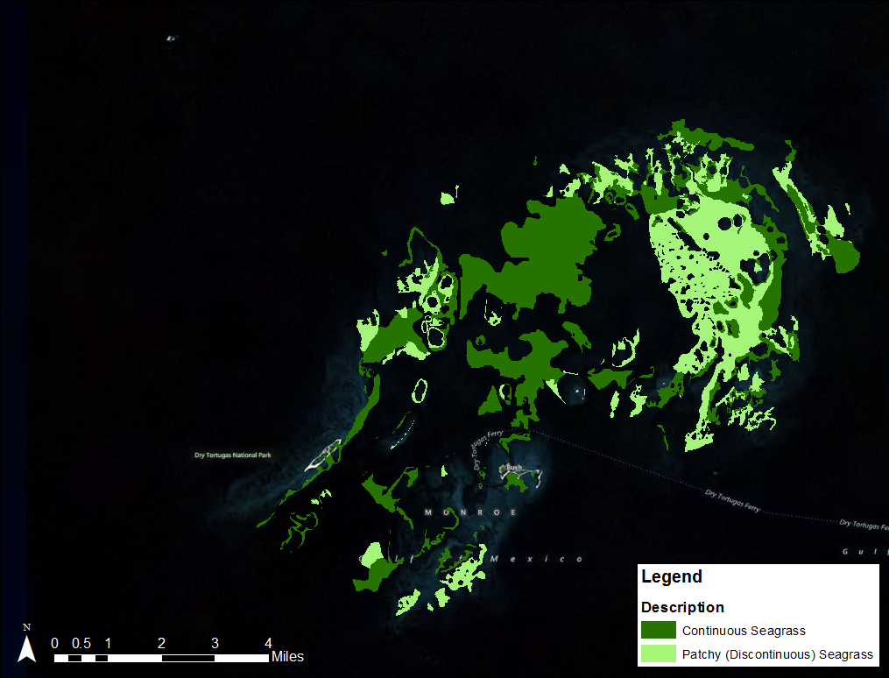
Easily Integrated Source Dataset

Slide 26
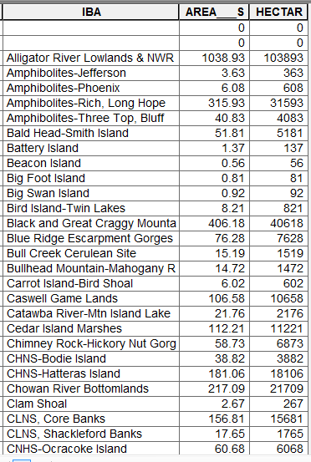
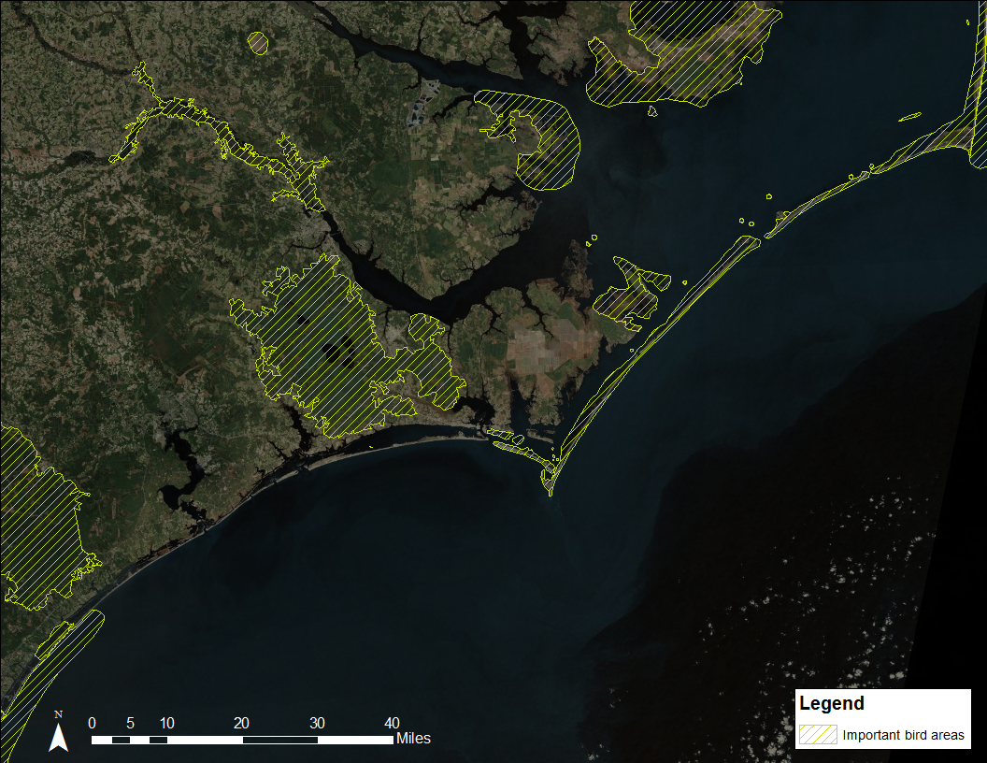
Source Dataset Needing Modification

Slide 27
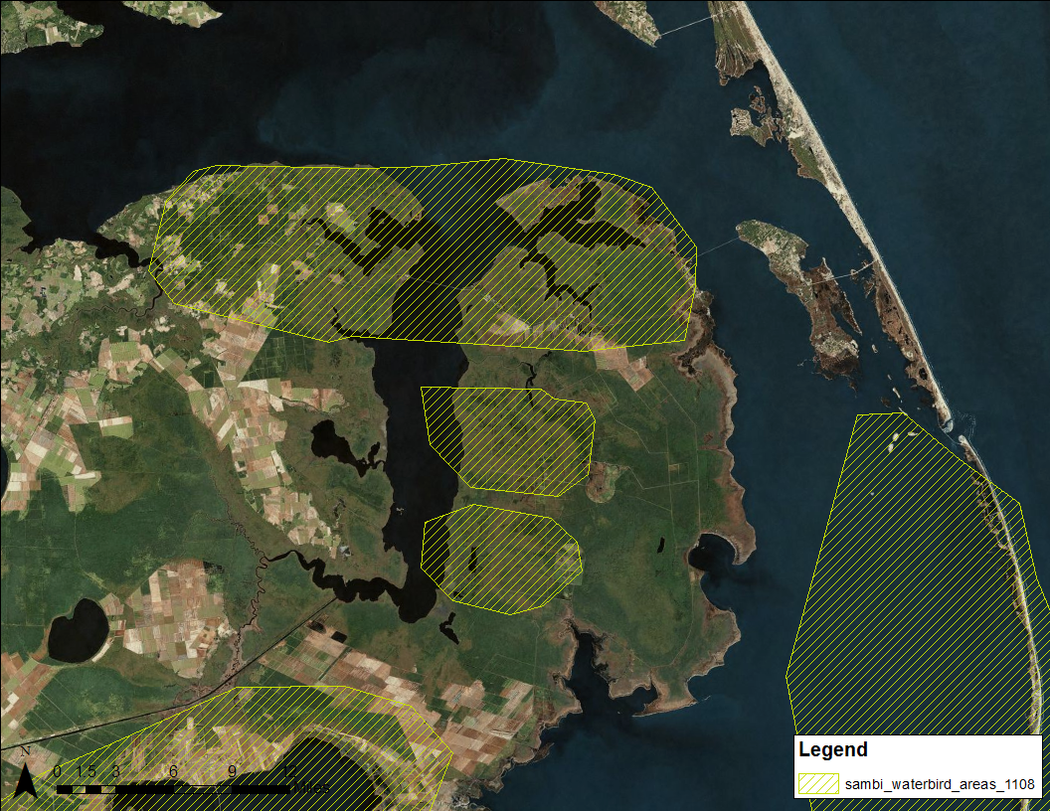

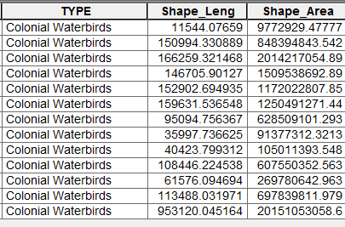
Excluded Source Dataset
More accurate information on colonial waterbirds is available

Slide 28
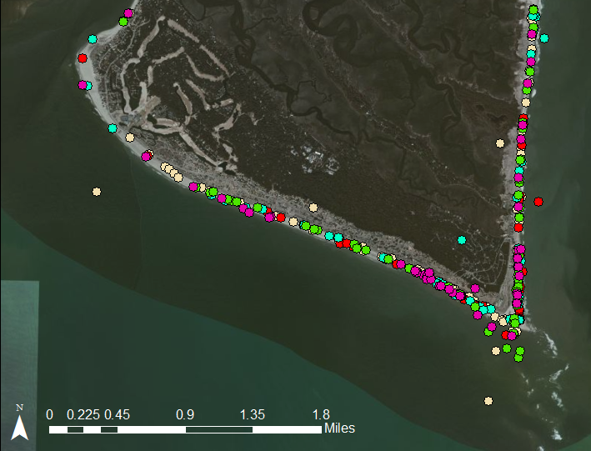
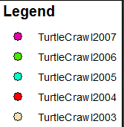
Typical Nesting Dataset

Slide 29
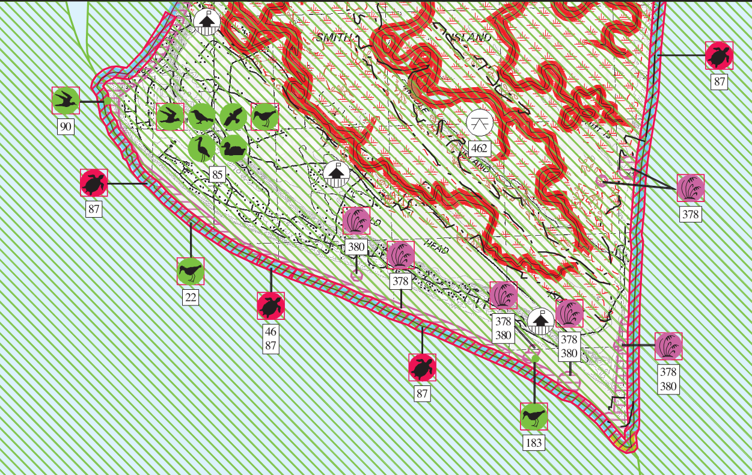
Nesting Dataset in ESI Product
Aggregated nests by shoreline segment
Buffered shoreline to create nesting polygon

Slide 30
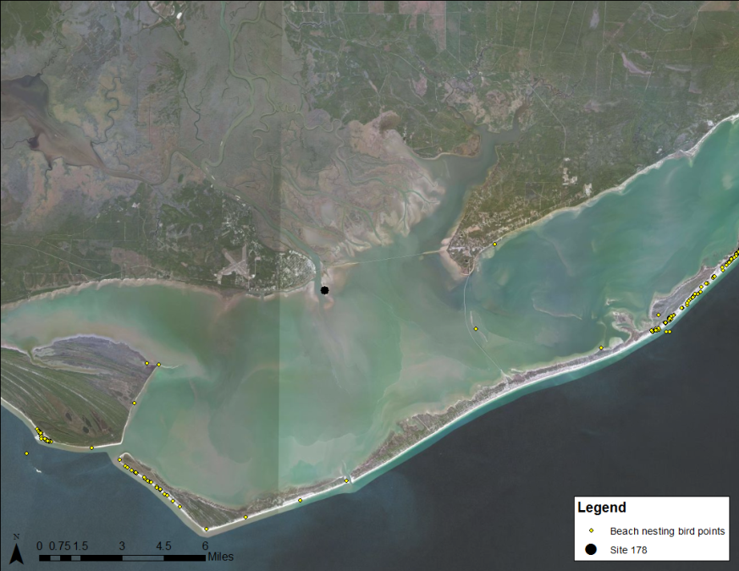
Variable Concentration Dataset
SITEN | SITENAME | SiteType | VisitDate | SPECIES | NESTS | CHICKS | CountType | NestStage
178 | Bird Island, Apalachicola | Ground Colony | 6/3/2005 0:00 | Black Skimmer | 68 | 0 | Precise | Eggs
178 | Bird Island, Apalachicola | Ground Colony | 6/1/2007 0:00 | Black Skimmer | 0 | 0 | Direct Counts
178 | Bird Island, Apalachicola | Ground Colony | 6/3/2005 0:00 | Caspian Tern | 189 | 0 | Precise | Eggs
178 | Bird Island, Apalachicola | Ground Colony | 6/21/2006 0:00 | Caspian Tern | 25 | 14 | Direct Counts | Unknown
178 | Bird Island, Apalachicola | Ground Colony | 6/1/2007 0:00 | Caspian Tern | 169 | 4 | Direct Counts
Multiple years of data for each species
Estimates vary
Type of counts vary

Slide 31
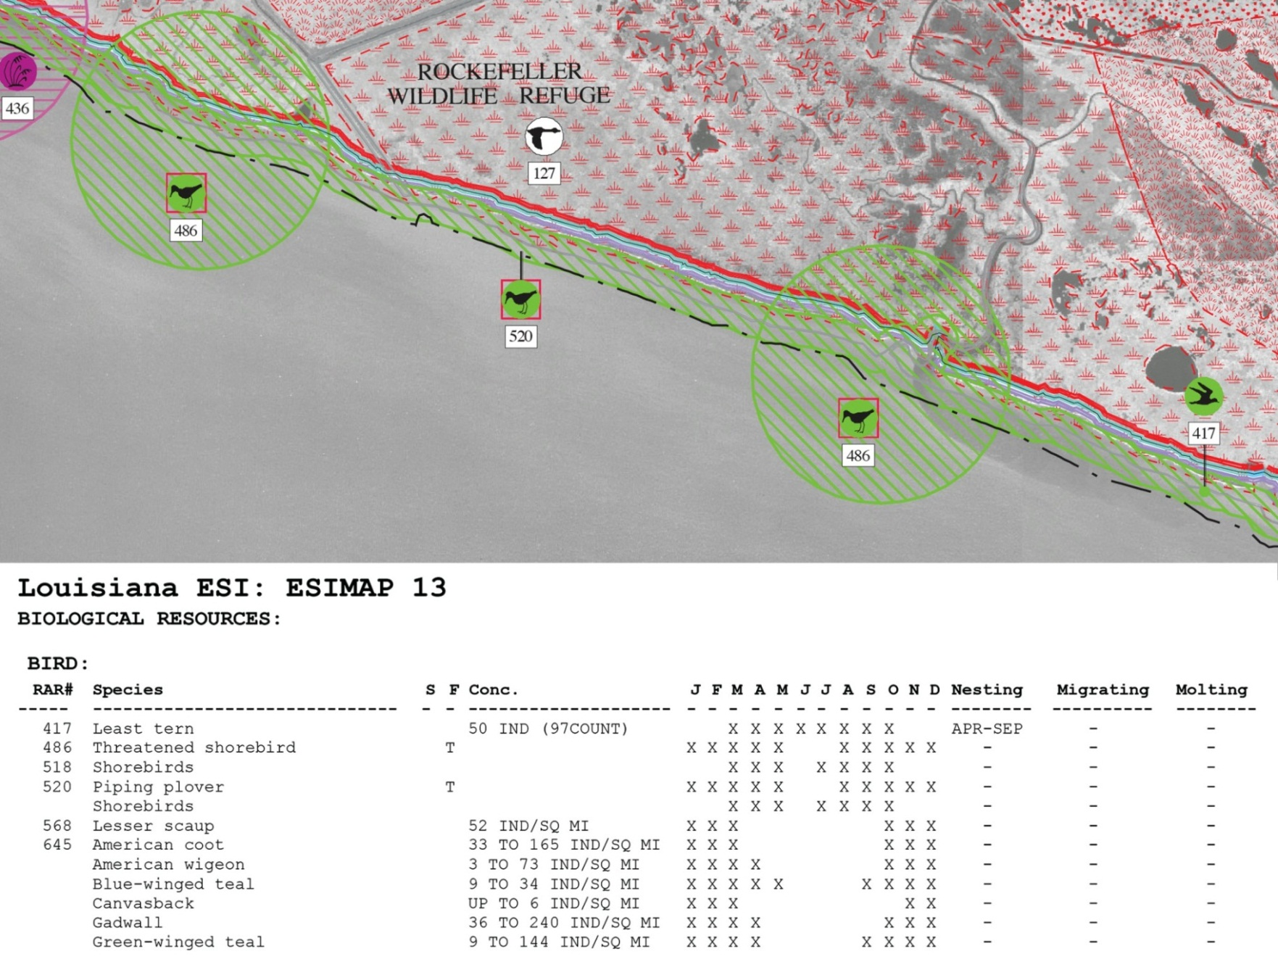
NHP datasets in ESI

Slide 32
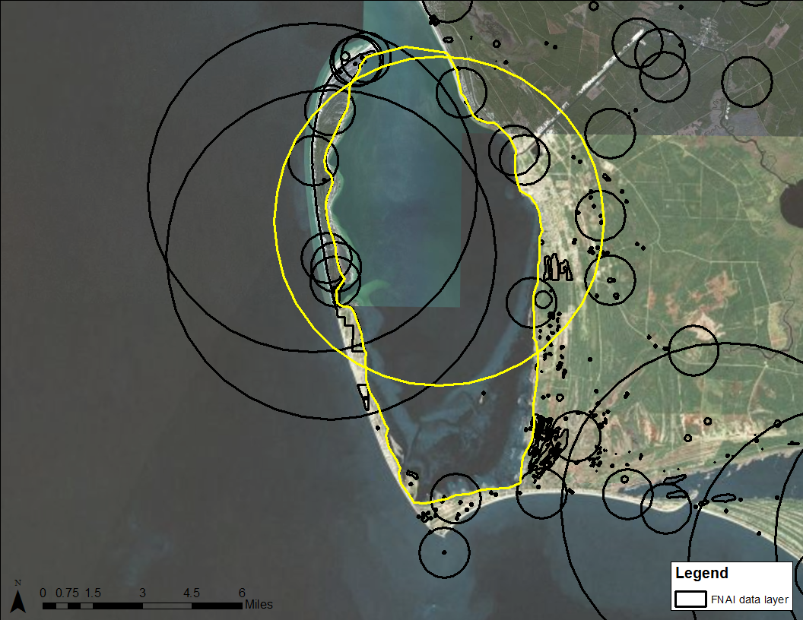
NHP datasets in ESI
Geoduck
Green Turtle

Slide 33
NHP Datasets in ESI

Slide 34
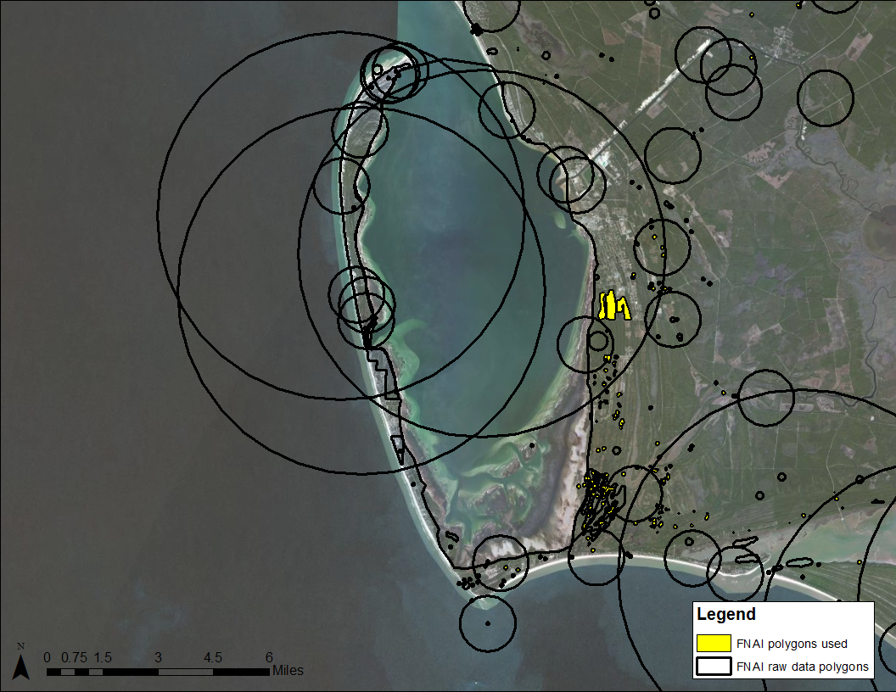
NHP Datasets in ESI

Slide 35
Metadata
Question: do the data sets that are provided for ESI come with metadata and/or projection information?
Answer: the VAST majority do not!
Why? Any insight from data providers in the room?

Slide 36
CHALLENGES FACED, past solutions, future perspectives

Slide 37
Challenges Faced
Data of varying scales
  Point level feature vs. all of Mobile Bay
Data of varying specificity
  ‘2 piping plovers wintering’ vs. ‘pelicans present in nearshore waters year round’
Appropriate # and type of species mapped/level of detail (by species or guild)
Too much data?
Too much or not enough detail to identify RAR for all possible spill scenarios?

Slide 38
Range vs. Hotspot Mapping
Range data
  ‘Large’ bodies of water (GOM or Mobile Bay) where highly mobile species migrate or reside
  OR: all salt marshes, all beaches, all flats over a broad area for suite of species (e.g., shorebirds, wading birds)
  Attribute information tends to be broad (most of the year) or simple (concentration fields are blank or use subjective terms)
  Makes up a large portion of ESI data set because alternative for many species due to behavior/movement patterns and/or lack of specific data would result in exclusion from atlas (often in PTO on hardcopy)

Slide 39
Range vs. hotspot mapping
Hot spot data
  Polygons of varying size and scale that represent a specific species, or small suite of species, in critical life history stage or high concentration
  Rookery or nesting data (birds, pinnipeds, turtles)
    Tricky…as this can go either way depending on concentration info and/or # of points or polygons
  Attribute information tends to be specific (seasonality, numeric concentrations, or ‘high’)
  Threatened and endangered species data

Slide 40
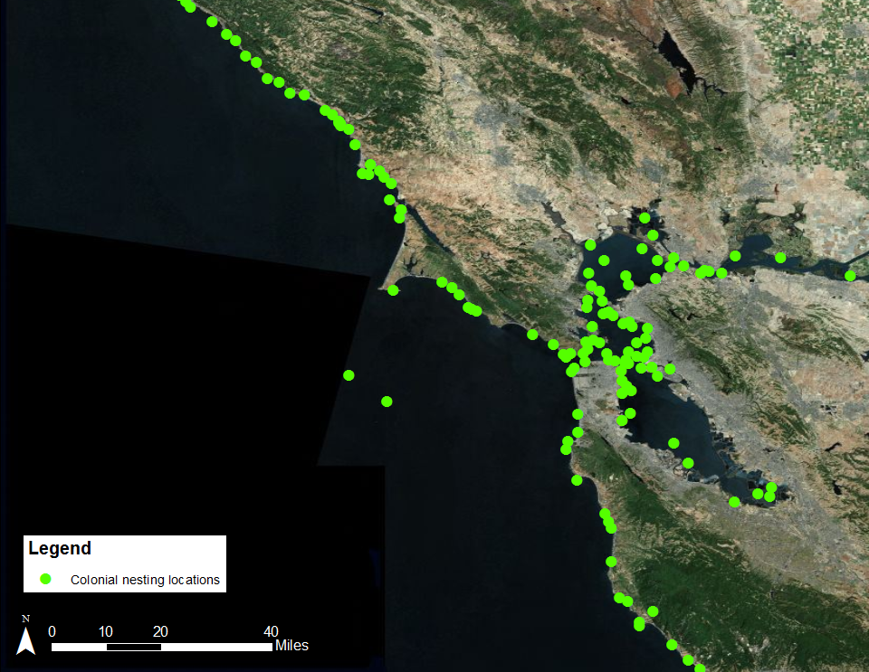
Regional scale (1:1,000,000)

Slide 41
Central California Example
Zone Based / Hot Spot Layered Approach
Large offshore study area: all of Monterey Bay NMS
  Extremely species rich and data rich
  13 T/E species mapped in-water (not colonies or haul-outs)
  Desire to show critical KNOWN hot spots
    High concentrations (‘High’ or 1,000s-10,000s individuals)
    T/E and/or protected species (marine mammals)
    Unique population or key migration/seasonal use area or corridor

Slide 42
Central California Example
Zone Based Approach: Why?
  Desire to easily identify potentially at-risk seabirds and marine mammals that have naturally broad geographic distributions
    Species names and T/E status
    Basic abundances (4 options chosen)
    Distribution based on oceanographic processes/habitats (depth, distance from shore, habitat features)
    Basic seasonality across all zones, no specific breed categories displayed for zones (typical ESI breed categories displayed for ‘hot spot’ polys)

Slide 43
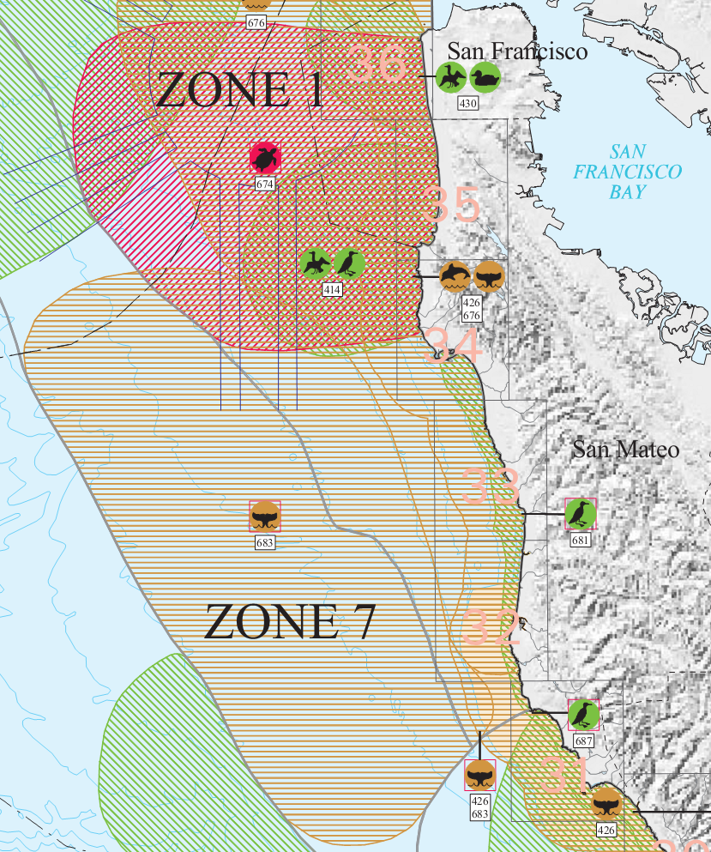
Layering Zones and Hotspots

Slide 44
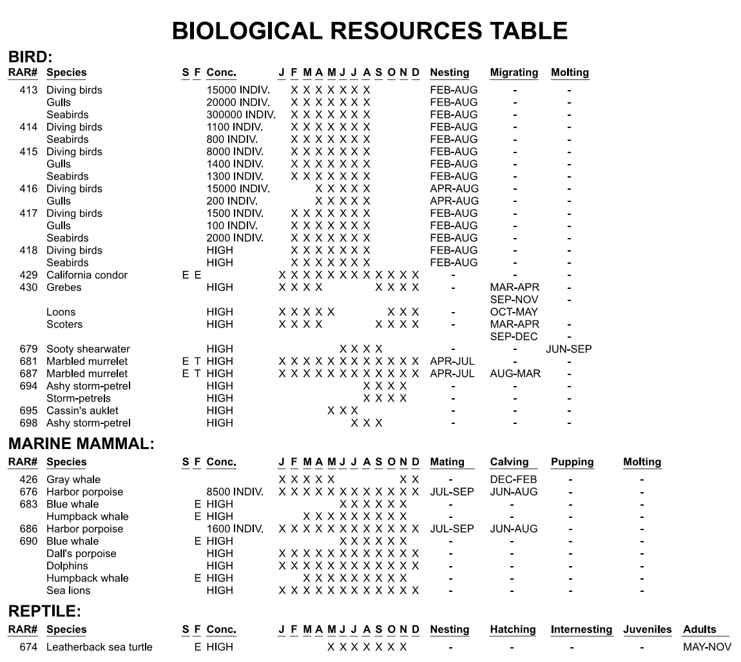

Slide 45
Hotspots

Slide 46
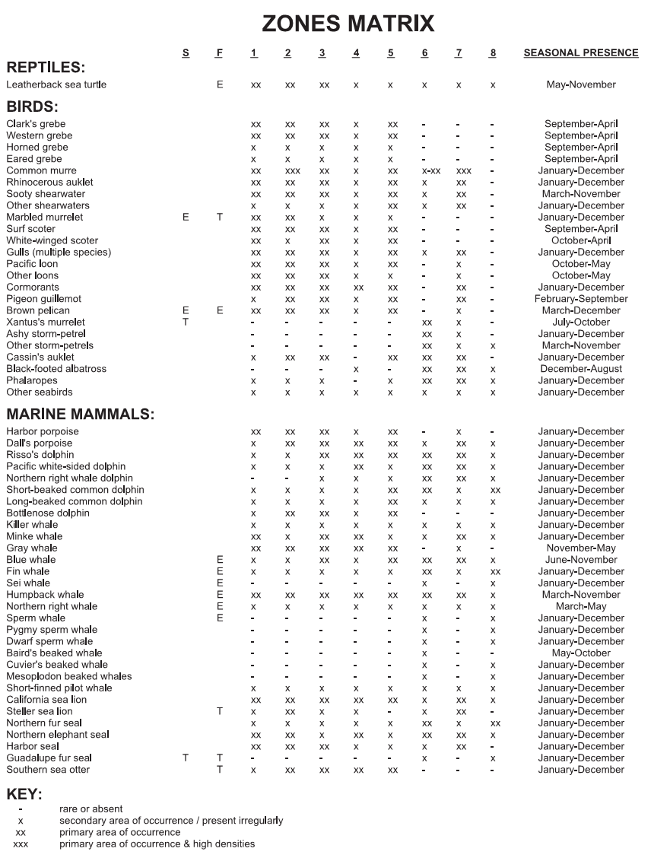

Slide 47
Zones

Slide 48
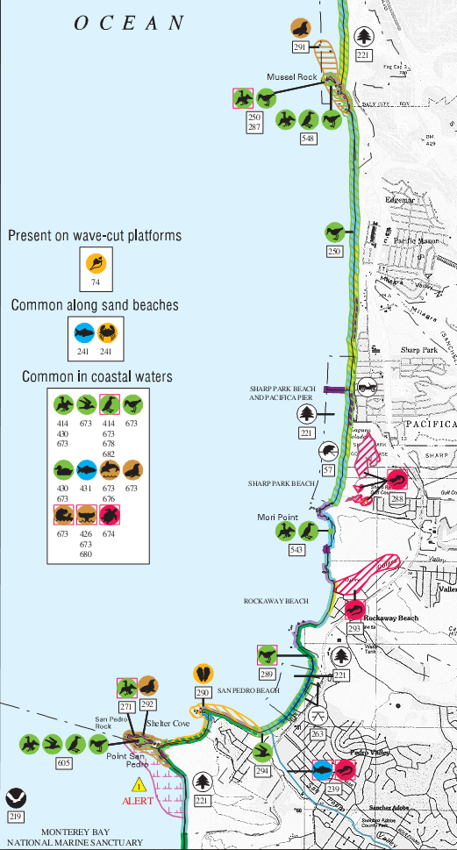

Quad Scale Map
Both zone and hotspot information are in ‘common throughout’ box because of the scale

Slide 49
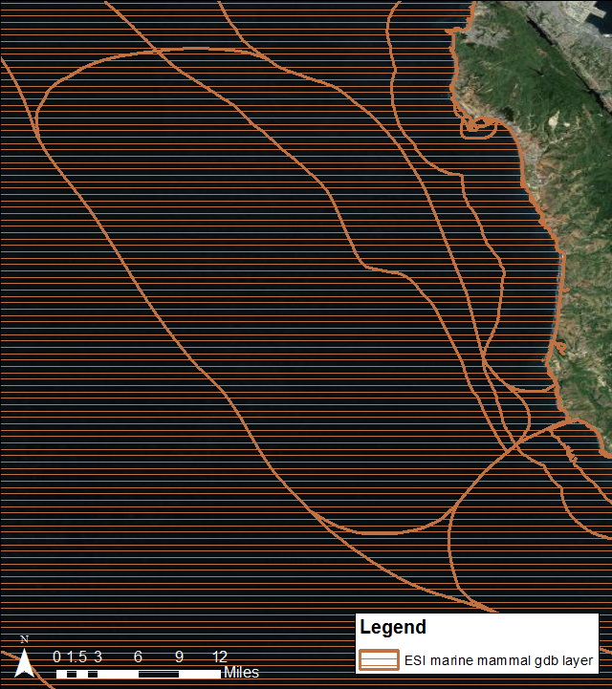
Layering Zones and Hotspots:
Digital Data

Slide 50
Prioritization:
Inclusion/Exclusion of Species
Species lists have evolved to be much larger in recent updates than in previous atlases
  FL example: 350-360 spp. in updated atlases vs. 190 spp. in 1990s atlases
Why?
  Digital Data Sets!!
  Digital NHP data (particularly plants) vs. drawn on NHP data (early 2000s and prior)
  Digital fish data
    States involved in recent updates (FL, NC, TX) provide polygons tied to water bodies and associated survey data

Slide 51
Prioritization: Inclusion/Exclusion of Species
Issue: Are the species lists getting too large?
How strict should our criteria be as we approach data providers (currently default to them as the experts with some guidance)?
Challenge: These type of debates can quickly derail a bio collection meeting

Slide 52
Prioritization: Inclusion/Exclusion of Species
Debatable topics:
  Should we maintain the integrity of data sets given by the data providers, or should we cull the list more than we do?
  Should we more fully embrace a ‘guild’ or ‘family’ approach and clearly separate these from the species level data structure?
  Any grouping limits the feasibility of collecting accurate conc and seas data.
  Should we keep T/E species all at species level?
  Only include ‘spill impacted’ or ‘at risk’ species (this is not as easy as it sounds…)

Slide 53
Use of Subelements
How are you using subelements do the categories currently meet your needs?
Worth evaluating subelements so that they can be more consistent and/or accurate?
  Some are behavior-based, some are life history-based, some are family-based
    Diving birds (behavior/spill risk based) vs. waterfowl (category widely recognized by ornithologists)
  Fish subelements are not mutually exclusive
    i.e. a fish can be an estuarine nursery species and demersal

Slide 54
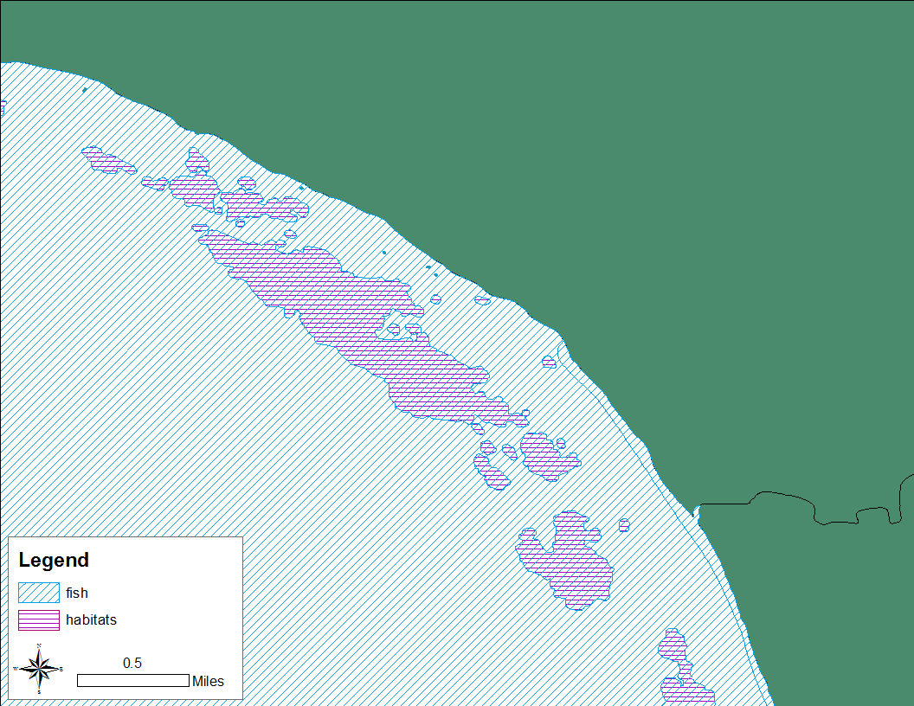
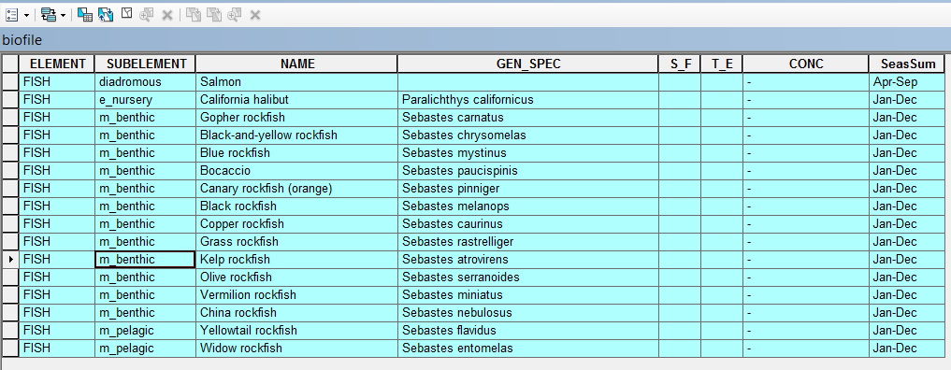
Fish Subelements and Habitats

Slide 55
Summary/Key Points
Offshore and inland mapping extent
Bio attributes
  Date of record
  Concentration field expansion
  ‘Hot spot’ or other prioritization attribute
  Subelement use
Range and hot spot mapping
  Criteria: do we need to be more strict in our guidance to data providers regarding inclusion/exclusion of data, species, etc.?

Slide 56
Discussion Topics
What offshore and inland extents would you like the biology mapped to?
How do you feel about the current attributes as they stand (format, level of detail, completeness)? Are there additional attributes you’d like to see?
  Suggestions?
  How do you feel these additions would add value as the end user?

Slide 57
Discussion Topics
What are your thoughts on current protocols for inclusion vs. exclusion of data and/or species in ESIs?
  Are the species being mapped appropriate?
  Is there “too much” information?
  Are there other species you would like to see mapped?

Slide 58
Discussion Topics
Hot spot vs. range data: Based on the brief example of both range and hot spot type data in hardcopy and digital products, what are your thoughts?
If we are able to do dynamic updates in the future, who should be allowed to make changes? To maintain the integrity of the data how should we decide which updates to incorporate into the “core” data set?

Slide 59
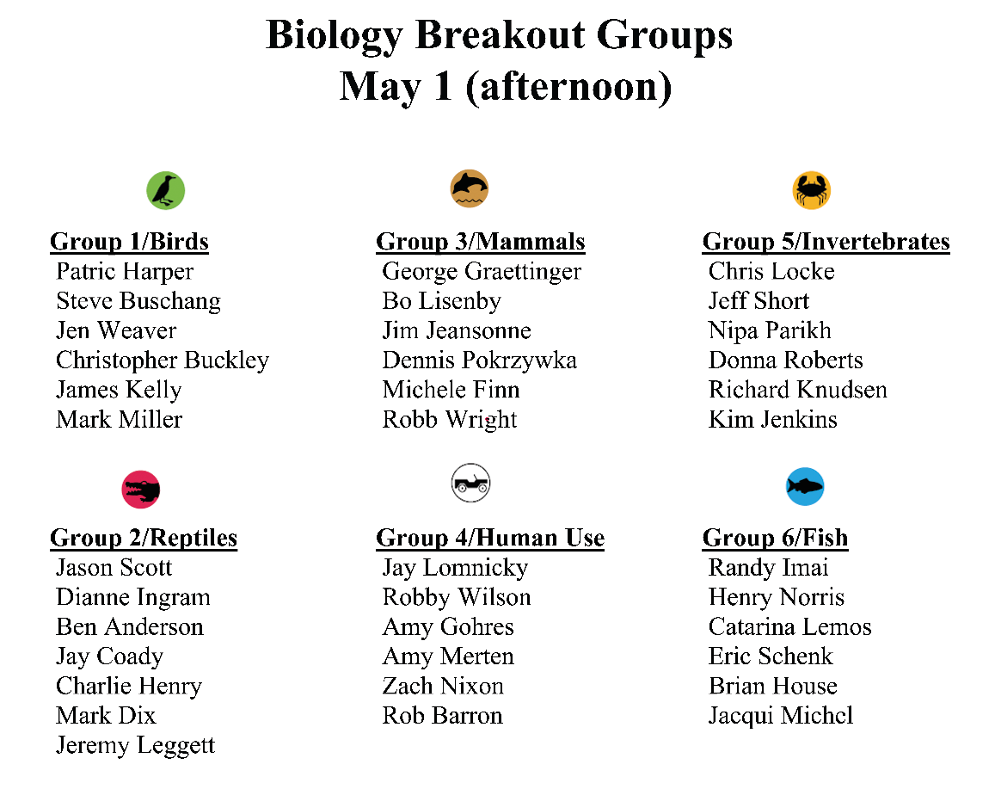
Breakout Group Assignments

Slide 60
Current socioeconomic data collection protocols, Challenges faced, and group discussion

Slide 61
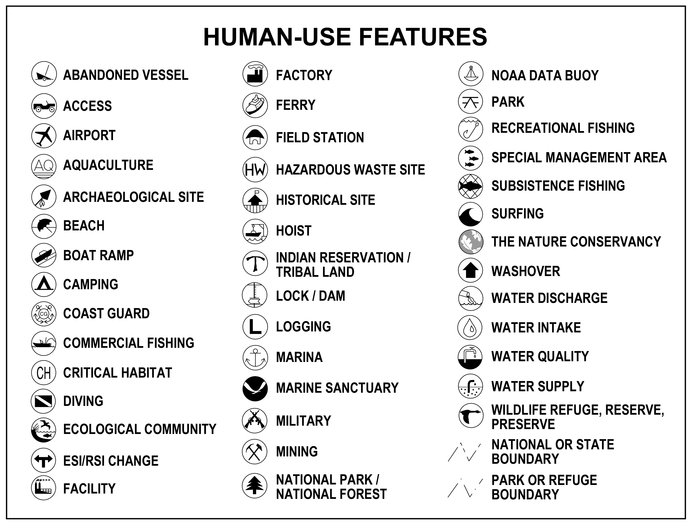
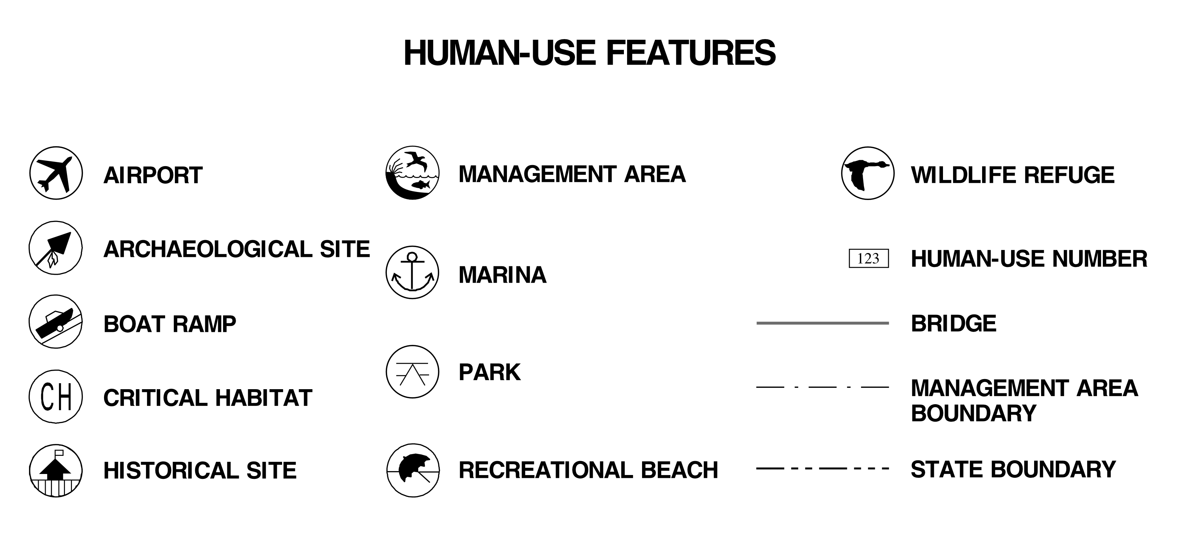

Slide 62
Human-Use Resources Emphasized
Recreation Areas and Access Locations
  Access points, airports/helipads, artificial reefs, beaches, boat ramps, dive sites, ferries, marinas, rec fishing, surfing
Management Areas
  Critical habitats, marine sanctuaries, national parks, state parks, national wildlife refuges, preserves, reserves
Resource extraction
  Aquaculture, commercial fishing, subsistence, water intake
Cultural resources
  Archaeological/historical sites, abandoned vessels

Slide 63
Human-Use Attributes
Type (e.g., beach, boat ramp, park)
Name (Monterey Bay NMS)
Owner (NOAA)
Contact (Sanctuary manager)
Phone
Feature level source metadata (G/A Source)

Slide 64
Formats of Human-use
Data Provided for ESI
Almost exclusively shapefiles and/or geodatabases with point or polygon locations
  FL Panhandle: 30+ digital data sets for soc/mgmt
Additional data points added or corrected at meetings based on expert knowledge
Sources
  Primarily provided by State or Federal agencies
  Level of QA/QC done prior to being provided to RPI varies widely by data set
  Often QA/QC of source data really happens during ESI review meetings (first time all data seen digitally or on a map by most local resource experts)

Slide 65
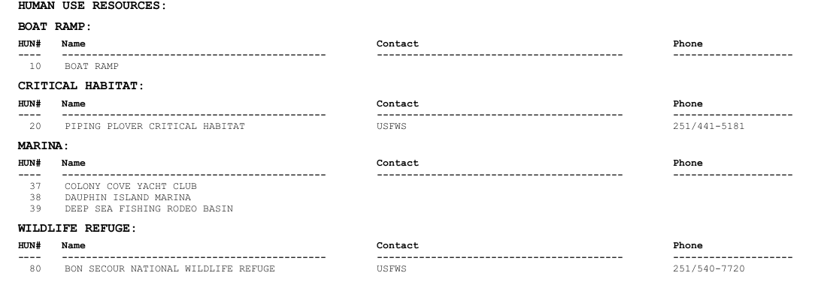
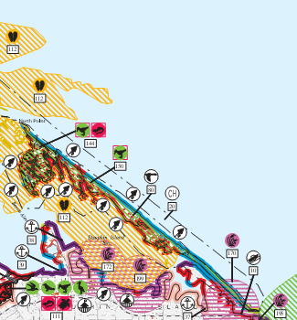
Typical human-use information

Slide 66
Challenges Faced
Some ‘bio’ layers contain data collected more for economic reasons than for ecological reasons
  Expansion of fisheries data from bio into soc/mgmt layer (Southern Cal example)

Slide 67
Socio-Economic Data: Fish
Fisheries data difficult to incorporate into biological mapping. Why?
  Statistical issues drawing inference on abundance from catch (non-standardized sampling, management restrictions on fishing locations)
  Coarse resolution of fishery data collection units
Often fisheries data is available and economically relevant to spill impacts. Is it appropriate to consider as a soc/management layer?
Should we expand on subsistence fisheries data?
  Typically shown only as a point location with limited attribute info
  More explicitly covered in other documents, etc. in Native communities

Slide 68
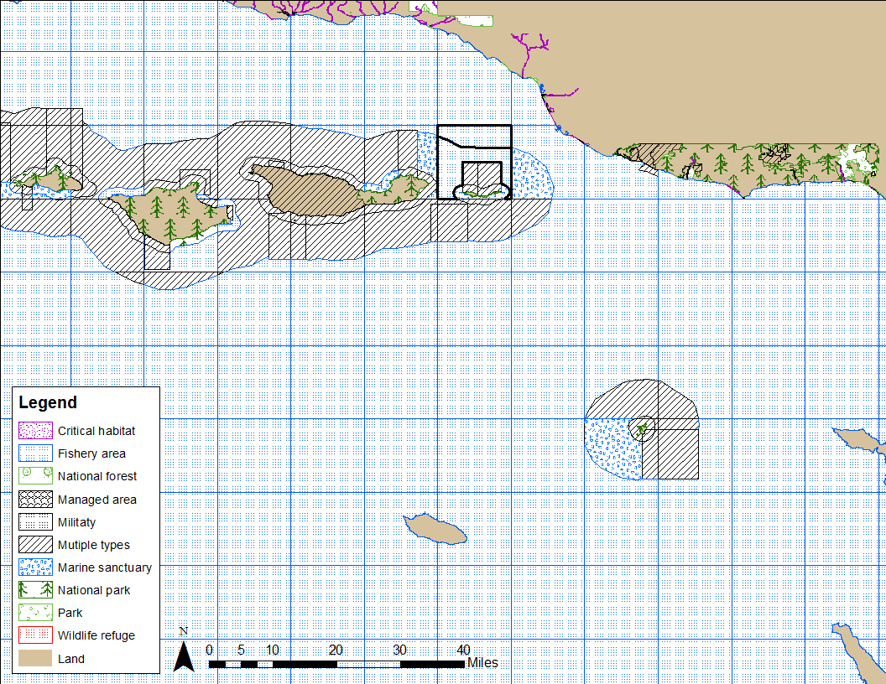
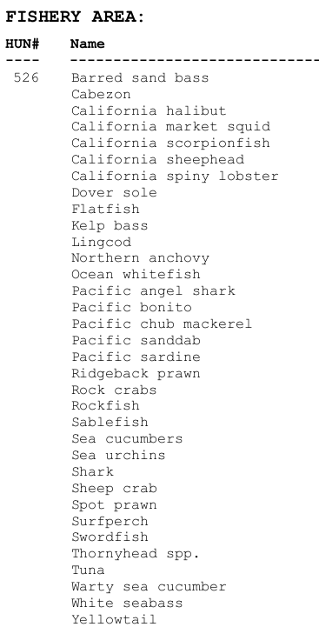
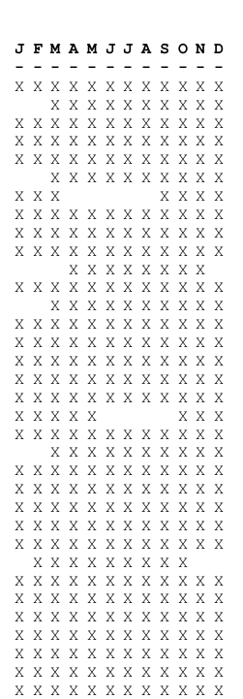
Fisheries data example

Slide 69
Challenges Faced
Other frequent issues/challenges:
  How recent/correct are attributes and contact info? Varies by data set/agency; also a frequency of ESI update issue
  Boundaries for individual holdings (particularly federal) may differ from boundaries found in statewide clearinghouse type data sets and need to be reviewed/corrected
  How should we handle coincident boundaries that aren’t identical (slivers)?

Slide 70
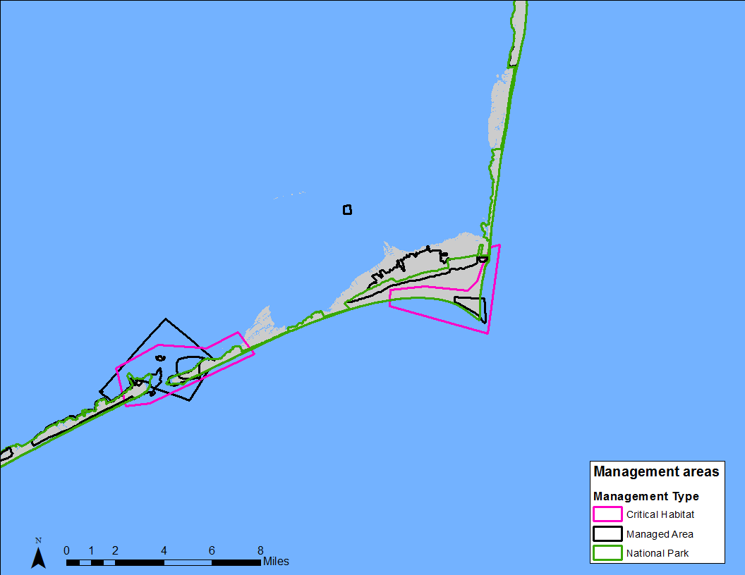
Management boundaries

Slide 71
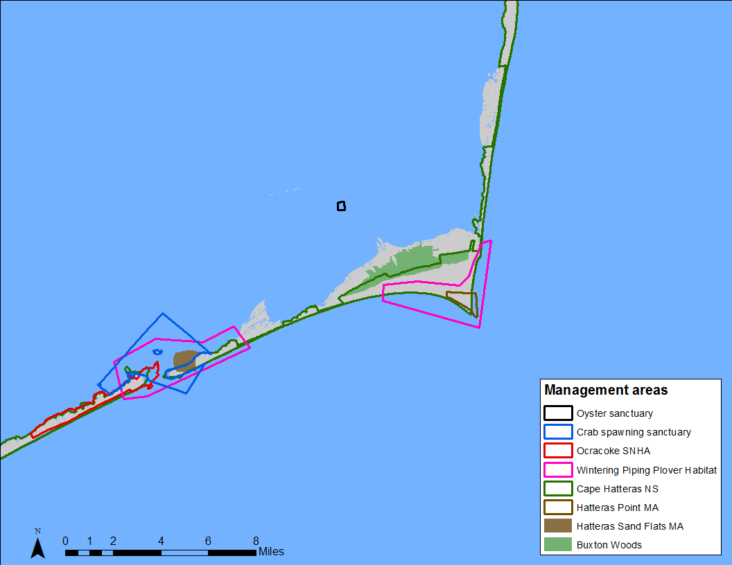
Management boundaries
State managed
Federally managed

Slide 72
Questions for Group Discussion
H-U poster: place dots on types that you use or think are useful. Discussion on collation of dots.
Do you have other suggested sources for a particular H-U layer?
What is a H-U layer that belongs in Area Plan, not the ESI?
What H-U layer should be added?
What H-U attributes that should be modified or added?

Slide 73
Questions for Group Discussion
6. What do you find to be negative about the H-U data in the ESI?
What do you find to be positive about the H-U data in the ESI?

Slide 74
Discussion Topics
Concern: Soc and Mgmt layers tend to receive the least attention of all of the ESI features. How could these be improved/expanded in general, or do they need to be?
From the slide displaying all of the soc/mgmt type icons, are there types you want to exclude? Are there additional layers you are interested in?
  Commercial fisheries with additional info
  Resorts/hotels, other

Slide 75
Discussion Topics
What types of mgmt layers are appropriate to map: fed/state/more local?
Are archaeological sites handled adequately in the ESI, since we are often unable to map these at all or with much detail due to sensitivity? Other sources that are used for this info?
Is there interest if having place names/a gazeteer layer added to digital data? Sources?

