Slide 1




GeoPDF Integration
ESI & Base Maps into one

Slide 2

Introduction
Applying GeoPDF capabilities for Electronic Oil Spill Response Maps allows users the tools needed to perform simple calculations, navigate, locate, draw, measure, toggle layers on & off and identify attributes.

Slide 3

TGLO Oil Spill Toolkit
10 year anniversary
GeoPDF Advantages:
Consolidate ESI & Base Maps
Utilization of GeoMark up tools
Locate by Latitude Longitude & MGRS coordinate systems
Measure distances and area(s)

Slide 4
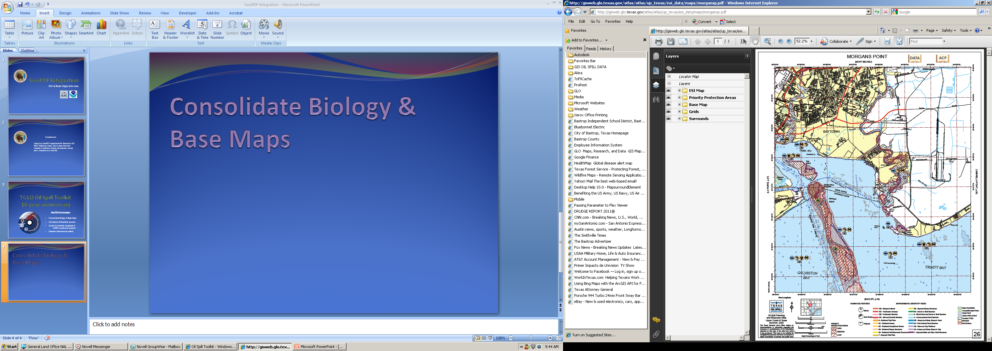
Consolidate ESI & Base Maps

Slide 5
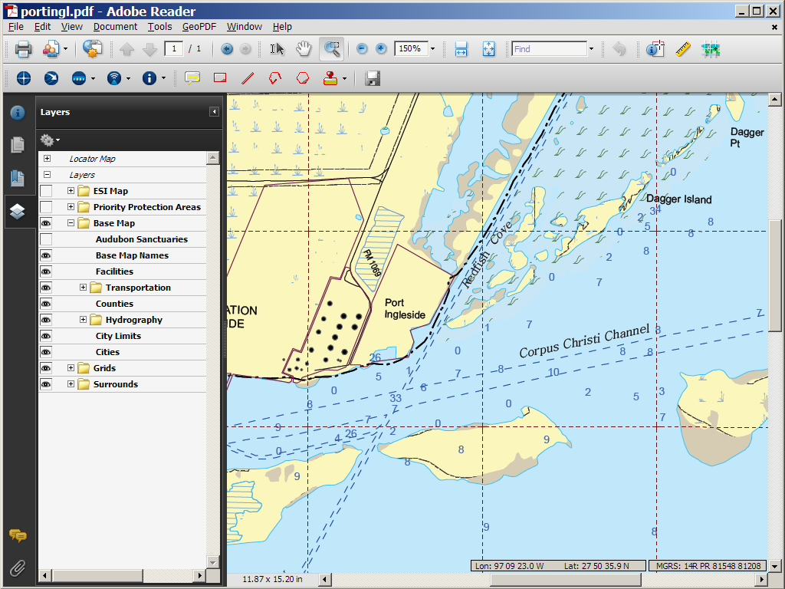
You control what layers to view.
Layers

Slide 6

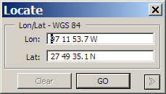
Make simple measurements.
Locate by coordinates
97 10 28.2 W
27 48 52.6 N

Slide 7
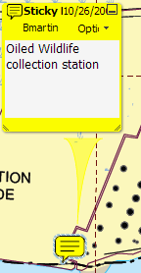
Sketch boom, delineate areas of operation and add descriptions.

Slide 8
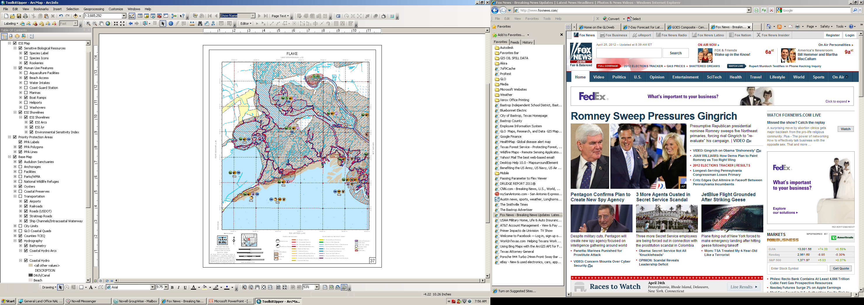
GeoPDF Implementation
Grouping 53 Layers
ESI Map
Sensitive Biological Features
Human Use Features
ESI Shorelines
Priority Protection Areas
Labels, Polygons, Lines
Base Map
Parks, Hydrology, Preserves, etc.

Slide 9
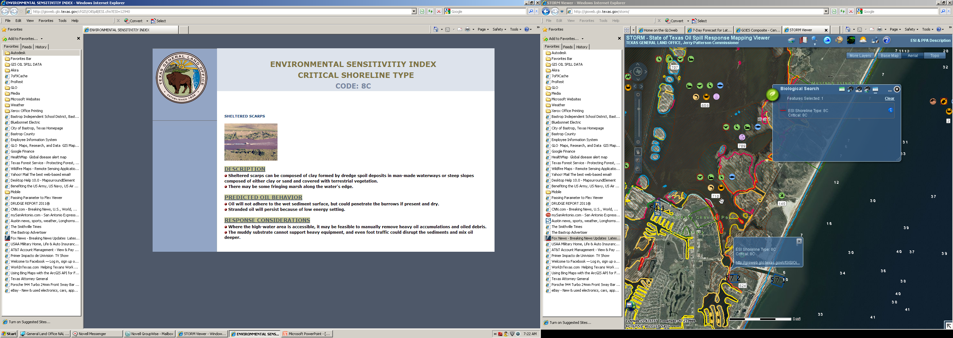
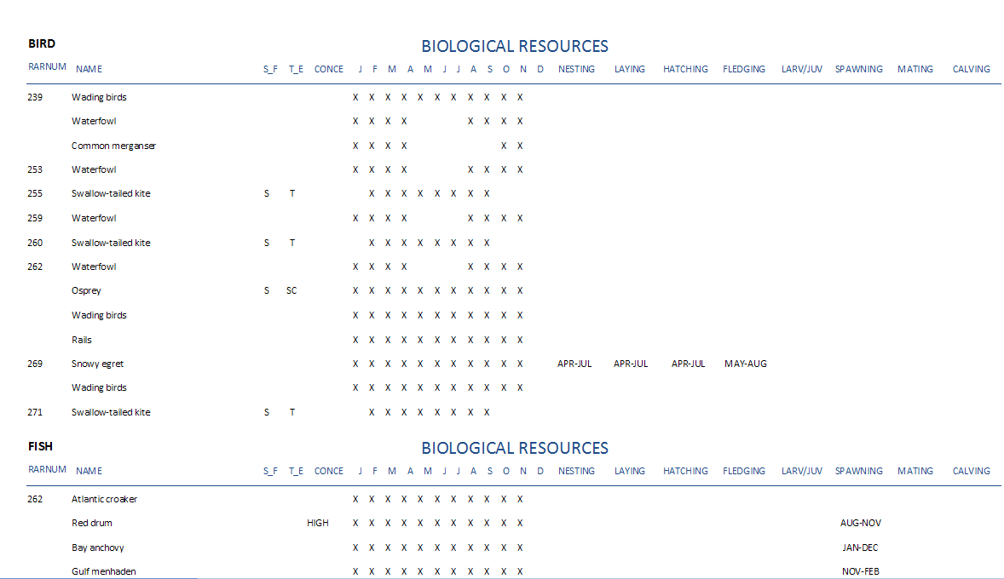
What we are doing now.

Slide 10
Costs.
2007 - Map2PDF for ArcGIS was $1,144.31 + maintenance $228.87
Yearly cost for maintenance on one license is $241.00 (single use)

Slide 11



Credits:
http://www.terragotech.com/
http://www.esri.com/
http://www.adobe.com/

Slide 12
Thank you!
Robert Barron – GIS Specialist
Texas General Land Office
512-463-5305
robert.barron@glo.state.gov

